Slide 1
FoodHub Data Analysis
Data Science and Business Analytics
Date: 4/19/2024 Khadidiatou Ndiaye

Slide 2
Contents / Agenda
Executive Summary
Business Problem Overview and Solution Approach
Data Overview
EDA - Univariate Analysis
EDA - Multivariate Analysis
Appendix

Slide 3
Executive Summary
The food aggregator company has stored the data of the different orders made by the registered customers in their online portal. They want to analyze the data to get a fair idea about the demand of different restaurants which will help them in enhancing their customer experience.
As a Data Scientist, we performed the data analysis to find answers to these questions that will help the company to improve the business model.
More than 700 customers did not give a review for their order and most the customers who gave a review gave a 5 or 4 rating.
The restaurant with an average higher review have more orders like Shake Shack, The Meatball Shop, Blue Ribbon Sushi and Blue Ribbon Fried Chicken. Also, the costumers with the rating is 5 or 4 are the one who put mostly a rating. So it is possible that mostly the very satisfied customers are the one rating the service. Maybe we should dig on the 'no rating customers' to see why they are not putting a rating. Is that they are unsatisfied or not.
The preparation time is relatively consistent compared to the delivery time, meaning that the delivery time is the significant variable in total preparation time (total time between order and delivery to customer).
The average cost of orders is higher with the customers rating 5 and 4 whereas the delivery time of customer rating 3 is high compare the others.

Slide 4
Recommendations:
The company should focus on customer satisfaction because more than 700 customers did not give a rating and if we have more rating that may change the distribution we have and help also improve some aspect of the service. So can come up with something to push customers to give a rating, for example a promotional offers or discount.
The company should try to improve on total order time by improving the delivery time. Also a high delivery time may be reason on certain review and the low orders during weekdays, We know weekdays we have traffic, so further analysis a necessary to see how can we do to improve the delivery.
To increase the Revenue, we should drawn a target segment market and differentiate the area where we have a higher concentration of students and a higher concentration of professionals. And depend of the demographic area we can launch specific marketing program. Further analysis of the customers demographics is needed for that,
A better marketing can be created to boost the orders for example a reward program. Also a discount program for least popular cuisines,.

Slide 5
Business Problem Overview and Solution Approach
The food aggregator company has stored the data of the different orders made by the registered customers in their online portal. They want to analyze the data to get a fair idea about the demand of different restaurants which will help them in enhancing their customer experience.
As a Data Scientist, we will perform the data analysis to find answers to these questions that will help the company to improve the business model.

Slide 6
Data Overview
We will work on data set with 1898 rows and 9 columns.
There are no missing values so no need to do any treatment for missing values
We can observe that the average cost of orders is around 16.49, and 50% of orders is 14.14 and below. 75% of orders cost more than $22 and the maximum cost of order is around 35.
Most of orders are placed on the weekend
Most customers did not submit a review,
The average and median food preparation time are almost the same around 27mn but we have small difference for the median and the average delivery time which are 25mn and 24mn.
As we can see 736 of the rating are not giving. And most of given rating are rating 5, 588 are rating 5.

Slide 7
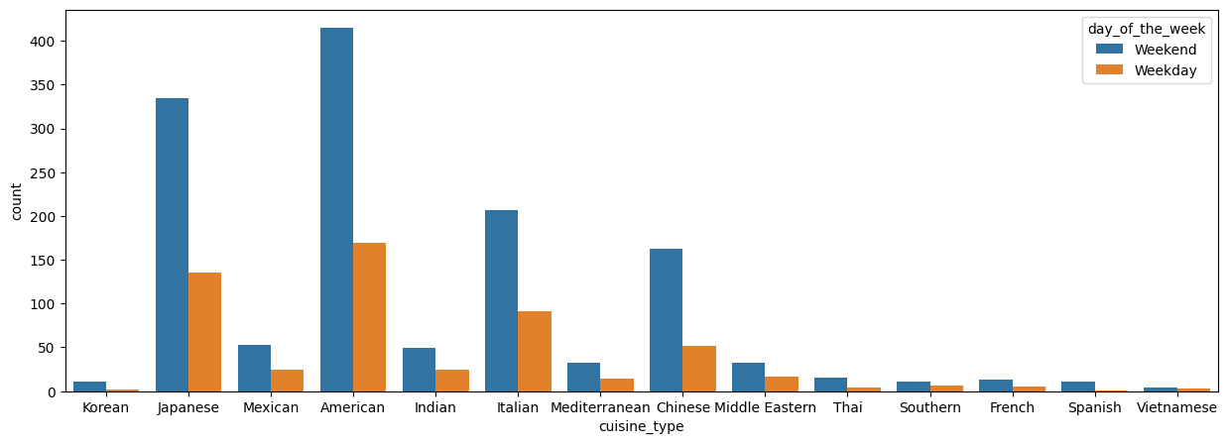
Univariate Analysis
We have 178 restaurants present in the system
We have 14 differents type of menu
Customers order most of the time American, Japanese, Italian and Chinese food, and on the weekend.

Slide 8
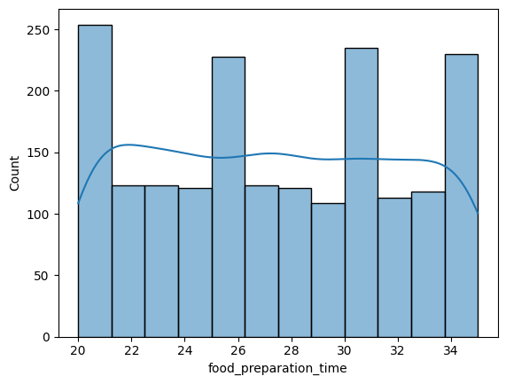
Food Preparation time
We can observe a fairly even distribution of the time it takes to prepare the dish between 20 minutes and 36 minutes and median around 27 minutes.

Slide 9
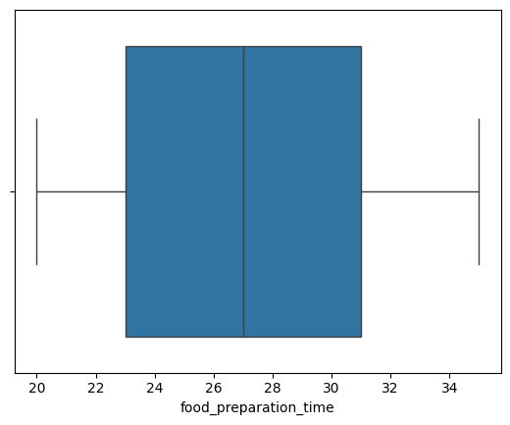
Box plot of the food preparation time

Slide 10
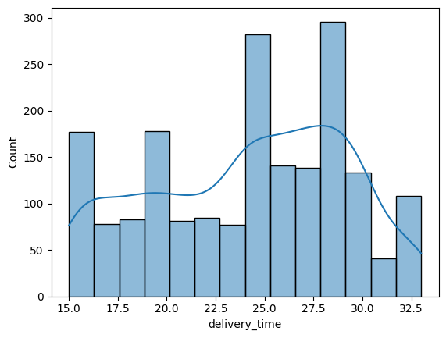
Delivery time
We can observe that the distribution is left skewed and the median delivery time is about 25 minutes.
From the histplot we can determine that most orders take between 25 and 28 minutes to be delivered.

Slide 11
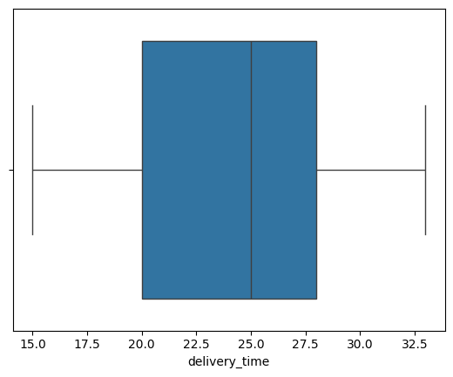
Box plot of the delivery time

Slide 12
The top 5 restaurant in term of number of orders
Shake Shack with 219 orders
The Meatball Shop with 132 orders
Blue Ribbon Sushi with 119 orders
Blue Ribbon Fried Chicken with 96 orders
Parm with 68 orders

Slide 13
Most popular cuisine on weekend
American Cuisine Type is the most popular during the weekends with a count of 415 orders.

Slide 14
percentage of the orders cost more than 20 dollars & the mean order delivery time
The number of total orders that cost above 20 dollars is: 555.
Percentage of orders above 20 dollars: 29.24 %.
The average delivery time for this dataset is 24.16 minutes

Slide 15
The company has decided to give 20% discount vouchers to the top 3 most frequent customers.
customer with id number 52832
customer with id number 47440
customer with id number 83287

Slide 16
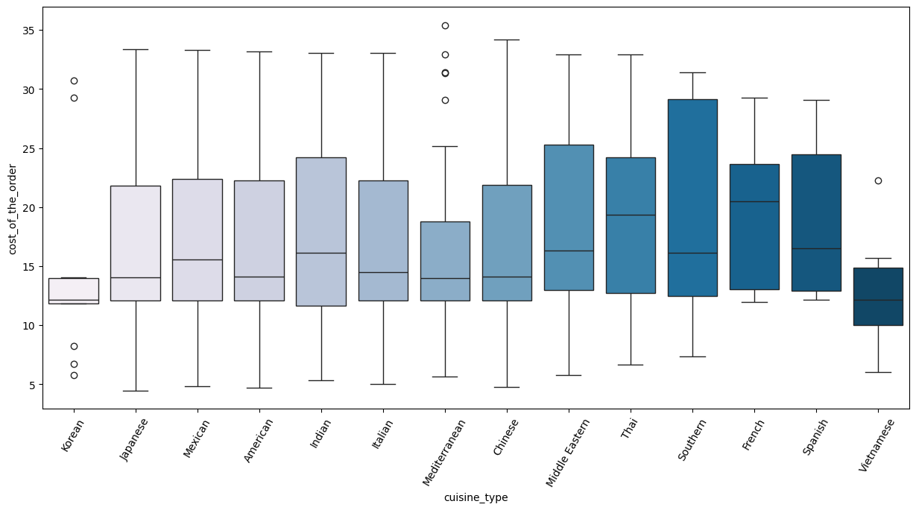
Multivariate Analysis
The median cost of order for the differents cuisines type vary between 13 to 17 dollard with a few having outliers such as Korean, Mediterranean and Vietnamese cuisines.

Slide 17
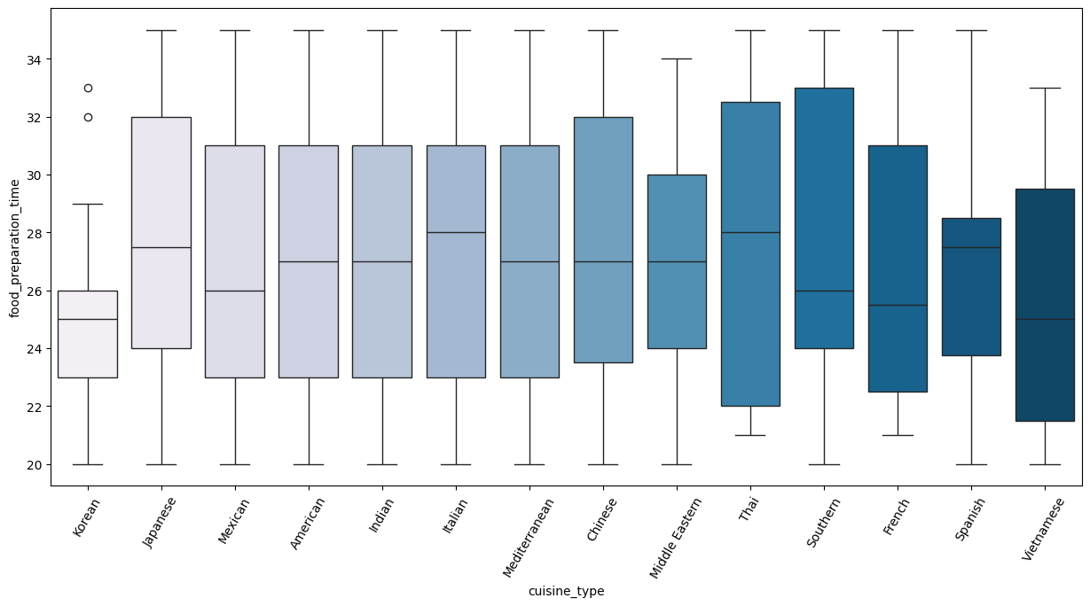
Relationship between food preparation time and cuisine type
Most cuisine types have more or less the same average preparation time.

Slide 18
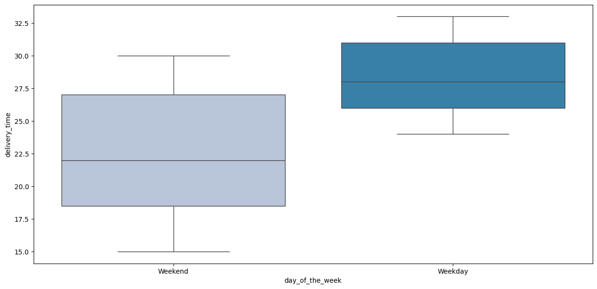
# Relationship between day of the week and delivery time
The delivery time on weekend is shorter than the week day with a median of around 22 minutes on weekend and 27 minutes of week day.

Slide 19
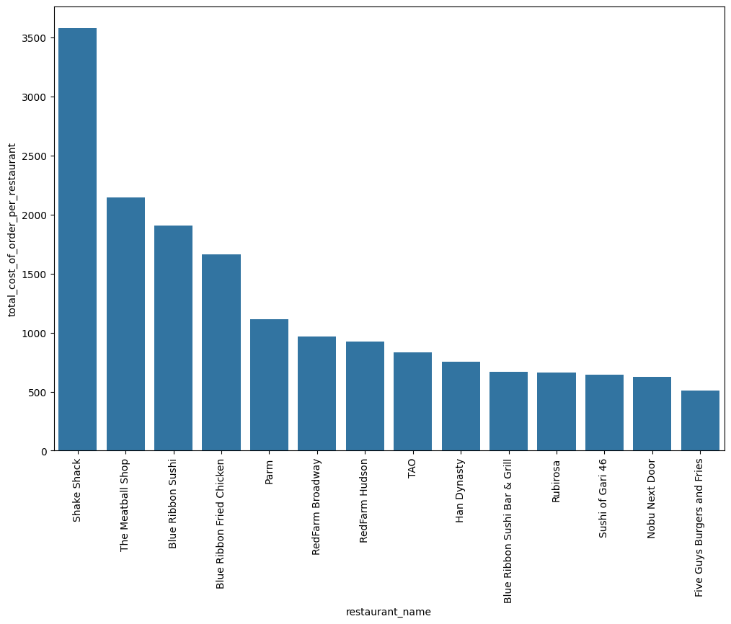
Revenue generated by each restaurant.

Slide 20
As we can see 5 restaurants more than $1000 revenu
Shake Shack with more than $3500
The Meatball Shop with more than $2000
Blue Ribbon Sushi with around $2000
Blue Ribbon Fried Chicken around $1700
Parm more than $1000
The rest of the restaurant make less than $1000

Slide 21
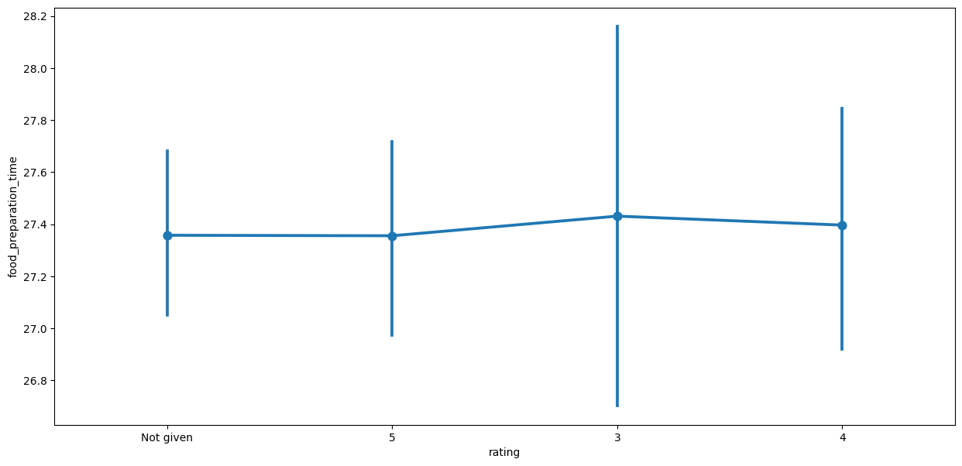
Rating vs Food preparation time
The average food preparation is almost the same

Slide 22
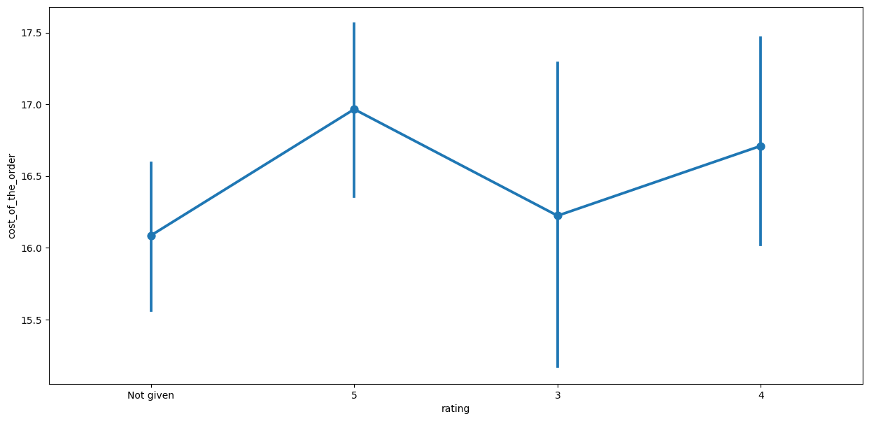
Relationship between rating and cost of the order
The cost of orders is higher with the customers rating 5 and 4

Slide 23
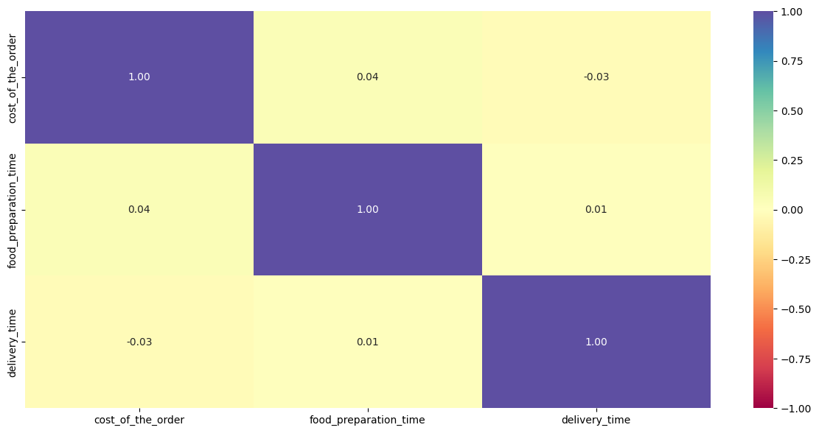
Plot the heatmap
The heatmap shows very weak correlation between the cost of order, the delivery time and the preparation time.

Slide 24
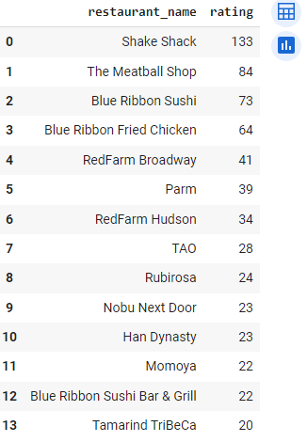
The company wants to provide a promotional offer in the advertisement of the restaurants. The condition to get the offer is that the restaurants must have a rating count of more than 50 and the average rating should be greater than 4.

Slide 25
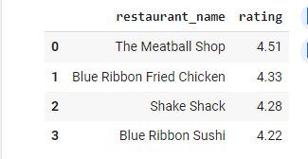
The top 5 restaurants with a rating greater than 4

Slide 26
the net revenue generated by the company across all orders.
The company charges the restaurant 25% on the orders having cost greater than 20 dollars and 15% on the orders having cost greater than 5 dollars
The total revenue of the company is $6166.3.

Slide 27
APPENDIX
Link to google colab project foodHub: https://drive.google.com/file/d/1TJbbjKFjjt81VDF43mR8QHnO9UfKVHci/view?usp=sharing

