Slide 1
TEXT QUALITY IN SEARCH –SUPPORTED WRITING TASKS
Supervised by : Michael Völske and Magdalena Wolska
02/03/2020
Tasks
Cosine Similarity of adjacent slot
Calculate Levenshtein Distance

Slide 2
Overview
A Text which contain a meaning full sentence at least with a verb and full stop in the end can be called good text.
We can say, a text which is well organized, cohesive, coherence, readable etc. has high text quality.
Goal:
use Webis TRC-12 Dataset corpus ,find text quality of the essay included in the corpus specially Coherence feature.
Predict the sentence is coherent to the text or not.
Coherence is a link or connection between the sentences or text on the basis of idea , concept or theme . Whereas Cohesion is link between the sentences or texts on basis of word, phrase or clause.

Slide 3
Distance Metrics https://www.analyticsvidhya.com/blog/2020/02/4-types-of-distance-metrics-in-machine-learning/#:~:text=Distance%20metrics%20are%20a%20key,the%20similarity%20between%20data%20points.&text=Hence%2C%20we%20can%20calculate%20the,define%20the%20similarity%20between%20them.
Is used to know the input data pattern.
Distance metric uses distance function which provides a relationship metric between each elements in the dataset.
A good distance metric improve the performance of model or algorithm.
Distance function is used to calculate distance between the points or elements of the set.0 then point or element are equivalent else they are different.

Slide 4
Popular Distance Metrics Source:Wikipedia,Towarddatascience
Levenshtein Distance:
Is a string metric to measure the difference between two sequence.
Minimum number of single character edits required to change one word to other.
It is also known as edit distance and comes under the family of edit distance metrics.
Euclidean Distance:
Length of segment connecting two point.
Distance is calculated from cartesian coordinate of the points using Pythagorean theorem.
Need to normalize data before using Euclidean distance.
It give best result on low dimensional data.
Cosine Similarity:
Calculate cosine angle between two vectors.
Value 1 means two vector with exactly same orientation else two vector are oppose.
Used in high dimensional data and where magnitude of vector is not important.

Slide 5
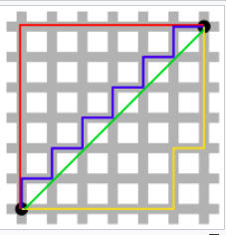
Popular Distance Metrics
Hamming Distance:
Is used to compare two binary string of equal length.
Also can be used to calculate similarity by calculating the number of characters that are different from each other.
It can be use to measure distance between categorical variable.
Manhattan Distance:
Calculate distance between real valued vectors.
It refer to distance between two vectors if they could only move right angle not in diagonal movement.
It suppose to give higher value than Euclidean distance .

Slide 6
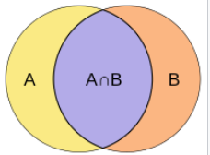
Popular Distance Metrics
Jaccard Index:
Is used to calculate similarity and diversity of sets.
It is a total number of similar entities between set divided by the total number of entities.
It is highly influenced by the size of data.

