Slide 1
TEXT QUALITY IN SEARCH –SUPPORTED WRITING TASKS
Supervised by : Michael Völske and Magdalena Wolska
Tasks
Literature (Related work papers )
Organizing Papers
Implementing Basic NLP technique
Papers : https://docs.google.com/spreadsheets/d/1WWCPG8flWpv701JAcuFt09D_6g3sQBL5G7TsuBuLV04/edit#gid=0

Slide 2
Slide 7 10/11/2020
Organize the topic
Bibek Khadayat

Slide 3
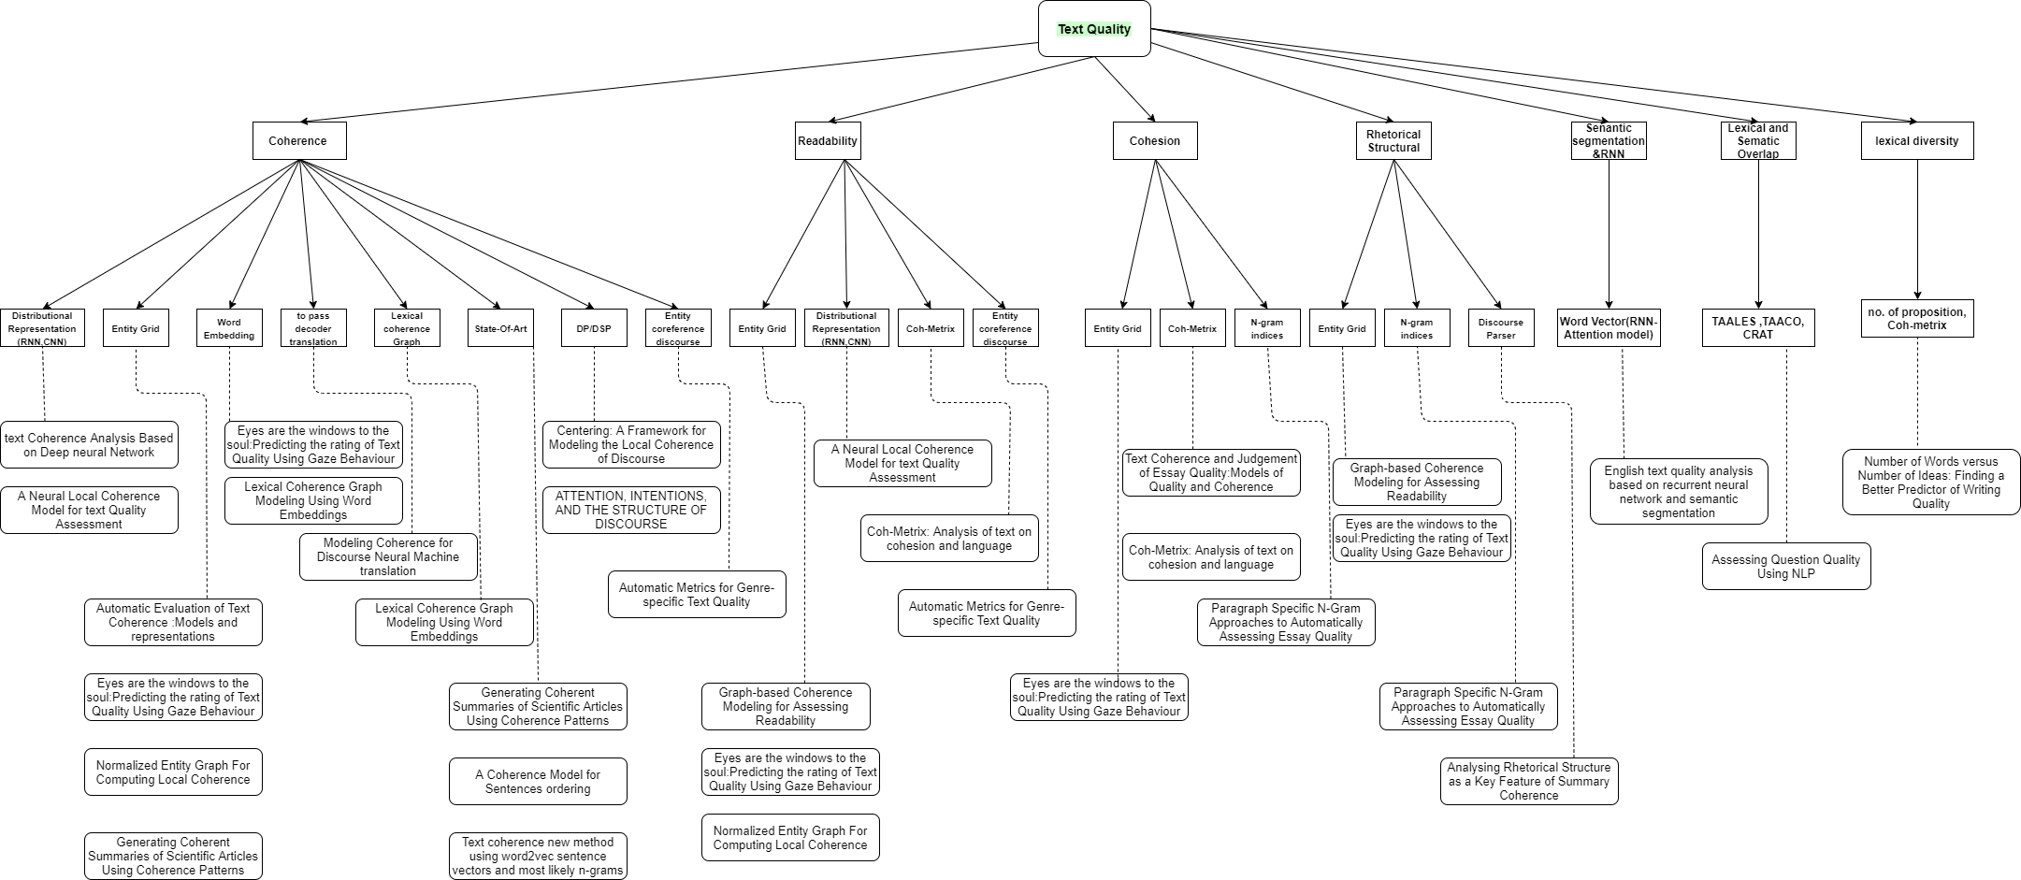
Graphical representation of Topic (https://app.diagrams.net/)

Slide 4
Using Argument Mining to Assess the Argumentation Quality of Essays Henning Wachsmuth, Khalid AL-khatib, Benno Stein (2016,COLING) https://webis.de/downloads/publications/papers/stein_2016r.pdf
Abstract
Find out Argumentative structure from the text.
Investigate the generated argumentation quality from the text.
Use statistical patterns for evaluating argumentation score.

Slide 5
Introduction
Extract argumentative structure from the plain text.
Use premises and conclusions for determining argumentative.
It is also used for automated grading in online courses.
Divided into three part:
Mining of argumentative structure.
Quality assessment.
Synthesis of suggestion for quality improvement.
Use state-of-art for mining argumentative structure pattern.
Then, apply to all text in order to analyse their argument structure.

Slide 6
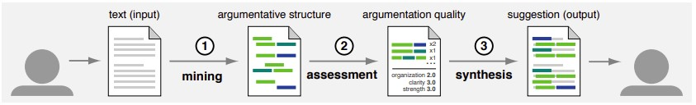
Introduction
Rate quality in basis of: organization, thesis clarity , prompt adherence and argument strength.

Slide 7
Conclusion
Use argument mining for rating argumentation quality.
ML algorithm for mining which was trained misclassifies one out of four units .
It does not solve assessment of argumentation quality in general.

