Slide 1


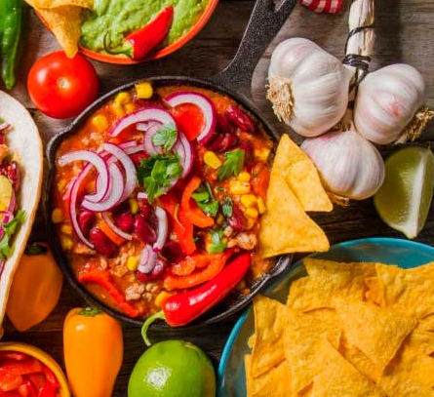

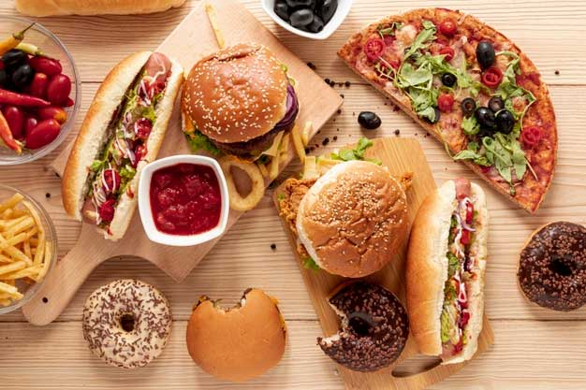
FOODIE APP
CAPSTONE PROJECT
Pawan Khade

Slide 2

Our Fast Food
Pizza
Donec fringilla est orci. Orci varius natoque penatibus et magnis dis. Donec fringilla est orci
Hamburger
Donec fringilla est orci. Orci varius natoque penatibus et magnis dis. Donec fringilla est orci
Hot Dog
Donec fringilla est orci. Orci varius natoque penatibus et magnis dis. Donec fringilla est orci
Donec fringilla est orci. Orci varius natoque penatibus et magnis dis. Donec fringilla est orci

Slide 3
1
CONTENT
4
2
OBJECTIVE
Objective
Technologies used
Backend Architectural Diagram
Work Flow Diagram
Features Implemented
Web Application Pages
To make restaurant discovery easy by availing one common platform.
To avail equal growth opportunities to small restaurants.
User engagement and community building.
Quality Control
Market expansion
Support to user as well as restaurants.
3

Slide 4

TECHNOLOGIES USED
Backend: Java(Core and Advance), Spring Boot Micro-services, Docker
Frontend: Angular, HTML, CSS, TypeScript, Bootstrap, Angular Material.
Databases: MYSQL, MONGODB
Testing: Junit, Mockito
Tools Used: draw.io

Slide 5
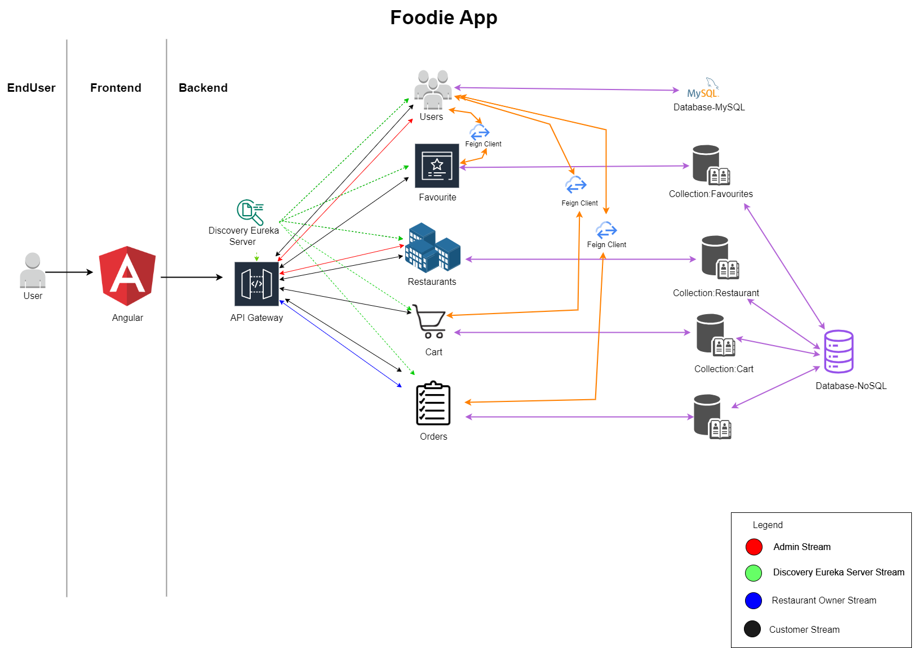
BACKEND ARCHITECTURAL DIAGRAM

Slide 6
WORK FLOW DIAGRAM

Slide 7
FEATURES IMPLEMENTED
1
2
3
Role based registration
User gets registered based on there role (Eg. User or Restaurant Owner)(Admin don’t have to register).
Customers
Resto Owner
Admin

Slide 8
FEATURES IMPLEMENTED…
Without signup or login user can see restaurant list but for making it favourite or adding it to cart user has to signup or login.
Email Verification:
OTP based email verification is mandatory before login.
Regeneration of OTP:
OTP can be regenerated at the time of email verification.
Forgot Password:
Forgot password feature is there. With that user can get link to update password on registered mail id.

Slide 9
FEATURES to customers
Features to Customers:
Can add restaurant or item into personalized favourite section.
Can search restaurants and items by there name and location.
Can see items list of particular restaurant
Can add items into cart
Can add more than one address and see address list at in profile section.
Can select any added address to place a order.
Can change item quantity in cart, also user can delete particular item from cart.
Can confirm qty of items added in cart by number showing on cart icon at navbar.
Can place order (needs restaurant’s acceptance).
Can cancel order before restaurant confirmation.
Gets order confirmation on registered mail Id.

Slide 10
FEATURES to Restaurant Owner
Can see all his restaurants.
Can add new restaurants (required admin’s approval).
Can delete particular restaurant.
Can see items in particular restaurant.
Can add new items in particular restaurant.
Can edit price of particular item.
Can delete particular item.
Gets mail when customer places order form one of his restaurants.
Can accept order which is mandatary for confirmation of order.
Gets mail when user cancels order placed from one of his restaurants.

Slide 11

FEATURES to Admin
Can see all registered users.
Can see all active restaurants.
Can approve any newly added restaurant by restaurant owner.

Slide 12
Future Scope
Rating as a input from user
GPS based address selection and validation features
Delivery boy role can be introduced
Delivery tracking features
Change profile picture
More sorting options
Payment Gateway
Delete or edit particular address for customer.
For security purpose OTP verification can be done while forgot password.

Slide 13
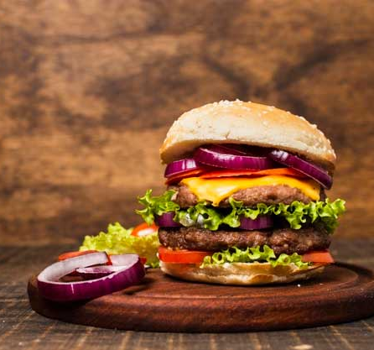

THANKS

