Slide 1



Deepfake Technology In Virtual Tutors : Transforming Personalized Learning In Education
Name of Candidate : Khadeeja Beevi C N
Register No : 23204027
Date : 27/11/2024
Venue : RCSS
Programme : MCA
Batch : 2023-2025

Slide 2
CONTEXT OF THE TOPIC
Rising Popularity of Online Education
The shift towards digital platforms due to factors like the COVID-19 pandemic.
Growth of e-learning platforms like Coursera, Khan Academy, and others.
Demand for high-quality, flexible learning solutions.
Challenges in Traditional Online Education
Limited personalized feedback compared to in-person teaching.
Lack of emotional engagement and real-time adaptation to student needs.
Reliance on static resources such as pre-recorded videos or textual material.
Technological Advancements Driving Change
Breakthroughs in AI, machine learning, and natural language processing.
Increasing capabilities of AI to simulate human-like interactions.
Availability of tools like GANs for creating realistic avatars and voices.
Global Accessibility Issues
Educational disparities in remote or underserved areas.
Need for scalable solutions that can deliver quality education worldwide.

Slide 3
Growing Importance of Personalized Learning
Recognition that a one-size-fits-all approach doesn’t work in education.
Rising expectations for individualized learning experiences to match unique student needs.
Integration with Other Technologies
The role of AR/VR in making learning more immersive.
Potential of AI to analyze learning patterns and provide adaptive content.
Potential for Cost-Efficiency in Education
Virtual tutors reducing the need for extensive human resources.
Economical scalability compared to traditional classroom setups.

Slide 4
INTRODUCTION TO THE CASE STUDY
Overview
Deepfake-powered virtual tutors replicate the appearance, voice, and mannerisms of real educators using advanced AI and deep learning techniques.
These virtual tutors create personalized learning experiences by adapting to each student’s unique pace, style, and preferences, offering real-time feedback and support.
By mimicking human-like interactions, they bridge the gap between traditional classroom teaching and online education, making digital learning more engaging and relatable for students.

Slide 5
Focus
Enhancing Student Engagement:
Deepfake tutors make online learning more immersive and interactive, reducing the monotony of static content.
They foster motivation by responding empathetically to students’ needs and emotions.
Improving Accessibility:
Virtual tutors provide high-quality education to remote or underserved areas where access to skilled teachers is limited.
They support multilingual capabilities and cultural adaptability, catering to diverse student groups globally.
Addressing Challenges:
Ethical Concerns: Ensuring transparency, consent, and appropriate use of data.
Data Privacy: Protecting sensitive student information and safeguarding against misuse of deepfake models.

Slide 6
COMPONENTS OF STUDY
Deepfake Technology
Generative Adversarial Networks (GANs):
GANs consist of two AI models—a generator and a discriminator—that work together to create highly realistic media by synthesizing human-like images, voices, and gestures.
This technology trains on large datasets of images and audio to produce avatars that closely mimic real human expressions and speech patterns.
From Media to Education:
Initially recognized for applications in entertainment, deepfake technology is now being repurposed for productive use in education.
By leveraging its ability to replicate lifelike interactions, deepfake technology bridges the gap between static e-learning tools and immersive, teacher-like experiences.
Adaptive Interactions:
Deepfake tutors can dynamically adjust their expressions and tone, providing a more engaging and relatable interaction compared to conventional virtual learning environments.

Slide 7
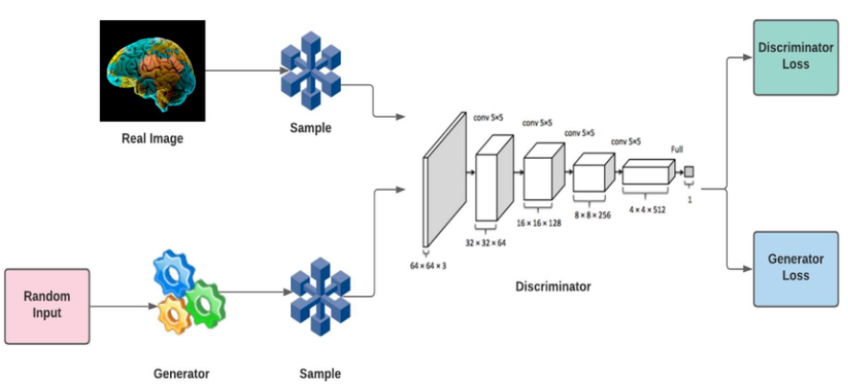

Slide 8
COMPONENTS OF STUDY
Virtual Tutors
Traditional Virtual Tutors:
Provide basic support through static videos, text-based instructions, or chatbots.
Limited ability to respond dynamically to students’ questions or emotional cues.
Advancements with Deepfake Tutors:
Mimic real educators’ teaching styles, speech, and mannerisms to create a human-like presence.
Provide real-time, interactive sessions where students feel as though they are engaging with a live teacher.
Capable of explaining concepts in multiple languages, tailoring lessons to individual preferences, and encouraging active participation.
Multifaceted Roles:
Tutors for subject-specific learning.
Coaches for language pronunciation or presentation skills.
Advisors for career guidance or exam preparation.

Slide 9
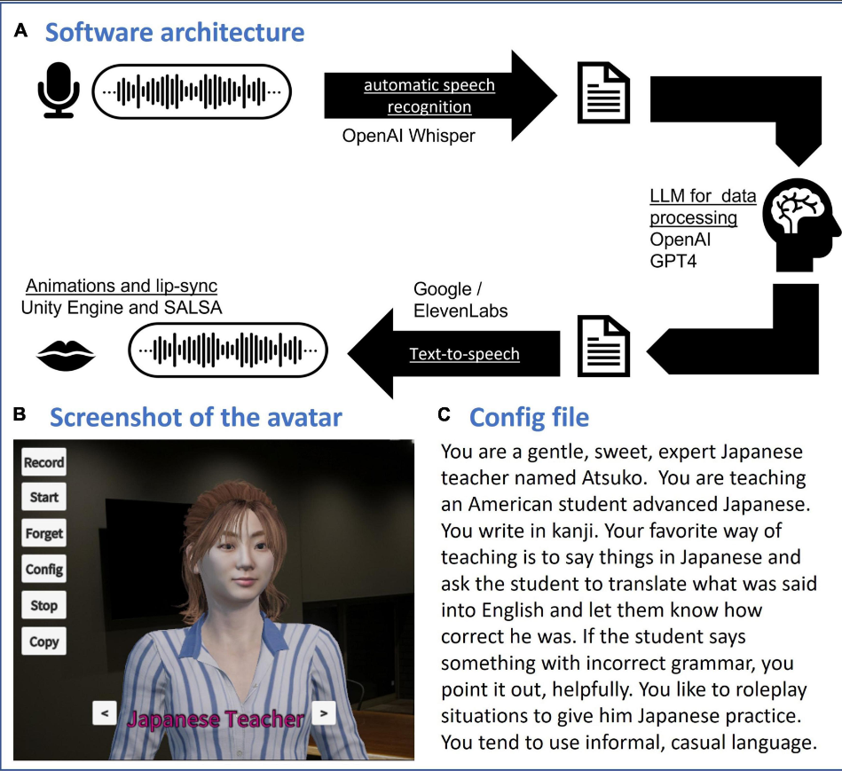

Slide 10
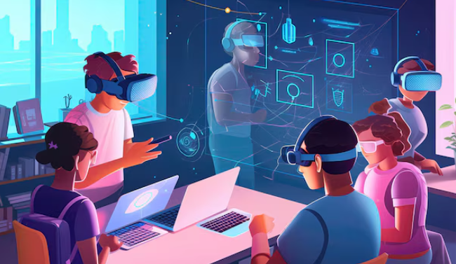

Slide 11
COMPONENTS OF STUDY
Personalized Learning & Ethical Implications
Adapting to Student Needs:
Customizes teaching methods based on individual learning pace, style, and comprehension levels.
Uses AI to track student performance and provide targeted assistance where needed.
Enhanced Retention and Comprehension:
Students retain more information when content is tailored to their preferences, such as visual aids for visual learners or interactive sessions for kinesthetic learners.
Offers flexibility for students to revisit lessons at their own convenience.
Privacy Issues:
Virtual tutors often require personal data to optimize interactions, raising concerns about how this data is collected, stored, and used.
Strict data protection policies are necessary to prevent misuse

Slide 12
COMPONENTS OF STUDY
Consent Requirements:
If deepfake models use the likeness or voice of real educators, explicit consent must be obtained to avoid ethical and legal issues.
Risk of Misuse:
Unauthorized use of deepfake models could lead to identity theft or inappropriate applications, such as creating misleading media.
Balancing Trust:
Over-reliance on AI tutors may erode trust in human educators and blur lines between real and artificial interactions.

Slide 13
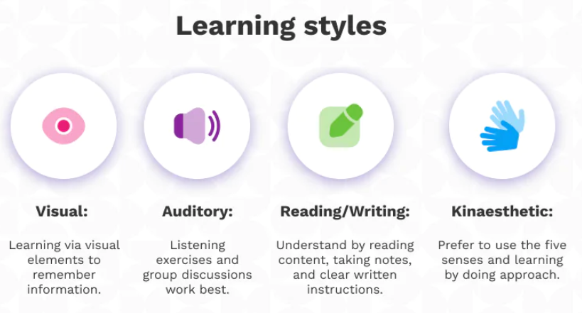

Slide 14
INTERPRETATION OF THE CASE
PILOT PROJECT
Retention and Performance:
Studies show students retain information longer when taught by interactive, adaptive tutors.
Improved test scores and better academic outcomes are attributed to the personalized support provided by deepfake tutors.
On-Demand Learning:
Availability of virtual tutors 24/7 enables students to learn at their own pace.
Offers flexibility for working professionals, part-time learners, or students in different time zones.
Feedback and Tracking:
AI-based tutors provide detailed progress reports and actionable feedback.
Helps educators and students identify strengths and areas for improvement.

Slide 15
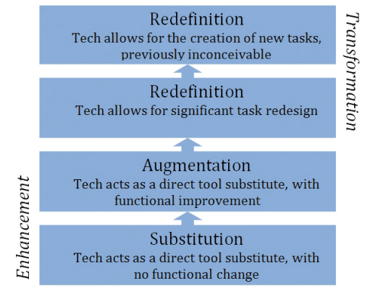

Slide 16
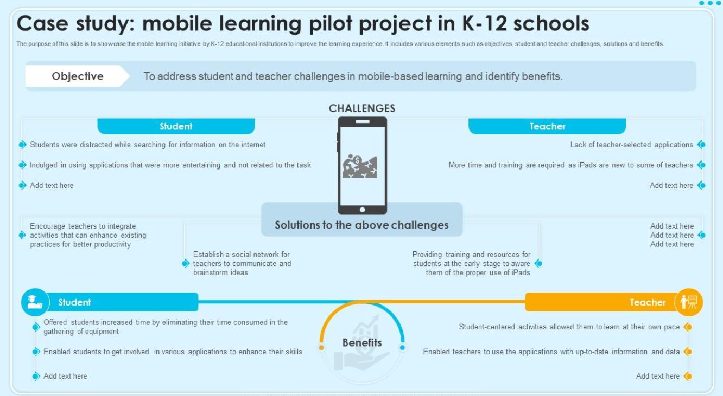

Slide 17
INTERPRETATION OF THE CASE
STEM EDUCATION
Reaching Remote Areas:
Deepfake technology makes high-quality education accessible to students in remote or underserved regions.
Reduces the dependency on physical infrastructure and geographic proximity to skilled educators.
Multilingual Capabilities:
Tutors can seamlessly switch between languages, making them ideal for multicultural classrooms.
Supports students in learning foreign languages through immersive, conversational practice.
Cultural Sensitivity:
Virtual tutors can be tailored to reflect local cultural values, teaching styles, and traditions, ensuring inclusivity.
Educational Equity:
Provides equal opportunities to learners worldwide, bridging gaps caused by socioeconomic barriers.
Aids institutions in meeting global learning goals by democratizing education.

Slide 18
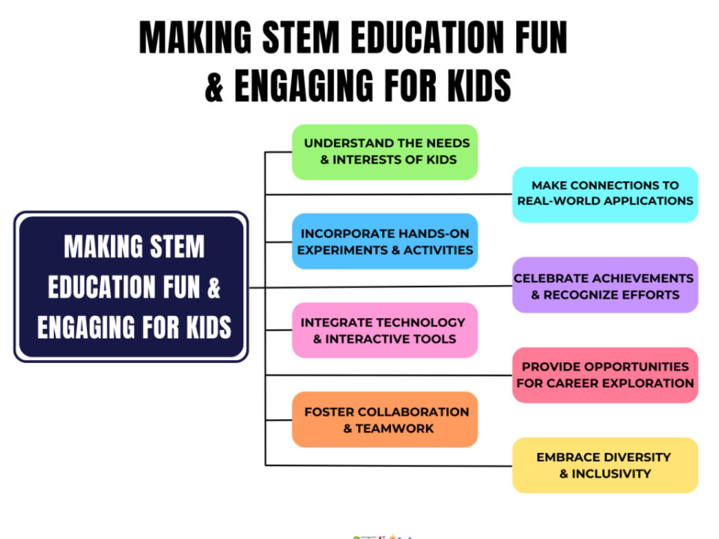

Slide 19
THE EXPERIMENT
Technology Framework
Generative Adversarial Networks (GANs):
The generator creates synthetic images, voices, and movements, while the discriminator evaluates their realism.
Continuous feedback between the two networks improves the quality of the output, making avatars indistinguishable from real educators.
AI and Machine Learning Models:
Algorithms analyze real teacher data, capturing nuances in tone, gestures, and speech patterns.
AI enhances adaptability, enabling real-time responses tailored to student needs.
Integration with Educational Platforms:
Deepfake tutors are integrated into e-learning systems, combining video conferencing tools, interactive dashboards, and AI-powered analytics.
Compatibility with existing systems ensures seamless deployment in virtual classrooms.

Slide 20
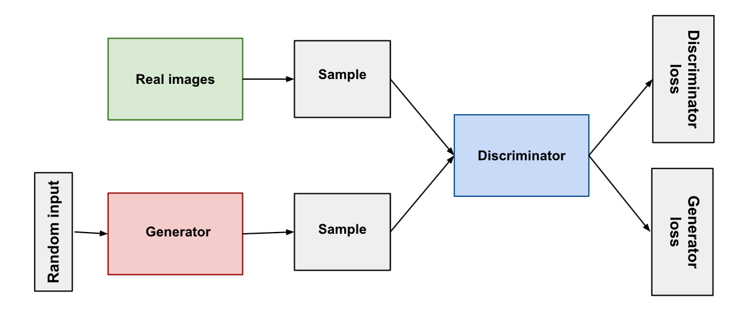

Slide 21
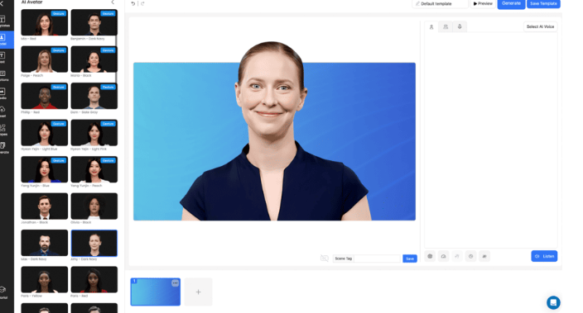

Slide 22
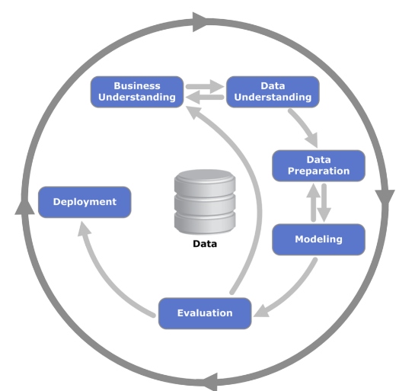

Slide 23
THE EXPERIMENT
Technology Framework
Generative Adversarial Networks (GANs):
The generator creates synthetic images, voices, and movements, while the discriminator evaluates their realism.
Continuous feedback between the two networks improves the quality of the output, making avatars indistinguishable from real educators.
AI and Machine Learning Models:
Algorithms analyze real teacher data, capturing nuances in tone, gestures, and speech patterns.
AI enhances adaptability, enabling real-time responses tailored to student needs.
Integration with Educational Platforms:
Deepfake tutors are integrated into e-learning systems, combining video conferencing tools, interactive dashboards, and AI-powered analytics.
Compatibility with existing systems ensures seamless deployment in virtual classrooms.

Slide 24
THE EXPERIMENT
Ethical Concerns and Adaptation
Bias in AI Models:
Deepfake models can inherit biases present in the datasets used to train them, potentially leading to unequal treatment of students from different backgrounds.
Trust and Authenticity:
The highly realistic nature of deepfake tutors may blur the lines between real and artificial interactions, leading to confusion or mistrust among students.
Educator Job Security:
Teachers may feel threatened by the integration of AI tutors, leading to resistance or fear of obsolescence.
Digital Literacy Challenges:
Both educators and students need training to effectively use and interact with deepfake-powered systems, especially in regions where digital literacy is low.
Misuse of Technology:
Risks of using deepfake models to create misleading or inappropriate content, particularly if the technology is not adequately secured.

Slide 25
CHALLENGES IN THE STUDY
Technical Challenges
Latency in Response Times:
Real-time interactions require ultra-low latency, especially in scenarios where students ask spontaneous questions or interact dynamically.
Updating and Maintaining Models:
AI models need frequent updates to stay relevant with changing educational curriculums, requiring ongoing resources and effort.
Compatibility Across Devices:
Ensuring deepfake tutors function seamlessly across various platforms and devices (smartphones, tablets, and PCs) can be technically challenging.
Handling Multilingual Capabilities:
Training deepfake models to deliver lessons fluently in multiple languages adds complexity and demands extensive datasets.

Slide 26
CHALLENGES IN THE STUDY
Ethical Concerns and Adaptation
Loss of Human Interaction:
Over-reliance on AI tutors could reduce opportunities for students to develop interpersonal and social skills.
Transparency in AI Decisions:
Students and educators may demand clear explanations for decisions made by AI, such as how it adapts to individual students.
Potential Overdependence on AI:
Students may develop an overreliance on AI tutors, making it harder for them to adjust to human educators or self-directed learning.
Ownership of Intellectual Property:
Questions arise regarding ownership of the deepfake avatars, especially if real teachers’ likenesses are used.
Balancing Technological and Human Roles:
Striking a balance between using AI tutors for efficiency and preserving the unique value human teachers bring to education.

Slide 27
CHALLENGES IN THE STUDY
Effectiveness in Learning
Improved Retention and Understanding:
Personalized feedback and real-time assistance help students grasp complex concepts more effectively.
Lessons tailored to individual learning paces reduce frustration and enhance retention.
Increased Engagement:
Lifelike interactions keep students focused and motivated compared to traditional static content like videos or text.
Dynamic teaching styles cater to different learning preferences, such as visual, auditory, or kinesthetic.
Support Beyond the Classroom:
On-demand availability allows students to access help anytime, providing flexibility for revision or self-paced learning.
Virtual tutors can adapt to student schedules, enabling learning during non-traditional hours.
Continuous Progress Monitoring:
AI-based tutors track student performance and provide actionable insights, enabling educators to offer targeted interventions.

Slide 28
CHALLENGES IN THE STUDY
Economic Impact
Reduced Operational Costs:
Once implemented, virtual tutors minimize the need for additional teaching staff for repetitive or routine tasks.
Scalable solutions allow institutions to serve more students without significant increases in resources.
Affordable Personalized Education:
Institutions can provide one-on-one tutoring experiences without the cost of hiring multiple educators.
Long-term savings in infrastructure and travel costs for remote learning programs.
Challenges of Initial Investment:
High costs for developing and deploying deepfake technology may limit adoption for smaller institutions or low-income regions.
Training educators and maintaining AI systems add to initial expenses.
Potential Economic Disparities:
Wealthier institutions may gain a competitive edge by adopting advanced technology, widening the gap with underfunded schools.
Collaborative funding models or subsidies could address this inequality.

Slide 29
INFERENCES
Effectiveness in Learning
Enhanced student engagement and comprehension.
Availability of personalized, on-demand support.
Economic Impact
Long-term cost-effectiveness for institutions.
Potential disparities in adoption due to initial costs.
Social and Cultural Effects
Increased access to quality education globally.
Balancing technological benefits with preserving interpersonal skills.

Slide 30
FUTURE SCOPE
Advanced AI and AR/VR Integration
Integration of AI-driven analytics to personalize lesson plans dynamically.
AR/VR-enabled virtual labs for experimenting in a risk-free environment.
Use of generative AI to create adaptive study materials in real-time.
Interactive multi-user AR environments for collaborative learning projects.

Slide 31
FUTURE SCOPE
Long-term Educational Impact
Bridging the global digital divide with low-cost, AI-powered educational tools.
Encouraging lifelong learning through AI-curated, modular microlearning content.
Revolutionizing assessment methods with AI-driven evaluations and instant feedback.
Creating global classrooms with AI translators breaking language barriers.

Slide 32
THANK YOU

