Slide 1


Clinical AI Support for Cardiovascular Risk Assessment
From patient data entry to risk prediction, clinical interpretation,
explainability, follow-up, and PDF reporting.
Presented by:
•ZIATI IKHLASSE
•ROUABHI RANYA KATYA
•BRIK FATIMA
•CHERIFI KHADIDJA
Team CardioAI
University of Saida Dr. Tahar Moulay | 2026
Supervisor:
Dr. Abderrahmane Khiat
Notes:
Today, we are presenting CardioAI, a system that uses artificial intelligence to assess cardiovascular risk.
It is designed to identify patients who may be at higher risk of heart disease.
To better understand this project, let’s first look at the problem.

Slide 2



The Problem: Risk Assessment Is Fragmented
Doctors need faster, structured, and interpretable decision support.
Manual assessment
What a useful solution needs
Time-consuming and variable.
Experimental ML
Patient Data Entry
Model Inference
Interpretation
Often trapped in notebooks.
Patient follow-up
Disconnected from predictions.
Reporting
History
Action Guidance
Clinical action
Not always translated from score.
Project Opportunity
Transform cardiovascular prediction into a structured, physician-facing workflow.
CardioAI
Notes:
Cardiovascular disease remains one of the biggest health problems in the world.
In many cases, patients are identified too late, which makes prevention and treatment more difficult.
Risk evaluation can also take time, because doctors often need to consider several clinical factors and tests.
Another challenge, is limited access to preventive cardiovascular care, especially in contexts such as Algeria.
In addition, the lack of rapid and data-driven tools can make personalized risk assessment more difficult.
As shown in the graph, cardiovascular mortality in Algeria remains high compared with the global average.
Because of this, the challenge affects different parts of the healthcare system, which is why this solution can support several groups.

Slide 3
CardioAI Vision
A practical clinical AI assistant, not an autonomous diagnostic system.
Workflow Concept
Clinical Data
Our Positioning
A practical clinical AI assistant, not an autonomous diagnostic system.
How It Supports Physicians
ML Model
Estimates cardiovascular risk from clinical indicators and translates model output into understandable clinical information.
The Platform
Predicts cardiovascular risk probability and normalized risk score
Risk Result
Classifies patients into low, moderate, or high risk
Generates clinical interpretation and follow-up action plans
Explains key contributors behind the prediction
Clinical Plan
Stores prediction history for longitudinal tracking
Notes:
Our mission is to use artificial intelligence to support more accurate cardiovascular risk assessment.
The aim is to detect risk sooner and improve health outcomes for patients.
The vision is to make advanced cardiovascular evaluation accessible to more people, regardless of their location or available resources.
We also highlight several key impact areas.
First, better detection can help save more lives.
Second, stronger prevention can reduce healthcare costs.
Another important impact is reaching more patients, especially in areas with limited access to healthcare.
Finally, we also aim to support healthcare institutions through better clinical workflows and decision support.
To make this vision practical, we built the project around a specific innovation.

Slide 4
Designed for Three Clinical Contexts
Solo Doctor
Clinic
Hospital
  Personal workspace
  Private patient history
  Fast consultation support
  Shared workspace
  Members and queue
  Coordinated follow-up
  Departments
  Analytics and audit logs
  Scalable governance
Evaluation Value
CardioAI is not limited to one user screen; it scales from a private doctor to a healthcare organization.
CardioAI
Notes:
in this part we will see the strategic partnerships of our project.
We collaborate with hospitals and cardiology clinics for clinical validation.
We also work with insurance organizations to support preventive healthcare.
Finally, technology partners help us deploy and scale the system.

Slide 5
End-to-End Workflow
A complete flow from login to prediction review and follow-up.
Sign In
Predict Risk
Select Workspace
Interpret Result
Save / Export
Enter Patient Data
Unlike a standalone notebook model, CardioAI connects data capture, inference, clinical output, history, and reporting in a single user journey.
Final output: probability + risk score + risk label + action plan + explanation + patient history + PDF export.
CardioAI
Notes:
CardioAI follows a structured workflow that transforms clinical information into useful risk insights.
The first step is patient data input. including important clinical and demographic features such as age, blood pressure, cholesterol levels, chest pain type, ECG indicators, and other relevant variables.
The next step is predictive model analysis, where the model identifies hidden patterns linked to cardiovascular risk.
After that, the system performs risk scoring by generating a personalized score for each patient.
It can then provide clinical recommendations to support follow-up actions and preventive care.
Finally, the model can continue to improve through additional data, external validation, and further refinement.

Slide 6
Main delivered features
CardioAI is more than a trained model. It is a full clinical decision support workflow that connects model performance, medical interpretation, user experience, patient follow-up, and organizational use.
Clinical Intelligence
AI & Monitoring
Product & Deployment
  Machine learning pipeline with preprocessing and calibration
  Model comparison evidence
  Patient history and trajectory monitoring
  Workspace modes for solo doctors, clinics, and hospitals
  PDF reporting
  Workspace-ready product experience
  Clinical form with structured cardiovascular variables
  Risk score, label, interpretation, and clinical action plan
CardioAI
Notes:
Next, we will see the value of our solution
For healthcare providers, it supports better and faster cardiovascular risk assessment.
For patients, it helps identify risk earlier and supports more personalized follow-up.
For health systems, it strengthens prevention and can reduce delays in treatment.
Overall, CardioAI creates value for clinicians, patients, and the wider healthcare system.

Slide 7
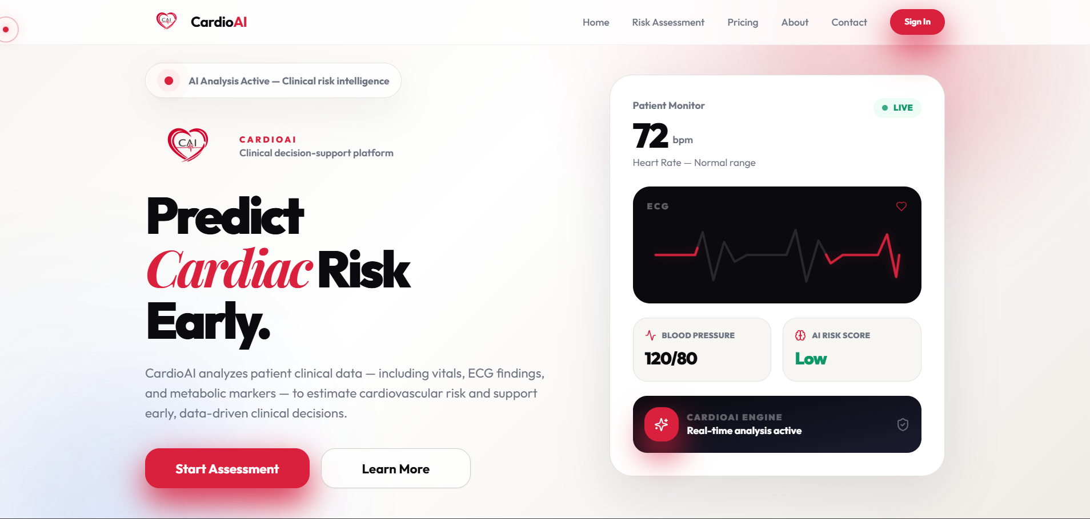
Landing Page: Professional First Impression
The public entry point communicates the medical AI positioning.
What it shows
Clear value proposition: “Predict Cardiac Risk Early”
Navigation for Home, Risk Assessment, Pricing, About, Contact
Call-to-action starts the assessment flow
Medical-tech branding with ECG and patient-monitor motifs
Why it matters
A strong landing page makes the prototype look like a real product, not only an academic experiment.
Notes:
Our mission is to use artificial intelligence to support more accurate cardiovascular risk assessment.
The aim is to detect risk sooner and improve health outcomes for patients.
The vision is to make advanced cardiovascular evaluation accessible to more people, regardless of their location or available resources.
We also highlight several key impact areas.
First, better detection can help save more lives.
Second, stronger prevention can reduce healthcare costs.
Another important impact is reaching more patients, especially in areas with limited access to healthcare.
Finally, we also aim to support healthcare institutions through better clinical workflows and decision support.
To make this vision practical, we built the project around a specific innovation.

Slide 8
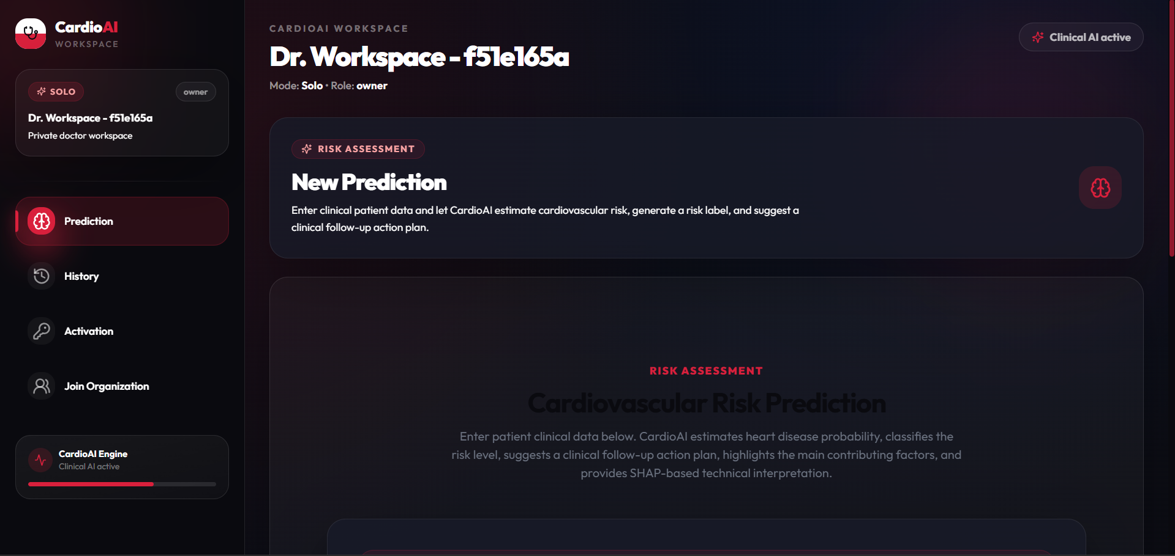
Dashboard: Workspace Navigation
Core features are accessible from a physician-oriented workspace.
What it shows
Prediction module for new risk assessments
History module for previous predictions
Activation and organization join workflow
Solo workspace mode displayed clearly
Clinical AI active indicator reinforces system readiness
Why it matters
The dashboard turns CardioAI into a usable clinical workspace, not just a prediction page.
Notes:
Partie gauche
Prototype Implementation
➡️ Implémentation du prototype
• Working Prototype
➡️ Prototype fonctionnel
Développé en Python en utilisant scikit-learn pour les capacités de machine learning.
• Integrated Pipeline
➡️ Pipeline intégré
Inclut le prétraitement, l’entraînement du modèle, la validation, l’optimisation et les étapes d’évaluation.
• Models Tested
➡️ Modèles testés
Régression logistique, Random Forest, K plus proches voisins (KNN) et machines à vecteurs de support (SVM).
• Development Environment
➡️ Environnement de développement
Utilisation de Google Colab pour un développement et une expérimentation efficaces.
🧪 Partie droite
Validation Strategy
➡️ Stratégie de validation
• Cross-Validation
➡️ Validation croisée
Utilisation d’une validation croisée stratifiée à 5 plis pour garantir une évaluation robuste et non biaisée.
• Performance Metrics
➡️ Mesures de performance
Évaluation basée sur l’accuracy, la précision, le rappel, le score F1, l’AUC-ROC, la spécificité et le MCC.
• Best Model Identified
➡️ Meilleur modèle identifié
Le modèle KNN optimisé a démontré de bonnes performances prédictives, en équilibrant efficacement le rappel et la précision.

Slide 9
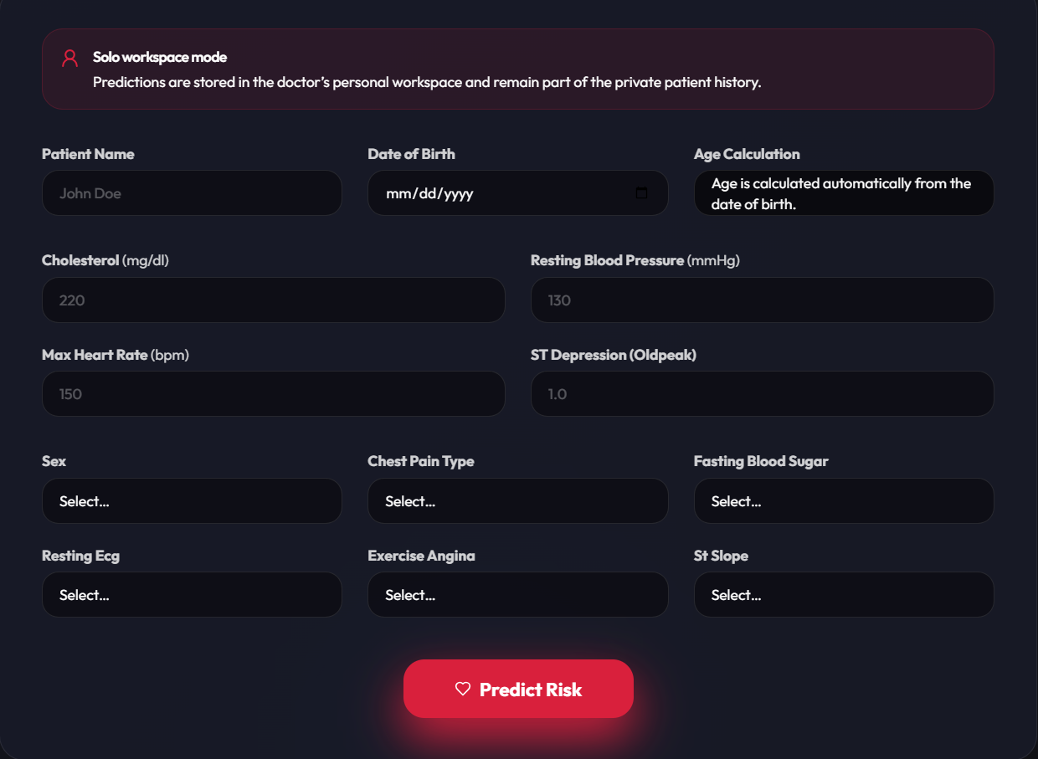
Prediction Form: Structured Clinical Input
The model receives standardized patient variables through the interface.
What it shows
Patient identity and date of birth are captured first
Age is calculated automatically to reduce input errors
Numerical indicators include cholesterol, blood pressure, max heart rate, and oldpeak
Categorical indicators include sex, chest pain type, fasting blood sugar, resting ECG, exercise angina, and ST slope
A single Predict Risk action triggers backend inference
Why it matters
A structured form ensures consistent data capture and prepares the input for reliable model inference.
Notes:
Partie gauche
Prototype Implementation
➡️ Implémentation du prototype
• Working Prototype
➡️ Prototype fonctionnel
Développé en Python en utilisant scikit-learn pour les capacités de machine learning.
• Integrated Pipeline
➡️ Pipeline intégré
Inclut le prétraitement, l’entraînement du modèle, la validation, l’optimisation et les étapes d’évaluation.
• Models Tested
➡️ Modèles testés
Régression logistique, Random Forest, K plus proches voisins (KNN) et machines à vecteurs de support (SVM).
• Development Environment
➡️ Environnement de développement
Utilisation de Google Colab pour un développement et une expérimentation efficaces.
🧪 Partie droite
Validation Strategy
➡️ Stratégie de validation
• Cross-Validation
➡️ Validation croisée
Utilisation d’une validation croisée stratifiée à 5 plis pour garantir une évaluation robuste et non biaisée.
• Performance Metrics
➡️ Mesures de performance
Évaluation basée sur l’accuracy, la précision, le rappel, le score F1, l’AUC-ROC, la spécificité et le MCC.
• Best Model Identified
➡️ Meilleur modèle identifié
Le modèle KNN optimisé a démontré de bonnes performances prédictives, en équilibrant efficacement le rappel et la précision.

Slide 10
Data Preparation and Preprocessing
Model quality depends on clean, consistent clinical variables.
Pipeline Overview
Raw Dataset
Cleaning
Preprocessing
Pipeline
  Impute
  Encode
  Scale
  Cap outliers
  Same transformations for training and prediction
  Heart disease clinical features
  Remove duplicates
  Replace invalid zeros
Key Preprocessing Choices
Why it matters
  Invalid cholesterol and resting BP zeros treated as missing
  Invalid ST slope handled before encoding
  Numerical variables scaled for distance-based KNN
  Categorical variables one-hot encoded with unknown handling
  A reproducible ML pipeline avoids data leakage and ensures consistent training and prediction transformations.
CardioAI
Notes:
Next, we will look at the cost gap
Late detection of cardiovascular disease increases treatment costs.
Early risk assessment with CardioAI can reduce these costs.

Slide 11




Machine learning pipeline
A complete flow from login to prediction review and follow-up.
Train/Test Split
Threshold Tuning
Split the dataset into training and testing sets.
Select the best decision threshold for classification.
Cross Validation
Final Evaluation
Evaluate models using repeated validation folds.
Test the selected model on unseen data.
Grid / Random Search
Deployment Model
Tune hyperparameters to improve performance.
Save the final model for application inference.
Evaluated Algorithms
Evaluation Logic
  Logistic Regression
  Random Forest
  K-Nearest Neighbors
  Support Vector Machine
  Accuracy describes general correctness
  Recall is critical for identifying at-risk patients
  F1-score balances recall and precision
  ROC-AUC measures discrimination across thresholds
  Threshold tuning was integrated into model selection
CardioAI
Notes:
CardioAI follows a structured workflow that transforms clinical information into useful risk insights.
The first step is patient data input. including important clinical and demographic features such as age, blood pressure, cholesterol levels, chest pain type, ECG indicators, and other relevant variables.
The next step is predictive model analysis, where the model identifies hidden patterns linked to cardiovascular risk.
After that, the system performs risk scoring by generating a personalized score for each patient.
It can then provide clinical recommendations to support follow-up actions and preventive care.
Finally, the model can continue to improve through additional data, external validation, and further refinement.

Slide 12
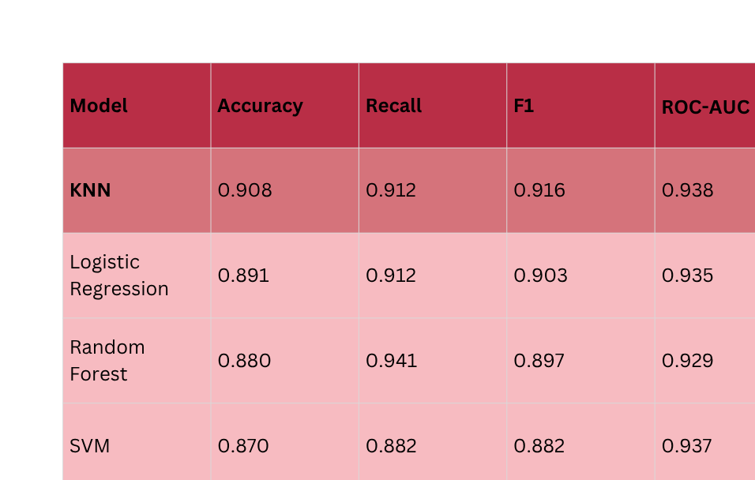
Model Comparison: Final Metrics
KNN achieved the best overall balance for the final selected model.
Main Conclusion
·
KNN was selected as the final model because it achieved the most reliable overall balance for clinical decision support, particularly in F1-score and ROC-AUC.
·
·
·
Evaluation Note
This comparison is reported before final probability calibration.
CardioAI
Notes:
Dans cette partie, on compare les performances des différents modèles de machine learning pour choisir le plus fiable.”
📊 Explication du tableau
👉
“On a testé 4 modèles : KNN, Logistic Regression, Random Forest et SVM.”
👉
“On les évalue avec 4 métriques importantes :
Accuracy → précision globale
Recall → capacité à détecter les cas positifs
F1-score → équilibre entre précision et rappel
ROC-AUC → performance globale du modèle”
🏆 Résultats principaux
👉
“Le modèle KNN donne les meilleurs résultats globaux :
meilleure accuracy
meilleur F1-score
et un très bon ROC-AUC”
👉
“Random Forest a un bon recall, mais moins équilibré globalement.”
👉
“SVM et Logistic Regression sont corrects, mais moins performants.”
✅ Conclusion (TRÈS IMPORTANT)
👉
“Donc, on a choisi KNN comme modèle final, car il offre le meilleur compromis entre précision et fiabilité.”

Slide 13
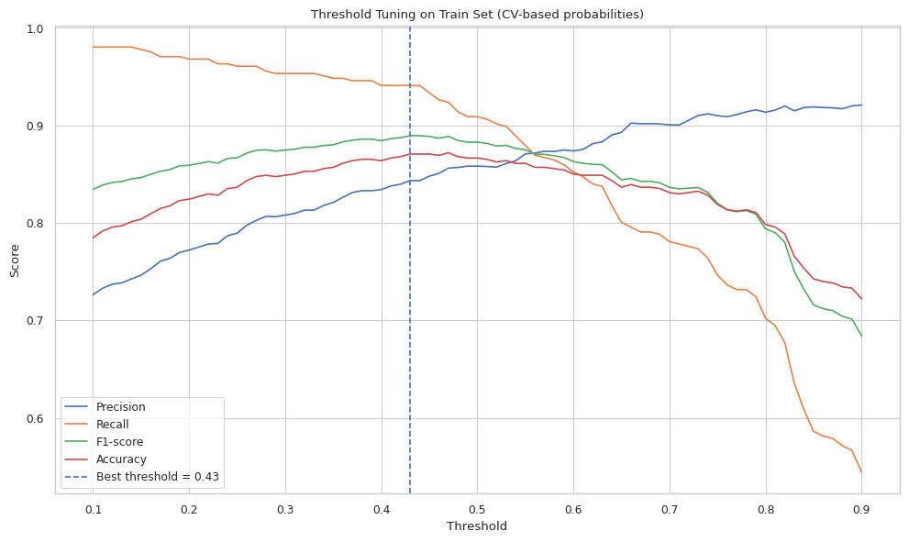
Threshold Tuning and Calibration
The decision threshold is selected to optimize clinical classification behavior.
Threshold Summary
  Before calibration: 0.43
  After calibration: 0.35
Threshold tuning balances precision, recall, F1-score, and accuracy.
Why calibration matters
Calibration improves the reliability of predicted probabilities. The final confusion matrix therefore uses the calibrated threshold.
CardioAI
Notes:
Partie gauche
Prototype Implementation
➡️ Implémentation du prototype
• Working Prototype
➡️ Prototype fonctionnel
Développé en Python en utilisant scikit-learn pour les capacités de machine learning.
• Integrated Pipeline
➡️ Pipeline intégré
Inclut le prétraitement, l’entraînement du modèle, la validation, l’optimisation et les étapes d’évaluation.
• Models Tested
➡️ Modèles testés
Régression logistique, Random Forest, K plus proches voisins (KNN) et machines à vecteurs de support (SVM).
• Development Environment
➡️ Environnement de développement
Utilisation de Google Colab pour un développement et une expérimentation efficaces.
🧪 Partie droite
Validation Strategy
➡️ Stratégie de validation
• Cross-Validation
➡️ Validation croisée
Utilisation d’une validation croisée stratifiée à 5 plis pour garantir une évaluation robuste et non biaisée.
• Performance Metrics
➡️ Mesures de performance
Évaluation basée sur l’accuracy, la précision, le rappel, le score F1, l’AUC-ROC, la spécificité et le MCC.
• Best Model Identified
➡️ Meilleur modèle identifié
Le modèle KNN optimisé a démontré de bonnes performances prédictives, en équilibrant efficacement le rappel et la précision.

Slide 14
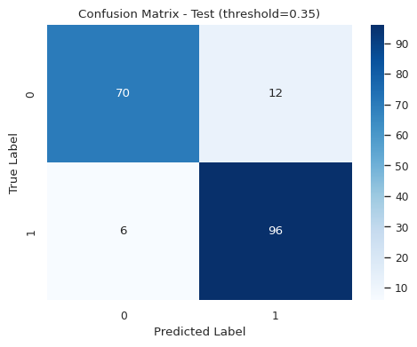
Final KNN Evaluation on the Test Set
Confusion matrix explains actual classification outcomes.
Results
  True negatives: 70
  False positives: 12
  False negatives: 6
  True positives: 96
Clinical Interpretation
The model identifies most positive cases, supporting early cardiovascular risk detection. False negatives remain clinically important, which is why CardioAI is positioned as decision support, not diagnosis.
Final calibrated KNN: Accuracy 0.902 · Recall 0.941 · F1-score 0.914 · ROC-AUC 0.940
Notes:
Partie gauche
Prototype Implementation
➡️ Implémentation du prototype
• Working Prototype
➡️ Prototype fonctionnel
Développé en Python en utilisant scikit-learn pour les capacités de machine learning.
• Integrated Pipeline
➡️ Pipeline intégré
Inclut le prétraitement, l’entraînement du modèle, la validation, l’optimisation et les étapes d’évaluation.
• Models Tested
➡️ Modèles testés
Régression logistique, Random Forest, K plus proches voisins (KNN) et machines à vecteurs de support (SVM).
• Development Environment
➡️ Environnement de développement
Utilisation de Google Colab pour un développement et une expérimentation efficaces.
🧪 Partie droite
Validation Strategy
➡️ Stratégie de validation
• Cross-Validation
➡️ Validation croisée
Utilisation d’une validation croisée stratifiée à 5 plis pour garantir une évaluation robuste et non biaisée.
• Performance Metrics
➡️ Mesures de performance
Évaluation basée sur l’accuracy, la précision, le rappel, le score F1, l’AUC-ROC, la spécificité et le MCC.
• Best Model Identified
➡️ Meilleur modèle identifié
Le modèle KNN optimisé a démontré de bonnes performances prédictives, en équilibrant efficacement le rappel et la précision.

Slide 15
Final Model Performance Summary
These results highlight CardioAI’s final predictive performance and clinical potential.
Final Model Performance
Final Model
KNN was selected as the final model
Recall
0.941
  Highest F1-score: 0.914
  Highest Accuracy: 0.902
  Strong Recall: 0.941
  Strong ROC-AUC: 0.940
ROC-AUC
0.940
F1-Score
0.914
KNN achieved the strongest overall balance between recall, F1-score, and ROC-AUC, making it the final selected model.
Accuracy
0.902
Notes:
34

Slide 16
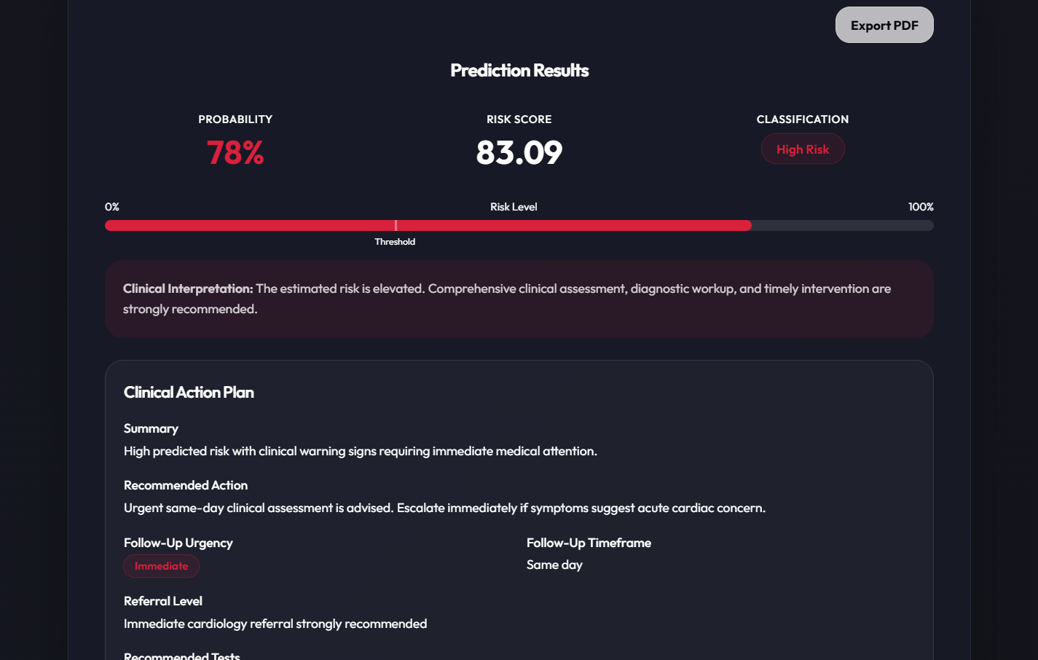
Prediction Result and PDF Export
The output is designed for clinical readability and documentation.
What it shows
  Probability shown as an intuitive percentage
  Normalized risk score for easy interpretation
  Classification: Low / Moderate / High Risk
  Clinical interpretation translates score into meaning
  Export PDF button supports documentation and sharing
Why calibration matters
The model output is translated into a readable clinical result that can be reviewed, saved, and shared.
CardioAI
Notes:
Partie gauche
Prototype Implementation
➡️ Implémentation du prototype
• Working Prototype
➡️ Prototype fonctionnel
Développé en Python en utilisant scikit-learn pour les capacités de machine learning.
• Integrated Pipeline
➡️ Pipeline intégré
Inclut le prétraitement, l’entraînement du modèle, la validation, l’optimisation et les étapes d’évaluation.
• Models Tested
➡️ Modèles testés
Régression logistique, Random Forest, K plus proches voisins (KNN) et machines à vecteurs de support (SVM).
• Development Environment
➡️ Environnement de développement
Utilisation de Google Colab pour un développement et une expérimentation efficaces.
🧪 Partie droite
Validation Strategy
➡️ Stratégie de validation
• Cross-Validation
➡️ Validation croisée
Utilisation d’une validation croisée stratifiée à 5 plis pour garantir une évaluation robuste et non biaisée.
• Performance Metrics
➡️ Mesures de performance
Évaluation basée sur l’accuracy, la précision, le rappel, le score F1, l’AUC-ROC, la spécificité et le MCC.
• Best Model Identified
➡️ Meilleur modèle identifié
Le modèle KNN optimisé a démontré de bonnes performances prédictives, en équilibrant efficacement le rappel et la précision.

Slide 17
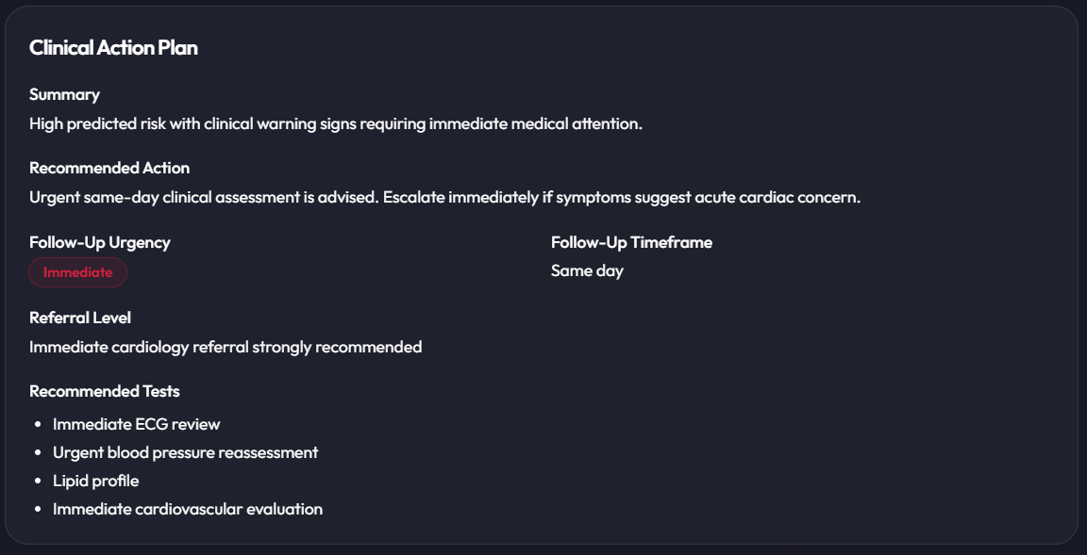
Clinical Action Plan
The system turns prediction into a concrete follow-up recommendation.
The action plan includes
  Risk situation summary
  Recommended action and urgency
  Follow-up timeframe
  Referral level
  Recommended medical tests
  Suggested care pathway
Key Differentiator
CardioAI transforms prediction into a clinical decision-support workflow, not just a probability score.
CardioAI
Notes:
Partie gauche
Prototype Implementation
➡️ Implémentation du prototype
• Working Prototype
➡️ Prototype fonctionnel
Développé en Python en utilisant scikit-learn pour les capacités de machine learning.
• Integrated Pipeline
➡️ Pipeline intégré
Inclut le prétraitement, l’entraînement du modèle, la validation, l’optimisation et les étapes d’évaluation.
• Models Tested
➡️ Modèles testés
Régression logistique, Random Forest, K plus proches voisins (KNN) et machines à vecteurs de support (SVM).
• Development Environment
➡️ Environnement de développement
Utilisation de Google Colab pour un développement et une expérimentation efficaces.
🧪 Partie droite
Validation Strategy
➡️ Stratégie de validation
• Cross-Validation
➡️ Validation croisée
Utilisation d’une validation croisée stratifiée à 5 plis pour garantir une évaluation robuste et non biaisée.
• Performance Metrics
➡️ Mesures de performance
Évaluation basée sur l’accuracy, la précision, le rappel, le score F1, l’AUC-ROC, la spécificité et le MCC.
• Best Model Identified
➡️ Meilleur modèle identifié
Le modèle KNN optimisé a démontré de bonnes performances prédictives, en équilibrant efficacement le rappel et la précision.

Slide 18
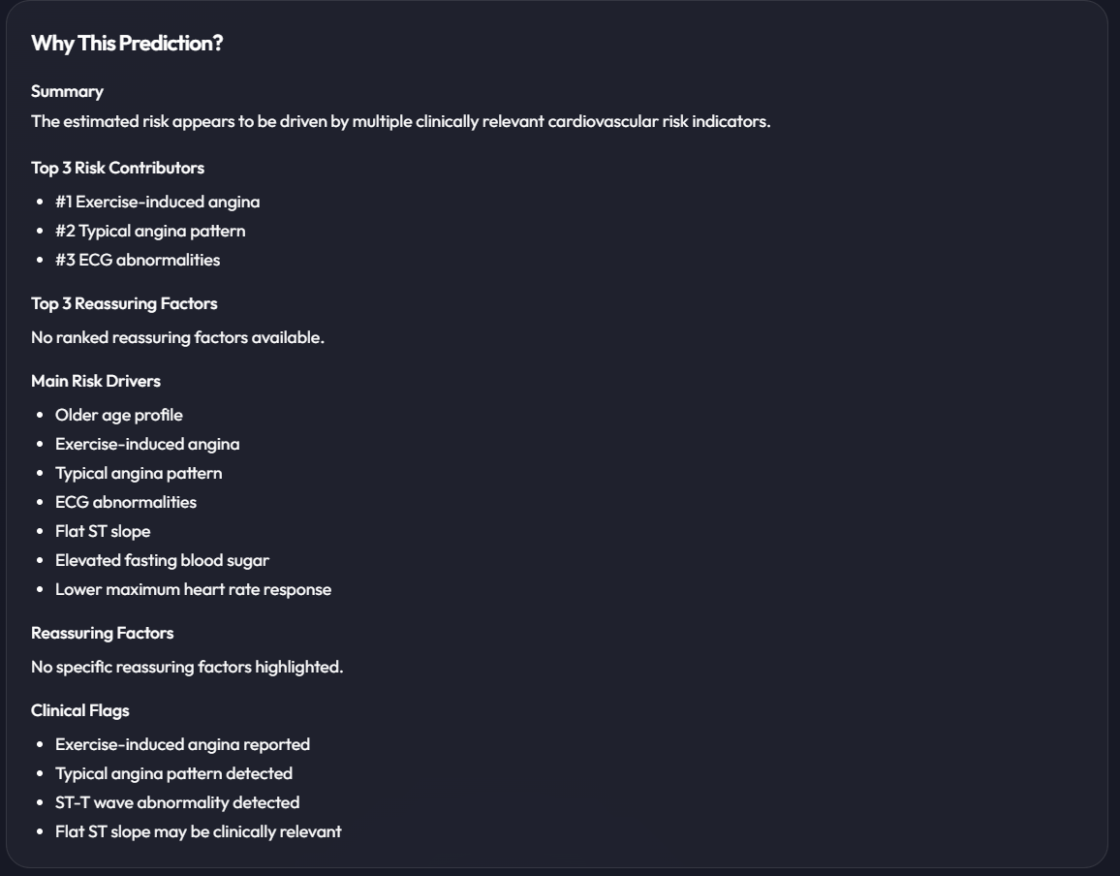
Explainability: “Why This Prediction?”
The doctor can see the clinical factors driving the result.
What it provides
  Summarizes why the estimated risk is elevated
  Ranks top risk contributors such as exercise-induced angina and ECG abnormalities
  Separates risk drivers from reassuring factors
  Supports clinician trust and transparency
  Can be extended with SHAP-based reasoning
Why it matters
The model output becomes more transparent and trustworthy when the clinician can see the main contributing factors.
CardioAI
Notes:
Partie gauche
Prototype Implementation
➡️ Implémentation du prototype
• Working Prototype
➡️ Prototype fonctionnel
Développé en Python en utilisant scikit-learn pour les capacités de machine learning.
• Integrated Pipeline
➡️ Pipeline intégré
Inclut le prétraitement, l’entraînement du modèle, la validation, l’optimisation et les étapes d’évaluation.
• Models Tested
➡️ Modèles testés
Régression logistique, Random Forest, K plus proches voisins (KNN) et machines à vecteurs de support (SVM).
• Development Environment
➡️ Environnement de développement
Utilisation de Google Colab pour un développement et une expérimentation efficaces.
🧪 Partie droite
Validation Strategy
➡️ Stratégie de validation
• Cross-Validation
➡️ Validation croisée
Utilisation d’une validation croisée stratifiée à 5 plis pour garantir une évaluation robuste et non biaisée.
• Performance Metrics
➡️ Mesures de performance
Évaluation basée sur l’accuracy, la précision, le rappel, le score F1, l’AUC-ROC, la spécificité et le MCC.
• Best Model Identified
➡️ Meilleur modèle identifié
Le modèle KNN optimisé a démontré de bonnes performances prédictives, en équilibrant efficacement le rappel et la précision.

Slide 19
Technical Architecture
A modular system built for maintainability and extension.
React Frontend
Backend Responsibilities
  UI
  Forms
  Dashboard
  Validates clinical inputs before inference
  Converts model outputs into risk scores and labels
  Generates clinical action plans and explanations
  Stores prediction history and patient follow-up data
  Manages workspace, organization, and role-based logic
  Supports analytics, PDF reporting, and audit logs
FastAPI Backend
  Validation
  Inference
ML Pipeline
  Preprocessing
  KNN
Supabase
  Auth
  Database
  Workspace
PDF / Reports
  Documentation output
CardioAI
Notes:
CardioAI follows a structured workflow that transforms clinical information into useful risk insights.
The first step is patient data input. including important clinical and demographic features such as age, blood pressure, cholesterol levels, chest pain type, ECG indicators, and other relevant variables.
The next step is predictive model analysis, where the model identifies hidden patterns linked to cardiovascular risk.
After that, the system performs risk scoring by generating a personalized score for each patient.
It can then provide clinical recommendations to support follow-up actions and preventive care.
Finally, the model can continue to improve through additional data, external validation, and further refinement.

Slide 20
Organization-Ready Features
The project includes foundations for real clinical team use.
Authentication
Subscriptions
Join Codes
Departments
  Secure user access
  Activation and billing logic
  Controlled organization entry
  Hospital-level organization
Members
Queue
Analytics
Audit Logs
  Roles and permissions
  Patient prioritization
  Risk distribution and activity
  Traceability of actions
Product Readiness
These features show that CardioAI is designed as a scalable healthcare product, not just an isolated model demo.
Notes:
Cardiovascular disease remains one of the biggest health problems in the world.
In many cases, patients are identified too late, which makes prevention and treatment more difficult.
Risk evaluation can also take time, because doctors often need to consider several clinical factors and tests.
Another challenge, is limited access to preventive cardiovascular care, especially in contexts such as Algeria.
In addition, the lack of rapid and data-driven tools can make personalized risk assessment more difficult.
As shown in the graph, cardiovascular mortality in Algeria remains high compared with the global average.
Because of this, the challenge affects different parts of the healthcare system, which is why this solution can support several groups.

Slide 21
Delivery package and GitHub structure
The repository is organized for demonstration, review, and future development.
Repository Structure
Included deliverables
cardioai-project/
├── backend/ FastAPI + model.pkl + schemas
├── frontend/ React application
├── docs/ reports and user guide
├── results/ evaluation figures and PDF table
├── presentation/ final PPTX and PDF
├── demo/ screenshots / demo material
└── README.md setup and project overview
Project description report
Model summary and evaluation results
User guide with screenshots
Evaluation images: ROC, confusion matrix, threshold tuning
Final presentation in PPTX and PDF formats
CardioAI
Notes:
Interprétation principalement manuelle
Repose fortement sur l’expertise individuelle du clinicien, ce qui peut entraîner une variabilité.
• May require more time for structured comparison
➡️ Peut nécessiter plus de temps pour une analyse structurée
Implique souvent une revue et une synthèse approfondies des dossiers, prolongeant les délais de diagnostic.
• Limited consistency across cases
➡️ Cohérence limitée entre les cas
Soumise à la variabilité humaine et à l’interprétation, ce qui impacte la standardisation des soins.
• Reactive case identification
➡️ Identification réactive des cas
Se concentre sur le diagnostic des conditions existantes plutôt que sur la prédiction proactive des risques.
🤖 Partie droite
CardioAI Support System
➡️ Système d’aide CardioAI
• AI-assisted risk estimation
➡️ Estimation du risque assistée par l’IA
Utilise des algorithmes avancés pour une évaluation du risque cardiovasculaire objective et basée sur les données.
• Faster support for risk stratification
➡️ Support plus rapide pour la stratification du risque
Fournit des analyses rapides, accélérant considérablement la prise de décision clinique.
• More standardized data-driven support
➡️ Support plus standardisé basé sur les données
Garantit des évaluations du risque cohérentes et reproductibles pour tous les patients.
• Earlier prioritization of higher-risk patients
➡️ Priorisation plus précoce des patients à haut risque
Permet une intervention proactive et des stratégies préventives pour améliorer les résultats.
⚠️ Note en bas
CardioAI ne remplace pas les médecins ni les examens diagnostiques ; il s’agit d’un outil d’aide à la décision clinique.

Slide 22
Impact and Future Work
A strong foundation for intelligent cardiovascular decision support.
1) Stronger Model
3) Privacy & Governance
Improve the model with larger and more diverse datasets to strengthen robustness, generalization, and clinical reliability.
Strengthen privacy, access control, and audit mechanisms to support secure and organization-ready deployment.
2) Richer Explainability
4) Product Expansion
Extend explainability using richer SHAP visualizations and more transparent reasoning to support clinician trust.
Add patient trajectory dashboards, triage views, and online deployment for real-time demonstration and testing.
Final Impact: CardioAI demonstrates how machine learning can be transformed into a structured, interpretable, and user-oriented medical technology solution.
CardioAI
Notes:
finally the key takeaways of our project.
First, there is an important clinical need for earlier cardiovascular risk detection.
Second, we developed an AI-powered solution that analyzes patient data using machine learning.
Third, our model achieved strong performance, with KNN providing the best results.
Finally, the system has strong real-world potential for hospitals, clinics, and preventive care programs.

Slide 23
Our Team
A student team developing CardioAI, a multidisciplinary project combining AI, data analysis, and cardiovascular healthcare.
Ikhlasse Ziati
Khadidja Cherifi
Ranya Katya Rouabhi
Fatima Briki
Project Lead
Data Preparation
Model Implementation
Evaluation & Visualization
Leading the strategic vision and overall project execution to bridge technology and patient care.
Ensuring high-quality data integrity and optimized feature sets for robust model training.
Developing and refining the core algorithms driving our predictive diagnostic capabilities.
Interpreting complex diagnostic outputs and delivering intuitive insights for clinical decision support.
Dr. Abderrahmane Khiat
Academic Supervisor
Provides academic guidance and supervises the project’s methodological and strategic development. PhD in Computer Science, specialized in AI systems and digital health. Former Project Lead at Fraunhofer IAIS and IT Project Manager at Hyundai AutoEver.
CardioAI
Notes:
Thank you for your attention.

Slide 24
Let's Connect
Team
Founder & Project Lead
Email
CardioAI Project Team
Ziati Ikhlasse
CardioAI4@gmail.com
University
Project
University of Saida Dr. Tahar Moulay
Clinical AI Support for Cardiovascular Risk Assessment
Together, we're transforming cardiovascular care through AI innovation.
Notes:
22

