Slide 1
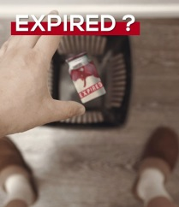

Slide 2


EBC/GNG5125 – Data Science Applications Final Project: Chatbot for Recipe Recommendation
Michael Khalil Gehad AboKamar Khadija Taha Youssef Metwally
mkhal120@uOttawa.ca gabok033@uOttawa.ca khesh072@uOttawa.ca ymetw027@uOttawa.ca

Slide 3
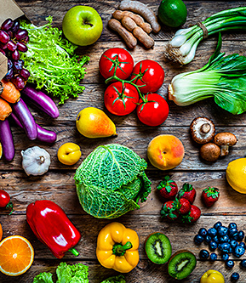
Problem Formulation
Identify a healthy and tasty recipe for cooking in the kitchen using the ingredients available at home.

Slide 4
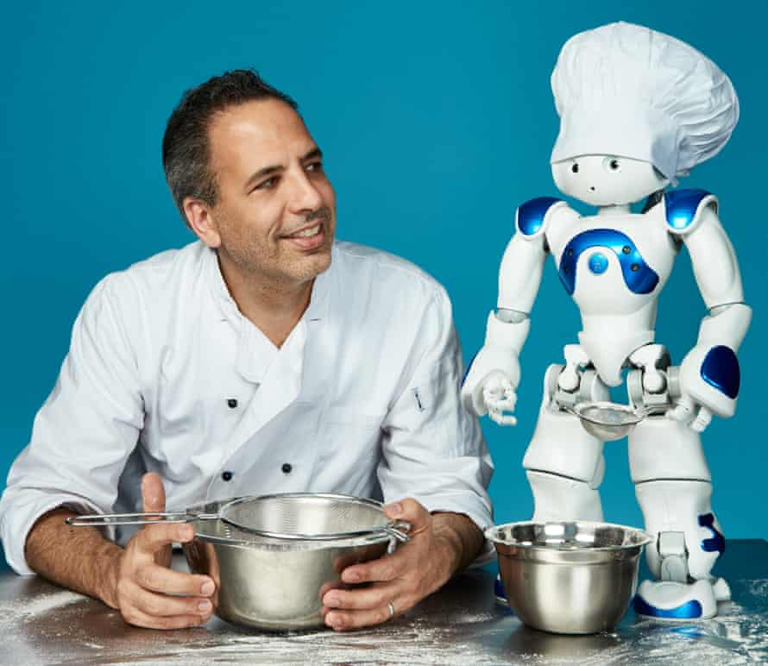
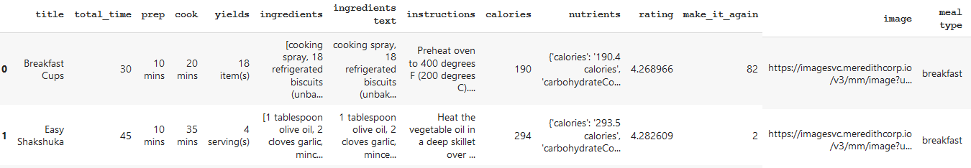
Data Preparation
Data scraped from “allrecipes.com” website using “apify.com”.

Slide 5
Data Preparation (for ingredients)
Remove brackets and strings inside.
Remove fractions such as '½' using regular expressions.
Remove any number.
Replace some words with different spelling such as:
'ricottum', 'ricotta'
'olife', 'olive'
Remove extra stop words found in the data:
['teaspoons', 'tablespoons', 'chopped', 'ground', 'minced', 'cups', 'extract', 'shredded', 'and', 'or', 'all-purpose', ....
Separate 'salt pepper' into two different ingredients: 'salt' and 'pepper'.

Slide 6
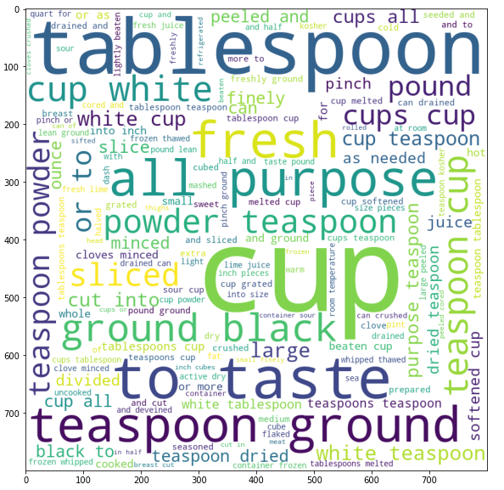
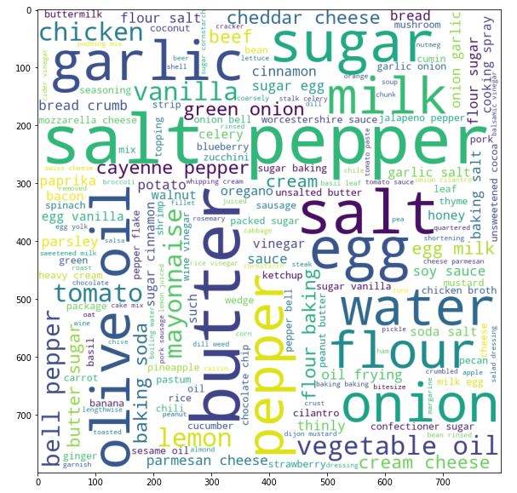
Data Preparation (for ingredients)
Top words (before and after)

Slide 7
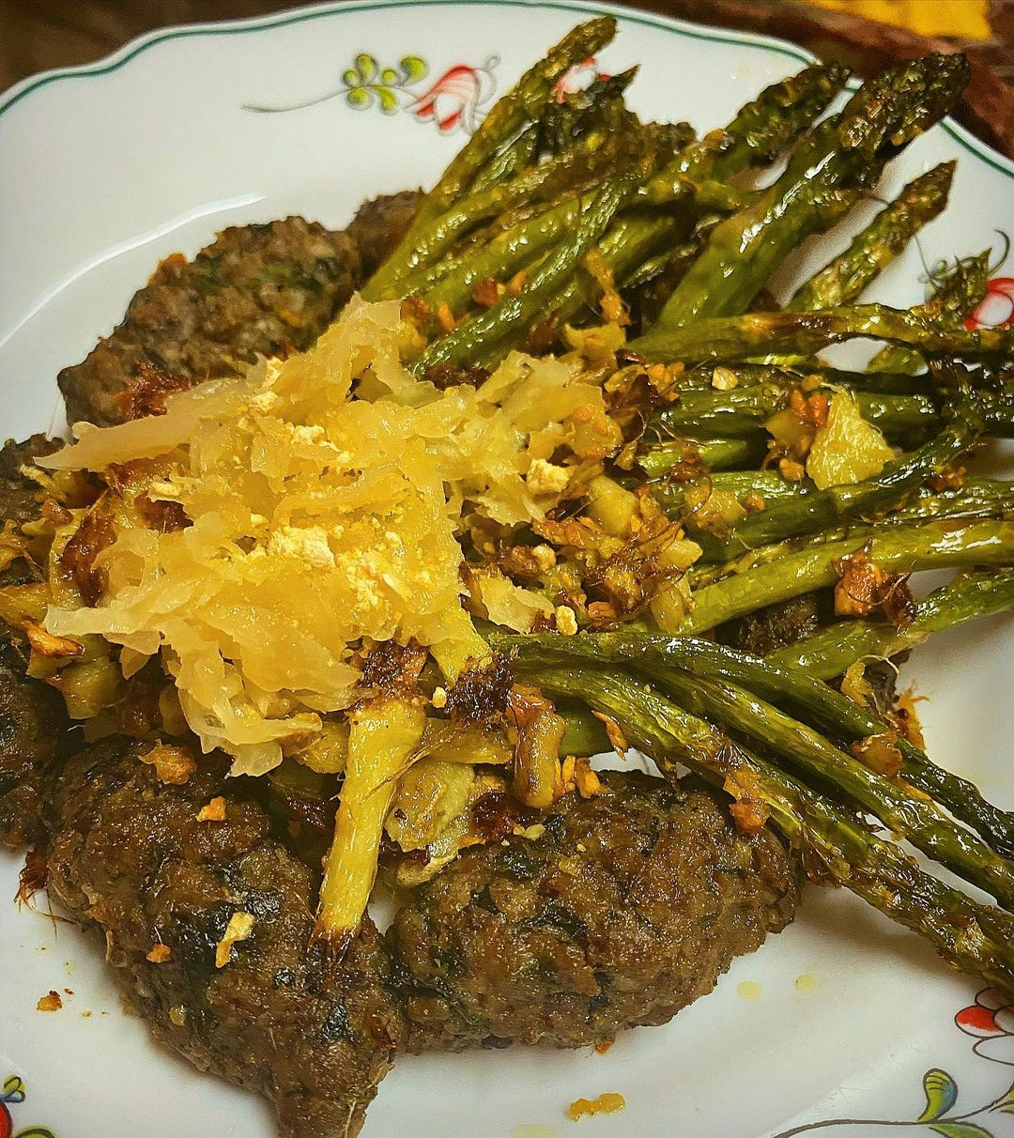
Data Preparation (for instructions)
Remove extra stop words found
in the data:
['.', ',', 'and', 'the', 'a', 'in',
'to','until','with','minutes','of',
'into', 'degrees','bowl','over','for',
‘oven','mixture','heat', ';']
Apply stemming algorithm:
PorterStemmer.

Slide 8
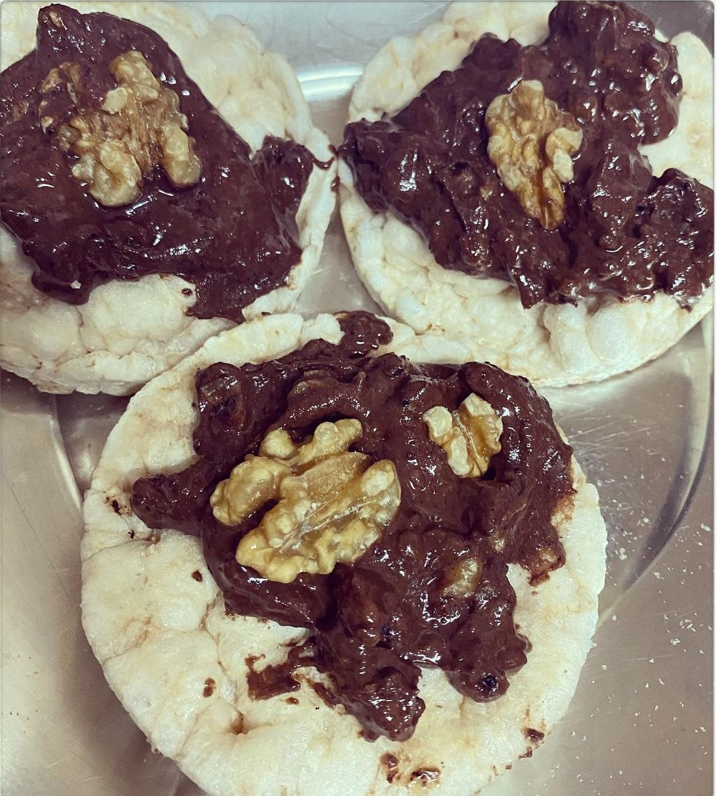
Text Transformation
For ingredients:
TF-IDF
CountVectorizer
Word2Vec
For recipes’ instructions:
TF-IDF
CountVectorizer

Slide 9
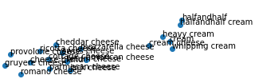
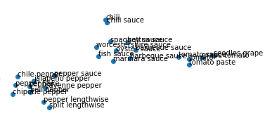
Modeling & Evaluation
Clustering: K-Means
Use T-SNE for visualizing the clusters

Slide 10
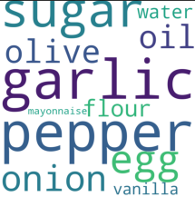
Modeling & Evaluation
Use Word2Vec to find the most similar ingredients to an ingredient in the vocabulary.
Silhouette Coefficient: 0.17660

Slide 11
Modeling & Evaluation
Recommendation system: Content-based
Use "pairwise_distances_argmin_min“ function with “Cosine Simiarity” metric.
Input:
pasta and tomato
Output:
“Emily’s Excellent Taco Casserole’’: 'cheddar cheese,lettuce,tomato,salsa,cream‘
OR
“Creamy Pasta Bake with Cherry Tomatoes and Basil”: 'olive oil,onion,garlic,tomato sauce,tomato paste,whipping cream,parmesan cheese,sugar,tomato,mozzarella cheese,salt,pepper'

Slide 12
Modeling & Evaluation
Classification:
Help the user by telling him the type of the meal he/she wants to know.
Used: SGD, SVM, Decision Tree, and K-Nearest Neighbor.
Champion model: K-Nearest Neighbor with 67.31% testing accuracy.
Performed hyper-parameter tuning.
Input:
# pizza
'dough, pepproni, tomato sauce, mozzarella'
Output:
‘dinner’

Slide 13
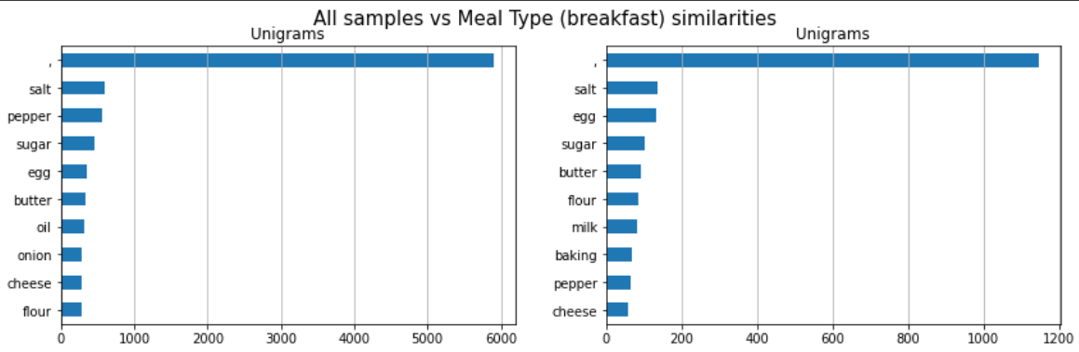
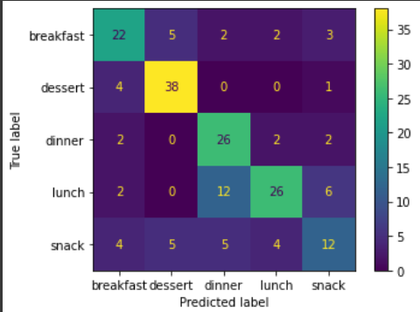
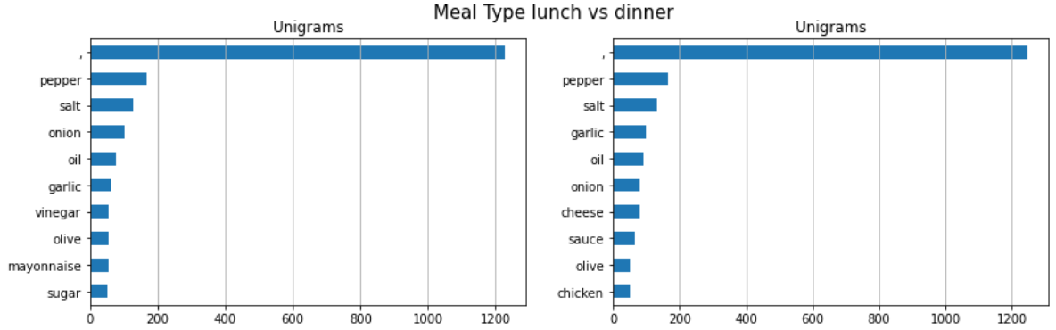
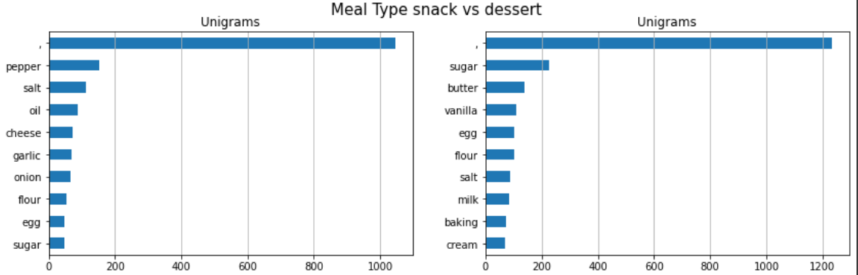
Error Analysis

Slide 14
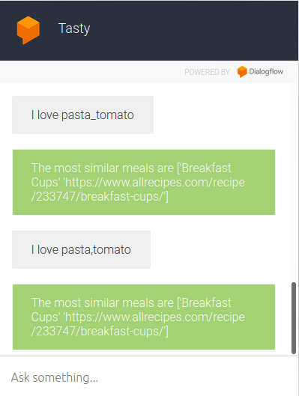
Chat bot Evaluation
Questions per cluster.
For each cluster or topic, how many variations of questions is your chatbot able to answer?
Tasty can combine between related items in one cluster
Notes:
Clusters supported.
This is the number of question and answer pairs you’re capable of responding to.
Questions per cluster.
For each cluster or topic, how many variations of questions is your chatbot able to answer?
Accuracy rate.
Within those known clusters and questions, how often is the bot giving a helpful and correct answer? We recommend aiming for 80% accuracy to be top quality.
Clusters supported.
This is the number of question and answer pairs you’re capable of responding to.
Questions per cluster.
For each cluster or topic, how many variations of questions is your chatbot able to answer?
Accuracy rate.
Within those known clusters and questions, how often is the bot giving a helpful and correct answer? We recommend aiming for 80% accuracy to be top quality.
Clusters supported.
This is the number of question and answer pairs you’re capable of responding to.
Questions per cluster.
For each cluster or topic, how many variations of questions is your chatbot able to answer?
Accuracy rate.
Within those known clusters and questions, how often is the bot giving a helpful and correct answer? We recommend aiming for 80% accuracy to be top quality

Slide 15
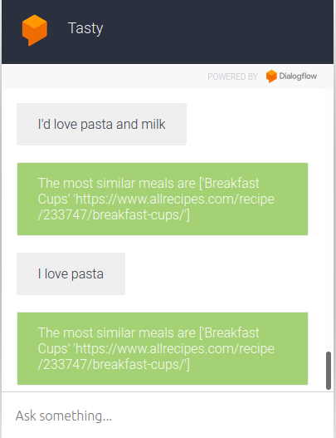
Chat bot Evaluation
Clusters supported
The number of questions and answer pairs we’re capable of responding to.
Tasty chat bot isn’t confused in misleading typing, as it’s able to split between incorrectly concatenated words.
Notes:
Clusters supported.
This is the number of question and answer pairs you’re capable of responding to.
Questions per cluster.
For each cluster or topic, how many variations of questions is your chatbot able to answer?
Accuracy rate.
Within those known clusters and questions, how often is the bot giving a helpful and correct answer? We recommend aiming for 80% accuracy to be top quality.
Clusters supported.
This is the number of question and answer pairs you’re capable of responding to.
Questions per cluster.
For each cluster or topic, how many variations of questions is your chatbot able to answer?
Accuracy rate.
Within those known clusters and questions, how often is the bot giving a helpful and correct answer? We recommend aiming for 80% accuracy to be top quality.
Clusters supported.
This is the number of question and answer pairs you’re capable of responding to.
Questions per cluster.
For each cluster or topic, how many variations of questions is your chatbot able to answer?
Accuracy rate.
Within those known clusters and questions, how often is the bot giving a helpful and correct answer? We recommend aiming for 80% accuracy to be top quality

Slide 16
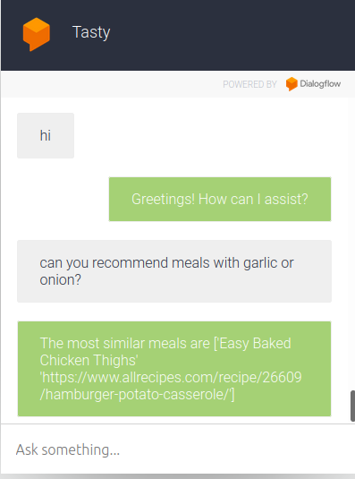
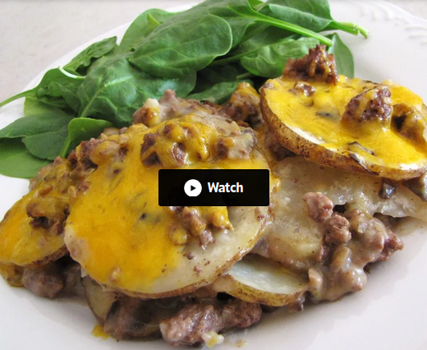
Chat bot Evaluation
Accuracy rate:
Within those known clusters and questions, how often is the bot giving a helpful and correct answer? We recommend aiming for 80% accuracy to be top quality.
Tasty can recommend recipe that suits the users
Notes:
Clusters supported.
This is the number of question and answer pairs you’re capable of responding to.
Questions per cluster.
For each cluster or topic, how many variations of questions is your chatbot able to answer?
Accuracy rate.
Within those known clusters and questions, how often is the bot giving a helpful and correct answer? We recommend aiming for 80% accuracy to be top quality.
Clusters supported.
This is the number of question and answer pairs you’re capable of responding to.
Questions per cluster.
For each cluster or topic, how many variations of questions is your chatbot able to answer?
Accuracy rate.
Within those known clusters and questions, how often is the bot giving a helpful and correct answer? We recommend aiming for 80% accuracy to be top quality.
Clusters supported.
This is the number of question and answer pairs you’re capable of responding to.
Questions per cluster.
For each cluster or topic, how many variations of questions is your chatbot able to answer?
Accuracy rate.
Within those known clusters and questions, how often is the bot giving a helpful and correct answer? We recommend aiming for 80% accuracy to be top quality

Slide 17
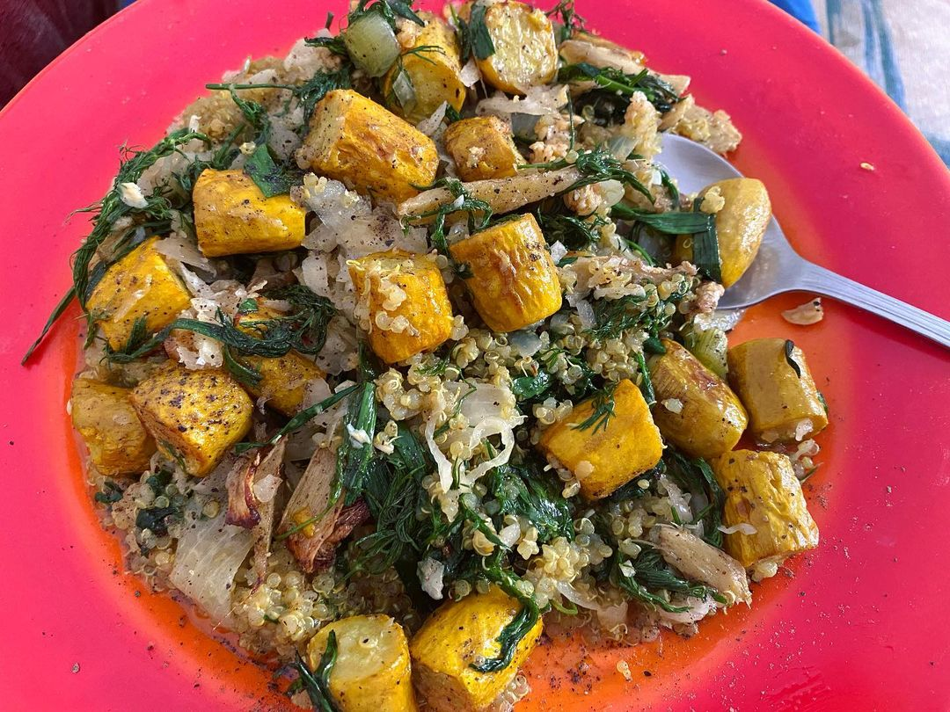
Now , for the Live Demo

Slide 18

Bye

