Slide 1
In the name of allah the most merciful and benificient

Slide 2
medical Image Analysis
Dr. zobia Suhail
PhD in Medical image processing
Aberystwyth university, Wales, uk (2019)

Slide 3
medical Image Analysis
Overview of Previous Lecture:
Image Features
How to select good features for image identification

Slide 4
medical Image Analysis
Image Features [Hand-Crafted Features / Manual Features]:
Manual feature extraction requires a good amount of time to MANUALLY extract the features.
In this mode of feature extraction, domain knowledge is highly required in order to machine learning
Algorithm to work better and with better accuracy.
We then use this features to fed into the machine learning algorithm to predict the output.

Slide 5

medical Image Analysis
Image Features [Hand-Crafted Features / Manual Features]:
Example:
To start with the simplest features…..

Slide 6
medical Image Analysis
Image Features [Hand-Crafted Features / Manual Features]:
Example:
To start with the simplest features…..
What features can be used to best describe this image?

Slide 7
medical Image Analysis
Image Features [Hand-Crafted Features / Manual Features]:
Example:
To start with the simplest features…..
Mean Intensity Value

Slide 8
medical Image Analysis
Image Features [Hand-Crafted Features / Manual Features]:
Example:
To start with the simplest features…..
Mean Intensity Value
Min Intensity Value

Slide 9
medical Image Analysis
Image Features [Hand-Crafted Features / Manual Features]:
Example:
To start with the simplest features…..
Mean Intensity Value
Min Intensity Value
Max Intensity Value

Slide 10
medical Image Analysis
Image Features [Hand-Crafted Features / Manual Features]:
Example:
To start with the simplest features…..
198
Image
Descriptor
12
215

Slide 11
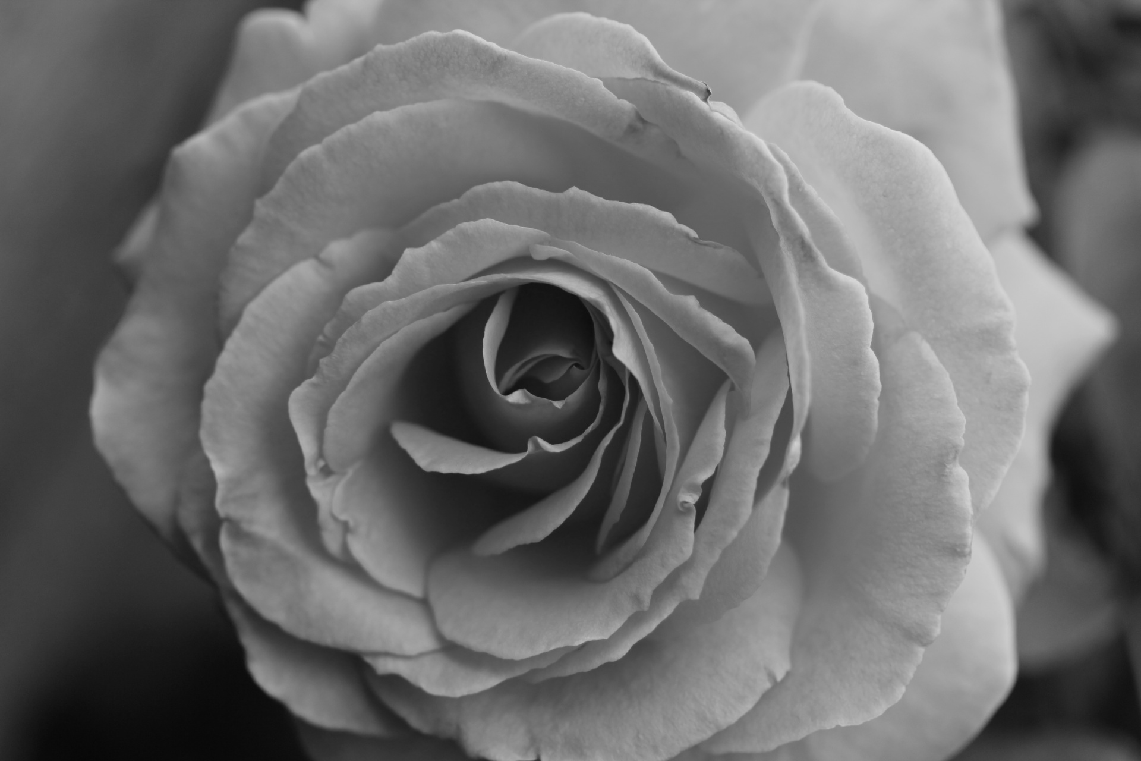
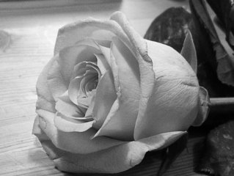
medical Image Analysis
Image Features [Hand-Crafted Features / Manual Features]:
Example:
To start with the simplest features…..
198
187
183
12
22
18
215
207
200

Slide 12
medical Image Analysis
Image Features [Hand-Crafted Features / Manual Features]:

Slide 13
medical Image Analysis
Image Features [Hand-Crafted Features / Manual Features]:
Intensity features
Quantify color/grayscale distribution of pixels
First-order statistical texture

Slide 14
medical Image Analysis
Image Features [Hand-Crafted Features / Manual Features]:
Intensity features
Quantify color/grayscale distribution of pixels
First-order statistical texture
Texture features
Similar structures repeated over and over again
(repeated patterns)
Statistical approach is to quantify spatial arrangement of pixel intensities
Structural approach is to define texture on objects/primitives

Slide 15
medical Image Analysis
Image Features [Hand-Crafted Features / Manual Features]:
Intensity features
Quantify color/grayscale distribution of pixels
First-order statistical texture
Texture features
Similar structures repeated over and over again
(repeated patterns)
Statistical approach is to quantify spatial arrangement of pixel intensities
Structural approach is to define texture on objects/primitives
Structural features to quantify spatial distribution of objects/primitives

Slide 16
medical Image Analysis
Image Features [Hand-Crafted Features / Manual Features]:
Intensity features
Quantify color/grayscale distribution of pixels
First-order statistical texture
Texture features
Similar structures repeated over and over again
(repeated patterns)
Statistical approach is to quantify spatial arrangement of pixel intensities
Structural approach is to define texture on objects/primitives
Structural features to quantify spatial distribution of objects/primitives
Morphological features to quantify the shape/size of a segmented object

Slide 17
medical Image Analysis
Image Features [Hand-Crafted Features / Manual Features]:
First Order Statistical Features:
Extracted based on histogram analysis
[Mean, Standard deviation, Skewness, Kurtosis, Entropy, Min, Max, Quartiles...

Slide 18
medical Image Analysis
Image Features [Hand-Crafted Features / Manual Features]:
First Order Statistical Features:
More useful if you first identify regions of interest ?

Slide 19
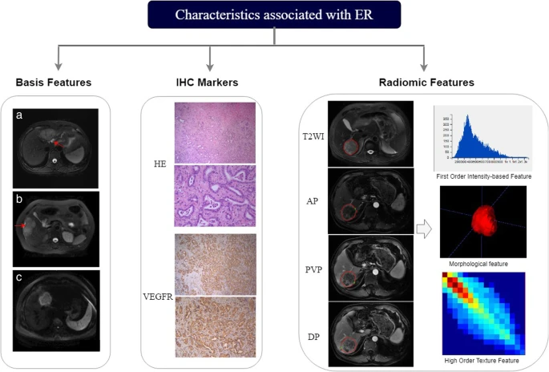
medical Image Analysis
Image Features [Hand-Crafted Features / Manual Features]:
First Order Statistical Features:
More useful if you first identify regions of interest ?
Notes:
Image Courtasy: https://cancerimagingjournal.biomedcentral.com/articles/10.1186/s40644-019-0234-4

Slide 20
medical Image Analysis
Image Features [Hand-Crafted Features / Manual Features]:
First Order Statistical Features:
First order statistical features computes local features of the image by keeping in view the
Intensity value of each image pixel.
Frist Order statistical features are the textual descriptors for image.
Let us assume we are computing First order statistical features for image patch I.

Slide 21
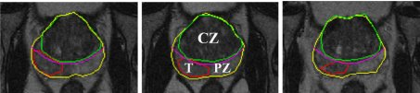
medical Image Analysis
Image Features [Hand-Crafted Features / Manual Features]:
First Order Statistical Features:
Let us assume we are computing First order statistical features for image patch I.
Image Courtasy: https://www.researchgate.net/publication/277871132_Computer_Aided_Diagnosis_of_Prostate_Cancer_within_the_Peripheral_Zone_in_T2-Weighted_MRI/figures?lo=1

Slide 22
medical Image Analysis
Image Features [Hand-Crafted Features / Manual Features]:
First Order Statistical Features:
Let us assume we are computing First order statistical features for image patch I.
Notes:
Image Courtasy: https://www.researchgate.net/publication/277871132_Computer_Aided_Diagnosis_of_Prostate_Cancer_within_the_Peripheral_Zone_in_T2-Weighted_MRI/figures?lo=1

Slide 23
medical Image Analysis
Image Features [Hand-Crafted Features / Manual Features]:
First Order Statistical Features:
Let us assume we are computing First order statistical features for image patch I.
I
Notes:
Image Courtasy: https://www.researchgate.net/publication/277871132_Computer_Aided_Diagnosis_of_Prostate_Cancer_within_the_Peripheral_Zone_in_T2-Weighted_MRI/figures?lo=1

Slide 24
medical Image Analysis
Image Features [Hand-Crafted Features / Manual Features]:
First Order Statistical Features:
Let us assume we are computing First order statistical features for Patch I of image IMG.
Patch I has in total m rows and n columns, and I(i,j) is representing image pixel at
Position (i,j) of patch I.

Slide 25
medical Image Analysis
Image Features [Hand-Crafted Features / Manual Features]:
First Order Statistical Features:
The following equations are representing some commonly used first order statistical features:
MEAN
Mean is computed by adding all grey level values within the image patch to the total number of
Pixels in the image patch.
Mean (µ) = I/N Ʃ I(I,j)
m,n
i=1 j=1
Where N = m x n, is the total number of pixels in image patch I.

Slide 26
medical Image Analysis
Image Features [Hand-Crafted Features / Manual Features]:
First Order Statistical Features:
MEDIAN
Median is the middle value of the list (L) contained the grey level intensity values of image patch I arrange in an ascending order.
Median (med) is the = ((N+1)/2) ^{th} element in the list L

Slide 27
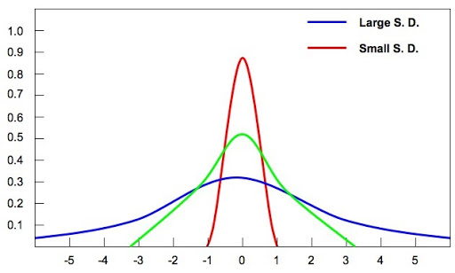
medical Image Analysis
Image Features [Hand-Crafted Features / Manual Features]:
First Order Statistical Features:
VARIANCE & STANDARD DEVIATION
Image Courtesy: http://www.old-ib.bioninja.com.au/standard-level/topic-1-statistical-analysi/11-statistical-analysis.html
Notes:
a variance is used to measure how far the data values are dispersed from the mean, and the standard deviation is the used to calculate the amount of dispersion of the given data set values.

Slide 28
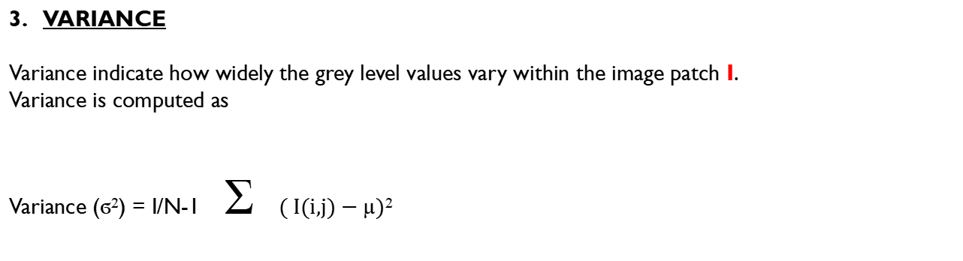
medical Image Analysis
Image Features [Hand-Crafted Features / Manual Features]:
First Order Statistical Features:
VARIANCE
Variance indicate how widely the grey level values vary within the image patch I.
Variance is computed as
Variance (ϭ²) = I/N-1 Ʃ $\text{( }\text{I}\text{(}\text{i}\text{,}\text{j}\text{) − }\text{µ}\text{)}\text{2}$
m,n
i=1 j=1
Notes:
Population variance: 1/N
Sample variance : 1/n-1

Slide 29
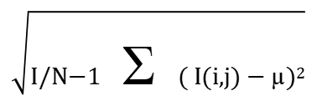
medical Image Analysis
Image Features [Hand-Crafted Features / Manual Features]:
First Order Statistical Features:
STANDARD DEVIATION
Standard deviation is computed by taking square root of the variance.
Standard Deviation (ϭ) =
$$\sqrt{\begin{aligned} \\ \text{I}\text{/}\text{N}\text{−}\text{1} \text{Ʃ} \text{( }\text{I}\text{(}\text{i}\text{,}\text{j}\text{) − }\text{µ}\text{)}\text{2}\end{aligned}}$$
m,n
i=1 j=1

Slide 30
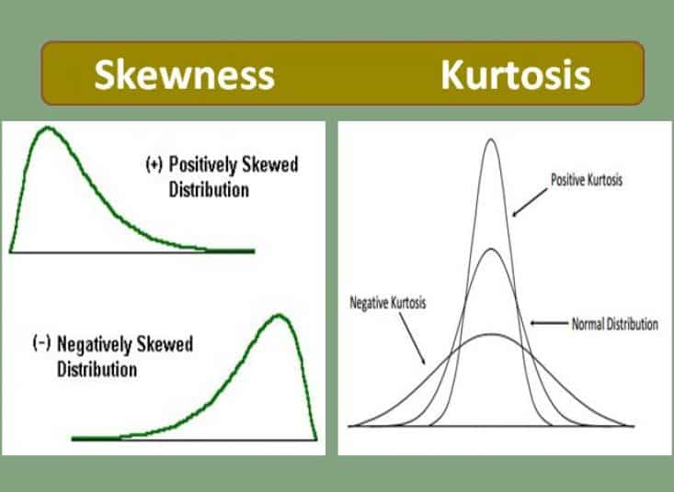
medical Image Analysis
Image Features [Hand-Crafted Features / Manual Features]:
First Order Statistical Features:
SKEWNESS & KURTOSIS
Notes:
Image Curtosy: https://www.excelr.com/skewness-and-kurtosis

Slide 31

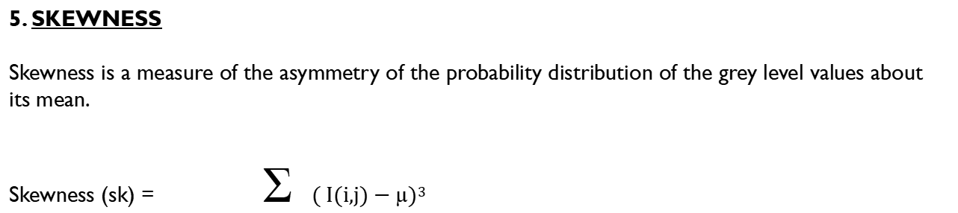
medical Image Analysis
Image Features [Hand-Crafted Features / Manual Features]:
First Order Statistical Features:
5. SKEWNESS
Skewness is a measure of the asymmetry of the probability distribution of the grey level values about its mean.
Skewness (sk) =$\text{Ʃ}\text{ ( }\text{I}\text{(}\text{i}\text{,}\text{j}\text{) − }\text{µ}\text{)}\text{3}$
m,n
i=1 j=1
$$\text{N}\text{−}\text{1}\text{ (}\text{ϭ}\text{3}\text{)}$$

Slide 32

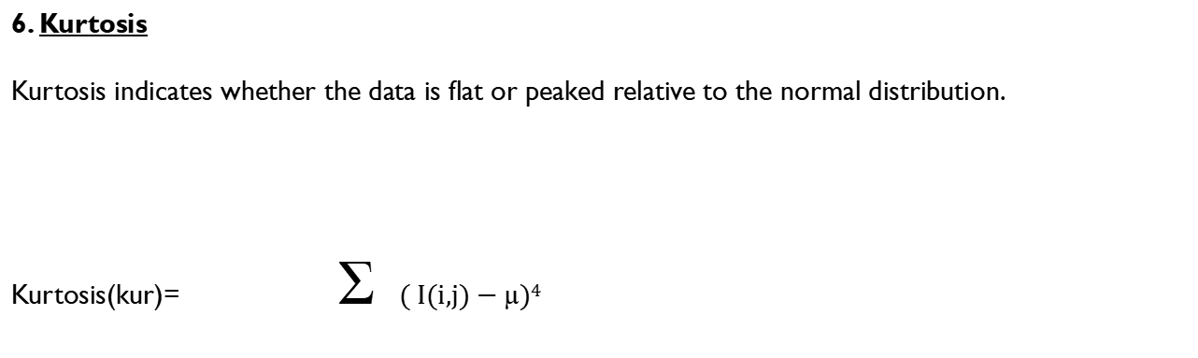
medical Image Analysis
Image Features [Hand-Crafted Features / Manual Features]:
First Order Statistical Features:
6. Kurtosis
Kurtosis indicates whether the data is flat or peaked relative to the normal distribution.
Kurtosis(kur)= $\text{Ʃ}\text{ ( }\text{I}\text{(}\text{i}\text{,}\text{j}\text{) − }\text{µ}\text{)}\text{4}$
m,n
i=1 j=1
$$\text{N}\text{−}\text{1}\text{ (}\text{ϭ}\text{4}\text{)}$$

Slide 33
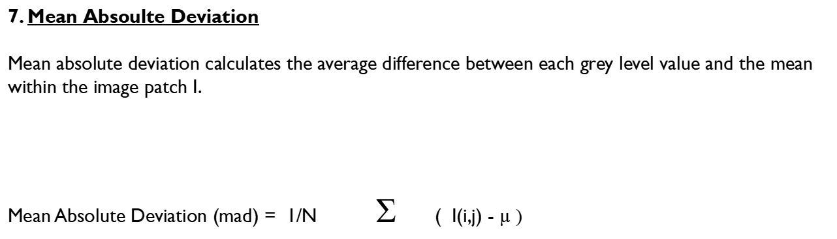
medical Image Analysis
Image Features [Hand-Crafted Features / Manual Features]:
First Order Statistical Features:
7. Mean Absoulte Deviation
Mean absolute deviation calculates the average difference between each grey level value and the mean within the image patch I.
Mean Absolute Deviation (mad) = 1/N $\text{Ʃ}$ ( I(i,j) - $\text{µ}\text{ )}$
m,n
i=1 j=1

Slide 34
medical Image Analysis
Image Features [Hand-Crafted Features / Manual Features]:
First Order Statistical Features:
8. Median Absoulte Deviation (mead)
Median absolute deviation is the middle value in Y, where Y is calculated as:
Y = I(i,j) - mad
Y is sorted in ascending order.
mead is the ((N+1)/2)^{th} element of Y.

Slide 35
medical Image Analysis
Image Features [Hand-Crafted Features / Manual Features]:
First Order Statistical Features:
9. Local Contrast
Local contrast represents the difference between the highest and the lowest grey level values within the image patch I.
Local Contrast (lc) = MAX(I) – MIN(I)

Slide 36
medical Image Analysis
Image Features [Hand-Crafted Features / Manual Features]:
First Order Statistical Features:
10. Local Probability
Local probability computes the probability of occurrences for each grey level within the image patch I.
Local Probability (lp) = No. of pixels at the k^{th} grey level i.e. (I(I,j) == k )
m x n

Slide 37
medical Image Analysis
Image Features [Hand-Crafted Features / Manual Features]:
First Order Statistical Features:
11. Percentile 25
Percentile 25 indicates the grey level distribution within the image patch I under a given threshold Local (i.e. 25%).
If X is indicating the sorted grey level values within the window W, p₂₅ is then computed as:
Index = N x 0.25 (where, N =mxn)
P₂₅ = X [index]
If index is not a whole number , round the index to the nearest integer value o get a propoer index.

Slide 38
medical Image Analysis
Image Features [Hand-Crafted Features / Manual Features]:
First Order Statistical Features:
12. Percentile 75
Percentile 25 indicates the grey level distribution within the image patch I under a given threshold Local (i.e. 75%).
If X is indicating the sorted grey level values within the window W, p₇₅ is then computed as:
Index = N x 0.75 (where, N =mxn)
P₇₅ = X [index]
If index is not a whole number , round the index to the nearest integer value o get a proper index.

Slide 39
medical Image Analysis
Image Features [Hand-Crafted Features / Manual Features]:
First Order Statistical Features:
Examples from Literature
Brain Tumor Classification: Evaluating the Efficiency of different Feature Sets on Brain Tumor Classification in MR Image
Covid-19 Classification: FEATURE EXTRACTION AND K-MEANS CLUSTERING APPROACH TO CLASSIFY THE COVID-19 LUNG CT-SCAN IMAGE

Slide 40
medical Image Analysis
Image Features [Hand-Crafted Features / Manual Features]:
First Order Statistical Features:
End of Lecture 11-12

