Slide 1
In the name of allah the most merciful and benificient

Slide 2
medical Image Analysis
Dr. zobia Suhail
PhD in Medical image processing
Aberystwyth university, Wales, uk (2019)

Slide 3
medical Image Analysis
Overview of Previous Lecture:
Image Features
First Order Statistical Features (FOSF)
Second Order Statistical Features (Haralick Features)

Slide 4
medical Image Analysis
Image Features [Hand-Crafted Features / Manual Features]:
Local Binary Patterns (LBP):
LBP are another image descriptors used for textural classification of images
(Proposed by Ojala et al., 1996).
As compared to first and second order statistical features LBP has low computational complexity and are
convenient to extend to multi-scale features.
The LBP operator is an operator which describes the surrounding of the central pixel
by generating a bit-code between the central pixel with its neighbouring pixels.
LBP value is a decimal value that is representing a binary code (LBP) constructed by the LBP
operator.
Unlike the Haralick features that are global texture features, LBP is a local textural representation.
T. Ojala, M. Pietikainen, and D. Harwood. A comparative study of texture measures with classification based on feature distribution. Pattern Recognition, 29(1):51{59, 1996..

Slide 5
medical Image Analysis
Image Features [Hand-Crafted Features / Manual Features]:
Local Binary Patterns (LBP):
The first step in extracting the LBP texture descriptor is to convert the image to grayscale image.
After converting the image to the grayscale, particular neighbourhood of size s is selected
That surrounds the centre pixel P(x_{c},y_{c}) .
A LBP value is then calculated for this centre pixel and stored in the output 2D array with the same
width and height as the input image.
5 | 8 | 1
5 | 4 | 1
3 | 7 | 2
Sample image window with size s=3, where the central pixel surrounds 8 neighbours

Slide 6
medical Image Analysis
Image Features [Hand-Crafted Features / Manual Features]:
Local Binary Patterns (LBP):
The LBP code is generated using the following condition:
1, if P(x_{c},y_{c}) >= P(x_{i},x_{j})
P(x_{i},y_{j}) =
0, if P(x_{c},y_{c}) < P(x_{i},x_{j})
Where P is the area of the image for which LBP is computing, whereas i and j are representing
neighbour Indexes to the central pixel P(x_{c},y_{c}).

Slide 7
medical Image Analysis
Image Features [Hand-Crafted Features / Manual Features]:
Local Binary Patterns (LBP):
5 | 8 | 1
5 | 4 | 1
3 | 7 | 2
0 | 0 | 1
0 |  | 1
1 | 0 | 1
3x3 window is used (with 8 neighbours around the central pixel) , where a set of 8 binary digits
Is constructed using thresholding.

Slide 8
medical Image Analysis
Image Features [Hand-Crafted Features / Manual Features]:
Local Binary Patterns (LBP):
5 | 8 | 1
5 | 4 | 1
3 | 7 | 2
0 | 0 | 1
0 |  | 1
1 | 0 | 1
Total possible combination of LBP codes using 3x3 window = ?.

Slide 9
medical Image Analysis
Image Features [Hand-Crafted Features / Manual Features]:
Local Binary Patterns (LBP):
5 | 8 | 1
5 | 4 | 1
3 | 7 | 2
0 | 0 | 1
0 |  | 1
1 | 0 | 1
Total possible combination of LBP codes using 3x3 window = 2⁸ = 256.

Slide 10
medical Image Analysis
Image Features [Hand-Crafted Features / Manual Features]:
Local Binary Patterns (LBP):
Now we generate LBP value for the central pixel.
Start from any of the 8 neighbours and start moving clock-wise or anti clock-wise (consistently).
Then we convert the 8 neighbours to 8-bit 1D array.
Finally convert the binary values to the corresponding decimal value.
0 | 0 | 1
0 |  | 1
1 | 0 | 1
0 | 0 | 1
0 |  | 1
1 | 0 | 1
6
7
0
5
1
4
3
2
0 | 0 | 0 | 1 | 0 | 1 | 1 | 1
7
6
5
4
3
2
1
0
2⁴
2²
2¹
2⁰
16 + 4 + 2 + 1 = 23
https://www.pyimagesearch.com/2015/12/07/local-binary-patterns-with-python-opencv/

Slide 11
medical Image Analysis
Image Features [Hand-Crafted Features / Manual Features]:
Local Binary Patterns (LBP):
0 | 0 | 1
0 |  | 1
1 | 0 | 1
0 | 0 | 1
0 |  | 1
1 | 0 | 1
6
7
0
5
1
4
3
2
0 | 0 | 0 | 1 | 0 | 1 | 1 | 1
7
6
5
4
3
2
1
0
2⁴
2²
2¹
2⁰
16 + 4 + 2 + 1 = 23
The value 23 is then stored is the pixel pointed by central pixel for which we computed LBP value.
https://www.pyimagesearch.com/2015/12/07/local-binary-patterns-with-python-opencv/

Slide 12
medical Image Analysis
Image Features [Hand-Crafted Features / Manual Features]:
Local Binary Patterns (LBP):
5 | 9 | 3 | 4 | 2
3 | 5 | 8 | 1 | 6
7 | 5 | 4 | 1 | 5
8 | 3 | 7 | 2 | 1
2 | 9 | 3 | 4 | 8
 |  | 23

Slide 13
medical Image Analysis
Image Features [Hand-Crafted Features / Manual Features]:
Local Binary Patterns (LBP):
5 | 9 | 3 | 4 | 2
3 | 5 | 8 | 1 | 6
7 | 5 | 4 | 1 | 5
8 | 3 | 7 | 2 | 1
2 | 9 | 3 | 4 | 8
 |  | 23
The process of moving 3x3 window, thresholding, generating binary string and then placing the
Decimal value to the central pixel is then repeated for every pixel of the input image.

Slide 14
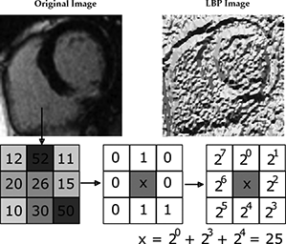
medical Image Analysis
Image Features [Hand-Crafted Features / Manual Features]:
Local Binary Patterns (LBP):
Input Image [cardiac MR image]
LBP Image
Image Courtesy: https://www.intechopen.com/books/assessment-of-cellular-and-organ-function-and-dysfunction-using-direct-and-derived-mri-methodologies/texture-analysis-in-magnetic-resonance-imaging-review-and-considerations-for-future-applications

Slide 15
medical Image Analysis
Image Features [Hand-Crafted Features / Manual Features]:
Local Binary Patterns (LBP):
The final step is to compute the histogram of the generated LBP codes.
As for 3 x 3 window maximum generated LBP codes can by 2⁸=256, the generated LBP image
Can have values from 0 to 255. Therefore, histogram of bin size equals to 256 is generated
That represents the final feature vector.

Slide 16
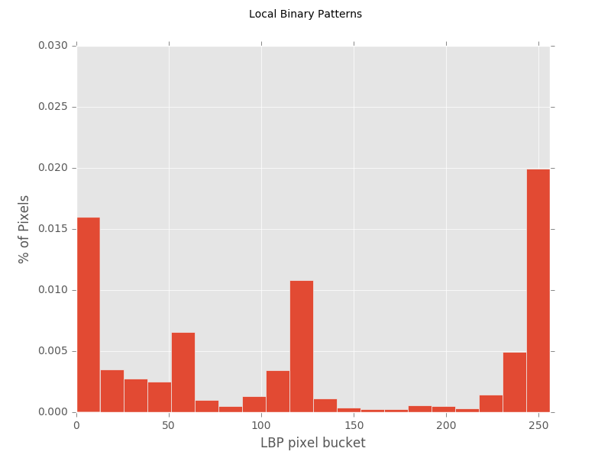
medical Image Analysis
Image Features [Hand-Crafted Features / Manual Features]:
Local Binary Patterns (LBP):
Input Image
LBP Image
Histogram of LBP codes
Histogram Courtasy: https://aurlabcvsimulator.readthedocs.io/en/latest/PlotLBPsHistogram/

Slide 17
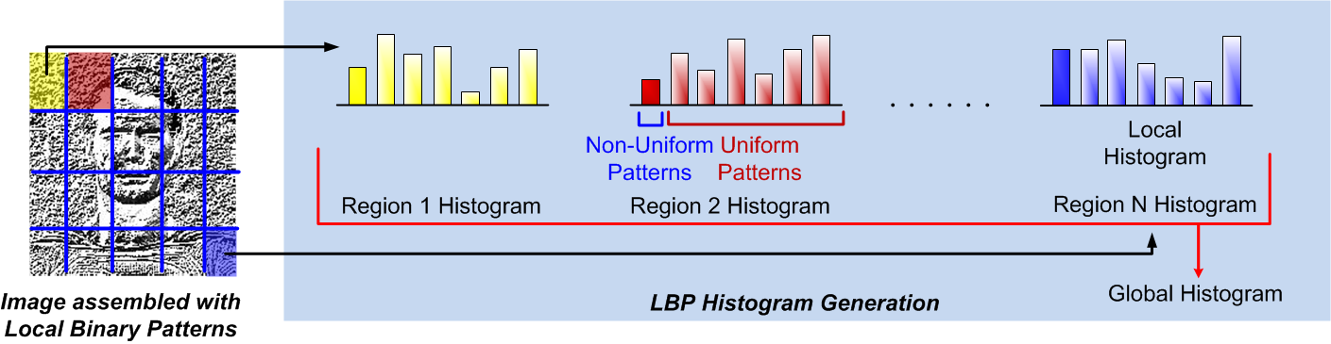
medical Image Analysis
Image Features [Hand-Crafted Features / Manual Features]:
Local Binary Patterns (LBP):
Image Courtasy: https://medium.com/@ckyrkou/object-detection-using-local-binary-patterns-50b165658368

Slide 18
medical Image Analysis
Image Features [Hand-Crafted Features / Manual Features]:
Local Binary Patterns (LBP) ------ Uniform and non-uniform LBP:
Uniform LBP: If there is atmost 2 transition from 0->1 or 1>0 in the generated LBP code
Non-Unifrom LBP: If there are more than 2 transotions from 0→1 or 1→ 0 in the generated
LBP code.
Example:
[unifrom pattern]: 00001000 (2 transitions) , 10000000 (1 transition)
[Nonunoform pattern]: 01010010 (six 0-1 or 1-0 transitions)
For all nonunifrm pattern a single code is assigned. If there are p+1 unifrom patterns, the final
Dimensionality of the histogram will be p+2 (the added entry is for all non-uniform patterns)

Slide 19
medical Image Analysis
Image Features [Hand-Crafted Features / Manual Features]:
Local Binary Patterns (LBP) ------------------- Multiscale:
LBP captures a very refined image details , however the mentioned LBP method only compute the features
At very small scale i.e. for 3x3 window.
A multiscale of LBP pattern was proposed by Ojala et. Al, where multiple neighbourhood sizes are
Used, for which 2 parameters are used.
a. The number of points p in a circularly symmetric neighborhood to consider
(thus removing relying on a square neighborhood).
b. The radius of the circle r, which allows us to account for different scales.

Slide 20
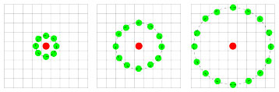
medical Image Analysis
Image Features [Hand-Crafted Features / Manual Features]:
Local Binary Patterns (LBP) ------------------- Multiscale:
a. The number of points p in a circularly symmetric neighbourhood to consider
b. The radius of the circle r, which allows us to account for different scales.
Three neighbourhood example with different p and r used to construct LBP patterns.

Slide 21
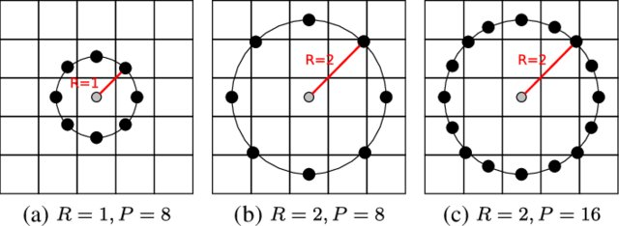
medical Image Analysis
Image Features [Hand-Crafted Features / Manual Features]:
Local Binary Patterns (LBP) ------------------- Multiscale:
a. The number of points p in a circularly symmetric neighbourhood to consider
b. The radius of the circle r, which allows us to account for different scales.
Image Courtesy: https://www.researchgate.net/publication/312092245_Blind_Image_Quality_Assessment_Using_Multiscale_Local_Binary_Patterns/figures?lo=1

Slide 22
medical Image Analysis
https://www.learnopencv.com/histogram-of-oriented-gradients/
https://www.learnopencv.com/histogram-of-oriented-gradients/
Image Features [Hand-Crafted Features / Manual Features]:
Local Binary Patterns (LBP) Extensions:
Local ternary patterns (LTP): are an extension of Local binary patterns (LBP) [Ref2]. Unlike LBP, it does not threshold the pixels into 0 and 1, rather it uses a threshold constant to threshold pixels into three values. Considering k as the threshold constant, c as the value of the center pixel, a neighboring pixel p, the result of threshold is:
1, if p > c + k
0, if p > c − k and p < c + k
− 1 if p < c − k
The obtained ternary pattern is further coded into upper and lower binary patterns. The upper pattern is obtained by retaining 1 and replacing 0 for -1 and 0. Lower pattern is coded by replacing -1 with 1 and 0 for 1 and 0.
Notes:
Ref 1: https://hal-univ-rennes1.archives-ouvertes.fr/hal-02924534/file/KK_SmartICT2019_Extended.pdf
Ref 2:https://en.wikipedia.org/wiki/Local_ternary_patterns

Slide 23
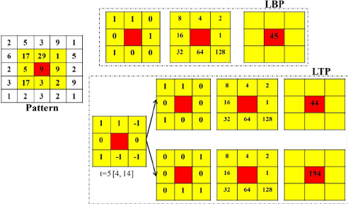
medical Image Analysis
https://www.learnopencv.com/histogram-of-oriented-gradients/
https://www.learnopencv.com/histogram-of-oriented-gradients/
Image Features [Hand-Crafted Features / Manual Features]:
Local Binary Patterns (LBP) Extensions:
Local ternary patterns (LTP): The obtained ternary pattern is further coded into upper and lower binary patterns. The upper pattern is obtained by retaining 1 and replacing 0 for -1 and 0. Lower pattern is coded by replacing -1 with 1 and 0 for 1 and 0.
Notes:
Image Courtasy: https://www.researchgate.net/figure/Calculation-of-the-LBP-and-LTP-operators-In-the-LTP-the-obtained-ternary-pattern-is_fig1_224708699

Slide 24
medical Image Analysis
https://www.learnopencv.com/histogram-of-oriented-gradients/
https://www.learnopencv.com/histogram-of-oriented-gradients/
Image Features [Hand-Crafted Features / Manual Features]:
Local Binary Patterns (LBP) Extensions:
Multi-Block Local Binary Pattern (MB-LBP): Proposed in 2007 by L. Zhang et al. [Ref1].
This method uses the LBP principle but applies to the mean value of the surrounding blocks (instead of pixel
intensities) and assign binary value ( 0 or 1) as per comparion.
Median Local Binary Pattern (MBP): proposed by Hafiane et al. [Ref1],MBP compares each pixel of the 3x3 neighborhood pixel with the median value of the block and includes the central pixel into the code leading to a
9-bits code.
Divided Local Binary Pattern (DLBP): Hua et al. [ref1] have proposed the Divided Local Binary Pattern (DLBP) which breaks down the LBP into two parts: one for even indices of the neighborhood and the other for
odd indices. This reduces the range of the data by reducing the code length from 8 to 4 bits.
.......
Notes:
Ref 1: https://hal-univ-rennes1.archives-ouvertes.fr/hal-02924534/file/KK_SmartICT2019_Extended.pdf
Ref 2:https://en.wikipedia.org/wiki/Local_ternary_patterns

Slide 25
medical Image Analysis
https://www.learnopencv.com/histogram-of-oriented-gradients/
https://www.learnopencv.com/histogram-of-oriented-gradients/
Image Features [Hand-Crafted Features / Manual Features]:
Local Binary Patterns (LBP) Extensions:
Notes:
Ref 1: https://hal-univ-rennes1.archives-ouvertes.fr/hal-02924534/file/KK_SmartICT2019_Extended.pdf
Ref 2:https://en.wikipedia.org/wiki/Local_ternary_patterns

