Slide 1
medical Image Analysis
Dr. zobia Suhail
PhD in Medical image processing
Aberystwyth university, Wales, uk (2019)

Slide 2
medical Image Analysis
Overview of Previous Lecture:
Course overview
Python Introduction using common libraries
How to read and analyze image in Python
Image Intensities
Difference in intensity levels for Grayscale and Color images
Image Histograms
Some Discussion on the Application areas of Image Histograms

Slide 3
medical Image Analysis
Histogram: [Applications]
Thresholding:
An image histogram can be used to threshold the image to convert it into binary image.
If the image intensities are well separated into two defined objects, the histogram is well
Suited to define the threshold of the image.
The histogram will be bi-modal and the pixel intensities can be separated into two well
Defined groups.

Slide 4
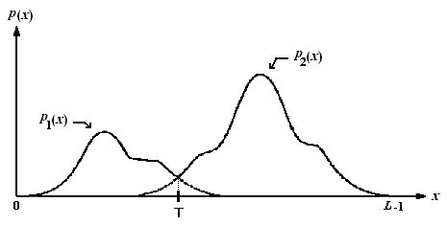
medical Image Analysis
Histogram: [Applications]
Thresholding:
Image Source: Optimal Threshold Computing in Automatic Image Thresholding using Adaptive Particle Swarm Optimization

Slide 5
medical Image Analysis
Histogram: [Applications]
Thresholding:
If T is the obtained threshold, then the image can be binarized using the following relation:
For all pixel p in image I:
If p >= T:
p = 0
Else
p = 1

Slide 6

medical Image Analysis
Histogram: [Applications]
Thresholding:
PYTHON
Import cv2 as cv
Import imageio as io
Im=io.imread(‘original.png’)
thresh=190
r,c=m_img.shape
i=0
j=0
new_im=np.zeros((r,c),dtype=np.uint8)
for i in range(r):
for j in range(c):
if(m_img[i,j]>=thresh):
new_im[i,j]=1
else:
new_im[i,j]=0
plt.imshow(new_im,cmap="gray")
plt.show()
plt.close()

Slide 7
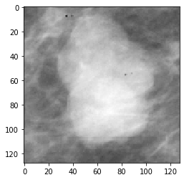
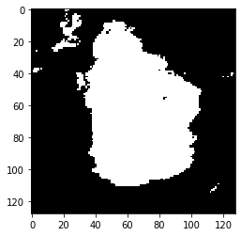
medical Image Analysis
Histogram: [Applications]
Thresholding:
PYTHON
Discussion:

Slide 8
medical Image Analysis
PYTHON
CV and image Resizing
import cv2 as cv
im1=cv.imread('original.png',0)
new_im= cv.resize(im1,(100,100))
plt.imshow(new_im,cmap="gray")
plt.show()
plt.close()
Discussion

Slide 9
medical Image Analysis
PYTHON
CV and Image show
Python:
import cv2 as cv
im1=cv.imread('original.png',0)
new_im= cv.resize(im1,(100,100))
cv.imshow("new image", im)
cv.waitKey(0)
cv.destroyAllWindows()
Discussion

Slide 10
medical Image Analysis
Histogram: [Applications]
Thresholding:
PYTHON
Thresholding using Pyhton libraries:
Cv2 library in Python for Thresholding
Cv2.threshold
Ret,dest=cv2.threshold(im,thresh,max_value,cv2.ThresholdType)

Slide 11
medical Image Analysis
Histogram: [Applications]
Thresholding:
PYTHON
Thresholding using Pyhton libraries:
Cv2 library in Python for Thresholding
Cv2.threshold
Ret,dest=cv2.threshold(im,thresh,max_value,cv2.ThresholdType)
Ret,thresh=cv2.threshold(im,120,256,cv2.Threshold_Binary)

Slide 12
medical Image Analysis
Histogram: [Applications]
Thresholding:
PYTHON
Thresholding using Pyhton libraries:
Cv2 library in Python for Thresholding
Cv2.threshold
Ret,dest=cv2.threshold(im,thresh,max_value,cv2.ThresholdType)
cv2.THRESH_BINARY
cv2.THRESH_BINARY_INV
cv2.THRESH_TRUNC
cv2.THRESH_TOZERO
cv2.THRESH_TOZERO_INV

Slide 13

medical Image Analysis
Histogram: [Applications]
Thresholding:
PYTHON
Thresholding using Pyhton libraries:
Cv2 library in Python for Thresholding
Cv2.threshold
Ret,dest=cv2.threshold(im,thresh,max_value,cv2.ThresholdType)
cv2.THRESH_BINARY

Slide 14

medical Image Analysis
Histogram: [Applications]
Thresholding:
PYTHON
Thresholding using Pyhton libraries:
Cv2 library in Python for Thresholding
Cv2.threshold
Ret,dest=cv2.threshold(im,thresh,max_value,cv2.ThresholdType)
cv2.THRESH_BINARY_INV

Slide 15

medical Image Analysis
Histogram: [Applications]
Thresholding:
PYTHON
Thresholding using Pyhton libraries:
Cv2 library in Python for Thresholding
Cv2.threshold
Ret,dest=cv2.threshold(im,thresh,max_value,cv2.ThresholdType
cv2.THRESH_TRUNC

Slide 16

medical Image Analysis
Histogram: [Applications]
Thresholding:
PYTHON
Thresholding using Pyhton libraries:
Cv2 library in Python for Thresholding
Cv2.threshold
Ret,dest=cv2.threshold(im,thresh,max_value,cv2.ThresholdType
cv2.THRESH_TOZERO

Slide 17

medical Image Analysis
Histogram: [Applications]
Thresholding:
PYTHON
Thresholding using Pyhton libraries:
Cv2 library in Python for Thresholding
Cv2.threshold
Ret,dest=cv2.threshold(im,thresh,max_value,cv2.ThresholdType
cv2.THRESH_TOZERO_INV

Slide 18
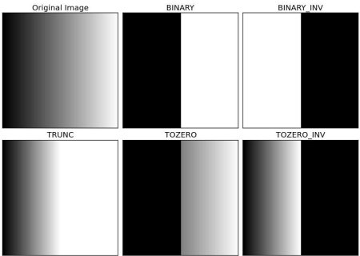
medical Image Analysis
Histogram: [Applications]
PYTHON
Thresholding using Python libraries:
Cv2 library in Python for Thresholding
Cv2.threshold

Slide 19
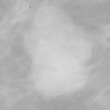

medical Image Analysis
Histogram: [Applications]
PYTHON
Thresholding using Python libraries:
Cv2 library in Python for Thresholding
Cv2.threshold
Ret,dest=cv.threshold(im1,190,255,cv.THRESH_BINARY)

Slide 20

medical Image Analysis
Histogram: [Applications]
PYTHON
Thresholding using Python libraries:
Cv2 library in Python for Thresholding
Cv2.threshold
Ret,dest=cv.threshold(im1,190,255,cv.THRESH_BINARY_INV)

Slide 21
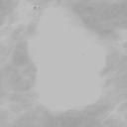
medical Image Analysis
Histogram: [Applications]
PYTHON
Thresholding using Python libraries:
Cv2 library in Python for Thresholding
Cv2.threshold
Ret,dest=cv.threshold(im1,190,255,cv.THRESH_TRUNC)

Slide 22

medical Image Analysis
Histogram: [Applications]
PYTHON
Thresholding using Python libraries:
Cv2 library in Python for Thresholding
Cv2.threshold
Ret,dest=cv.threshold(im1,190,255,cv.THRESH_TOZERO)

Slide 23
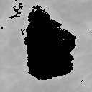
medical Image Analysis
Histogram: [Applications]
PYTHON
Thresholding using Python libraries:
Cv2 library in Python for Thresholding
Cv2.threshold
Import cv2 as cv
Thresh=190
Ret,dest=cv.threshold(im,thresh,255,cv.THRESH_TOZERO_INV)
plt.imshow(dest,cmap="gray")
plt.show()
plt.close()

