Slide 1

Medical Image Analysis
Dr. Zobia Suhail

Slide 2
Canny edge detection

Slide 3
Canny edge detection
The Canny edge detector is an edge detection operator that uses a multi-stage algorithm to detect a wide range of edges in images. It was developed by John F. Canny in 1986. Canny also produced a computational theory of edge detection explaining why the technique works.
Wikipedia

Slide 4
Canny edge detection
The Canny edge detector is an edge detection operator that uses a multi-stage algorithm to detect a wide range of edges in images. It was developed by John F. Canny in 1986. Canny also produced a computational theory of edge detection explaining why the technique works.
The algorithm is based on grayscale pictures. Therefore, the pre-requisite is to convert the image to grayscale before following the above-mentioned steps.
Wikipedia

Slide 5
Canny edge detection
The Canny edge detection algorithm is composed of 5 steps:
Noise reduction;
Gradient calculation;
Non-maximum suppression;
Double threshold;
Edge Tracking by Hysteresis.
https://towardsdatascience.com/canny-edge-detection-step-by-step-in-python-computer-vision-b49c3a2d8123

Slide 6
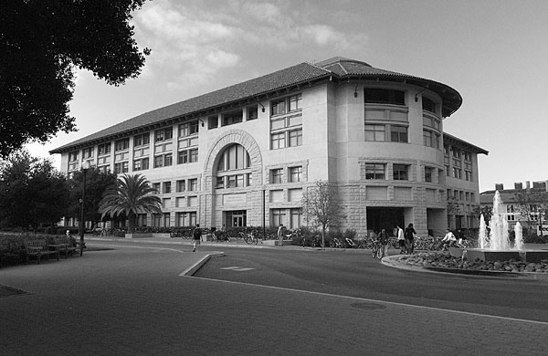
Canny edge detection
Canny Edge Detection Results:
Image Courtesy: https://automaticaddison.com/how-the-canny-edge-detector-works/

Slide 7
Canny edge detection
Step 1: Noise Reduction
As the edge detection is highly sensitive to noise (and the main logic to
Detect edges is using derivatives) , noise reduction is required as first step.

Slide 8
Canny edge detection
Step 1: Noise Reduction
As the edge detection is highly sensitive to noise (and the main logic to
Detect edges is using derivatives) , noise reduction is required as first step.
One way to get rid of the noise on the image, is by applying Gaussian blur to smooth it. To do so, image convolution technique is applied with a Gaussian Kernel (3x3, 5x5, 7x7 etc…). The kernel size depends on the expected blurring effect. Basically, the smallest the kernel, the less visible is the blur. In our example, we will use a 5 by 5 Gaussian kernel.

Slide 9

Canny edge detection
Step 1: Noise Reduction
As the edge detection is highly sensitive to noise (and the main logic to
Detect edges is using derivatives) , noise reduction is required as first step.
One way to get rid of the noise on the image, is by applying Gaussian blur to smooth it. To do so, image convolution technique is applied with a Gaussian Kernel (3x3, 5x5, 7x7 etc…). The kernel size depends on the expected blurring effect. Basically, the smallest the kernel, the less visible is the blur. In our example, we will use a 5 by 5 Gaussian kernel.
Formula to compute Kernel:

Slide 10
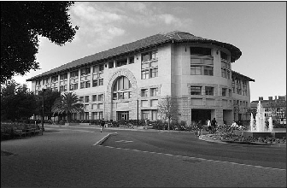
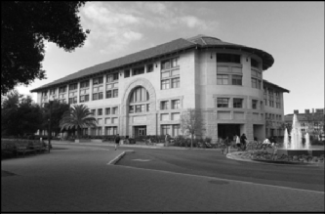
Canny edge detection
Step 1: Noise Reduction

Slide 11
Canny edge detection
Step 2: Gradient Calculation
The Gradient calculation step detects the edge intensity and direction by calculating the gradient of the image using edge detection operators.

Slide 12
Canny edge detection
Step 2: Gradient Calculation
The Gradient calculation step detects the edge intensity and direction by calculating the gradient of the image using edge detection operators.
When the image is smoothed, the derivatives Ix and Iy w.r.t. x and y are calculated. It can be implemented by convolving I with Sobel kernels Kx and Ky, respectively:

Slide 13
Canny edge detection
Step 2: Gradient Calculation
Computes approximation of the gradient of the image intensity function.
At each point in the image, the result of the Sobel operator is either the
corresponding gradient vector or the norm of this vector.
K_{x} = 1 0 -1 K_{y} = 1 2 1
2 0 -2 0 0 0
1 0 -1 -1 -2 -1

Slide 14
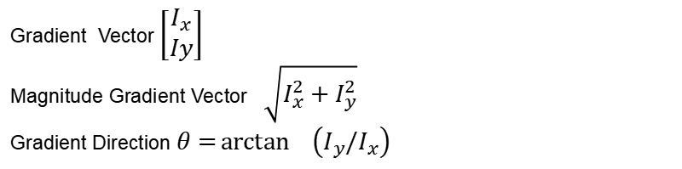
Canny edge detection
Step 2: Gradient Calculation
Then, the magnitude G and the slope θ of the gradient are calculated as follow:
Gradient Vector $\left[\begin{matrix}I_{x} \\ Iy\end{matrix}\right]$
Magnitude Gradient Vector $\sqrt{I_{x}^{2}+I_{y}^{2}}$
Gradient Direction$θ=\arctan^{}\left(I_{y}/I_{x}\right)$
Notes:
Radian to Degree:
angle = D * 180. / np.pi
angle[angle < 0] += 180

Slide 15
Canny edge detection
More on Angles:
By default atan function in python returns angle in radians:
to convert radians to degree :
angle in degree = angle in radina * 180 / PI
if angle > 0 += 180
Notes:
Radian to Degree:
angle = D * 180. / np.pi
angle[angle < 0] += 180

Slide 16
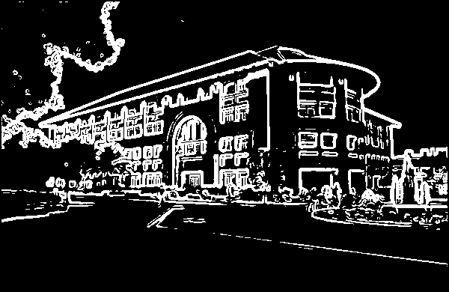
Canny edge detection
Step 2: Gradient Calculation

Slide 17
Canny edge detection
Step 3: Non Maxima Suppression

Slide 18
Canny edge detection
Step 3: Non Maxima Suppression
The final image should have thin edges. Thus, we must perform non-maximum suppression to thin out the edges.
The principle is simple: the algorithm goes through all the points on the gradient intensity matrix and finds the pixels with the maximum value in the edge directions.

Slide 19
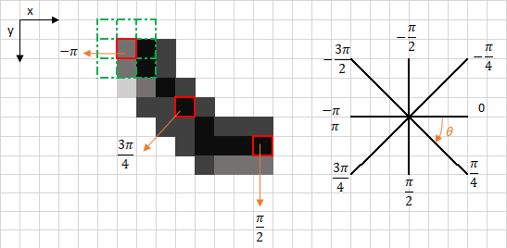
Canny edge detection
Step 3: Non Maxima Suppression
Notes:
Arctan2 -> Return the angle in radians. Set convert_to_degree option to TRUE in order to convert to degrees, that will reurn in degrees from -180 to 180.
In order to convert from 0-360 add 180 to resultant gradients.

Slide 20
Canny edge detection
Step 3: Non Maxima Suppression
The edge direction is the orange dotted line (horizontal from left to right). The purpose of the algorithm is to check if the pixels on the same direction are more or less intense than the ones being processed. In the example above, the pixel (i, j) is being processed, and the pixels on the same direction are highlighted in blue (i, j-1) and (i, j+1). If one those two pixels are more intense than the one being processed, then only the more intense one is kept. Pixel (i, j-1) seems to be more intense, because it is white (value of 255). Hence, the intensity value of the current pixel (i, j) is set to 0. If there are no pixels in the edge direction having more intense values, then the value of the current pixel is kept.

Slide 21
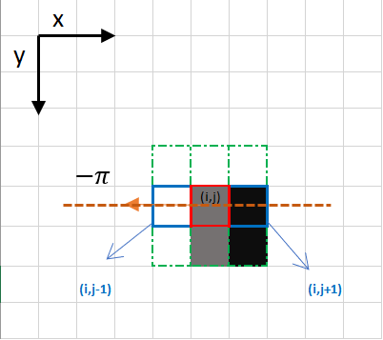
Canny edge detection
Step 3: Non Maxima Suppression

Slide 22
Canny edge detection
Step 4: Double Thresholding
The double threshold step aims at identifying 3 kinds of pixels: strong, weak, and non-relevant:
Strong pixels are pixels that have an intensity so high that we are sure they contribute to the final edge.
Weak pixels are pixels that have an intensity value that is not enough to be considered as strong ones, but yet not small enough to be considered as non-relevant for the edge detection.
Other pixels are considered as non-relevant for the edge.

Slide 23
Canny edge detection
Step 4: Double Thresholding
highThreshold = img.max() * highThresholdRatio
lowThreshold = highThreshold * lowThresholdRatio
Notes:
Ratio Can be1:2 or 1:3

Slide 24
Canny edge detection
Step 4: Double Thresholding
Now you can see what the double thresholds holds for:
High threshold is used to identify the strong pixels (intensity higher than the high threshold)
Low threshold is used to identify the non-relevant pixels (intensity lower than the low threshold)
All pixels having intensity between both thresholds are flagged as weak and the Hysteresis mechanism (next step) will help us identify the ones that could be considered as strong and the ones that are considered as non-relevant.

Slide 25
Canny edge detection
Step 4: Edge Tracking by Hysteresis
Based on the threshold results, the hysteresis consists of transforming weak pixels into strong ones, if and only if at least one of the pixels around the one being processed is a strong one, as described below:

Slide 26
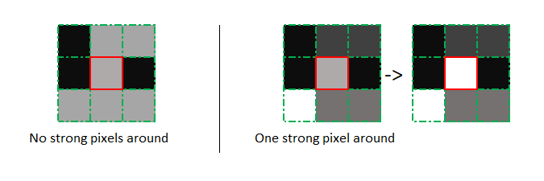
Canny edge detection
Step 5: Edge Tracking by Hysteresis
Based on the threshold results, the hysteresis consists of transforming weak pixels into strong ones, if and only if at least one of the pixels around the one being processed is a strong one, as described below:

Slide 27
End of Lecture 16
End of Lecture 16

Slide 28
Morphology
End of Lecture 16

Slide 29
Morphology:
Morphology:
Morphology is a broad set of image processing operations that process images based on shapes. Morphological operations apply a structuring element to an input image, creating an output image of the same size. In a morphological operation, the value of each pixel in the output image is based on a comparison of the corresponding pixel in the input image with its neighbors.

Slide 30
Morphology:
Types of Morphological Operations:
DILATION:
The value of the output pixel is the maximum value of all pixels in the neighborhood. In a binary image, a pixel is set to 1 if any of the neighboring pixels have the value 1.
Morphological dilation makes objects more visible and fills in small holes in objects. Lines appear thicker, and filled shapes appear larger.

Slide 31

Morphology:
Types of Morphological Operations:
DILATION:
Notes:
Image Courtasy: https://www.mathworks.com/help/images/morphological-dilation-and-erosion.html

Slide 32
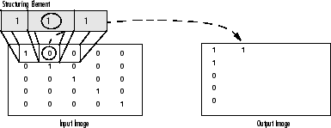
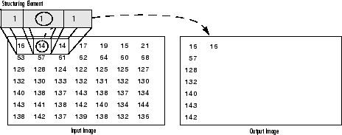
Morphology:
Types of Morphological Operations:
DILATION:
Morphological Dilation of a Binary Image
Morphological Dilation of a GrayScale Image
Notes:
Image Courtasy: https://www.mathworks.com/help/images/morphological-dilation-and-erosion.html

Slide 33
Morphology:
Types of Morphological Operations:
EROSION:
The value of the output pixel is the minimum value of all pixels in the neighborhood. In a binary image, a pixel is set to 0 if any of the neighboring pixels have the value 0.
Morphological erosion removes floating pixels and thin lines so that only substantive objects remain. Remaining lines appear thinner and shapes appear smaller.

Slide 34
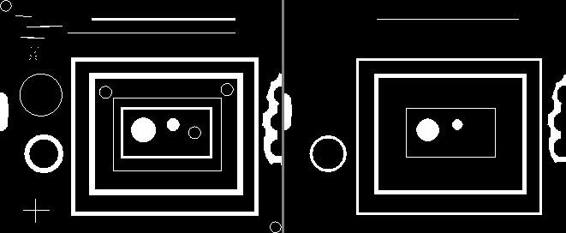
Morphology:
Types of Morphological Operations:
EROSION:

Slide 35
Morphology:
Types of Morphological Operations:
OPEN: Erosion Followed by Dilation
CLOSE: Dilation Followed by Erosion

Slide 36
End of Lecture 16 _ 17

