Slide 2
medical Image Analysis
Dr. zobia Suhail
PhD in Medical image processing
Aberystwyth university, Wales, uk (2019)

Slide 4
medical Image Analysis
Overview of Previous Lecture:
Course overview
Use of Computerized Diagnosis System by health professionals
Imaging Modalities
Image data formats (DICOM (.dcm))

Slide 5
medical Image Analysis
Overview of Previous Lecture:
Course overview
Use of Computerized Diagnosis System by health professionals
Imaging Modalities
Image data formats (DICOM (.dcm))

Slide 6

medical Image Analysis
PYTHON
Python is an interpreted, high-level and general-purpose programming language. Created by Guido van Rossum and first released in 1991.
Simple syntax like English language.

Slide 7
medical Image Analysis
PYTHON
Python Syntax compared to other programming languages
Python was designed for readability, and has some similarities to the English language with influence from mathematics.
Python uses new lines to complete a command, as opposed to other programming languages which often use semicolons or parentheses.
Python relies on indentation, using whitespace, to define scope; such as the scope of loops, functions and classes. Other programming languages often use curly-brackets for this purpose.

Slide 8

medical Image Analysis
PYTHON
Python: Installation
Free and Open Source Distribution of Python with simple package management and deployment.

Slide 9
medical Image Analysis
PYTHON
Python: Common Libraries
Numpy: Used for working with arrays
Scipy: The SciPy library depends on NumPy,
which provides convenient and fast N-dimensional array manipulation.
Matplotlib: Use to create static, animated and interactive visualizations
Opencv: Programming functions for real-time computer vision
Imageio: to read and write images

Slide 10
medical Image Analysis
PYTHON
Practice: To read DICOM image and view it using imageIO and
Matplotlib libraries in Python

Slide 11
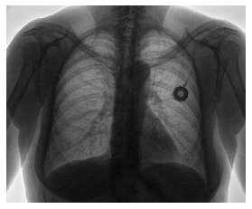
medical Image Analysis
Image Intensities:

Slide 12
medical Image Analysis
Image Intensities:
Digital Images are represented as two dimension array array, where each element of the
Array represents individual component of the image that us called picture element
Or pixel.
The number of bits used to store that value of the pixel identify the number of grey levels (or
Possible grey level values) used to describe a pixel.
How many values can be stored to represent image pixel ?
Source Courtesy: https://www.allaboutcircuits.com/technical-articles/image-histogram-characteristics-machine-learning-image-processing/

Slide 13
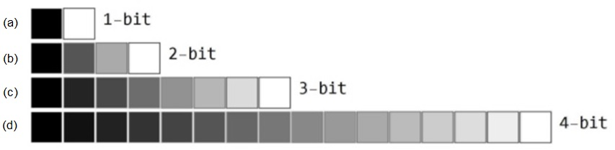
medical Image Analysis
Image Intensities:
Digital Images are represented as two dimension array array, where each element of the
Array represents individual component of the image that us called picture element
Or pixel.
The number of bits used to store that value of the pixel identify the number of grey levels (or
Possible grey level values) used to describe a pixel.
Source Courtesy: https://www.allaboutcircuits.com/technical-articles/image-histogram-characteristics-machine-learning-image-processing/

Slide 14
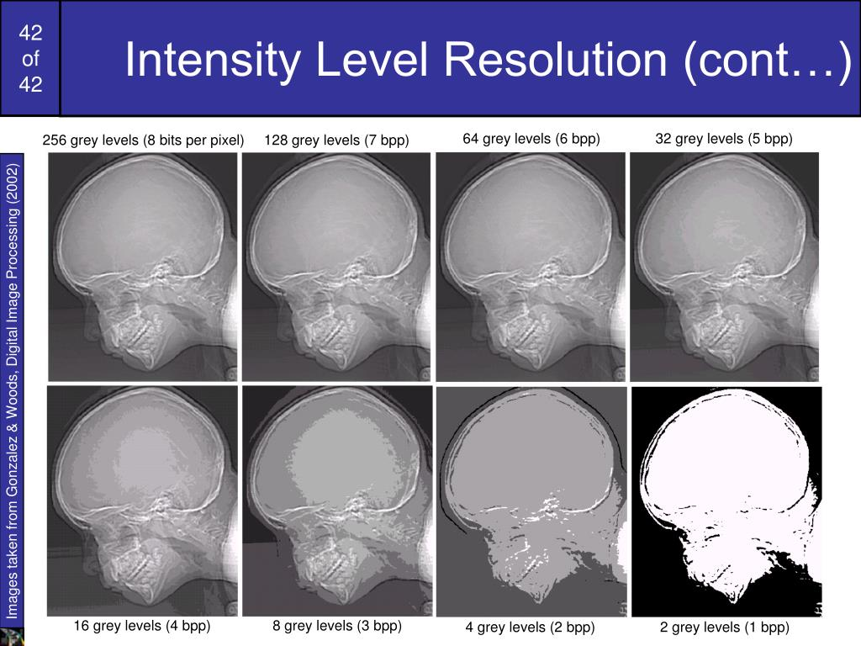
medical Image Analysis
Image Intensities:
Effects of Grey Values:
Resolution: 452 x 354 (for all images)
copyright: Gonzalez & Woods

Slide 15
medical Image Analysis
Image Intensities:
Effects of Grey Values:
Resolution: 452 x 354 (for all images)
copyright: Gonzalez & Woods

Slide 16
medical Image Analysis
Image Intensities:

Slide 17
medical Image Analysis
Image Intensities:
Intensity of Pixel [1,1]
Intensity of Pixel [3,1]
Intensity of Pixel [6,1]

Slide 18
medical Image Analysis
Image Intensities:
Color image is composed of three channels of 2D images, where each channel
Represents RED , GREEN and BLUE (RGB) components of the image

Slide 19
medical Image Analysis
Image Intensities:
Color image is composed of three channels of 2D images, where each channel
Represents RED , GREEN and BLUE (RGB) components of the image
180
70
P (180, 70, 230)
230

Slide 20
medical Image Analysis
How we can process images using computers?

Slide 21

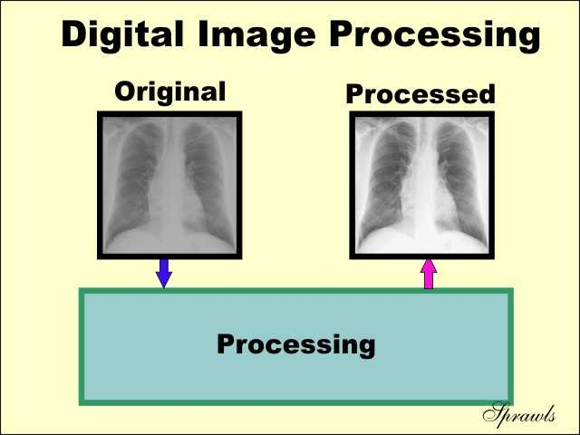
medical Image Analysis
How we can process images using computers?
Input
Output
Process

Slide 22
medical Image Analysis
How we can process images using computers?
210
Input
In Memory Image
Read Image
178

Slide 23
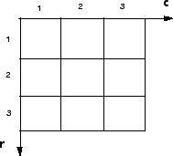
medical Image Analysis
How we can process images using computers?
C
R
I [2,3] access pixel value from second row and third column.

Slide 24
medical Image Analysis
How we can process images using computers?
I [2,3] access pixel value from second row and third column.

Slide 25
medical Image Analysis
Image as Function:
f( x, y ) gives the intensity at position ( x, y ) with a finite range:
f: [a,b]x[c,d] [0,1]
A color image is just three functions pasted together.
f (x,y) = [ f_{r}(x,y) , f_{g}(x,y) , f_{b}(x,y) ]

Slide 26
medical Image Analysis
Image as Function:
Image processing usually defines a new image in terms of the existing
Image f.
i.e. f ^{ꞌ} (x,y) = g ( f (x,y) )
Is an example of a simple operation that transforms each pixel individually.

Slide 27
medical Image Analysis
Image as Function:
Example : Convert color image to Greyscale Image.
f ^{ꞌ} (x,y) = g ( f (x,y) )
Where f ꞌ (x,y) is the greyscale image and f in representing color image,
Whereas g is a function that is used to convert color image to greyscale.

Slide 28
medical Image Analysis
Image as Function:
Example : Convert color image to Greyscale Image.
f ^{ꞌ} (x,y) = g ( f (x,y) )
New grayscale image = ( (0.3 * R) + (0.59 * G) + (0.11 * B) )

Slide 29
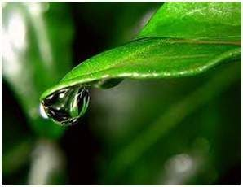
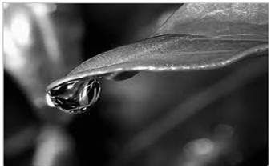
medical Image Analysis
Image as Function:
Example : Convert color image to Greyscale Image.
f ^{ꞌ}= g ( f (x,y) )
f
f’
Image Courtesy: https://www.tutorialspoint.com/dip/grayscale_to_rgb_conversion.htm

Slide 30
medical Image Analysis
Histograms:
An image histogram in a graphical representation of pixel intensities count.
Possible intensity values are represented along x-axis and their count are
Represented along y-axis.

Slide 31
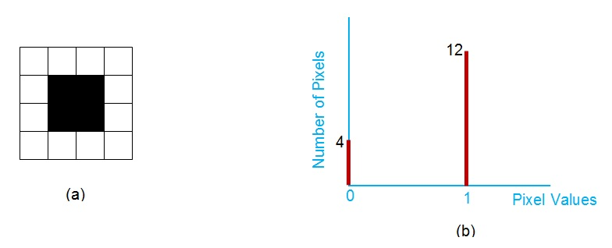
medical Image Analysis
Histograms:
Histogram of Binary Image
Image Courtesy: https://www.allaboutcircuits.com/technical-articles/image-histogram-characteristics-machine-learning-image-processing/

Slide 32
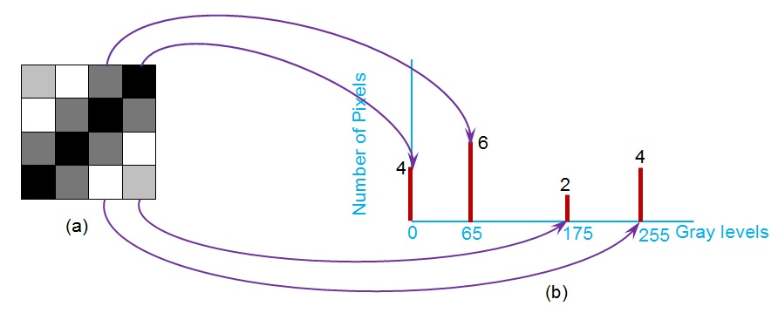
medical Image Analysis
Histograms:
Histogram of Gray Scale Image
Image Courtesy: https://www.allaboutcircuits.com/technical-articles/image-histogram-characteristics-machine-learning-image-processing/

Slide 33
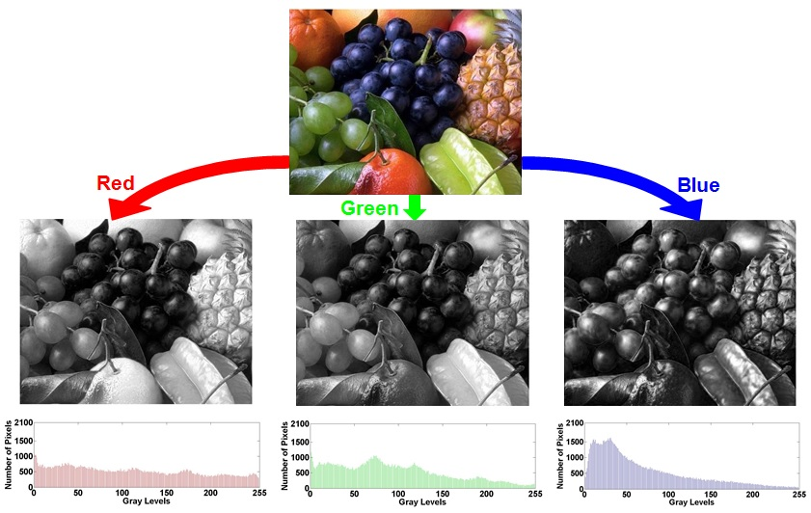
medical Image Analysis
Histograms:
Histogram of Color Image
Image Courtesy: https://www.allaboutcircuits.com/technical-articles/image-histogram-characteristics-machine-learning-image-processing/

Slide 34
medical Image Analysis
Histograms:
PYTHON
Import imageio as io
Import matplotlib.pyplot as plt
Im=io.imread(‘original.png’)
plt.hist(im, bins=100)
plt.ylabel('frequency')
plt.show()
Discussion

