Slide 1

Medial Image Analysis
Dr. Zobia Suhail

Slide 2
Medical image analysis: image filtering
© 2002 R. C. Gonzalez & R. E. Woods

Slide 3
Medical image analysis : image filtering
Image filtering is used either to compress or to enhance some image
Features.
Normally used as pre-processing step to achieve better results.
Filters can be spatial or frequency
Through image filtering, we achieve the following operations:
Smoothing
Sharpening
Edge Enhancement
Image filtering is normally achieved using kernel and the process is called convolution.

Slide 4
Medical image analysis : image filtering
Spatial Neighbours:
Origin
(x, y)
3x3 neighborhood about a point (x, y) in the
Spatial domain
Image f in a spatial domain

Slide 5
Medical image analysis : spatial filtering
Let I and J be the images such thar : J = T(I)
Where T is representing any transformation such that:
J(r,c) = T[I](r,c) = f { I(u,v) | u € {r-s , … ,r, … , r+s} , v € {c-d,… , c, … c+d} }
Where the value of the transformed image, J, at pixel location(r,c) is a function of the values of the original image, I, in a 2s+1 x 2d+1 rectangular neighborhood centered on pixel location (r,c).
Source Courtesy: http://engr.case.edu/merat_francis/eecs490f07/lectures/lecture6.pdf

Slide 6
Medical image analysis : Moving windows
The value, J(r,c) = T[I](r,c), is a function of a rectangular neighborhood centered on pixel location (r,c) in I.
There is a different neighborhood for each pixel location, but if the dimensions of the neighbor-hood are the same for each location, then transform T is sometimes called a moving window transform.

Slide 7
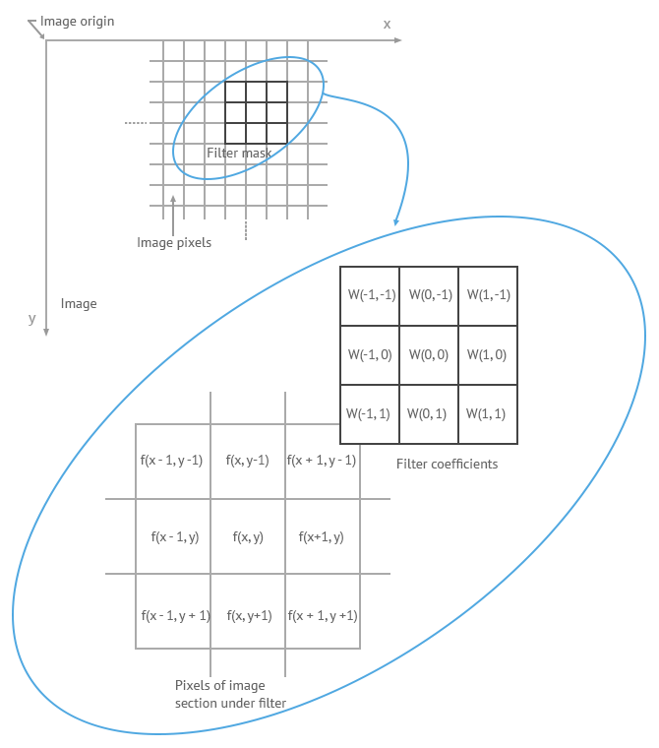
Medical image analysis : spatial filtering
The moving window is placed over image pixel
(r,c) , corresponding pixels are multiplies and
The result summed .

Slide 8
Medical image analysis : image filtering
Image Filtering:
In General [For linear Filtering]:
If W is indicating kernel window where the rows and cols range from -1 to 1
And F is indicating the image area to be processed that is centred at F(x,y), linear spatial filtering is given by:
G(x,y)= W(-1,-1) * F(x-1,y-1) + W(-1,0) * F(x-1,y) + W(-1,1) * F(x-1,y+1)+ W(0,-1) * F(x,y-1) + W(0,0) * F(x,y) +
W(0,1) * F(x,y+1) + W(1,-1) * F(x+1,y-1) + W(1,0) * F(x+1,y) + W(1,1) * F(x+1,y+1)
In general, it can be written as:
G(x,y) = ∑ ∑ [W(s,t) F(x+s,y+t) ] Where, x and y varies so that each pixel in W visits every pixel in F.
s=-a : a t=-b:b

Slide 9
Medical image analysis : image filtering
Image Filtering: [Convolution]
Object w[s,t] is the equation is a weighted function (rectangular matrix of numbers)
This matrix is the moving window
Pixel (r,c) in the output image is the weighted sum of pixels from the original image in the neighborhood of (r,c) traced by the matrix.
Each pixel in the neighborhood of (r,c) is multiplied by the corresponding matrix value — after the matrix is rotated by180º.
The sum of those products is the value of pixel (r,c) in the output image
The convolution of W(x,y) and F(X,Y) is given as:
W(x,y) * F(X,Y)= ∑ ∑ [W(s,t) F(x-s,y-t) ]
S= -a : a t= -b: b

Slide 10
Medical image analysis : spatial filtering
The mask is the kernel w(s,t).
F (r-s, c-t)
The neighborhood T(r-s, c-t) around r,c

Slide 11
Medical image analysis : spatial filtering
For example, suppose the image is and the convolutional kernel is
Source Courtesy: http://matlab.izmiran.ru/help/toolbox/images/linfilt3.html
17 | 24 | 1 | 8 | 15
23 | 5 | 7 | 14 | 16
4 | 6 | 13 | 20 | 22
10 | 12 | 19 | 21 | 3
11 | 18 | 25 | 2 | 9
8 | 1 | 6
3 | 5 | 7
4 | 9 | 2

Slide 12
Medical image analysis : spatial filtering
The following figure shows how to compute the (2,4) output pixel using these steps:
Rotate the convolution kernel 180 degrees about its center element.
Slide the center element of the convolution kernel so that it lies on top of the (2,4) element of A.
Multiply each weight in the rotated convolution kernel by the pixel of A underneath.
Sum the individual products from step 3.
Hence the (2,4) output pixel is

Slide 13
Medical image analysis : image filtering
Image Filtering: [Convolution mask Flipping]
8 | 1 | 6
3 | 5 | 7
4 | 9 | 2
4 | 9 | 2
3 | 5 | 7
8 | 1 | 6
2 | 9 | 4
7 | 5 | 3
6 | 1 | 8

Slide 14
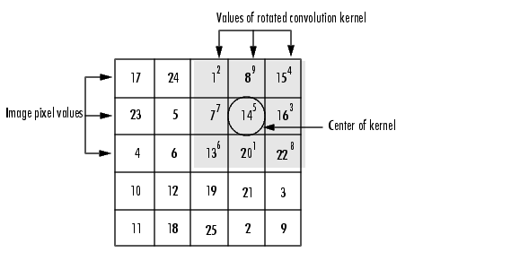
Medical image analysis : spatial filtering

Slide 15
Medical image analysis : image filtering
Image Filtering: [Convolution]
I₁ | I₂ | I₃ | I₄ | I₅ | I₆ | I₇
I₈ | I₉ | I₁₀ | I₁₁ | I₁₂ | I₁₃ | I₁₄
I₁₅ | I₁₆ | I₁₇ | I₁₈ | I₁₉ | I₂₀ | I₂₁
I₂₂ | I₂₃ | I₂₄ | I₂₅ | I₂₆ | I₂₇ | I₂₈
I₂₉ | I₃₀ | I₃₁ | I₃₂ | I₃₃ | I₃₄ | I₃₅
I₃₆ | I₃₇ | I₃₈ | I₃₉ | I₄₀ | I₄₁ | I₄₂
I₄₃ | I₄₄ | I₄₅ | I₄₆ | I₄₇ | I₄₈ | I₄₉
A | B | C
D | E | F
G | H | I
I₂₅
I₂₅ = A * I₁₇ + B * I₁₈ + C * I₁₉ + D * I₂₄ + E * I₂₅ + F * I₂₆ + G * I₃₁ + H * I₃₂ + I * I₃₃

Slide 16
Medical image analysis : image filtering
Image Filtering: [Convolution]
I₁ | I₂ | I₃ | I₄ | I₅ | I₆ | I₇
I₈ | I₉ | I₁₀ | I₁₁ | I₁₂ | I₁₃ | I₁₄
I₁₅ | I₁₆ | I₁₇ | I₁₈ | I₁₉ | I₂₀ | I₂₁
I₂₂ | I₂₃ | I₂₄ | I₂₅ | I₂₆ | I₂₇ | I₂₈
I₂₉ | I₃₀ | I₃₁ | I₃₂ | I₃₃ | I₃₄ | I₃₅
I₃₆ | I₃₇ | I₃₈ | I₃₉ | I₄₀ | I₄₁ | I₄₂
I₄₃ | I₄₄ | I₄₅ | I₄₆ | I₄₇ | I₄₈ | I₄₉
A | B | C
D | E | F
G | H | I
I₂₆
I₂₆ = A * I₁₈ + B * I₁₉ + C * I₂₀ + D * I₂₅ + E * I₂₆ + F * I₂₇ + G * I₃₂ + H * I₃₃ + I * I₃₄

Slide 17
Medical image analysis : Convolution
Normalizing the Kernel response
Resulting kernel response values may not be in the rage 0-255
We may need to map the new values in the range 0-255
Find the maximum and minimum values
First compute the maximum (MAX) and minimum (MIN) values
From kernel response, then for each intermediate value I compute:
I’ = (I – MIN) * 255 / (MAX – MIN)

Slide 18
Medical image analysis : Convolution
Normalizing the Kernel response
For example consider the image after applying filter:
Image after mapping :
3060 | 3080 | 3390
3450 | 3620 | 3740
3720 | 3870 | 4060
0 | 5 | 84
99 | 142 | 173
168 | 206 | 255
MAX = 4060, MIN = 3060
I’ = (I – MIN) * 255 / (MAX – MIN)

Slide 19
Medical image analysis : image filtering
Image Filtering:
Low pass filters (Smoothing) Low pass filtering, is employed to remove high spatial frequency noise from a digital image. The low-pass filters usually employ moving window operator which affects one pixel of the image at a time, changing its value by some function of a local region (window) of pixels. The operator moves over the image to affect all the pixels in the image.
High pass filters (Edge Detection, Sharpening) A high-pass filter can be used to make an image appear sharper. These filters emphasize fine details in the image - the opposite of the low-pass filter. High-pass filtering works in the same way as low-pass filtering; it just uses a different convolution kernel.
Contents Courtesy: https://www.bogotobogo.com/Matlab/Matlab_Tutorial_Digital_Image_Processing_6_Filter_Smoothing_Low_Pass_fspecial_filter2.php

Slide 20
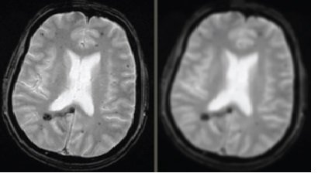
Medical image analysis : image filtering
Smoothing Filters : [Low Pass Filters]
Smoothing filters are used for giving image blurring effect or to reduce the noise in the image.
Image Courtesy: https://www.researchgate.net/publication/324673471_Parallel_Processing_of_Images_in_Mobile_Devices_using_BOINC/figures?lo=1

Slide 21
Medical image analysis : image filtering
Smoothing Filters : [Low Pass Filters]
Linear Spatial filters are simply the averaging of the pixels contained in the neighbors of the filter mask.
Results in reduced sharp transitions in the image greyscale.

Slide 22
Medical image analysis : image filtering
Smoothing Filters
Smoothing Masks:
1.Averaging / Mean Filters
2. Weighted Averaging filters

Slide 23
Medical image analysis : image filtering
Average Filters: [Smoothing Filters]
Smoothing Masks:
1.Averaging Filters
Are used to reduce the unwanted details in the image.
If the size of the mask is m x n , the normalized constant in equal To 1 / m x n

Slide 24
Medical image analysis : image filtering
Average Filters: [Smoothing Filters]
Smoothing Masks:
1.Averaging Filters
Are used to reduce the unwanted details in the image.
If the size of the mask is m x n , the normalized constant in equalt
To 1 / m x n
1
1 | 1 | 1
1 | 1 | 1
1 | 1 | 1
*
R = 1 * ∑ _{i=I,9} I _{i}
9
9

Slide 25
Medical image analysis : image filtering
Average Filters: [Smoothing Filters]
Example: [Border Values unchanged]
1 | 4 | 0 | 1 | 3 | 1
2 | 2 | 4 | 2 | 2 | 3
1 | 0 | 1 | 0 | 1 | 0
1 | 2 | 1 | 0 | 2 | 2
2 | 5 | 3 | 1 | 2 | 5
1 | 1 | 4 | 2 | 3 | 0
Notes:
https://www.cs.auckland.ac.nz/courses/compsci373s1c/PatricesLectures/Image%20Filtering_2up.pdf

Slide 26
Medical image analysis : image filtering
Average Filters: [Smoothing Filters]
Input
Output
Example: [Border Values unchanged]
1 | 4 | 0 | 1 | 3 | 1
2 | 2 | 4 | 2 | 2 | 3
1 | 0 | 1 | 0 | 1 | 0
1 | 2 | 1 | 0 | 2 | 2
2 | 5 | 3 | 1 | 2 | 5
1 | 1 | 4 | 2 | 3 | 0
1 | 4 | 0 | 1 | 3 | 1
2 | 2 | 2 | 2 | 1 | 3
1 | 2 | 1 | 1 | 1 | 0
1 | 2 | 1 | 1 | 1 | 2
2 | 2 | 2 | 2 | 2 | 5
1 | 1 | 4 | 2 | 3 | 0
Average = round(1+4+0+2+2+4+1+0+1)/9 = 2

Slide 27
Medical image analysis : image filtering
Average Filters: [Smoothing Filters]
Average = round(1+4+0+1+4+0+2+2+4)/9 = 2
1 4 0 1 3 1
Example: [Extending Border Values]
1 | 4 | 0 | 1 | 3 | 1
2 | 2 | 4 | 2 | 2 | 3
1 | 0 | 1 | 0 | 1 | 0
1 | 2 | 1 | 0 | 2 | 2
2 | 5 | 3 | 1 | 2 | 5
1 | 1 | 4 | 2 | 3 | 0
2 | 2 | 2 | 2 | 2 | 2
2 | 2 | 2 | 2 | 1 | 2
1 | 2 | 1 | 1 | 1 | 2
2 | 2 | 1 | 1 | 1 | 2
2 | 2 | 2 | 2 | 2 | 2
2 | 2 | 3 | 3 | 2 | 2
1 1 2 1 1 2 1 1
1 3 0 2 5 0 0
1 1 4 0 1 3

Slide 28
Medical image analysis : image filtering
Average Filters: [Smoothing Filters]
Average = round(2+5+0+3+0+0+0+0+0)/9 = 1
0 0 0 0 0 0
Example: [Zero Padding]
1 | 4 | 0 | 1 | 3 | 1
2 | 2 | 4 | 2 | 2 | 3
1 | 0 | 1 | 0 | 1 | 0
1 | 2 | 1 | 0 | 2 | 2
2 | 5 | 3 | 1 | 2 | 5
1 | 1 | 4 | 2 | 3 | 0
1 | 1 | 1 | 1 | 1 | 1
1 | 2 | 2 | 2 | 1 | 1
1 | 2 | 1 | 1 | 1 | 1
1 | 2 | 1 | 1 | 1 | 1
1 | 2 | 2 | 2 | 2 | 2
1 | 2 | 2 | 2 | 1 | 1
0 0 0 0 0 0 0 0
0 0 0 0 0 0
0 0 0 0 0 0 0 0

Slide 29
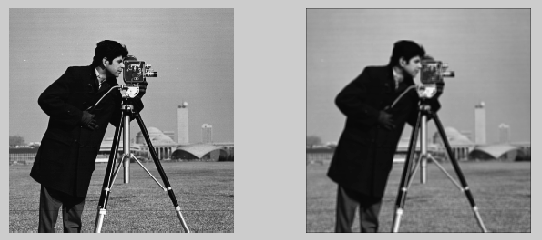
Medical image analysis : image filtering
Average Filters: [Image Results]
https://www.bogotobogo.com/Matlab/Matlab_Tutorial_Digital_Image_Processing_6_Filter_Smoothing_Low_Pass_fspecial_filter2.php

Slide 30
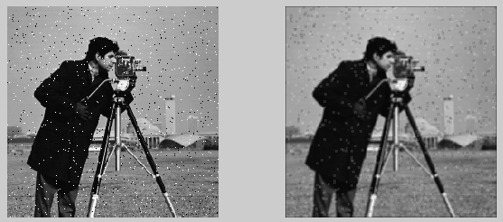
Medical image analysis : image filtering
Average Filters: [Image Results]
https://www.bogotobogo.com/Matlab/Matlab_Tutorial_Digital_Image_Processing_6_Filter_Smoothing_Low_Pass_fspecial_filter2.php

Slide 31
Medical image analysis : image filtering
Weighted Average Filters: [Smoothing Filters]
Smoothing Masks:
2. Weighted Averaging filters
Image pixels are multiplied by different coefficients instead of 1.
Normally the centered pixel is multiplied by higher value to give it more weight
In overall computation
The other pixels are weighted according to their distance from the central pixel.
1
1 | 2 | 1
2 | 4 | 2
1 | 2 | 1
*
R = 1 * ∑ _{i=I,9} W _{i} I _{i}
16
16

Slide 32
Medical image analysis : image filtering
Weighted Average Filters: [Smoothing Filters]
Smoothing Masks:
2. Weighted Averaging filters
The general form of weighted filters is given by:
R = ∑ ∑ [W(s,t) I(x-s,y-t) ]
a
b
S=-a
t=-b
a
b
∑ ∑
[W(s,t)]
S=-a
t=-b

Slide 33
Medical image analysis : image filtering
Image Filtering: [Order Statistical Filters]
Order Statistical Filters:
Are non linear filters, where the response of the filter is based on order / ranking of the filters.
Example: Median Filters:
Are commonly used for noise removal with less blurring as compared to linear filters.

Slide 34
Medical image analysis : image filtering
Order Statistical Filters [Median Filter]:
Image Filtering: [Smoothing Filters]
I₁ | I₂ | I₃ | I₄ | I₅ | I₆ | I₇
I₈ | I₉ | I₁₀ | I₁₁ | I₁₂ | I₁₃ | I₁₄
I₁₅ | I₁₆ | I₁₇ | I₁₈ | I₁₉ | I₂₀ | I₂₁
I₂₂ | I₂₃ | I₂₄ | I₂₅ | I₂₆ | I₂₇ | I₂₈
I₂₉ | I₃₀ | I₃₁ | I₃₂ | I₃₃ | I₃₄ | I₃₅
I₃₆ | I₃₇ | I₃₈ | I₃₉ | I₄₀ | I₄₁ | I₄₂
I₄₃ | I₄₄ | I₄₅ | I₄₆ | I₄₇ | I₄₈ | I₄₉
3 | 3 | 4
1 | 5 | 7
8 | 2 | 2
I (x,y)
1 2 2 3 3 4 5 7 8

Slide 35
Medical image analysis : image filtering
Order Statistical Filters [Median Filter]:
Image Filtering: [Smoothing Filters]
I₁ | I₂ | I₃ | I₄ | I₅ | I₆ | I₇
I₈ | I₉ | I₁₀ | I₁₁ | I₁₂ | I₁₃ | I₁₄
I₁₅ | I₁₆ | I₁₇ | I₁₈ | I₁₉ | I₂₀ | I₂₁
I₂₂ | I₂₃ | I₂₄ | I₂₅ | I₂₆ | I₂₇ | I₂₈
I₂₉ | I₃₀ | I₃₁ | I₃₂ | I₃₃ | I₃₄ | I₃₅
I₃₆ | I₃₇ | I₃₈ | I₃₉ | I₄₀ | I₄₁ | I₄₂
I₄₃ | I₄₄ | I₄₅ | I₄₆ | I₄₇ | I₄₈ | I₄₉
3 | 3 | 4
1 | 5 | 7
8 | 2 | 2
I (x,y)
1 2 2 3 3 4 5 7 8

Slide 36
Medical image analysis : image filtering
Order Statistical Filters [Median Filter]:
Image Filtering: [Smoothing Filters]
I₁ | I₂ | I₃ | I₄ | I₅ | I₆ | I₇
I₈ | I₉ | I₁₀ | I₁₁ | I₁₂ | I₁₃ | I₁₄
I₁₅ | I₁₆ | I₁₇ | I₁₈ | I₁₉ | I₂₀ | I₂₁
I₂₂ | I₂₃ | I₂₄ | I₂₅ | 3 | I₂₇ | I₂₈
I₂₉ | I₃₀ | I₃₁ | I₃₂ | I₃₃ | I₃₄ | I₃₅
I₃₆ | I₃₇ | I₃₈ | I₃₉ | I₄₀ | I₄₁ | I₄₂
I₄₃ | I₄₄ | I₄₅ | I₄₆ | I₄₇ | I₄₈ | I₄₉
3 | 3 | 4
1 | 5 | 7
8 | 2 | 2
I (x,y)
1 2 2 3 3 4 5 7 8

Slide 37
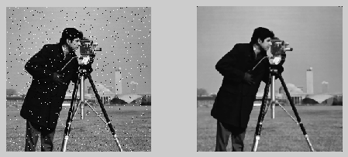
Medical image analysis : image filtering
Median Filters: [Image Results]
Median filtering is a nonlinear operation often used in image processing to reduce "salt and pepper" noise.
https://www.bogotobogo.com/Matlab/Matlab_Tutorial_Digital_Image_Processing_6_Filter_Smoothing_Low_Pass_fspecial_filter2.php

Slide 38
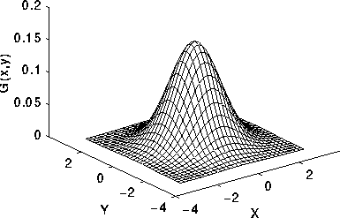

Medical image analysis : image filtering
Gaussian Filter: [Smoothing Filters]
Gaussian Filter: Gaussian filter is derived from Gaussian function.
Results in reduced image noise and also reduce the image details.
In this sense it is similar to the mean filter, but it uses a different kernel
that represents the shape of a Gaussian (`bell-shaped') hump.
Image Courtesy: https://homepages.inf.ed.ac.uk/rbf/HIPR2/gsmooth.htm

Slide 39
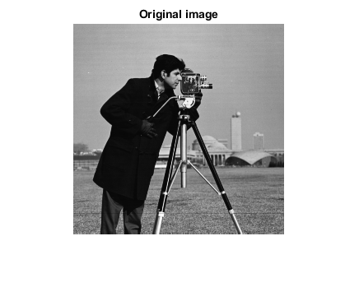



Medical image analysis : image filtering
Gaussian Filter: [Smoothing Filters]
Notes:
https://www.mathworks.com/help/images/apply-gaussian-smoothing-filters-to-images.html

Slide 40
Medical image analysis : image filtering
Image Filtering: [Python]
How to apply filters in Python:
cv2.blur(image,(figure_size, figure_size))
cv2.medianBlur(image, figure_size)
cv2.GaussianBlur(image2, (figure_size, figure_size),0)

Slide 41
Medical Image Analysis Low Pass Filters

