Slide 1

Medical Image Analysis
Dr. Zobia Suhail

Slide 2
Medical Image Analysis: image filtering
© 2002 R. C. Gonzalez & R. E. Woods

Slide 3
Medical image analysis: image filtering
High pass filters (Edge Detection, Sharpening)
Image edges and fine details are associated with high frequency component
Of the image. High pass filters only allow to pass the high frequencies and drop
The low ones:
We can say that high pass frequencies are the reverse of low pass frequencies:
i.e.
R_{hp} (u,v) = 1 – R_{lp}(u,v)

Slide 4
Medical image analysis : image filtering
Derivatives in Image Processing:
f

f(x+ ▲x) – f(x)
=
x
=
f(x+1) – f(x)

▲x
²f

=
f(x+1) + f(x-1) – 2f(x)
x²

Notes:
Keeping f(x) – f(x-1) for second derivative (to take derivative of f(x+1) –f(x))

Slide 5
Medical image analysis : image filtering
Derivatives in Image Processing:

Slide 6
Medical image analysis : image filtering
Derivatives in Image Processing:
1
1
0
0

Slide 7
Medical image analysis : image filtering
First Derivatives:
1
1
0
0
-1

Slide 8
Medical image analysis : image filtering
First Derivatives
1
1
0
0
-1

Slide 9
Medical image analysis : image filtering
Second Derivatives
1
1
0
0
-1
-1

Slide 10
Medical image analysis : image filtering
Second Derivatives
1
1
0
0
-1
-1

Slide 11
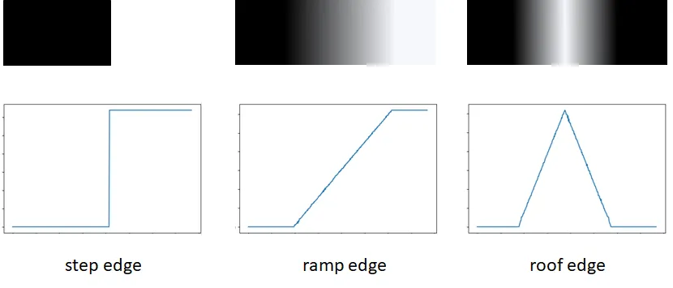
Medical image analysis : image filtering
i
Notes:
https://towardsdatascience.com/image-derivative-8a07a4118550

Slide 12
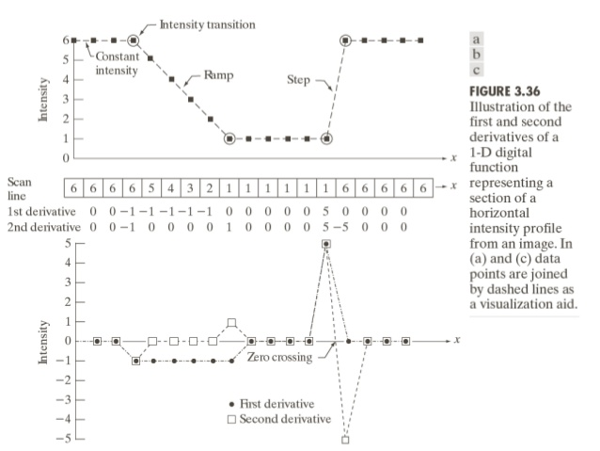
Medical image analysis : image filtering
Notes:
G. Gonzelaz & Woods ; Digital Image Processing (3rd Edition)
Step, Ramp, Line or Roof

Slide 13
Medical image analysis : image filtering
Edge Detection using Derivatives
Often, points that lie on an edge are detected by:
Detecting the local maxima or minima of the first derivative
Detecting the zero-crossings of the second derivative.
First derivative detect thick edges , Second order derivative detect thin edges

Slide 14
Medical image analysis : image filtering
Edge Detection using First Derivatives
f / y = f(x,y+1) - f(x,y) : Gradient in y-directions
f / x = f(x+1,y) – f(x,y) : Gradient in x-directions




Notes:
http://dept.me.umn.edu/courses/me5286/vision/VisionNotes/2017/ME5286-Lecture7-2017-EdgeDetection2.pdf

Slide 15
Medical image analysis : image filtering
Edge Detection using Derivatives
We can implement df / dx and df / dy using the following masks:
(x + 1 /2 , y) Good Approximation
-1 | 1
*
*
Good Approximation
(x, y+1 / 2)
-1
1

Slide 16
Medical image analysis : image filtering
Edge Detection using Derivatives
We can implement df / dx and df / dy using the following masks:
(x + 1 /2 , y) Good Approximation
-1 | 1
*
*
Good Approximation
(x, y+1 / 2)
-1
1
[ −1 0 1] (centred about x):

Slide 17
Medical image analysis : image filtering
Approximation of First Derivatives
Let’s consider the following pixel alignment around pixel (i,j)
a0 a1 a2
a7 [i,j] a3
a6 a5 a4
The partial and f/ y derivatives can be computed as:
f/ x



Notes:
http://dept.me.umn.edu/courses/me5286/vision/VisionNotes/2017/ME5286-Lecture7-2017-EdgeDetection2.pdf

Slide 18
Medical image analysis : image filtering
Approximation of First Derivatives [Gradient]
a0 a1 a2
a7 [i,j] a3
a6 a5 a4
Mx = (a2+ca3+a4) – (a0 + ca7 +a6)
My = (a6+ca5+a4) – (a0 +ca1+a2)
C implies more weightage for the closest pixel to the center of the mask.

Slide 19
Medical image analysis : image filtering
Prewit Operator:
Computes approximation of the gradient of the image intensity function.
At each point in the image, the result of the Prewitt operator is either the
corresponding gradient vector or the norm of this vector.
M_{x} = 1 0 -1 M_{y} = 1 1 1
1 0 -1 0 0 0
1 0 -1 -1 -1 -1
Notes:
http://dept.me.umn.edu/courses/me5286/vision/VisionNotes/2017/ME5286-Lecture7-2017-EdgeDetection2.pdf
Here using forward difference

Slide 20
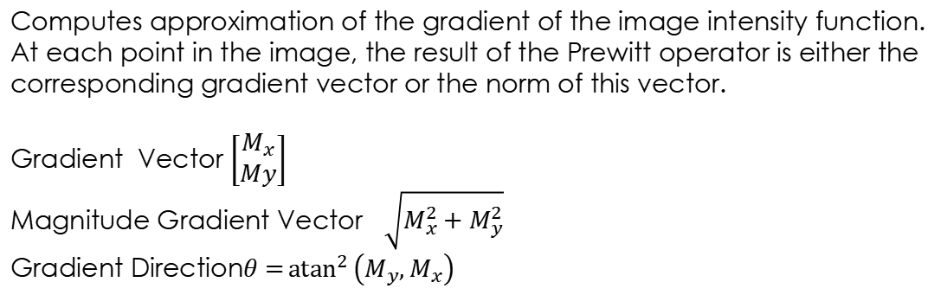
Medical image analysis : image filtering
Prewitt Operator:
Computes approximation of the gradient of the image intensity function.
At each point in the image, the result of the Prewitt operator is either the
corresponding gradient vector or the norm of this vector.
Gradient Vector $\left[\begin{matrix}M_{x} \\ My\end{matrix}\right]$
Magnitude Gradient Vector $\sqrt{M_{x}^{2}+M_{y}^{2}}$
Gradient Direction$θ={atan}^{2}\left(M_{y},M_{x}\right)$

Slide 21
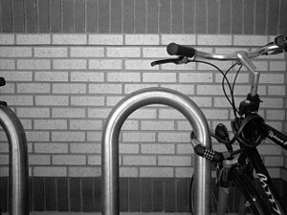
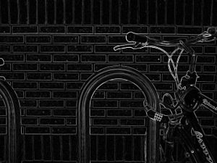
Medical image analysis : image filtering
Prewitt Operator:
Image Gradient Using Prewitt Operator
Notes:
https://en.wikipedia.org/wiki/Prewitt_operator

Slide 22
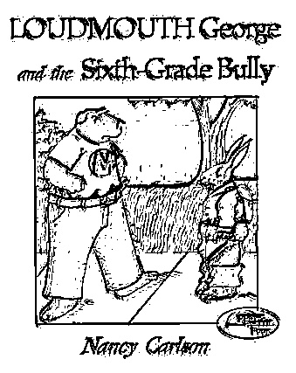
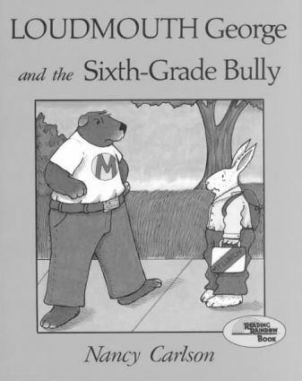
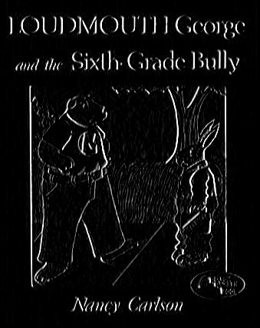
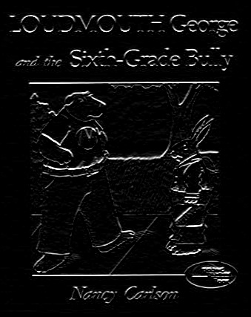

Medical image analysis : image filtering
Prewitt Operator:
Gradient_x
Gradient_y
Gradient_Mag
Edges
Image Gradient Using Prewitt Operator
Notes:
https://en.wikipedia.org/wiki/Prewitt_operator

Slide 23
Medical image analysis : image filtering
Sobel Operator:
Computes approximation of the gradient of the image intensity function.
At each point in the image, the result of the Sobel operator is either the
corresponding gradient vector or the norm of this vector.
M_{x} = 1 0 -1 M_{y} = 1 2 1
2 0 -2 0 0 0
1 0 -1 -1 -2 -1
Notes:
http://dept.me.umn.edu/courses/me5286/vision/VisionNotes/2017/ME5286-Lecture7-2017-EdgeDetection2.pdf

Slide 24
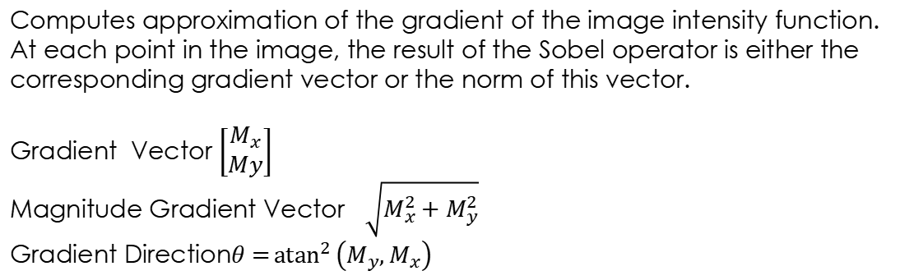
Medical image analysis : image filtering
Sobel Operator:
Computes approximation of the gradient of the image intensity function.
At each point in the image, the result of the Sobel operator is either the
corresponding gradient vector or the norm of this vector.
Gradient Vector $\left[\begin{matrix}M_{x} \\ My\end{matrix}\right]$
Magnitude Gradient Vector $\sqrt{M_{x}^{2}+M_{y}^{2}}$
Gradient Direction$θ={atan}^{2}\left(M_{y},M_{x}\right)$

Slide 25
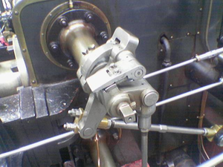
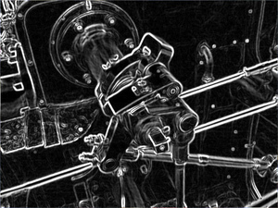
Medical image analysis : image filtering
Sobel Operator:
Sobel Operator applied to an image
Notes:
https://en.wikipedia.org/wiki/Sobel_operator

Slide 26
Medical image analysis : image filtering
Derivative Filter and Noise
Derivative operator is affected by noise, Numerical derivatives can amplify noise! (particularly higher order derivatives)
E = Derivative_Filter * (Smoothing_Filter * I)
Or (Associativity of Convolution Operators)
E = (Derivative_Filter * (Smoothing_Filter) * I
Notes:
https://en.wikipedia.org/wiki/Sobel_operator

Slide 27
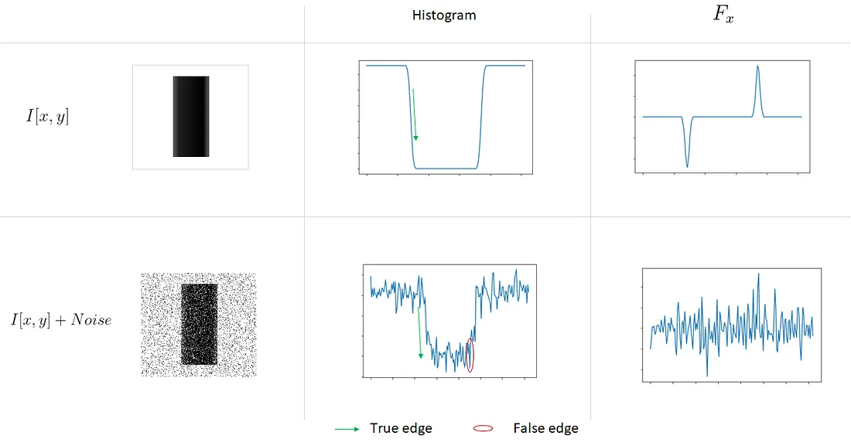
Medical image analysis : image filtering
Derivative Filter and Noise
Notes:
https://towardsdatascience.com/image-derivative-8a07a4118550

Slide 28
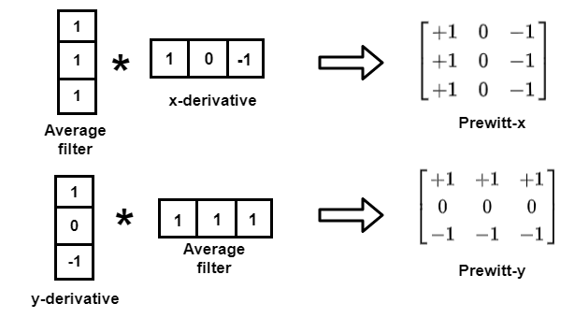
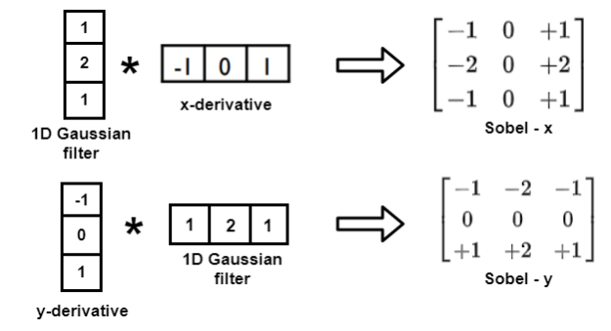
Medical image analysis : image filtering
Derivative Filter and Noise
Notes:
https://theailearner.com/2019/05/24/first-order-derivative-kernels-for-edge-detection/

Slide 29
Medical image analysis : image filtering
Laplacian Filters (Second Derivative for Image Sharpening)
Defining a Discrete formulation of second order derivative and then construct
a filter mask based on that formulation.
Isotropic Filters (Rotation Invariant)

Slide 30
Medical image analysis : image filtering
Laplacian Filters (Second Derivative for Image Sharpening)
Simplest isotropic derivative operator as a function of image is defined as:
▼²f =
f / +
f / x = f(x+1,y) – f(x,y)
²
x²
²f /
y²


f / x² = f(x+1) + f(x-1) – 2f(x)
²


Slide 31
Medical image analysis : image filtering
Laplacian Filters (Second Derivative for Image Sharpening)
Simplest isotropic derivative operator as a function of image is defined as:
▼²f =
f / +
f / x = f(x+1,y) – f(x,y)
²
x²
²f /
y²


f / x² = f(x+1) + f(x-1) – 2f(x)
²

We have to keep the second variable:
f / x² = f(x+1,y) + f(x-1,y) – 2f(x,y)
f / y² = f(x,y+1) + f(x,y-1) – 2f(x,y)
²

²

For x-Direction
For y-Direction

Slide 32
Medical image analysis : image filtering
Laplacian Filters (Second Derivative for Image Sharpening)
Therefore, from the preceding equation, the discrete Laplacian of 2
variables can be defined as:
▼²f (x,y) = f(x+1,y) + f(x-1,y) + f(x,y+1) + f(x,y-1) -4f(x,y)
Filter Mask: 0 1 0 0 -1 0
1 -4 1 -1 4 -1
0 1 0 0 -1 0

Slide 33
Medical image analysis : image filtering
Laplacian Filters (Second Derivative for Image Sharpening)
Extended Filter Mask To include Diagonal terms:
1 1 1 -1 -1 -1
1 -8 1 -1 8 -1
1 1 1 -1 -1 -1
Notes:
Image Scaling is required after applying Laplacian due to negative values: Fm = f – min(f)
Fs = K [fm / max(fm)]
Resultant filter response is subtracted from the original image if the central value is negative and added otherwise (to sharp the image).

Slide 34
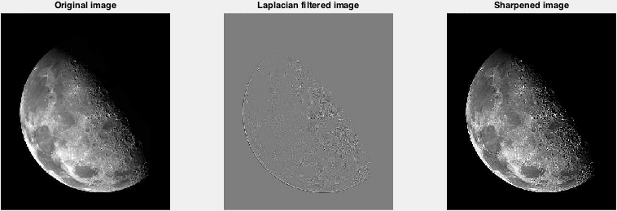
Medical image analysis : image filtering
Laplacian Filters (Second Derivative for Image Sharpening)
Notes:
Gonzalez & Woods
Normalize the filter response: (Res-MinR) / (MaxR-MinR)
Sharpened = response + img
Sharpened =( Shaprpened – MinS) / (MaxS – MinS)
Or
G= img + c * LaplacianImage //c=-1 if central value is negative and +1 otherwise
G_Clip=np.clip(G,0,255)

Slide 35
Medical image analysis : image filtering
Image Filtering: [Python]
How to apply filters in Python:
cv2.blur(image,(figure_size, figure_size))
cv2.medianBlur(image, figure_size)
cv2.GaussianBlur(image2, (figure_size, figure_size),0)
cv2.Laplacian(img,cv.CV_64F)

Slide 36
Computer Vision
High pass filters
Image derivative
First and second derivative edge detection operators
End of Lecture 9-10

