Slide 1
In the name of allah the most merciful and benificient

Slide 2
medical Image Analysis
Dr. zobia Suhail
PhD in Medical image processing
Aberystwyth university, Wales, uk (2019)

Slide 3
medical Image Analysis
Overview of Previous Lecture:
Image Features
Local Binary Patterns (LBP)
Histogram of Oriented Gradients (HOG)

Slide 4
medical Image Analysis
MACHINE LEARNING:
What is Machine Learning (ML):
Machine Learning is a field of study in which we train the computers to think like humans.
In this study we make the computers to perform without explicitly programmed.
Using Machine learning, the computer find the patterns of the huge amount of data that is given
to the particular Machine learning algorithm. (Data can be anything that we fed into the Machine Learning
algorithm, it can be number, words, digits etc.)

Slide 5
medical Image Analysis
MACHINE LEARNING:
Uses of Machine Learning:
Machine Learning is being used in many applications that we use.
YouTube
Google
Twitter
Facebook
And lots and lots of other applications that are using Machine Learning as underlying technology.

Slide 6
medical Image Analysis
MACHINE LEARNING:
Uses of Machine Learning:
Each of the mentioned applications collects as much data about you as possible so as to
Predict your next actions.
Which links you are clicking
Which groups you are joining
Which video you are watching
Which status you are reacting to.
And then use this information to make guess of your next action.

Slide 7
medical Image Analysis
MACHINE LEARNING:
Artificial Intelligence || Machine Learning || Deep Learning
What is Relationship?

Slide 8
medical Image Analysis
MACHINE LEARNING:
Artificial Intelligence || Machine Learning || Deep Learning
Use statistical methods to enable the machines to improve with experience
Technique that enables the machine to mimic the human behaviour.
Artificial Intelligence
Machine Learning
Make the computation of multi-layer neural network feasible.
Deep Learning

Slide 9
medical Image Analysis
MACHINE LEARNING:
BIG Picture:
Input Data
Probably Large amount
Find underlying
pattern of the data
Apply the learned pattern to
unseen data for output

Slide 10
medical Image Analysis
MACHINE LEARNING:
How does Machine Learning work?
Training dataset is used to train the machine using machine learning algorithm.
New input of data is introduced to the machine learning algorithm to make a prediction on the basis of the model.
The prediction is evaluated for an accuracy and if the accuracy is acceptable, the machine learning algorithm is deployed.
If not, the machine learning algorithm is trained again and again with an enhanced training data set.

Slide 11
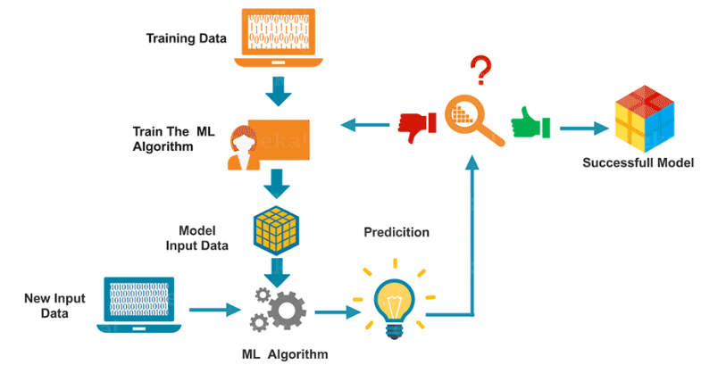
medical Image Analysis
MACHINE LEARNING:
How does Machine Learning work?

Slide 12
medical Image Analysis
MACHINE LEARNING:
Potential areas of Machine Learning:
Agriculture
Bioinformatics
Classifying DNA sequences
Computer Networks
Telecommunication
Computer vision, object recognition
Detecting credit-card fraud
General game playing
Information retrieval
Machine learning control
Machine perception
Automated medical diagnosis
Natural language processing
Online advertising
Search engines
Sentiment analysis (or opinion mining)
Speech and handwriting recognition
Machine translation

Slide 13
medical Image Analysis
MACHINE LEARNING:
Potential areas of Machine Learning:
Agriculture
Bioinformatics
Classifying DNA sequences
Computer Networks
Telecommunication
Computer vision, object recognition
Detecting credit-card fraud
General game playing
Information retrieval
Machine learning control
Machine perception
Automated medical diagnosis
Natural language processing
Online advertising
Search engines
Sentiment analysis (or opinion mining)
Speech and handwriting recognition
Machine translation

Slide 14
medical Image Analysis
MACHINE LEARNING:
Types of Machine Learning:
Machine Learning
Supervised Learning
Unsupervised Learning
Reinforcement Learning

Slide 15
medical Image Analysis
MACHINE LEARNING:
Types of Machine Learning:
Machine Learning
Supervised Learning
Unsupervised Learning
We train the machine to provide
Specific output against specific input.
2 Categories:
Regression & Classification
We do not provide the machine with output values.
The machine define the rules based on the
Input data in order to detect the data patterns and then use
Those patterns for similarity measure.
Clustering

Slide 16
medical Image Analysis
MACHINE LEARNING:
Types of Machine Learning:
Machine Learning
Supervised Learning
Unsupervised Learning
Reinforcement Learning
About taking suitable action to maximize
Reward in a particular situation.
It is about learning by interacting with the
Environment.

Slide 17
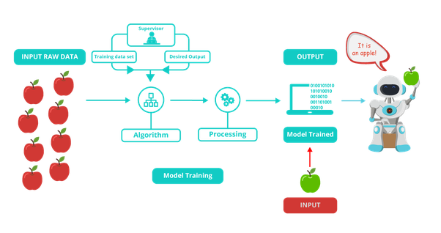
medical Image Analysis
MACHINE LEARNING:
Supervised Learning:

Slide 18
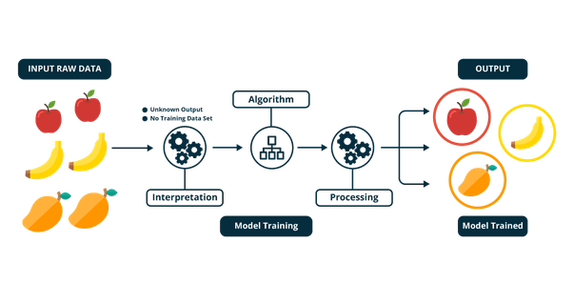
medical Image Analysis
MACHINE LEARNING:
Unsupervised Learning:

Slide 19
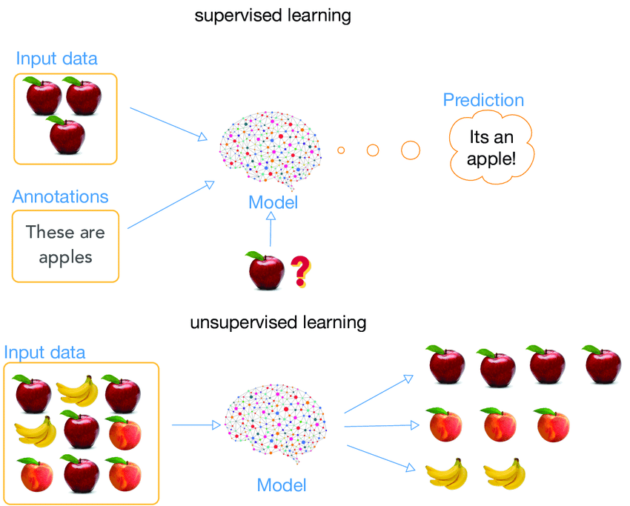
medical Image Analysis
MACHINE LEARNING:
Supervised
VS
Unsupervised
Learning:

Slide 20
medical Image Analysis
MACHINE LEARNING:
Supervised Learning ----- > Regression:
Regression is a statistical way of defining relationship between two or more variables, where one variable
Is dependent variable (normally termed as Y)and the other are known as independent variables.
Regression can be linear or non linear.
Linear regression can be simple or multiple linear regression.
Linear regression uses one independent variable to predict the outcome of the dependent variable (Y)
Multiple linear regression uses two or more independent variables to predict the outcome of the
Dependent variable.

Slide 21
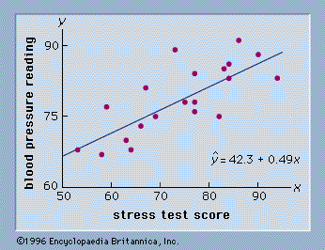
medical Image Analysis
MACHINE LEARNING:
Supervised Learning ----- > Regression
Simple Linear regression: a+bx : where a is y-intercept, b is the slope.
Learned parameters are:
a=42.3
b=0.49
Image Courtesy: http://abyss.uoregon.edu/~js/glossary/correlation.html

Slide 22
medical Image Analysis
MACHINE LEARNING:
Supervised Learning ----- > Regression [Python Implementation]
from sklearn.linear_model import LinearRegression
X -> Independent Variable
Y-> Dependent Variable
Split the data into Train and test (normally 20% for test and 80% for training)
X_train
X_test
y_train
y_test
regressor = LinearRegression() regressor.fit(X_train, y_train) #training the algorithm
print(regressor.intercept_) to check the value of c (intercept) print(regressor.coef_) to check the value of m (slope)
y_pred = regressor.predict(X_test)
Y_test -> actual value and y_pred->predicted value

Slide 23
medical Image Analysis
MACHINE LEARNING:
Supervised Learning ----- > Classification
Classification is a type of supervised learning.
It specifies the class to which data elements belong to and is best used when the output has finite and discrete values.
It predicts a class for an input variable as well.

Slide 24
medical Image Analysis
MACHINE LEARNING:
Supervised Learning ----- > Classification

Slide 25
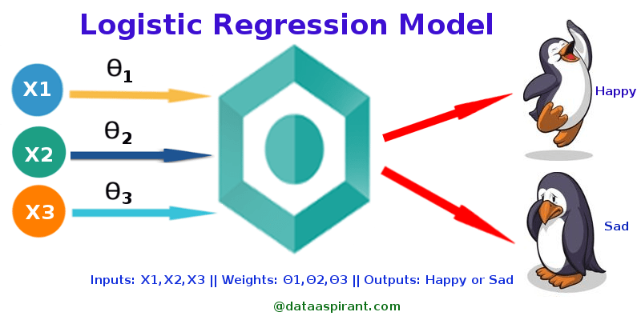
medical Image Analysis
MACHINE LEARNING:
Supervised Learning ----- > Classification (Logistic Regression)
Image Courtasy: https://towardsdatascience.com/logistic-regression-detailed-overview-46c4da4303bc

Slide 26
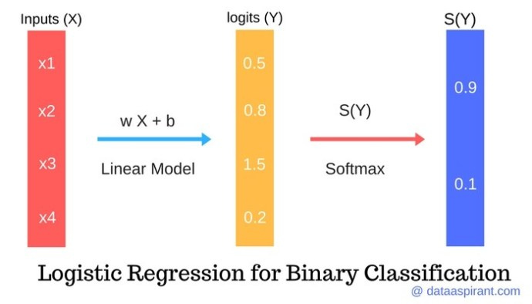
medical Image Analysis
MACHINE LEARNING:
Supervised Learning ----- > Classification (Logistic Regression)
Image Courtasy: https://towardsdatascience.com/logistic-regression-detailed-overview-46c4da4303bc

Slide 27
medical Image Analysis
MACHINE LEARNING:
Supervised Learning ----- > Classification (Logistic Regression -> Python)
from sklearn.linear_model import LogisticRegression
X -> Independent Variable
Y-> Dependent (categorical) Variable
Split the data into Train and test
X_train
X_test
y_train
y_test
logistic_regression= LogisticRegression()
logistic_regression.fit(X_train,y_train)
y_pred=logistic_regression.predict(X_test)

Slide 28
medical Image Analysis
MACHINE LEARNING:
Supervised Learning ----- > Support Vector Machine (SVM)
SVM is a machine learning algorithm that can be used for regression and classification, but
Normally it is used for classification.
In the SVM algorithm, we plot each data item as a point in n-dimensional space
(where n is number of features you have) with the value of each feature being the value of a
particular coordinate.
Then, we perform classification by finding the hyper-plane that differentiates the two classes
very well.

Slide 29
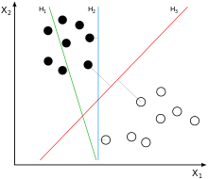
medical Image Analysis
MACHINE LEARNING:
Supervised Learning ----- > Support Vector Machine (SVM) (Regression & Classification)
H₁ does not separate the classes.
H₂ does, but only with a small margin.
H₃ separates them with the maximal margin.
Image Courtesy: https://en.wikipedia.org/wiki/Support-vector_machine

Slide 30
medical Image Analysis
MACHINE LEARNING:
Supervised Learning ----- > Support Vector Machine (SVM) (Python Implementation)
from sklearn.svm import SVC (Support Vector Classifier)
svclassifier = SVC(kernel='linear')
svclassifier.fit(X_train, y_train)
y_pred = svclassifier.predict(X_test)

Slide 31
medical Image Analysis
MACHINE LEARNING:
Supervised Learning ----- > Classification (Evaluation)
True vs. False and Positive vs. Negative
Suppose we have 2 image classes:
Cancerous -> image contains cancerous symptoms
Non-cancerous-> image does not have cancerous symptoms
True Positive(TP): a correct detection (cancerous image if classified as cancerous) False Positive (FP): an incorrect detection (Non-cancerous image is classified as cancerous) True Negative (TN): a correct non-detection (Non-cancerous image is classified as con-cancerous) False Negative (FN): an incorrect non-detection (Cancerous image is classified as non-cancerous)

Slide 32
medical Image Analysis
MACHINE LEARNING:
Supervised Learning ----- > Classification (Evaluation)
Evaluation Metrics:
Accuracy: Accuracy can also be calculated in terms of positives and negatives as follows:
Accuracy=TP+TN / TP+TN+FP+FN
Where TP = True Positives, TN = True Negatives, FP = False Positives, and FN = False Negatives.
Precision attempts to answer the following question:
What proportion of positive identifications was actually correct?
Precision is defined as follows:
Precision=TP / TP+FP

Slide 33
medical Image Analysis
MACHINE LEARNING:
Supervised Learning ----- > Classification (Evaluation)
Evaluation Metrics:
Sensitivity: Sensitivity refers to the test's ability to correctly detect cancerous patients who do have the condition.
Sensitivity = TP / TP+FN
Specificity: Specificity relates to the test's ability to correctly reject healthy patients without a cancerous condition
Specificity: TN / TN + FP

Slide 34
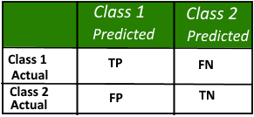
medical Image Analysis
MACHINE LEARNING:
Supervised Learning ----- > Classification (Evaluation)
Evaluation Metrics:
Confusion Matrix (Error Matrix)
A confusion matrix is a table that is often used to describe the performance of a classification model (or “classifier”) on a set of test data for which the true values are known. It allows the visualization of the performance of an algorithm.
Suppose Class 1 is Positive (cancerous) and Class 2 is Negative (Non Cancerous)

Slide 35
medical Image Analysis
MACHINE LEARNING:
Supervised Learning ----- > Classification (Evaluation)
Evaluation Metrics:
Building Confusion Matrix in Pyhton
# Python script for confusion matrix creation.
from sklearn.metrics import confusion_matrix
from sklearn.metrics import accuracy_score
from sklearn.metrics import classification_report
actual = [1, 1, 0, 1, 0, 0, 1, 0, 0, 0]
predicted = [1, 0, 0, 1, 0, 0, 1, 1, 1, 0]
results = confusion_matrix(actual, predicted)
print 'Confusion Matrix :'
print(results)
print 'Accuracy Score :',accuracy_score(actual, predicted)
print('True positive = ', results[0][0])
print('False positive = ', results[0][1])
print('False negative = ', results[1][0])
print('True negative = ', results[1][1])

Slide 36
medical Image Analysis
MACHINE LEARNING:
Unsupervised Learning ----- > Clustering
Clustering is the task of dividing the population or data points into a number of groups
such that data points in the same groups are more similar to other data points in the same
group and dissimilar to the data points in other groups.

Slide 37
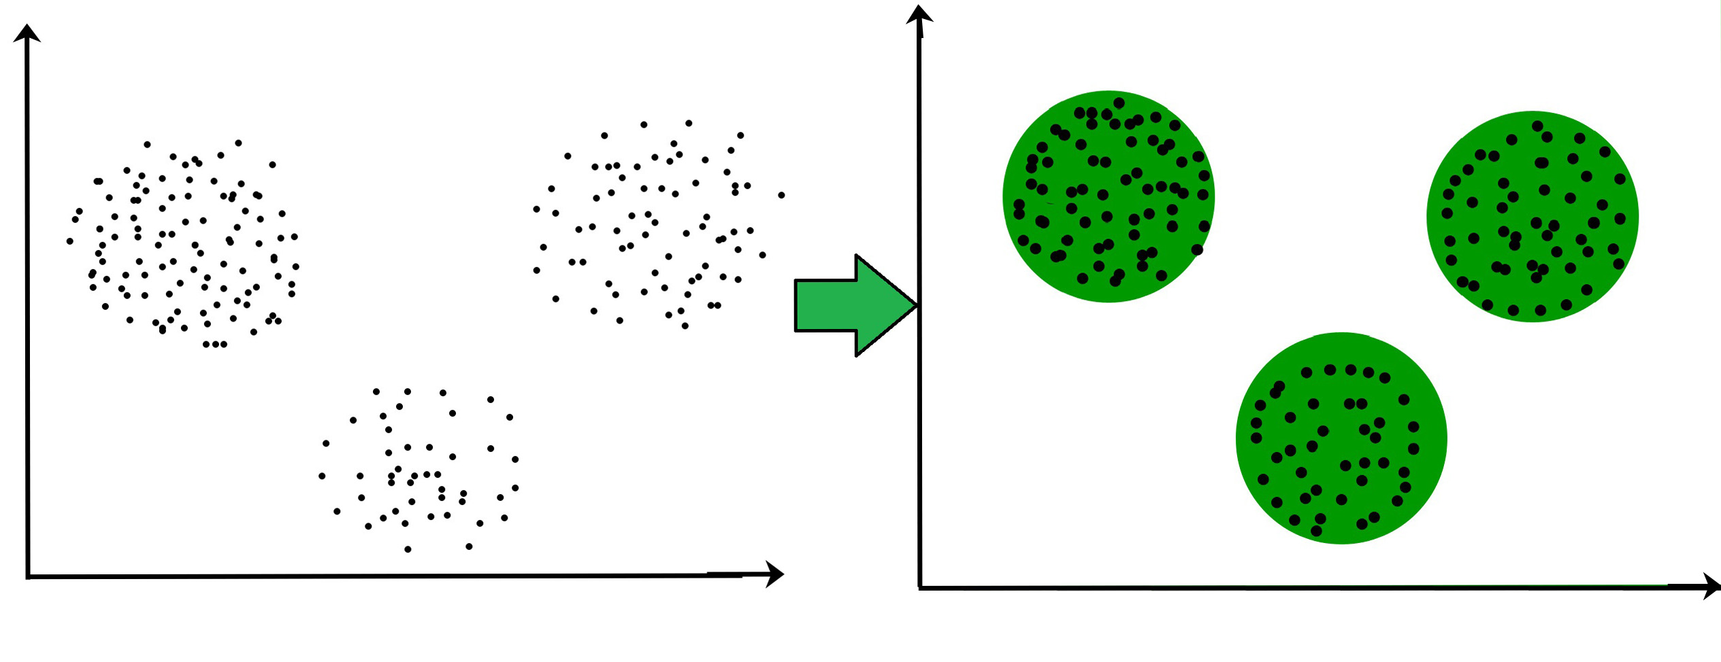
medical Image Analysis
MACHINE LEARNING:
Unsupervised Learning ----- > Clustering
Clustering is the task of dividing the population or data points into a number of groups
such that data points in the same groups are more similar to other data points in the same
group and dissimilar to the data points in other groups.
Image Courtesy: https://www.geeksforgeeks.org/clustering-in-machine-learning/

Slide 38
medical Image Analysis
MACHINE LEARNING:
Unsupervised Learning ----- > Clustering
K-Mean Clustering:
K-means clustering algorithm – It is the simplest unsupervised learning algorithm that solves
clustering problem. K-means algorithm partition n observations into k clusters where each observation belongs to the cluster with the nearest mean serving as a prototype of the cluster .

Slide 39
medical Image Analysis
MACHINE LEARNING:
Unsupervised Learning ----- > Clustering
K-Means Clustering [Algorithm]:
The algorithm works as follows:
First we initialize k points, called means, randomly.
2. We categorize each item to its closest mean and we update the mean’s coordinates, which are the averages of the items categorized in that mean so far.
3. We repeat the process for a given number of iterations (or the centroids become stabilized) and at the end, we have our clusters.
Image Courtesy: https://www.geeksforgeeks.org/clustering-in-machine-learning/

Slide 40
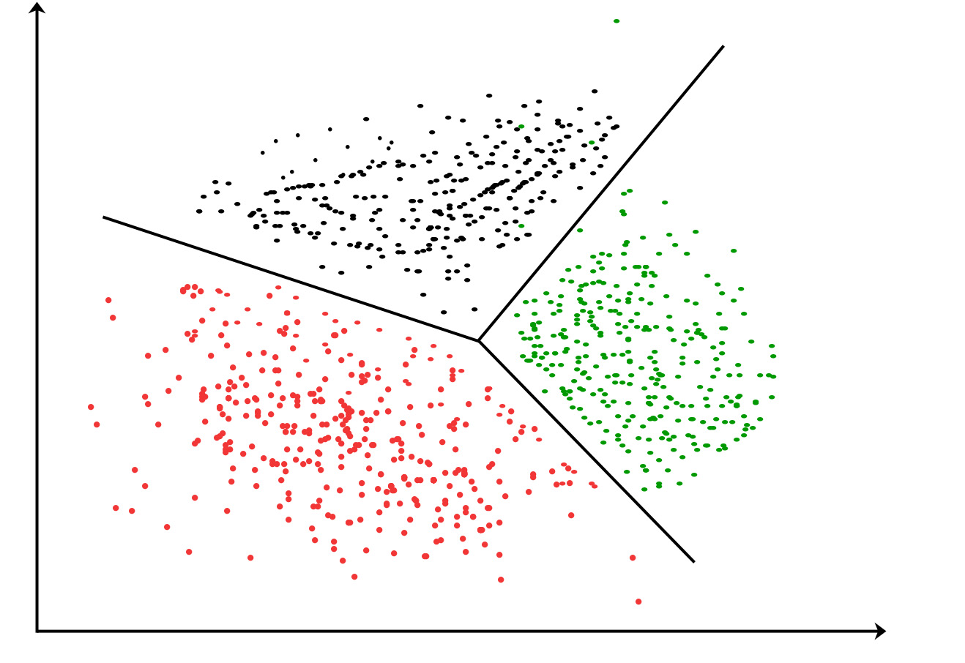
medical Image Analysis
MACHINE LEARNING:
Unsupervised Learning ----- > Clustering
K-Means Clustering:
Image Courtesy: https://www.geeksforgeeks.org/clustering-in-machine-learning/

Slide 41
medical Image Analysis
MACHINE LEARNING:
Unsupervised Learning ----- > ClusteringK-Means Clustering [Python]:
from sklearn.cluster import KMeans
>>> import numpy as np
>>> X = np.array([[1, 2], [1, 4], [1, 0], [10, 2], [10, 4], [10, 0]])
>>> kmeans = KMeans(n_clusters=2, random_state=0).fit(X)
>>> kmeans.labels_
array([1, 1, 1, 0, 0, 0], dtype=int32)
>>> kmeans.predict([[0, 0], [12, 3]])
array([1, 0], dtype=int32)
>>> kmeans.cluster_centers_
array([[10., 2.],
[ 1., 2.]])
Code Courtesy: https://scikit-learn.org/stable/modules/generated/sklearn.cluster.KMeans.html

Slide 42


medical Image Analysis
MACHINE LEARNING:
WEKA : A collection of Maching Learning Algorithms
Waikato Environment for Knowledge Analysis, developed at the University of Waikato, New Zealand.
Weka contains tools for
Data pre-processing
Classification
Regression
Clustering and Visualizations.

Slide 43
medical Image Analysis
MACHINE LEARNING:
WEKA : A collection of Maching Learning Algorithms
Website [to install]: https://www.cs.waikato.ac.nz/ml/weka/

Slide 44
medical Image Analysis
MACHINE LEARNING:
WEKA : A collection of Maching Learning Algorithms
ARFF (Attribute-Relation File Format):
An ARFF (Attribute-Relation File Format) file is an ASCII text file that describes a list of instances sharing
a set of attributes.
ARFF files were developed by the Machine Learning Project at the Department of Computer Science
of The University of Waikato for use with the Weka Machine Learning Software.

Slide 45
medical Image Analysis
MACHINE LEARNING:
WEKA : A collection of Maching Learning Algorithms
ARFF (Attribute-Relation File Format):
Example:
% 1. Title: Iris Plants Database
%
% 2. Sources:
% (a) Creator: R.A. Fisher
% (b) Donor: Michael Marshall (MARSHALL%PLU@io.arc.nasa.gov)
% (c) Date: July, 1988
%
@RELATION iris
@ATTRIBUTE sepallength NUMERIC //Other datatypes couldbe string, date (YYYY-MM-DD)
@ATTRIBUTE sepalwidth NUMERIC
@ATTRIBUTE petallength NUMERIC
@ATTRIBUTE petalwidth NUMERIC
@ATTRIBUTE class {Iris-setosa,Iris- versicolor,Iris-virginica}
@DATA
5.1,3.5,1.4,0.2,Iris-setosa
4.9,3.0,1.4,0.2,Iris-setosa
4.7,3.2,1.3,0.2,Iris-setosa
4.6,3.1,1.5,0.2,Iris-setosa
5.0,3.6,1.4,0.2,Iris-setosa
5.4,3.9,1.7,0.4,Iris-setosa
4.6,3.4,1.4,0.3,Iris-setosa
5.0,3.4,1.5,0.2,Iris-setosa
4.4,2.9,1.4,0.2,Iris-setosa
4.9,3.1,1.5,0.1,Iris-setosa

Slide 46
medical Image Analysis
MACHINE LEARNING:
WEKA : A collection of Maching Learning Algorithms
ARFF (Attribute-Relation File Format):
Example:
ARFF file for IRIS data (150 instances)
http://www.cas.mcmaster.ca/~cs4tf3/iris.arff

Slide 47
medical Image Analysis
MACHINE LEARNING:
Supervised & Unsupervised Learning
End of Lecture → MACHINE LEARNING:

