Slide 1
medical Image Analysis
Dr. zobia Suhail
PhD in Medical image processing
Aberystwyth university, Wales, uk (2019)

Slide 2
medical Image Analysis
Overview of Previous Lecture:
Course overview
Python Introduction using common libraries
How to read and analyze image in Python
Image Intensities
Difference in intensity levels for Grayscale and Color images
Image Histograms
Some Discussion on the Application areas of Image Histograms

Slide 3
medical Image Analysis
Histogram: [Applications]
Thresholding:
An image histogram can be used to threshold the image to convert it into binary image.
If the image intensities are well separated into two defined objects, the histogram is well
Suited to define the threshold of the image.
The histogram will be bi-modal and the pixel intensities can be separated into two well
Defined groups.

Slide 4
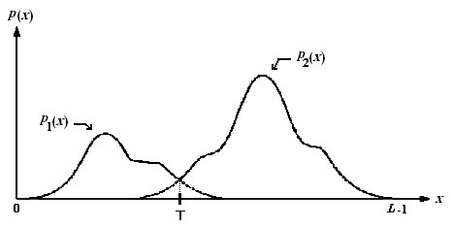
medical Image Analysis
Histogram: [Applications]
Thresholding:
Image Source: Optimal Threshold Computing in Automatic Image Thresholding using Adaptive Particle Swarm Optimization

Slide 5
medical Image Analysis
Histogram: [Applications]
Thresholding:
If T is the obtained threshold, then the image can be binarized using the following relation:
For all pixel p in image I:
If p >= T:
p = 0
Else
p = 1

Slide 6

medical Image Analysis
Histogram: [Applications]
Thresholding:
PYTHON
Import cv2 as cv
Import imageio as io
Im=io.imread(‘original.png’)
thresh=190
r,c=m_img.shape
i=0
j=0
new_im=np.zeros((r,c),dtype=np.uint8)
for i in range(r):
for j in range(c):
if(m_img[i,j]>=thresh):
new_im[i,j]=1
else:
new_im[i,j]=0
plt.imshow(new_im,cmap="gray")
plt.show()
plt.close()

Slide 7
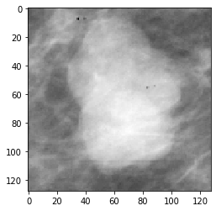
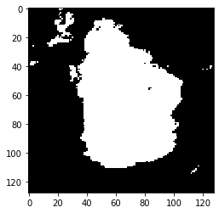
medical Image Analysis
Histogram: [Applications]
Thresholding:
PYTHON
Discussion:

Slide 8
medical Image Analysis
Histogram: [Applications]
Thresholding:
PYTHON
Thresholding using Pyhton libraries:
Cv2 library in Python for Thresholding
Cv2.threshold
Ret,dest=cv2.threshold(im,thresh,max_value,cv2.ThresholdType)

Slide 9
medical Image Analysis
Histogram: [Applications]
Thresholding:
PYTHON
Thresholding using Pyhton libraries:
Cv2 library in Python for Thresholding
Cv2.threshold
Ret,dest=cv2.threshold(im,thresh,max_value,cv2.ThresholdType)
Ret,thresh=cv2.threshold(im,120,256,cv2.Threshold_Binary)

Slide 10
medical Image Analysis
Histogram: [Applications]
Thresholding:
PYTHON
Thresholding using Pyhton libraries:
Cv2 library in Python for Thresholding
Cv2.threshold
Ret,dest=cv2.threshold(im,thresh,max_value,cv2.ThresholdType)
cv2.THRESH_BINARY
cv2.THRESH_BINARY_INV
cv2.THRESH_TRUNC
cv2.THRESH_TOZERO
cv2.THRESH_TOZERO_INV

Slide 11

medical Image Analysis
Histogram: [Applications]
Thresholding:
PYTHON
Thresholding using Pyhton libraries:
Cv2 library in Python for Thresholding
Cv2.threshold
Ret,dest=cv2.threshold(im,thresh,max_value,cv2.ThresholdType)
cv2.THRESH_BINARY

Slide 12

medical Image Analysis
Histogram: [Applications]
Thresholding:
PYTHON
Thresholding using Pyhton libraries:
Cv2 library in Python for Thresholding
Cv2.threshold
Ret,dest=cv2.threshold(im,thresh,max_value,cv2.ThresholdType)
cv2.THRESH_BINARY_INV

Slide 13

medical Image Analysis
Histogram: [Applications]
Thresholding:
PYTHON
Thresholding using Pyhton libraries:
Cv2 library in Python for Thresholding
Cv2.threshold
Ret,dest=cv2.threshold(im,thresh,max_value,cv2.ThresholdType
cv2.THRESH_TRUNC

Slide 14

medical Image Analysis
Histogram: [Applications]
Thresholding:
PYTHON
Thresholding using Pyhton libraries:
Cv2 library in Python for Thresholding
Cv2.threshold
Ret,dest=cv2.threshold(im,thresh,max_value,cv2.ThresholdType
cv2.THRESH_TOZERO

Slide 15

medical Image Analysis
Histogram: [Applications]
Thresholding:
PYTHON
Thresholding using Pyhton libraries:
Cv2 library in Python for Thresholding
Cv2.threshold
Ret,dest=cv2.threshold(im,thresh,max_value,cv2.ThresholdType
cv2.THRESH_TOZERO_INV

Slide 16
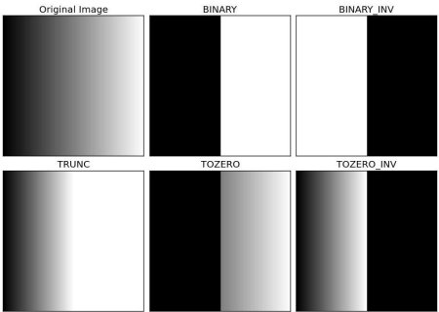
medical Image Analysis
Histogram: [Applications]
PYTHON
Thresholding using Python libraries:
Cv2 library in Python for Thresholding
Cv2.threshold

Slide 17
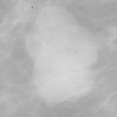

medical Image Analysis
Histogram: [Applications]
PYTHON
Thresholding using Python libraries:
Cv2 library in Python for Thresholding
Cv2.threshold
Ret,dest=cv.threshold(im1,190,255,cv.THRESH_BINARY)

Slide 18

medical Image Analysis
Histogram: [Applications]
PYTHON
Thresholding using Python libraries:
Cv2 library in Python for Thresholding
Cv2.threshold
Ret,dest=cv.threshold(im1,190,255,cv.THRESH_BINARY_INV)

Slide 19
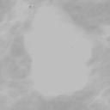
medical Image Analysis
Histogram: [Applications]
PYTHON
Thresholding using Python libraries:
Cv2 library in Python for Thresholding
Cv2.threshold
Ret,dest=cv.threshold(im1,190,255,cv.THRESH_TRUNC)

Slide 20

medical Image Analysis
Histogram: [Applications]
PYTHON
Thresholding using Python libraries:
Cv2 library in Python for Thresholding
Cv2.threshold
Ret,dest=cv.threshold(im1,190,255,cv.THRESH_TOZERO)

Slide 21
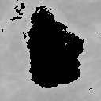
medical Image Analysis
Histogram: [Applications]
PYTHON
Thresholding using Python libraries:
Cv2 library in Python for Thresholding
Cv2.threshold
Import cv2 as cv
Thresh=190
Ret,dest=cv.threshold(im,thresh,255,cv.THRESH_TOZERO_INV)
plt.imshow(dest,cmap="gray")
plt.show()
plt.close()

Slide 22
medical Image Analysis
Histogram: [Applications]
Thresholding:
The thresholds that we used so far are arbitrary chosen threshold values , that is not a good choice.
Our algorithm should be able to find the optimum threshold value……
[REASEARCH POINT]
Otsu method determines the threshold value of the image automatically.
We just need to pass an extra argument to cv.threshold function
Ret, dest=cv2.threshold(im,thresh,max_value,cv2.ThresholdType+cv2.Thresh_Otsu)
Ret is the optimum threshold value calculated using Otsu method.

Slide 23
medical Image Analysis
Histogram: [Applications]
PYTHON
Applications of Histograms: [Image Thresholding + OTSU Method]
Python:
Import cv2 as cv
Import imageio as io
Io.imread(‘original.png’)
Ret,dest=cv.threshold(im,0,255,cv.THRESH_BINARY+cv.THRESH_OTSU)
plt.imshow(dest,cmap="gray")
plt.show()
plt.close()
Discussion:

Slide 24
medical Image Analysis
Histogram: [Applications]
Thresholding: [Otsu Method ---- Continued ]
Otsu Method maximized the between class variance……
Otsu method iterate through all possible threshold values
And find the spread of pixels on each side of the threshold i.e. for foreground and for background.
Select that particular intensity as threshold value having minimum foreground
And background spread i.e minimize the within class variance.

Slide 25
medical Image Analysis
Histogram: [Applications]
Thresholding:
The techniques that we studies so far are Global Thresholding
i.e. it selects only one value for the whole image.
Problem: What is different section of the image has variation in
lighting.?
Global Thresholding is not appropriate solution:
Adaptive thresholding is a better solution in that case.
The algorithm determines the threshold of a pixel based
On the surrounding region.

Slide 26
medical Image Analysis
Histogram: [Applications]
Thresholding [Local Thresholding]:
Different options are available for adaptive thresholding
Grid of Cells
Statistically measurement of intensity values of the
Local neighbourhood for each pixel.

Slide 27
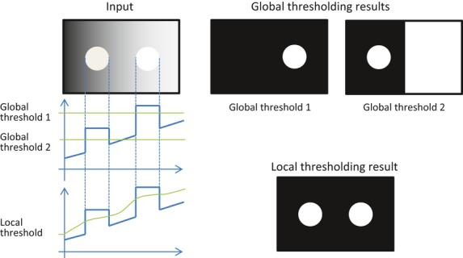
medical Image Analysis
Histogram: [Applications]
Applications of Histograms: [Local Thresholding]
local threshold is determined at each pixel
by the local average around the pixel.
Image Courtesy: https://www.researchgate.net/figure/Binarization-by-global-thresholding-and-local-thresholding-For-this-input-image-no_fig3_236125496

