Slide 1

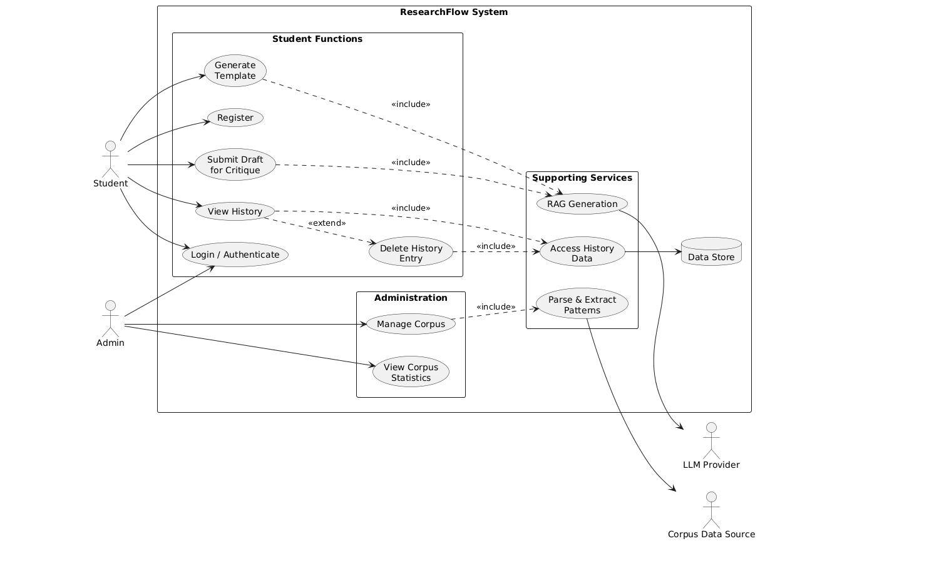
ResearchFlow System — Use Case Diagram
The use case diagram illustrates how students, administrators, and external services interact with the ResearchFlow System.

Slide 2


Actors & Main Use Cases
ACTORS
MAIN SYSTEM FUNCTIONS
Student
Student Functions:
Registers and authenticates in the system.
Generates research templates.
Submits drafts for critique.
Views and manages history.
Register
Login / Authenticate
Generate Template
Submit Draft for Critique
View History
Delete History Entry
Admin
Authenticates into the system.
Manages the research corpus.
Views corpus statistics.
Administrations:
Manage Corpus
View Corpus Statistics
External Entities
Supporting Services:
LLM Provider — supports RAG-based generation.
Corpus Data Source — provides corpus data for processing.
Data Store — stores and provides history data.
RAG Generation
Parse & Extract Patterns
Access History Data

Slide 3




Use Case Relationships & System Interactions
01
INCLUDE RELATIONSHIPS
Generate Template
Submit Draft for Critique
Manage Corpus
View History
Delete History Entry
RAG Generation
RAG Generation
Parse & Extract Patterns
Access History Data
Access History Data
<<include>> represents supporting functionality that is provoked as part of the corresponding use case.
02
EXTEND RELATIONSHIP
<<extend>> represents the optional deletion action associated with viewing history.
View History
Delete History Entry
03
EXTERNAL INTERACTIONS
ResearchFlow uses external services and data sources to support AI generation, corpus processing, and history management.
RAG Generation
Parse & Extract Patterns
Access History Data
LLM Provider
Corpus Data Source
Data Store

