Slide 1
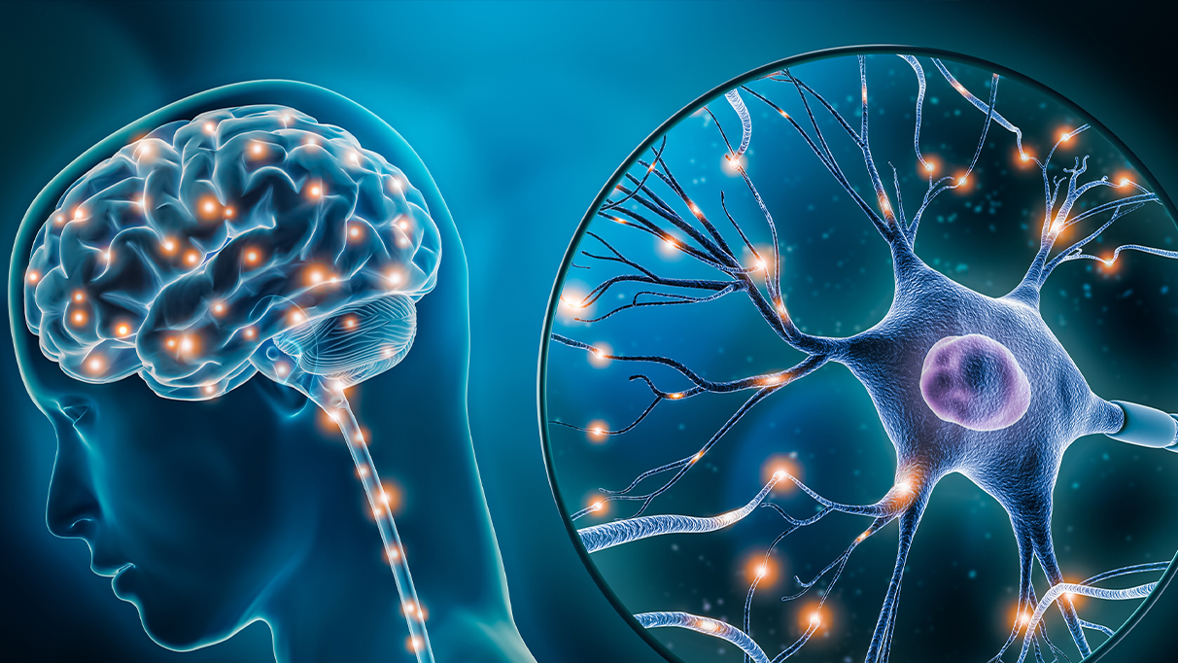
Integration of omic data in neurodegenerative disease
Khadija Paderwala

Slide 2
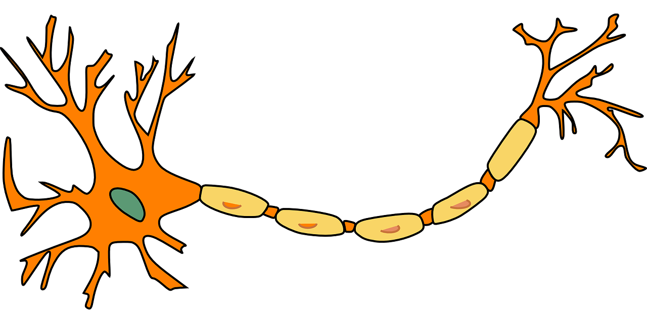
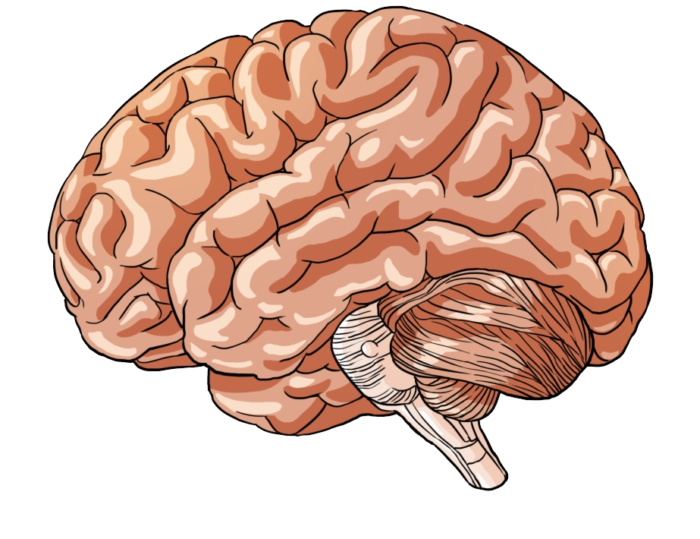



Neurodegenerative disease
Affect structure of neurons in the brain and nervous system
Gradual loss of neurons and its connections leading to cognitive decline
Typically worsen overtime, with no known cure
Treatment is based on managing symptoms and slowing progression

Slide 3
Early onset Alzheimer’s disease
Late onset Alzheimer’s disease
Alzheimer's disease
Parkinson’s disease
Amyotrophic lateral sclerosis
Dementia with Lewy bodies
Huntington's disease
Multiple sclerosis
Spinal onset
Bulbar onset
Parkinson’s disease dementia
Lewy body dementia
Clinically isolated syndrome
Relapse remitting Multiple sclerosis
Primary progressive Multiple sclerosis
Secondary progressive Multiple sclerosis

Slide 4
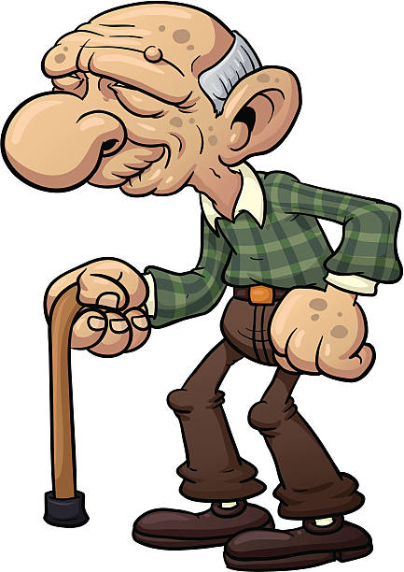
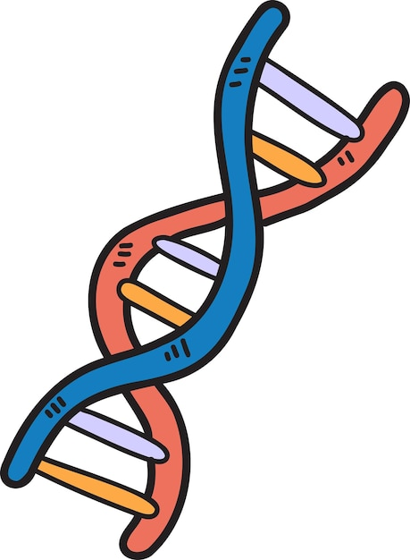

Disease overlap – Risk factors
Age – the biggest one!
Genetics
Environmental factors

Slide 5
Disease overlap- Symptoms
COGNITIVE DECLINE
IMPAIRED MOVEMENT AND CO-ORDINATION
AD
PD
DLB
HD
ALS
MS
EMOTIONAL AND BEHAVIOURAL

Slide 6
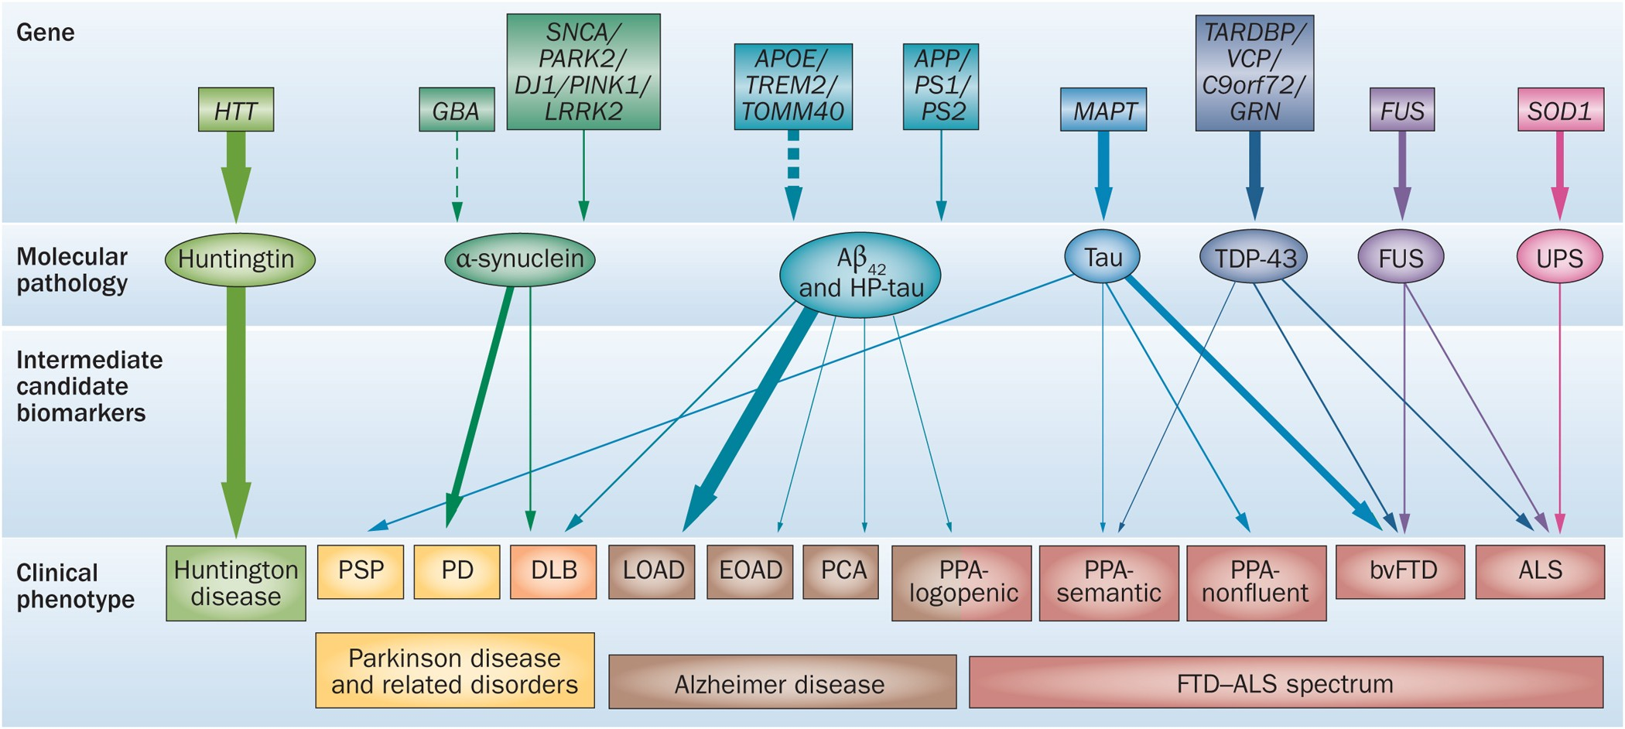
Disease overlap- Genes
SOD1

Slide 7
Disease overlap- Pathology
Inflammation
Oxidative stress
Mitochondrial dysfunction Excitotoxicity
Synaptic dysfunction
Protein misfolding and aggregation
Progressive loss of neurons
Alzheimer’s disease -> Tau
Parkinson’s disease -> a-synuclein
ALS -> UPS, FUS, TDP-43
Dementia with Lewy bodies -> a-synuclein
Huntington’s disease -> mHTT

Slide 8

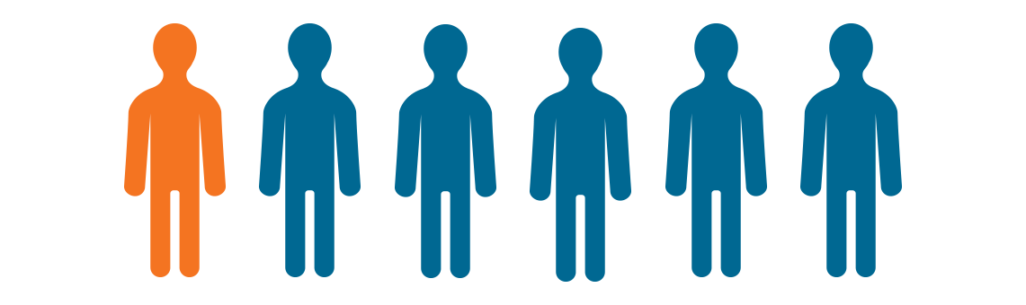

Why is this important?
Increasing cases of neurodegenerative disease as population is aging
Dementia estimated to effect 1 in 3 babies born this year
Parkinson’s disease is set to increased by 18% by 2025
Estimates of babies born this year
80 years old’s today

Slide 9
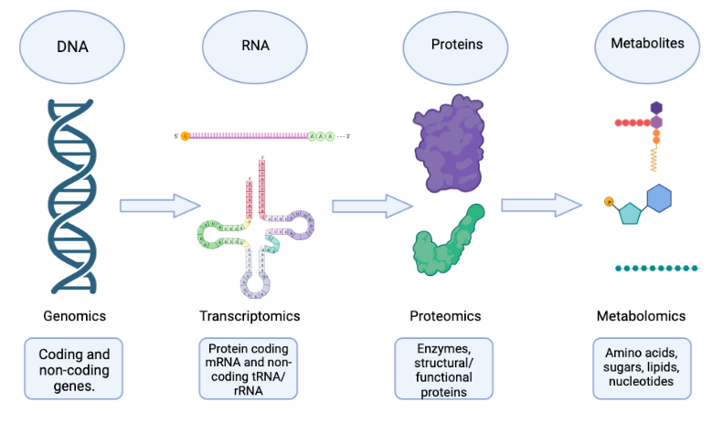
Methods

Slide 10
GWAS Metadata
Disease | Author | Participants | Ancestry | SNP’s | P-value
AD | Wightman et al | 1126563 | NR | 12688339 | P < 5x10-8
PD | Nalls et al | 1456306 | European | 17510617 | P < 5x10-8
ALS | Rheenan et al | 152268 | European | 10461755 | P < 5x10-8
DLB | Chia et al | 6618 | European | 7843595 | P < 5x10-8
HD | Moss et al | 1989 | European | 7518232 | P <10^-5
MS | IMSGC | 115803 | European | 8589719 | P < 5x10-8

Slide 11
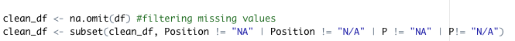
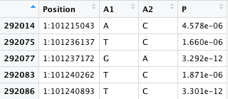
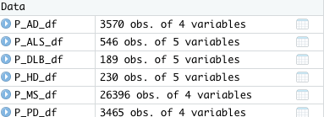
GWAS data cleaning
1- Removed columns not consistent
2- Ordered by chromosome order
3- Renamed and reordered columns
4- Removed missing values
5- Filtered by p-value

Slide 12
SNP’S
Disease | SNP’s before cleaning | SNP’s after cleaning | SNPs after filtered by p < 5x10-8
AD | 12688339 | 12688339 | 3570
PD | 17510617 | 17510617 | 3465
ALS | 10461755 | 10461755 | 546
DLB | 7843595 | 7644957 | 189
HD | 7518232 | 7518232 | 230
MS | 8589719 | 8278136 | 26396
-198,638
-311,583

Slide 13
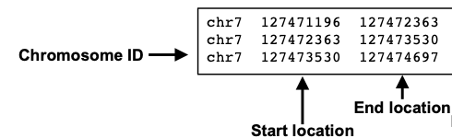
Current steps
GENE MAPPING in R:
1- Convert dataframe format into a bed file
2- Do this by adjusting the columns
3- Install Biomart, connect to the ensemble database with specific genome build
4- Output will be a gene ID and gene name column
R dataframe
.bed file
Disease | Genome build
AD | GRCh37
PD | GRCh37
ALS | GRCh37
DLB | GRCh38
HD | GRCh37
MS | GRCh37
PATHWAY ENRICHMENT in R:
1- Install EnrichR package in R
2- Get a gene list
3- Perform analysis using enrichR() function, specify GO database (broader range)
4- once outputted, visualize using barplot or heatmap
Expected output:
Enriched pathways with statistical measures like p-value and adjusted p-value for multiple testing.

Slide 14
…Next steps
Percentage similarity analysis – GOSemSim
Transcriptomic data analysis- GEO-NCBI

Slide 15


Thanks to Sarah and my peers at Morgan Lab!
QUESTIONS?

