Slide 1
CompTIA IT Fundamentals Study Guide (FC0-U61)
Chapter 9:
Security Concepts and Threats

Slide 2
Chapter 9: Security Concepts and Threats
Explain the value of data and information
Data and information as assets
Importance of investing in security
Relationship of data to creating information
Intellectual property
Trademarks
Copyright
Patents
Digital products
Data-driven business decisions
Data capture and collection
Data correlation
Meaningful reporting
Summarize confidentiality, integrity, and availability concerns
Confidentiality concerns
Snooping
Eavesdropping
Wiretapping
Social engineering
Dumpster diving
Integrity concerns
Man-in-the-middle
Replay attack
Impersonation
Unauthorized information alteration
Availability concerns
Denial of service
Power outage
Hardware failure
Destruction
Service outage

Slide 3
Chapter 9: Security Concepts and Threats (con’t)
Compare and contrast authentication, authorization, accounting, and non-repudiation concepts
Authentication
Single factor
Multifactor
Examples of factors
Password
PIN
One-time password
Software token
Hardware token
Biometrics
Specific location
Security questions
Single sign-on
Authorization
Permissions
Least privilege model
Role-based user access
User account types
Rule-based user access
Mandatory access controls
Discretionary access controls
Accounting
Logs
Tracking
Web browser history
Non-repudiation
Video
Biometrics
Signature
Receipt

Slide 4
Understanding Hackers and Motives
Stealing passwords or personal information
Gaining remote access to a server or an operating system
Logging in locally and stealing data
Changing a website’s content
Gaining access to the contents of a database (perhaps one that contains passwords or credit card information)
Surreptitiously analyzing network traffic
Installing software designed to cause harm or steal data
Creating a condition in which a computer or network no longer works well
Modifying existing software so that it no longer performs as it should or so that it secretly does harmful things in addition to its usual activity

Slide 5
The Value of Data
Data as a driver of business decisions
Intellectual property
Trademarks
Copyright
Patents
Digital products

Slide 6
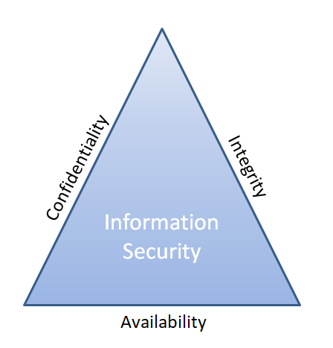
Understanding Security Threats
CIA triad

Slide 7
Confidentiality Concerns
Snooping
Eavesdropping
Wiretapping
Social Engineering
Phishing
Shoulder surfing
Dumpster diving

Slide 8
Integrity Concerns
Man-in-the-middle attack
Replay attack
Impersonation
Unauthorized information alteration

Slide 9
Availability Concerns
Denying service
Hardware concerns
Hardware damage
Hardware theft

Slide 10
Software-Based Security Threats
OS and Application Exploits
Viruses
Worms
Trojan horses
Adware
Spyware
Ransomware
Rootkits
Backdoors
Spam
Password cracking

Slide 11
Understanding Access Control
Triple A:
Authentication
Authorization
Accounting
(and non-repudiation)

Slide 12
Authentication
Validates identity
Types of authentication
Single-factor
Multifactor
One-time password
Smart card or security token
Location-specific
Biometrics
Single sign-on (SSO)

Slide 13
Authorization
Determines what users can do
Mandatory access control
Discretionary access control
Role-based access control
Rule-based access control

Slide 14
Accounting
Records who does what
OS and application logs
Web browser history

