Slide 1
EduConnect CS6P05NP
Abishek Khadka
22068940
04/09/2024

Slide 2
Introduction
Edu Connect is a creative forum website created to support an engaged college community. It gives students a stage to present their successes and experiences with creating and fascinating with chat feature and it lets teachers provide priceless study materials. By means of likes and comments on postings, the site promotes interaction, therefore developing a strong feeling of community. To further user interaction and support, Edu Connect also provides premium membership options and paid and unpaid event registration. The project aims to create a vibrant online environment where community-building, knowledge, and teamwork grow.

Slide 3
Problem Statement and Project as a Solution
Problem Statement
Ineffective Communication : College staff and student communication is often dispersed and ineffective
Limited Interaction: Students have limited opportunities outside the classroom to interact, share resources, or engage in intellectual discussions
Opposing Online Behavior: Users tend to post harsher and more opposing comments online
Purpose of OSNs: Online social networks (OSNs) like discussion forums and blogs are designed to facilitate information and opinion sharing
Fake Accounts: Various factors lead users to create fake accounts on social networking sites

Slide 4
Problem Statement and Project as a Solution
Project as a Solution
EduConnect Platform: Centralizes for instructors and students' interaction and communication.
Forum Features: Facilitates sharing of achievements, resources, and active participation through posts and comments.
eSewa Integration: Ensures secure payments for premium memberships and event registrations.
Enhanced Experience: Improves academic and social engagement, modern university life.

Slide 5
Aims and Objectives
Aims
Improve Communication: Build a platform with chat and file-sharing tools for seamless student communication.
Enhance Resource Accessibility: Enable educators to easily share resources and content with specific student groups.
Promote Collaborative Learning: Build a collaborative learning environment where students can interact with materials, share ideas, and engage with posts.

Slide 6
Aims and Objectives
Objectives
User Authentication: Implement a secure registration and login system for students, teachers, and admins.
Real-Time Chat and Resource Sharing: Develop a chat feature that allows real-time communication and resource sharing.
Post Creation and Interaction: Enable users to create and manage posts, share achievements, and provide learning resources. Integrate payment gateways for premium memberships with exclusive features.
Event Registration and Payment: Create an interface for event registration and payment processing for organizers to manage and track registrations and payments.

Slide 7
Expected Outcomes and Deliverables
Expected Outcomes:
User Authentication: A fully functional registration and login system for admins, teachers, and students.
Real-Time Chat Box: A platform enabling students to communicate and share resources in real-time.
Post and Interaction System: A feature allowing students to create posts, attach files, and interact through comments and reactions.
Admin Panel: A management interface for admins to register teachers and manage system operations.

Slide 8
Expected Outcomes and Deliverables
Deliverables:
Fully Functional Website: A complete web application with user authentication, chat, post system, group management, and payment gateway.
Source Code: Organized and documented source code for both front-end and back-end, hosted on GitHub.
Database Schema: Design and structure of the database, including SQL scripts for user data, posts, messages, and payments.
Project Documentation: Comprehensive documentation covering goals, architecture, design, implementation, and testing, including proposal, interim report, and final report.

Slide 9
Methodology
Incremental Development: Breaks the project into smaller, manageable parts.
Handles Complexity: Allows features like user authentication, chat, file sharing, and payment integration
to be developed, tested, and implemented separately.
Early Delivery: Key features, such as login and chat, can be delivered and improved based on feedback.
Flexibility: Adapts to changing user needs without disrupting the entire project.
Risk Control: Issues can be resolved within specific increments, minimizing impact on the overall system.

Slide 10
Resource Required
VS Code: Ideal for full-stack web development with support for Tailwind CSS and Prisma.
Prisma: Ensures schema alignment and type-safe searches with seamless Node.js integration.
Next.js: Enhances performance with built-in routing and API integration.
Node.js: Ideal for real-time features like chat and file sharing.
PostgreSQL: Reliable and scalable for managing user data.
MS Word: Used for preparing professional and well-structured paperwork.

Slide 11
Resource Required
TeamGantt: Tracks work and manages timelines with clear Gantt charts.
Figma: Ensures an aesthetically pleasing and user-friendly interface.
eSewa: Simplifies payment processes for premium memberships and event registration.
Postman: Efficiently tests and debugs API endpoints.
PowerPoint: Creates clear and engaging presentations.

Slide 12
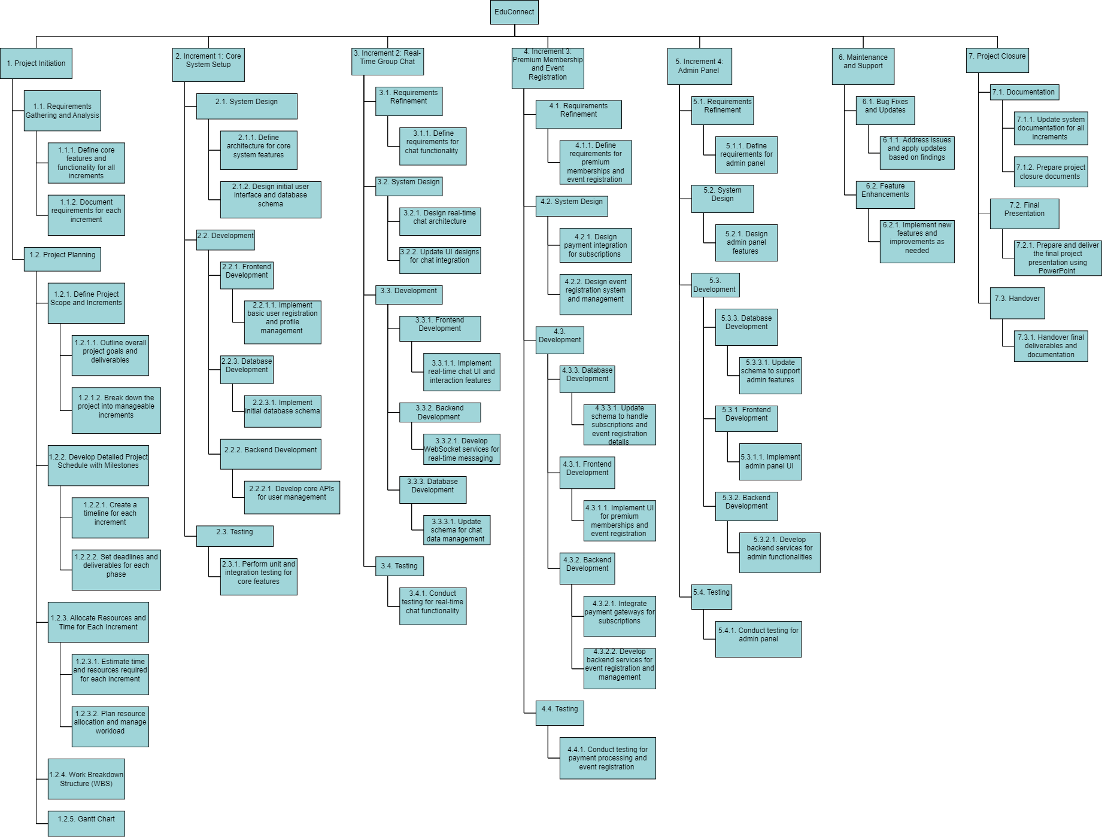
Work Breakdown Structure

Slide 13
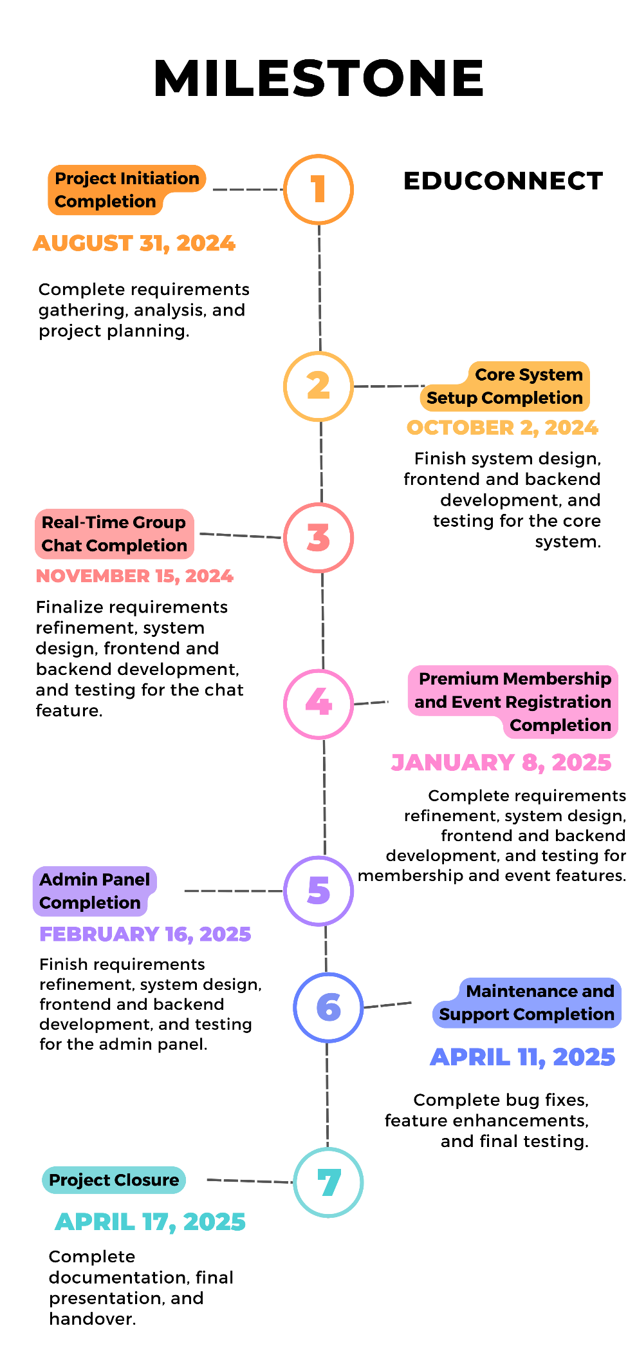
Milestone Listing
Milestone 1: Project Initiation Completion
Target Date: August 31, 2024
Milestone 2: Increment 1 - Core System Setup Completion
Target Date: October 2, 2024
Milestone 3: Increment 2 - Real-Time Group Chat Completion
Target Date: November 15, 2024
Milestone 4: Increment 3 - Premium Membership and Event Registration Completion
Target Date: January 8, 2025
Milestone 5: Increment 4 - Admin Panel Completion
Target Date: February 16, 2025
Milestone 6: Maintenance and Support Completion
Target Date: April 11, 2025
Milestone 7: Project Closure
Target Date: April 17, 2025

Slide 14
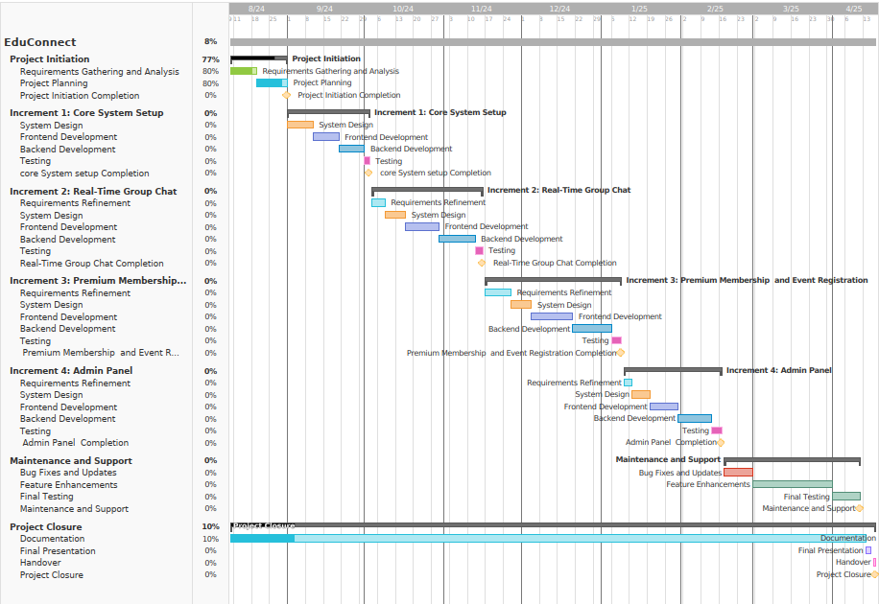
Gantt Chart

Slide 15
Thankyou!

