Slide 1
Fire Away Pizza
Sean Bodine, Nick Lewis, Sajan Khadka

Slide 2
Objectives
Limit use of large blocks to text to draw users eye towards the images.
Keep a consistent theme across all pages.
Minimal links that redirect to external documents of text, the user shouldn’t need to leave page for more information.
Be sure website is easy to navigate with large links and clear font.

Slide 3
Positive Feedback
Collected both positive and constructive feedback from three distinct users.
Consistently found the website to be easy-to-use, simple to navigate.
Comments were also made on the cleanliness and “modern look” of the pages.
Users found the choice of font and color pleasing to the eye, good contrast between text and background.

Slide 4
Suggestive Feedback
User 1 noted that banner images for some pages were large and distracting.
User 2 recommended that we remove extra space from our original Jobs page.
User 3 suggested that the spacing on the About Us page could be increased to pull text away from edges of screen.

Slide 5
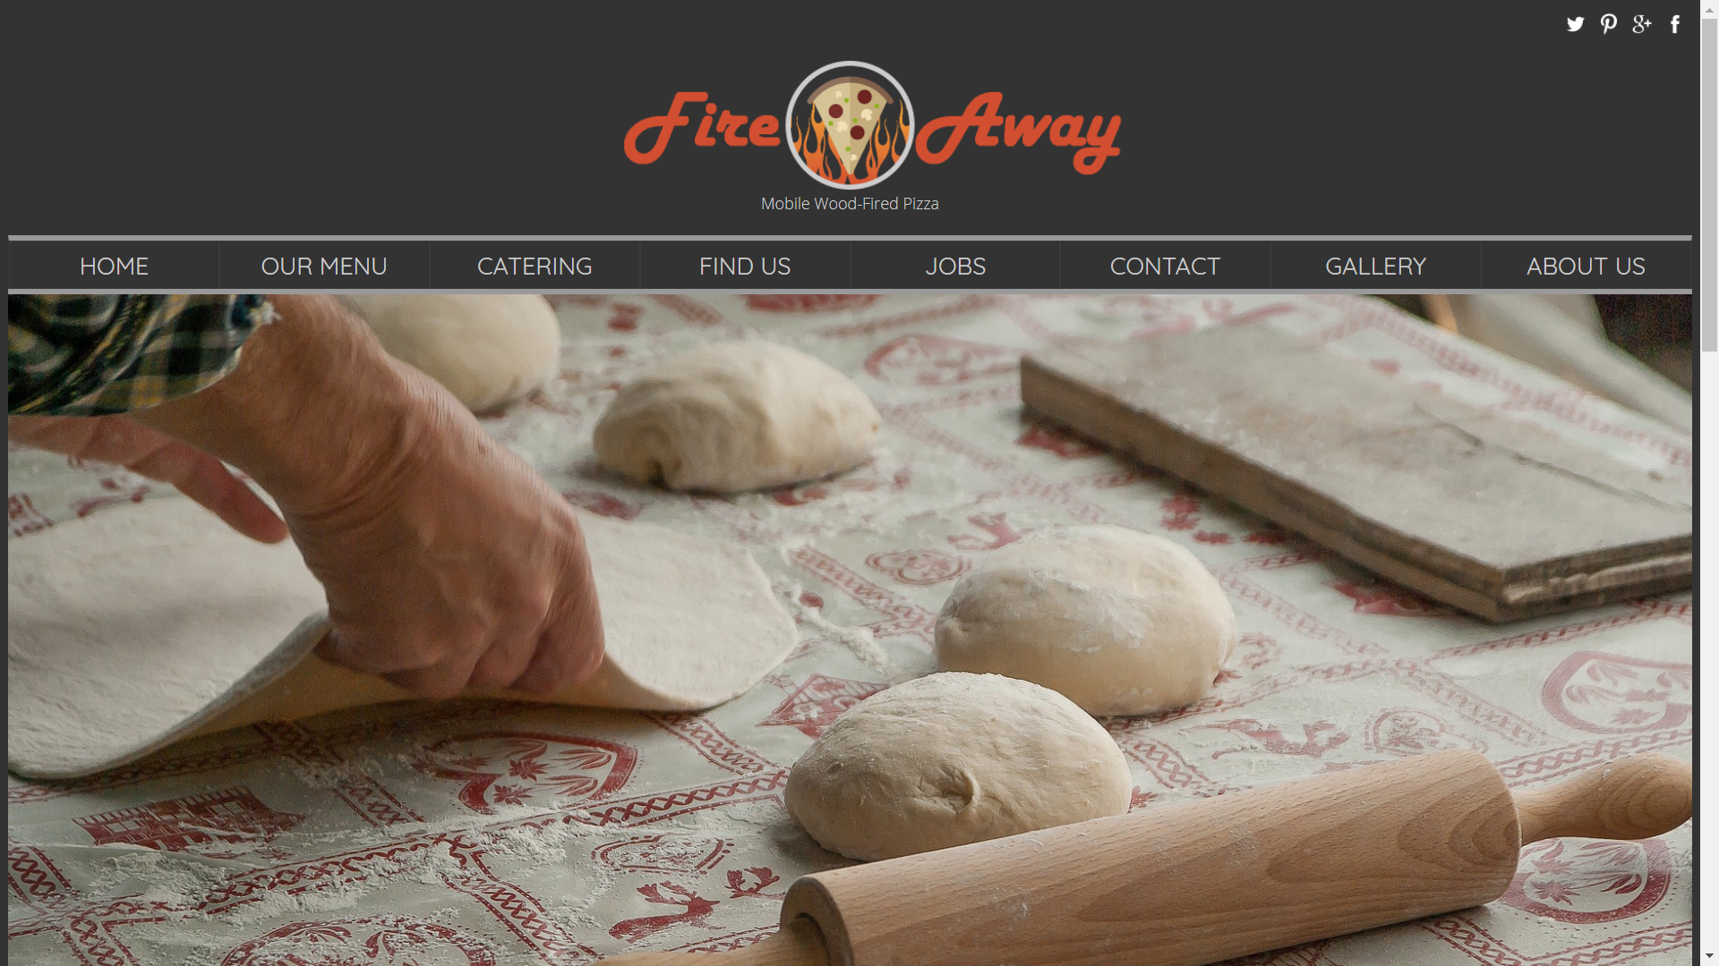
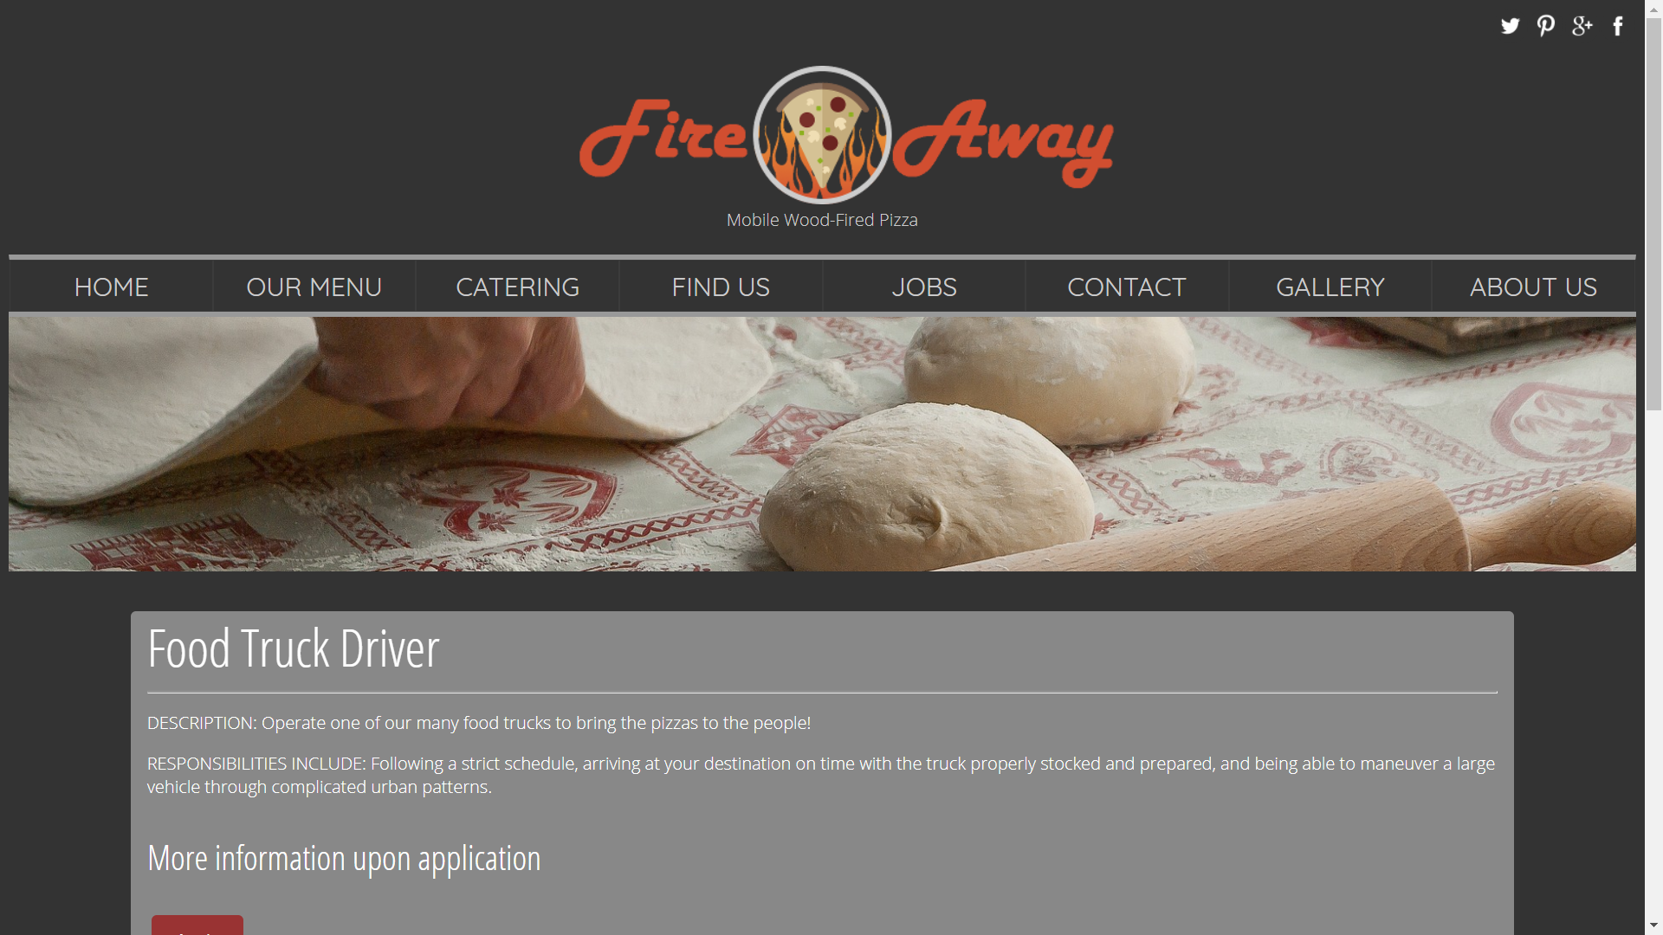
Changes

Slide 6
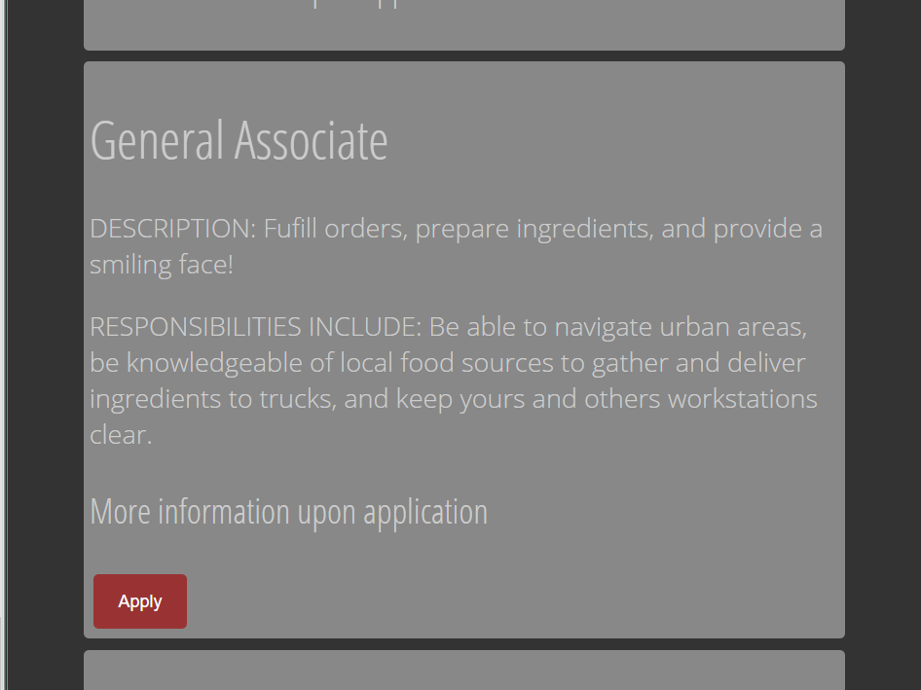
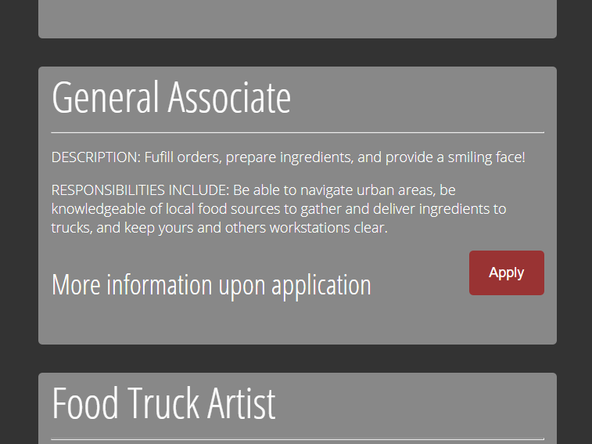
Changes

Slide 7
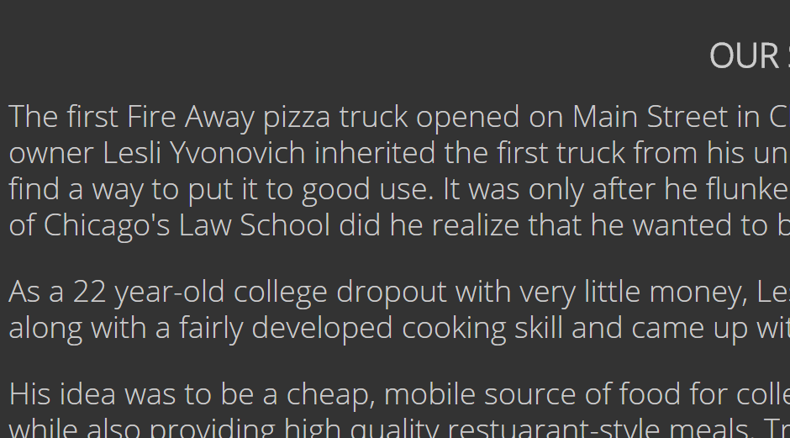
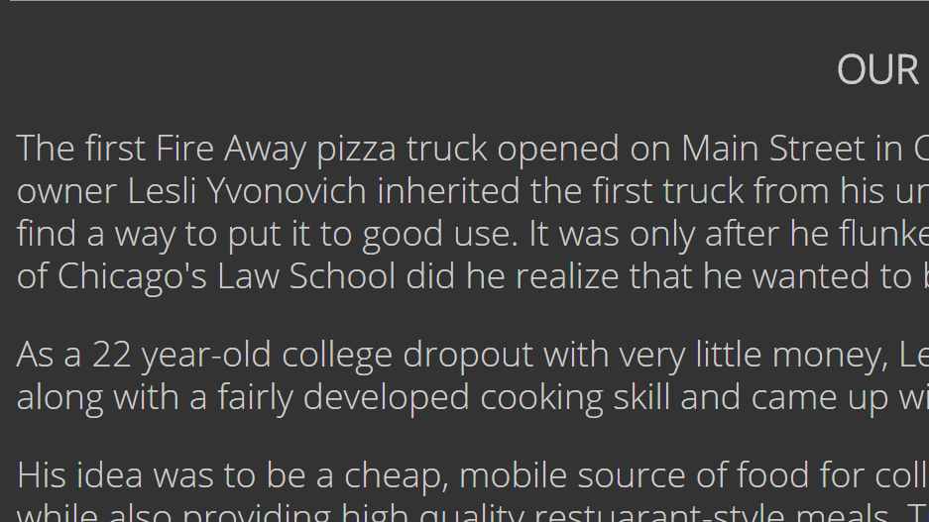
Changes

