Slide 1
Smart Contract in Real Estate
Group 1
Duaa, Yasmeen, Abdullah, Lama, Bashayer, Khadija

Slide 2
What is your use case? Are there any pain points currently for this use case?
Use Case : Real Estate
Pain Areas in the Real Estate:
- Regulatory Structure
- Licensed Platforms
- Security

Slide 3
Why does this use case need smart contracts? What are the benefits vs. a centralized solution? Any drawbacks of using/implementing blockchain?
Benefits
- Inclusion
Drawbacks
- Infrastructure
- Transparent Records
- Compliance
- Difficult to change
- Possibility of loopholes

Slide 4
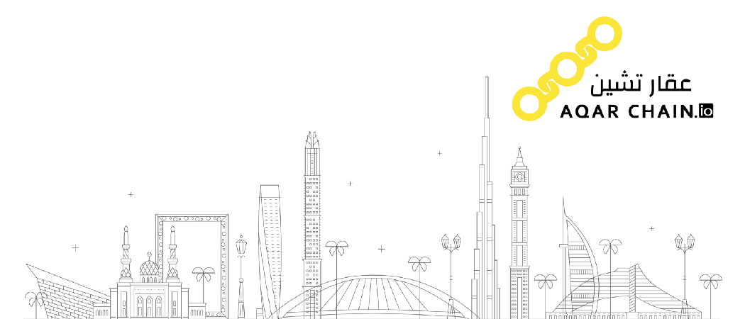
Are there any implementations using a blockchain solution for this use case (enterprise apps, apps, DAOs, etc)? What is the adoption like (users, volume, funding, press coverage, etc)?
Aqarchain.io
Adoption:
Users, Volume ,Funding

Slide 5
Any Question?

