Slide 1

wordoku enhancements
Siva R Jasthi
Computer Science and Cyber Security
Metropolitan State University

Slide 2
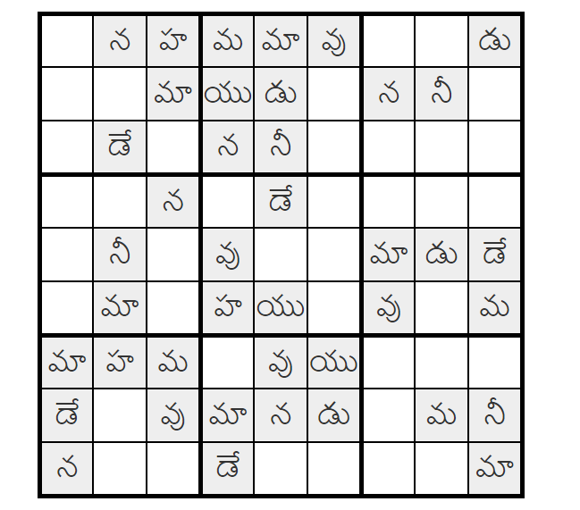
Background
Wordoku is a puzzle generation application that generates SUDOKU like puzzles based on the characters.
It works for English and Telugu (an Indian language).
It now only works for 9 letter words.
GITHUB Link:
www.github.com/sjasthi/wordoku

Slide 3
Enhancements (Phase 2)
[1] Refactor the application so that it makes use of indic-wp application (www.github.com/sjasthi/indic-wp)
[2] (FP2) As of now it works only for 2x2, 3x3 and 4x4 words.
Enhance the application so that it works for 8 letter words (4x2 or 2 *4) and 6 letter words (2x3 or 3x2).
[3] (FP1 done) Provide database persistence support for saving the words.
[4] Provide the database persistence support for saving the puzzles and solutions.
[5] (FP3 and FP4) Provide support for the mass-generation of the puzzles.
[6] (FP1 done) Provide support for the list view of the words
[7] Provide support for the web-services using which sudoku puzzles can be created.
[8] Provide support for playing the puzzles online.

Slide 4
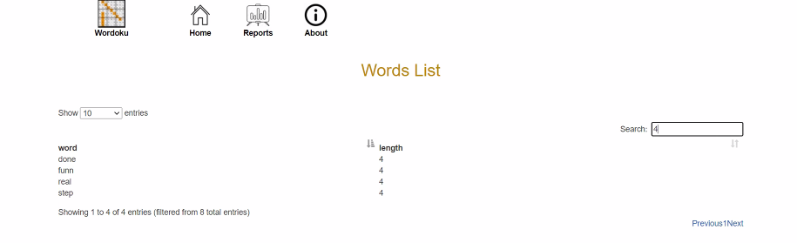
FP2: Add three buttons called “Modify”, Delete “Generate”
Modify, Delete, Generate
Modify: It helps the users to EDIT the word
DELETE: It deletes the word from the database and control comes back to the list
Generate: It takes the control to the existing page.
http://localhost/wordoku/wordokuPuzzle.php?size=4x4&hidecount=70&difficulty=Expert&word=123456789abcdefg&showsolution=true

Slide 5
FP2: Test Cases
Modify : clicking it will show the Modify form using which the users can update the word (and the length)
OR
Enable in-cell editing of the work and length (In that case, you do NOT have to implement the MODIFY action)
2. DELETE: the word will be deleted. And the control comes back to the list.
And the word deleted will disappear from the list.
And you show a confirmation message on the top of the table saying “word xyz is deleted”

Slide 6
FP2: Test Cases
3. Generate: Clicking on it will take the control to the current “Generate” page.
http://localhost/wordoku/wordokuPuzzle.php?size=4x4&hidecount=70&difficulty=Expert&word=123456789abcdefg&showsolution=true
Size : easy to figure out; 4 (2x2) 9 (3x3) 16 (4x4)
6 (2x3) 8 (2x4)
Any other length is NOT supported
Difficulty: simply ignore
Word: = selected word
hidecount = 50% of the cells will be hidden by default
showSolution = true

Slide 7
FP2: Test Cases
How do you determine the “hidecount”?
Size : easy to figure out; 4 (2x2) 9 (3x3) 16 (4x4)
6 (2x3) 8 (2x4)
Any other length is NOT supported
hidecount = 50% of the cells will be hidden by default
4 (2x2) = 16 cells > hidecount = 8
9 (3x3) = 81 cells > hidecount = 40
16 (4x4) = 256 cells > hidecount = 128
6 (2x3) = 36 cells > hidecount = 18
8 (2x4) = 64 cells > hidecount = 32

Slide 8
Different examples of how the URL gets generated?
http://localhost/wordoku/wordokuPuzzle.php?size=4x4&hidecount=128&word=123456789abcdefg&showsolution=true
http://localhost/wordoku/wordokuPuzzle.php?size=3x3&hidecount=40&word=character&showsolution=true
Biggest Challenge in FP2: Making the puzzle work for lengths 6 and 8.

Slide 9
FP3 and FP4: Mass Generation (HTML)
Batch
Batch ICON: https://static.thenounproject.com/png/2204540-200.png

Slide 10
FP3 and FP4: Mass Generation (HTML)
When Batch action is Clicked, we will show a form to the user.
Select the range of words:
Starting ID: [ 101 ]
Ending ID: [ 200 ]
HTML
Power Point

Slide 11
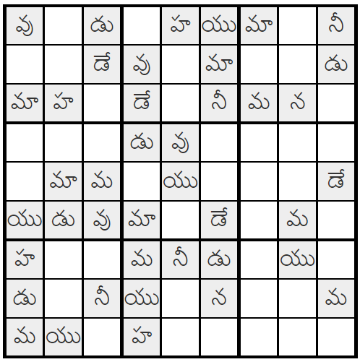
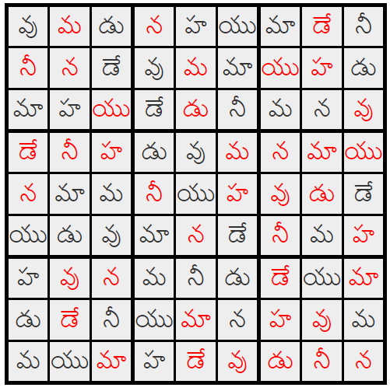
FP3 and FP4: Mass Generation (HTML)
మా న వు డే మ హ నీ యు డు
character

Slide 12
FP3 and FP4: Mass Generation (Power Point)
A Power Point presentation will be created.
wordoku_timestamp.pptx
Test Case: If my range is from 1 to 50, you will produce a PPTX
With 100 slides
If my range is 10, your PPTx will have 20 slides.

Slide 13

Any questions?

