Slide 1

wordoku enhancements
Siva R Jasthi
Computer Science and Cyber Security
Metropolitan State University

Slide 2
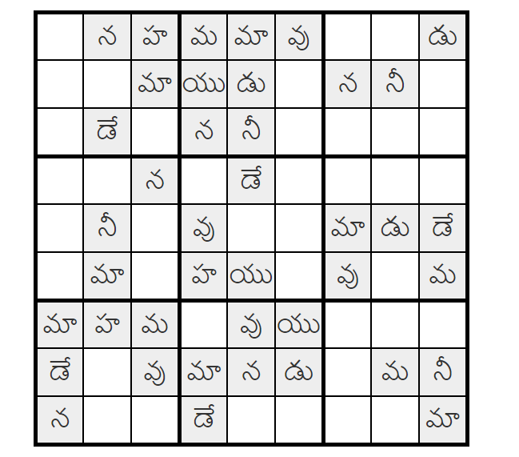
Background
Wordoku is a puzzle generation application that generates SUDOKU like puzzles based on the characters.
It works for English and Telugu (an Indian language).
It now only works for 9 letter words.
GITHUB Link:
www.github.com/sjasthi/wordoku

Slide 3
Enhancements (Phase 2)
[1] Refactor the application so that it makes use of indic-wp application (www.github.com/sjasthi/indic-wp)
[2] As of now it works only for 2x2, 3x3 and 4x4 words.
Enhance the application so that it works for 8 letter words (4x2 or 2 *4) and 6 letter words (2x3 or 3x2).
[3] Provide database persistence support for saving the words.
[4] Provide the database persistence support for saving the puzzles and solutions.
[5] Provide support for the mass-generation of the puzzles.
[6] Provide support for the list view of the words
[7] Provide support for the web-servies using which sudoku puzzles can be created.
[8] Provide support for playing the puzzles online.

Slide 4

Any questions?

