Slide 1


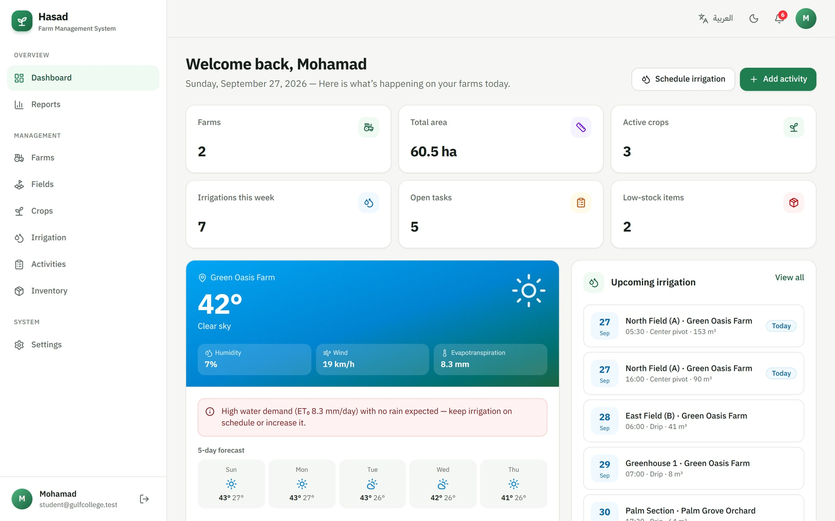



GRADUATION PROJECT · 2026
Hasad
Agricultural Farm Management System
A bilingual web-based information system that helps farmers manage crop data, irrigation schedules and farm activities efficiently.
Prepared by Mohamad
Supervisor Dr. ArunKumar Sivaraman
Institution Gulf College
Notes:
Good morning. My graduation project is Hasad — an Agricultural Farm Management System. It is a web portal that helps farmers manage crop data, irrigation schedules and farm activities from one place, in Arabic or English, on any device. It was supervised by Dr. ArunKumar Sivaraman.

Slide 2
AGENDA
01
Problem & objectives
What we will cover
Why farms need a digital information system
02
Proposed solution
The modules of the Hasad platform
03
Architecture & technologies
Next.js, Supabase and external services
04
Database design & security
Tables, relationships and Row Level Security
05
System demonstration
Dashboard, crops, irrigation, activities, reports
06
Testing
How the system was verified
07
Conclusion & future work
Results and next steps
Notes:
This is the outline of the presentation: I will start with the problem and objectives, then the proposed solution and its architecture, the database design and security, a demonstration of the system, how it was tested, and finally the conclusion and future work.

Slide 3




PROBLEM STATEMENT
Many farms are still managed on paper and memory
Scattered crop records
70%
Planting dates, varieties and yields live in notebooks or memory — easy to lose and impossible to analyse.
Inefficient irrigation
Watering without a schedule or weather awareness wastes water and can stress crops.
of global freshwater withdrawals are used by agriculture.
Untracked field work
Source: FAO, AQUASTAT
Tasks, workers and costs are not followed up, so deadlines like fertilizing or spraying are missed.
Every litre of irrigation that is planned instead of guessed matters.
No decision support
Without reports, farmers cannot compare costs, water use and yields across seasons.
Hasad · Farm Management System
3
Notes:
Agriculture uses about seventy percent of the world's freshwater, yet many farms are still managed with notebooks and memory. That causes four problems: crop records get lost, irrigation is done without planning or weather awareness, field tasks and their costs are not tracked, and there is no data to support decisions.

Slide 4






PROJECT OBJECTIVES
What the system sets out to achieve
01
02
03
Centralise farm data
Plan irrigation
Organise field work
Store farms, fields and crops in one secure cloud database.
Schedule and track irrigation per field, guided by live weather.
Manage activities with type, priority, status, assignee and cost.
04
05
06
Control inventory
Support decisions
Be accessible
Track seeds, fertilizers and pesticides with low-stock alerts.
Dashboards and reports on costs, water use and yield.
Bilingual Arabic/English portal that works on phones and desktops.
Hasad · Farm Management System
4
Notes:
The project has six objectives: centralise the farm data, plan irrigation with the help of live weather, organise field work, control inventory, support decisions with reports, and make the system accessible in Arabic and English on any device.

Slide 5



PROPOSED SOLUTION
Hasad: one platform, six integrated modules
Farms & fields
Crop management
Location, area, soil type and irrigation system for every plot.
Varieties, planting & harvest dates, growth progress and yield.
Irrigation scheduling
Farm activities
Date, time, duration, water volume, method — mark done in one click.
Plowing, fertilizing, spraying, harvesting — with priorities and costs.
Inventory
Reports & weather
Seeds, fertilizers, pesticides and fuel with stock value and alerts.
Charts, CSV export, printing, live forecast and ET₀ irrigation advice.
Hasad · Farm Management System
5
Notes:
The solution is Hasad, which means 'harvest' in Arabic. It is made of six integrated modules: farms and fields, crops, irrigation scheduling, farm activities, inventory, and reports with live weather. All modules share the same data, so for example an irrigation schedule is always linked to a specific field of a specific farm.

Slide 6


SYSTEM ARCHITECTURE
Three tiers connected over HTTPS
Client
Application server
Supabase cloud
Any browser — desktop or phone
Next.js 16 (App Router)
Backend as a service
Responsive UI (React 19)
HTTPS
Proxy: session refresh & route guard
REST API
Authentication (email & password)
Arabic RTL / English LTR
Server Components: data fetching
PostgreSQL database
Light & dark themes
Server Actions: validated writes (Zod)
Row Level Security policies
Open-Meteo API
The browser never talks to the database directly: every read and write passes through the server, which checks the session and validates the input first.
Forecast · ET₀ · geocoding
Hasad · Farm Management System
6
Notes:
The system follows a three-tier architecture. The client is any browser. The application server is built with Next.js 16: a proxy refreshes the user session and protects the dashboard routes, server components fetch data, and server actions perform validated writes. The data tier is Supabase, which provides authentication and a PostgreSQL database protected by Row Level Security. Weather data comes from the free Open-Meteo API.

Slide 7



TECHNOLOGIES
Modern, open and production-ready tools
Frontend
Backend & data
Libraries
Services
Next.js 16 & React 19
TypeScript
Tailwind CSS 4
IBM Plex Arabic font
Supabase Auth
PostgreSQL 15+
Row Level Security
Server Actions
Recharts (charts)
Zod (validation)
Lucide (icons)
Sonner, next-themes
Open-Meteo forecast
Geocoding API
Vercel (hosting)
GitHub
Why this stack: server-side rendering keeps phones fast, TypeScript catches errors early, and Supabase gives a secure database with authentication without managing servers.
Hasad · Farm Management System
7
Notes:
For the frontend I used Next.js 16 with React 19 and TypeScript, styled with Tailwind CSS. The backend is Supabase, which gives us authentication and a PostgreSQL database with Row Level Security. Charts use Recharts, and every input is validated with Zod on the server. Weather and geocoding come from Open-Meteo.

Slide 8
DATABASE DESIGN
Seven related tables in PostgreSQL
profiles
farms
fields
crops
1 : N
1 : N
id (PK = user)
full_name, phone
currency
id (PK)
user_id (FK)
name, location
area, latitude, longitude
id (PK)
farm_id (FK)
soil_type
irrigation_type, status
field_id (FK)
planting / harvest dates
status, yield
1 : N
irrigation_schedules
1 : N
field_id (FK)
date, start_time
water_amount, method
inventory_items
activities
user_id (FK)
category, quantity
min_quantity, unit_cost
farm_id (FK)
field_id (FK, optional)
type, priority, status
cost, assigned_to
Every table has a user_id linked to Supabase Auth, so each farmer only sees their own data.
Deleting a farm cascades to its fields, crops, irrigation and activities.
CHECK constraints keep statuses and units valid (e.g. harvest after planting).
Hasad · Farm Management System
8
Notes:
The database has seven tables. A farm has many fields; each field has many crops and many irrigation schedules; activities belong to a farm and optionally to a field. Profiles and inventory items belong to the user. Every table carries a user id, deletions cascade from a farm to all its child records, and check constraints keep the data valid — for example, the expected harvest date cannot be before the planting date.

Slide 9





SECURITY
Protection at every layer
Authentication
Sign-up, sign-in, email confirmation and password reset with Supabase Auth.
Row Level Security policy (SQL)
alter table farms
enable row level security;
create policy "Owner can select"
on farms for select
to authenticated
using (auth.uid() = user_id);
-- same rule for insert, update
-- and delete on all 7 tables
Row Level Security
PostgreSQL policies allow each user to read and change only their own rows.
Ownership triggers
A record can only be linked to a farm or field owned by the same user.
Server-side validation
Every form is validated with Zod on the server before reaching the database.
Protected routes
The proxy refreshes sessions and redirects visitors away from /dashboard.
Hasad · Farm Management System
9
Notes:
Security is applied at every layer. Users authenticate with Supabase Auth. In the database, Row Level Security policies make sure each user can only read and change their own rows — even if someone called the API directly. Triggers prevent linking a record to another user's farm, every form is validated on the server with Zod, and the proxy protects the dashboard routes.

Slide 10


SYSTEM DEMONSTRATION
Dashboard — the farm at a glance
Key figures
Farms, area, active crops, irrigations this week, open tasks, low stock.
Live weather
Forecast, humidity, wind and ET₀ for the farm's location.
Irrigation advice
Automatic recommendation: postpone, keep or reduce watering.
What's next
Upcoming irrigation, tasks and crops close to harvest.
Notifications
Alerts for today's irrigation, overdue tasks and low stock.
Hasad · Farm Management System
10
Notes:
After signing in, the farmer lands on the dashboard. The top cards summarise the farm. The weather card shows the live forecast for the farm's coordinates and an automatic irrigation recommendation. On the right are the upcoming irrigations, and further down the cost and water charts and the upcoming tasks. The bell icon shows alerts.

Slide 11
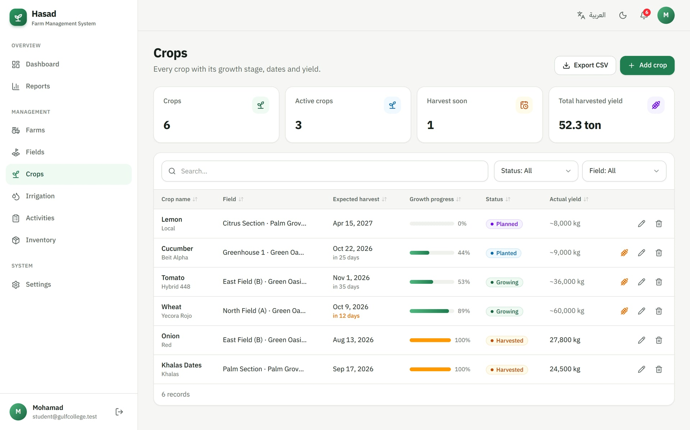



SYSTEM DEMONSTRATION
Crop management
Full crop record
Crop, variety, field, planting and expected harvest dates.
Growth progress
Calculated automatically from the planting and harvest dates.
Harvest countdown
Crops within 14 days of harvest are highlighted.
One-click harvest
Mark a crop as harvested; the date is recorded.
Search & export
Search, filter, sort, paginate and export to CSV.
Hasad · Farm Management System
11
Notes:
The crops page lists every crop with its field, dates, growth progress and yield. Progress is calculated automatically from the planting and expected harvest dates, and crops that are close to harvest are highlighted. Like every list in the system, it supports search, filters, sorting and CSV export.

Slide 12
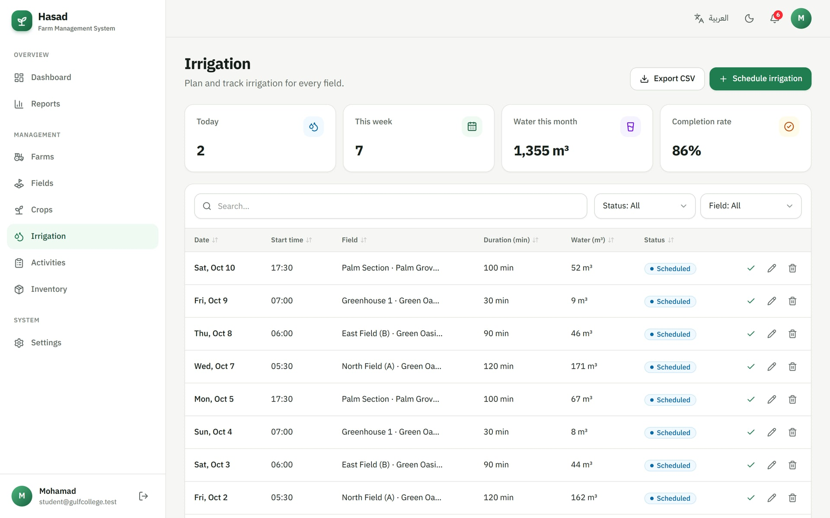
SYSTEM DEMONSTRATION
Irrigation scheduling & smart advice
Weather-based recommendation
Uses FAO reference evapotranspiration (ET₀) and rain forecast from Open-Meteo.
Rain ≥ 5 mm in 48 h
Postpone irrigation
ET₀ ≥ 6 mm/day
High demand — keep or increase
ET₀ 3 – 6 mm/day
Moderate — normal plan
ET₀ < 3 mm/day
Low demand — reduce
Hasad · Farm Management System
12
Notes:
The irrigation page schedules watering per field with the date, start time, duration, water volume and method, and the farmer can mark it as done with one click. The system also gives a recommendation based on the FAO reference evapotranspiration and the rain forecast: if rain of five millimetres or more is expected, it suggests postponing; if evapotranspiration is high, it suggests keeping or increasing irrigation; and if it is low, reducing it.

Slide 13
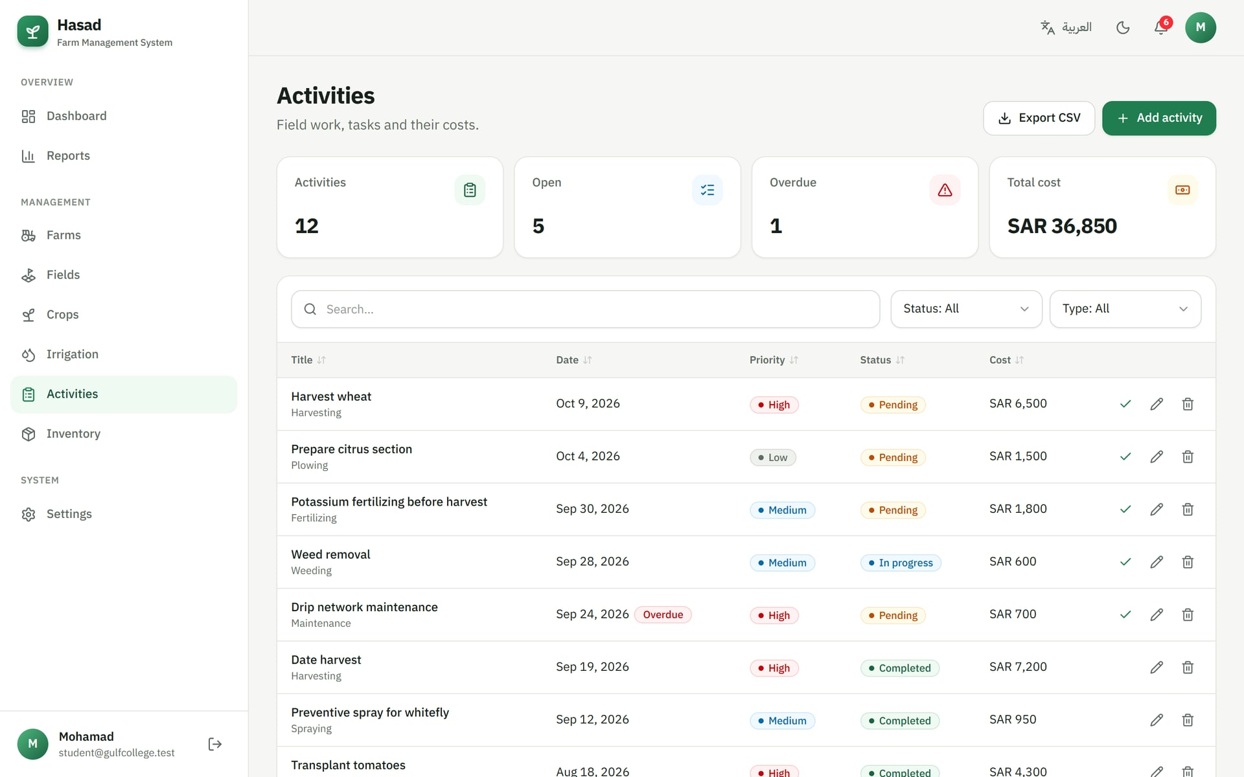
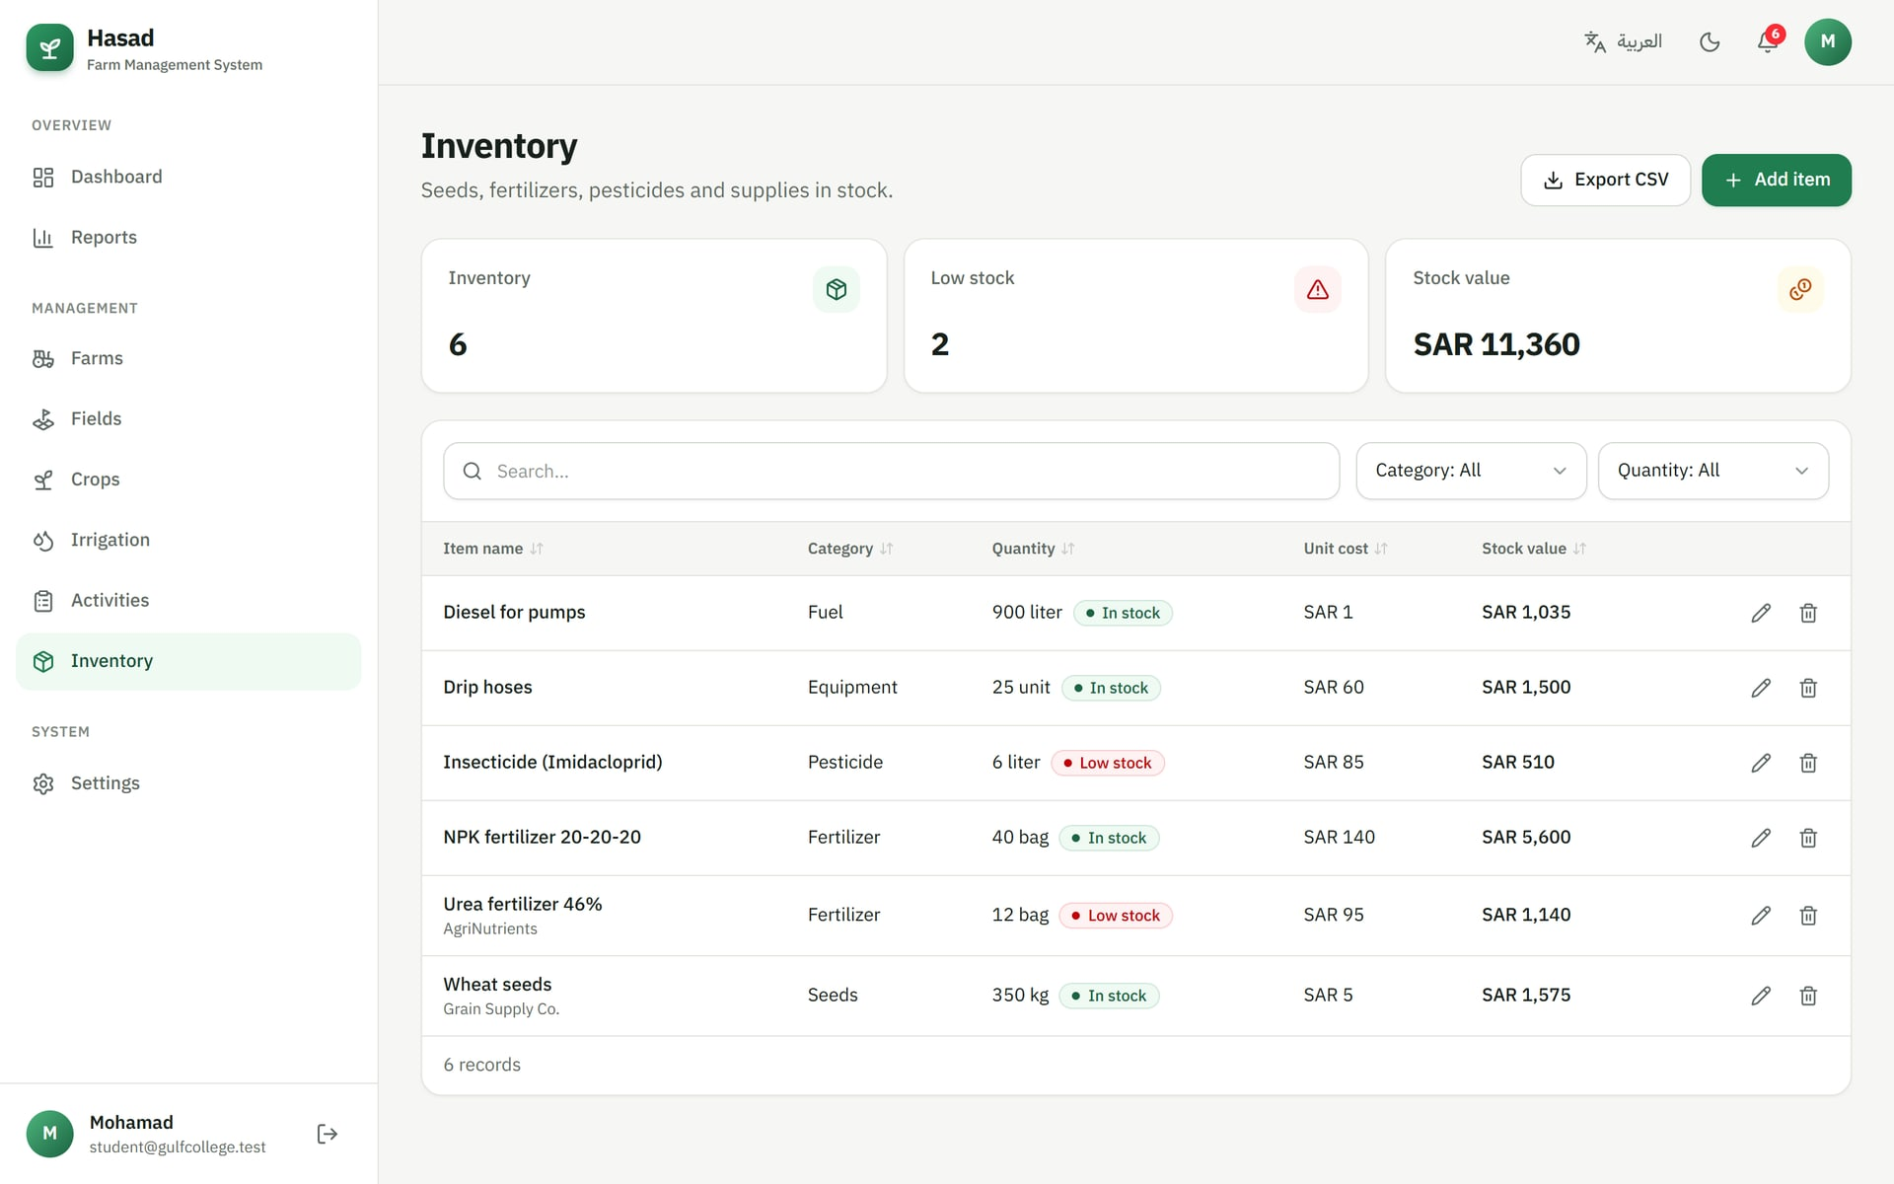
SYSTEM DEMONSTRATION
Farm activities & inventory
Activities
Inventory
Plan plowing, fertilizing, spraying and harvesting with priority, status, assignee and cost. Overdue tasks are flagged automatically.
Quantities, units, minimum levels and unit cost. Items at or below the minimum are marked 'Low stock' and raise an alert.
Hasad · Farm Management System
13
Notes:
The activities page organises field work: each task has a type, farm and field, date, priority, status, assignee and cost, and overdue tasks are flagged. The inventory page tracks supplies with their minimum levels; anything at or below the minimum is marked as low stock and appears in the notifications.

Slide 14
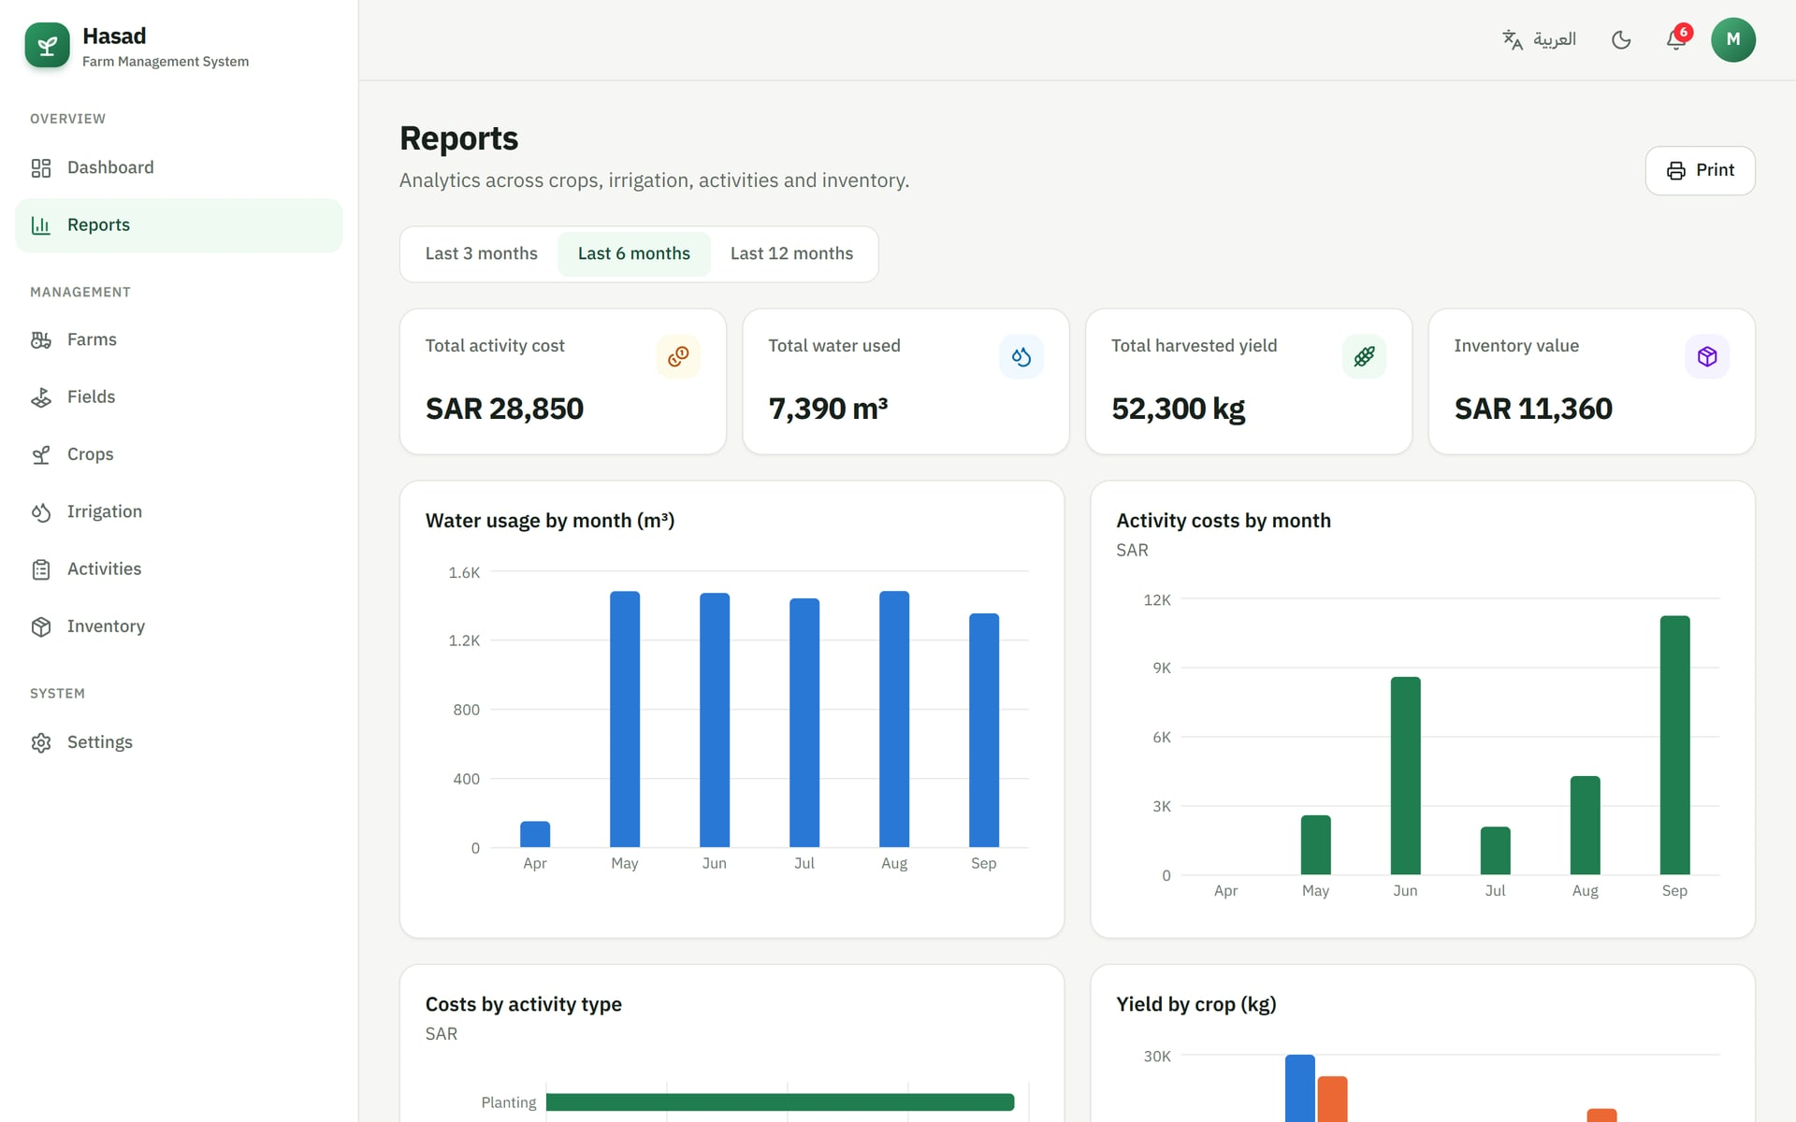

SYSTEM DEMONSTRATION
Reports & analytics
Summary figures
Total cost, water used, harvested yield and inventory value.
Time ranges
Switch between the last 3, 6 or 12 months.
Water & cost trends
Monthly water usage and activity costs.
Yield analysis
Expected vs. actual yield for each harvested crop.
Print & export
Print-ready layout and CSV export from every list.
Hasad · Farm Management System
14
Notes:
The reports page gives the farmer decision support: total costs, water use, harvested yield and inventory value for the selected period, monthly trends for water and costs, costs by activity type, and expected versus actual yield. The page is print-ready, and every list can be exported to CSV.

Slide 15
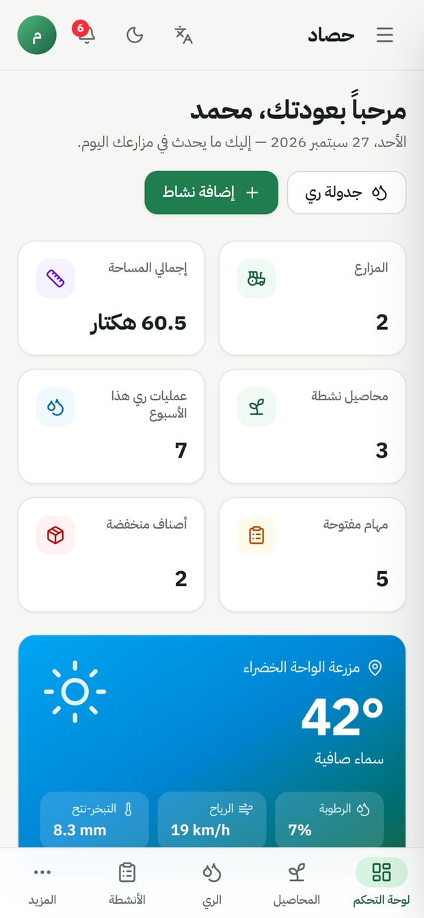
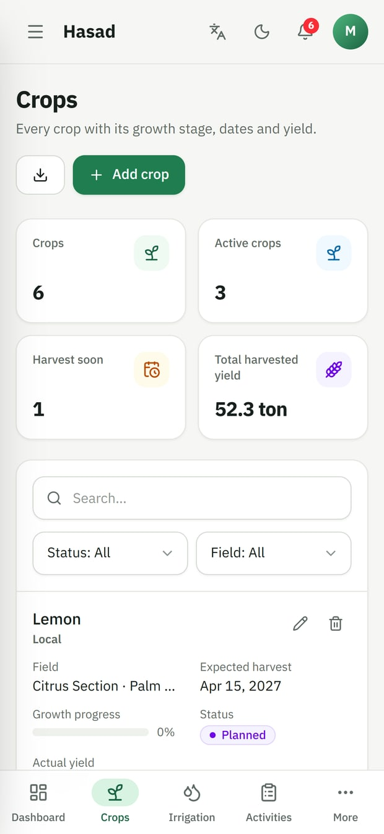
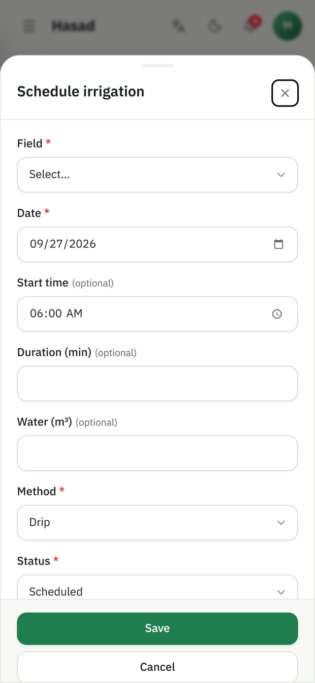



USER EXPERIENCE
Bilingual, mobile-first and accessible
Arabic & English
Switch language instantly; Arabic uses full right-to-left layout.
Designed for phones
Bottom navigation, card lists and bottom-sheet forms on small screens.
Light & dark themes
Follows the device setting or the user's choice.
Helpful by default
Demo data in one click, empty states, confirmations and toasts.
Arabic · dashboard
English · crops
Add form (bottom sheet)
Hasad · Farm Management System
15
Notes:
The system is bilingual: the user can switch between Arabic and English at any time, and Arabic uses a complete right-to-left layout. It was designed mobile-first — on phones there is a bottom navigation bar, lists become cards, and forms open as bottom sheets. It also supports light and dark themes.

Slide 16
TESTING & VALIDATION
How the system was verified
13 / 13
0
17
database checks passed
type & lint errors
routes built
RLS isolation, ownership, constraints, cascades
TypeScript strict mode + ESLint
Successful optimised production build
End-to-end scenarios tested in the browser
Registration, sign-in, wrong password, sign-out
Protected routes redirect to sign-in
Load demo data and view the dashboard
Create, edit, delete and 'mark as done'
Search, filters, sorting and CSV export
Language, theme and currency switching
Phone layouts: navigation, cards, forms
Live weather and irrigation advice
Hasad · Farm Management System
16
Notes:
To verify the system, I ran thirteen automated checks on the database design, covering Row Level Security isolation between users, the ownership triggers, the check constraints and the cascade deletes — all passed. The code compiles in TypeScript strict mode with no lint errors, and the production build succeeds. I also tested the main scenarios end to end in the browser, on desktop and phone sizes, in both languages.

Slide 17





CONCLUSION & FUTURE WORK
From paper notebooks to a digital farm
Future work
Conclusion
IoT soil-moisture sensors
Hasad centralises farms, fields, crops, irrigation, activities and inventory in one secure platform.
Weather-aware advice helps farmers use irrigation water more efficiently.
Dashboards and reports turn daily records into decisions.
Works in Arabic and English on phones and computers.
Trigger irrigation automatically from field sensors.
SMS & WhatsApp reminders
Notify farmers of irrigation and overdue tasks.
Team roles
Accounts for workers and engineers with permissions.
AI crop-disease detection
Diagnose diseases from a photo of the leaf.
Offline mode (PWA)
Keep working in fields without internet.
Hasad · Farm Management System
17
Notes:
To conclude, Hasad replaces paper records with one secure platform for the whole farm, helps save irrigation water with weather-aware advice, and turns daily records into reports that support decisions. In the future, the system can be extended with IoT soil-moisture sensors, SMS or WhatsApp reminders, team roles, AI-based crop-disease detection, and an offline mode for use in the field.

Slide 18
Thank you
Questions & discussion
Hasad — Agricultural Farm Management System
Mohamad · Supervisor: Dr. ArunKumar Sivaraman · Gulf College
Notes:
Thank you for listening. I am happy to answer your questions, and I can also show a live demonstration of the system.

