Slide 1
Karamoja Crop Yield & Population Analysis
A Tableau Data Visualization Project examining food security, production disparities, and population distribution across districts in the Karamoja region of Uganda.

Slide 2
Introduction
This analysis evaluates population distribution and crop production across districts in the Karamoja region of Uganda one of the country's most food insecure zones to inform targeted planning and resource allocation.
Identify Disparities
Evaluate Availability
Support Planning
Reveal production imbalances across districts
Assess food per capita at the district level
Enable evidence-based regional interventions

Slide 3
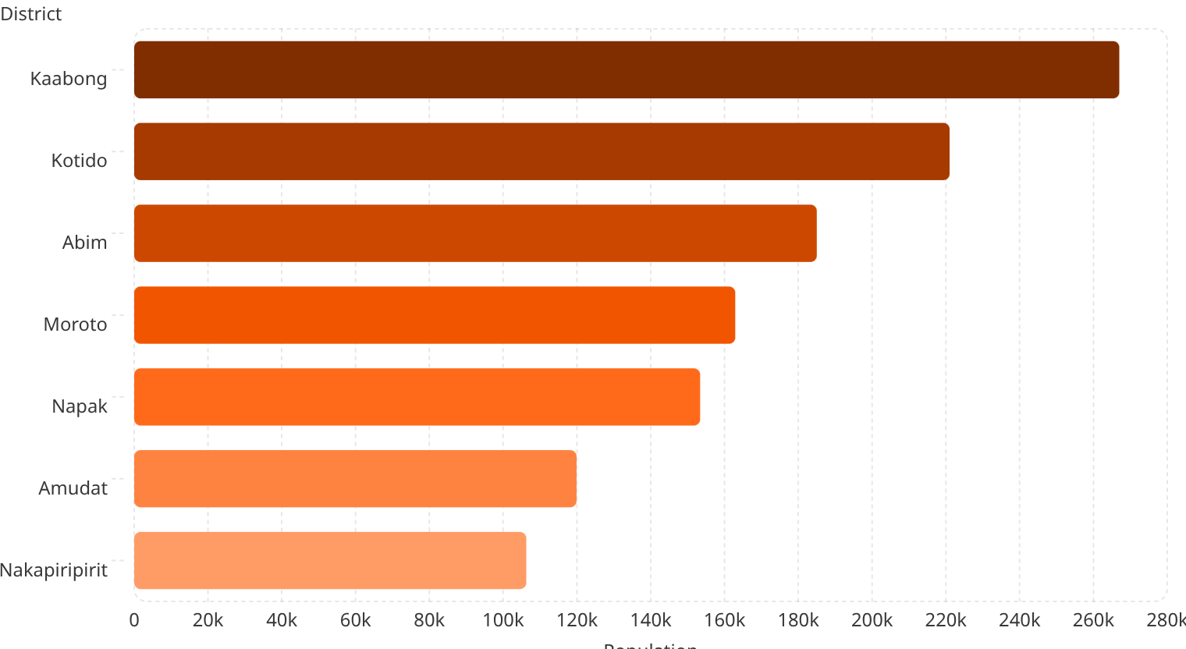
Population by District
Population is distributed unevenly across Karamoja's districts a critical driver of food demand. Districts are ranked from highest to lowest population, revealing where pressure on food systems is most acute.

Slide 4
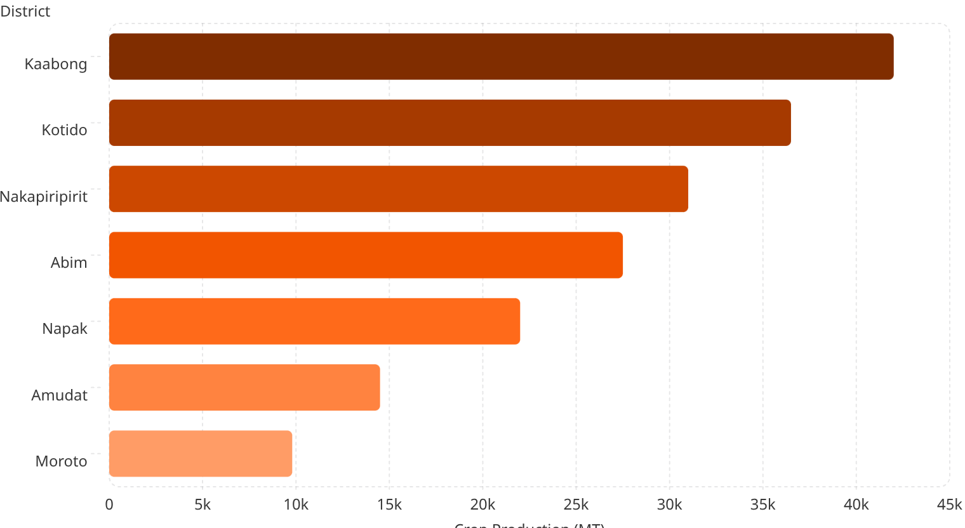
Total Crop Production by District
Crop production levels vary sharply across Karamoja. Districts are ranked in descending order of output,
exposing deep agricultural imbalances that do not always mirror population size.

Slide 5
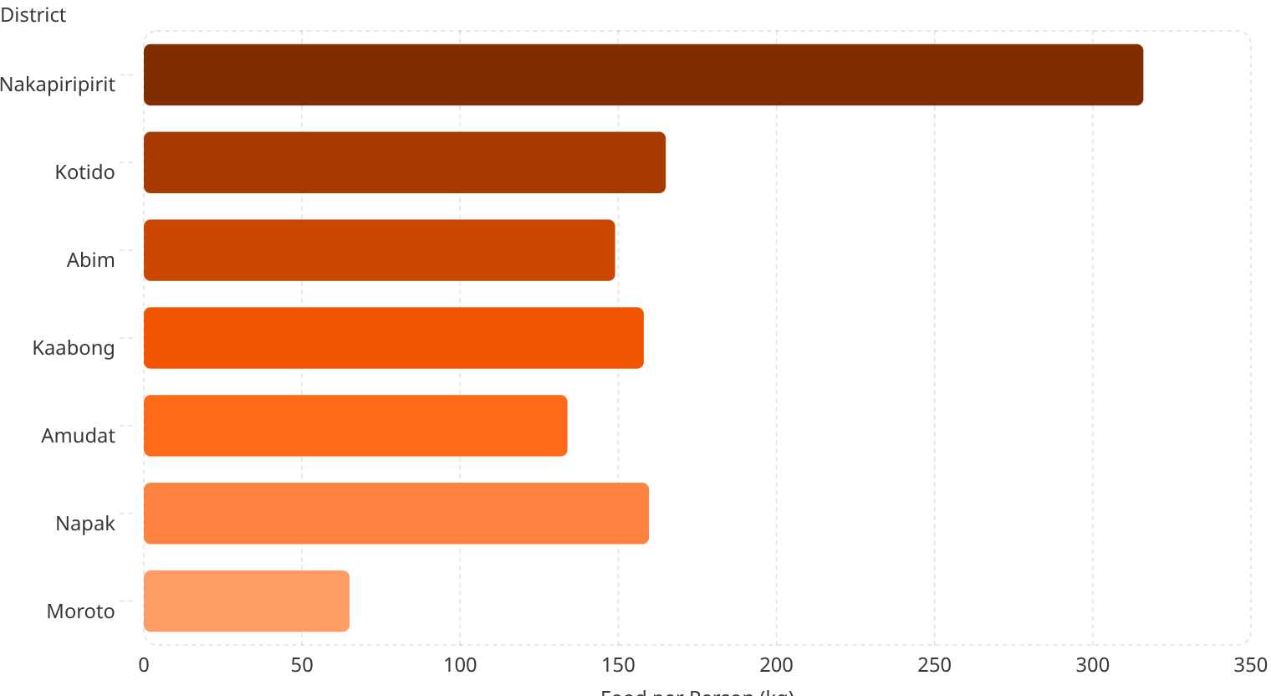
Food per Person by District
Food per capita crop production divided by population is the most direct indicator of food security risk. Districts are ranked in descending order, with lower values signaling the greatest vulnerability.

Slide 6
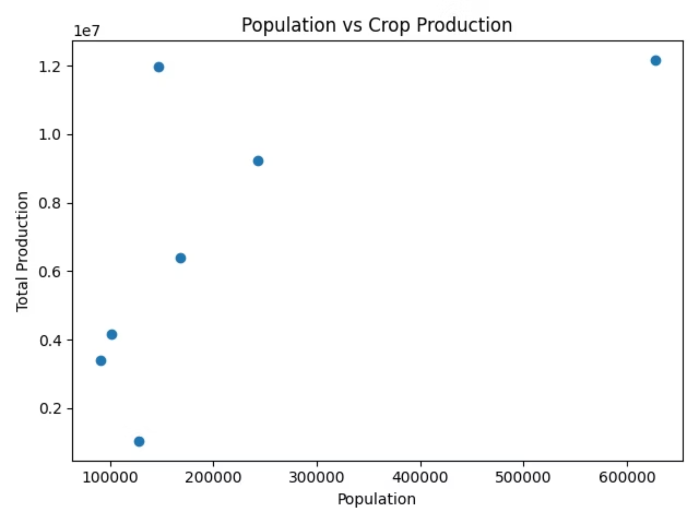
Population vs. Crop Production
This scatter plot tests whether larger populations correspond with greater crop output. The relationship reveals which districts punch above their weight — and which are critically underproducing relative to their population size.

Slide 7
Key Findings
Kaabong — Highest Population & Production
Leads the region in both total population and absolute crop output, making it the agricultural anchor of Karamoja.
Nakapiripirit — Highest Food per Person
Despite a smaller population, this district achieves the best food availability ratio — a model worth examining for scalable practices.
Moroto — Lowest Production & Food per Person
Critically underperforms on both production volume and per capita availability, representing the region's most acute food security risk.

Slide 8
Recommendations
Evidence from this analysis points to four priority action areas for policymakers and development planners in Karamoja.
1
2
Strengthen Agricultural Investment
Improve Irrigation Systems
Prioritize funding for inputs, extension services, and farmer training, especially in low-output districts.
Karamoja's arid climate demands climate-resilient water infrastructure to reduce reliance on erratic rainfall.
3
4
Target Low-Performing Districts
Address Subcounty Disparities
Direct interventions to Moroto and Amudat, where production deficits relative to population are most severe.
District-level data masks local variation — subcounty analysis is essential for precise, equitable resource distribution.

Slide 9
Conclusion
This analysis reveals a critical mismatch between population pressure and agricultural productivity across Karamoja's districts. High population does not guarantee food security; per capita production is the decisive metric.
Tableau visualizations enabled rapid, district level comparisons, reinforcing the value of data driven tools for regional food security planning. Sustained investment guided by this evidence can meaningfully reduce vulnerability across Karamoja.
Disparities Are Structural
Data Drives Action
Production gaps reflect deep infrastructure and investment deficits
Visualization tools translate complexity into actionable policy insights
Targeted Response Needed
Blanket approaches will fail — precision planning by district is essential

