Slide 1

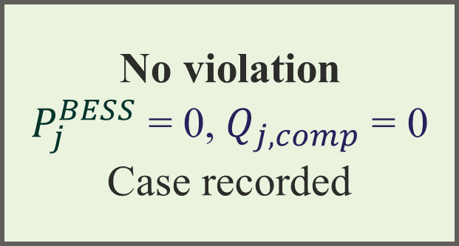

Input data
IEEE 33-bus, P1/P2 EVCS placements, D1–D4 demand levels, BESS parameters
No-BESS BFS power-flow screening
Compute $V_{min}$, $L_{max}$, $P_{loss}$, HCM — all placement–demand cases
Voltage or thermal violation?
No
No violation
$P_{j}^{BESS}$ = 0,$Q_{j, comp}$ = 0
Case recorded
Yes
B4-P active-power bisection sizing
$P_{j}^{BESS}$​= [$P_{j}^{EVCS}$​− $P_{j}^{allow}$​$]^{+}$
Post-B4-P BFS validation
Validate $V_{min}$, $L_{max}$, $P_{loss}$, HCM, identify residual voltage limitation
$V_{min}$< $V_{thr}$ after B4-P?
No
Thermal + Voltage
B4-P sufficient; proceed
Yes
B4-PQ residual-voltage recovery
Find ${\text{γ}}_{min}$ and compute $Q_{j, comp}$= ${\text{γ}}_{min}Q_{j}^{EVCS}$
Off-peak recharge deliverability
Evaluate ${\text{R(T}}_{w})$ for ${\text{T}}_{w}$ = 7 h / 10 h / 12 h
Planning outputs
$P_{j}^{BESS}, Q_{j, comp}{, \text{R(T}}_{w})$

Slide 2




Prescribed Feeder Stress State
IEEE 33-bus, P1/P2 EVCS placements, D1–D4 demand levels
No-storage BFS Assessment
$V_{min}$, $L_{max}$, $P_{loss}$
Branch overload?
No
No Branch-Loading Violation
$P_{j}^{BESS}$ = 0
Yes
Centralized Branch-Loading Relief
$$L_{l}≤100\%$$
Post-Allocation BFS
$V_{min}≥$ 0.95 pu.?
Unity-Power-Factor Correction
$$Q_{PFC}$$
Additional Local Capacitive Support
$$Q_{add∗}$$
No
Yes
Conditional PCS Capability
if the BESS PCS supplies the local $Q_{add,j}$
Storage-Energy Envelope
$T_{peak}=$ 2 / 4 / 6 h
Synchronous Recharge
post-stress state, common recharge duration$T_{rec}^{∗}$
What constraint binds?
Active-rating/efficiency-limited
Voltage-limited
Five Adequacy Requirements
$$P_{BL}^{BESS},(Q_{PFC},Q_{add}^{∗}),S^{PCS,req}, (E_{AC,out},E_{batt,wd}, E_{nom}),T_{rec}^{∗}$$

