Slide 1

Computer Vision Lab
Five-class classification of heart sound

Slide 2
Outline
Short term Fourier Transform
Phonocardiograms (PCG)
Different categories of heart signals
Audio/Sound classification using deep learning.
Various CNNs models to achieve best scores

Slide 3
References
The slides are prepared from the following two major sources:
EDA-Audio Classification Project Using Deep Learning
https://www.youtube.com/watch?v=mHPpCXqQd7Y&t=207s
Classification of Heart Sound Signal Using Multiple Features https://www.mdpi.com/2076-3417/8/12/2344
Datasets used:
Yaseen Khan Dataset (500 files)
New Yaseen Khan Dataset (1000 files)

Slide 4
Motivation
Phonocardiography allows the detection of subaudible sounds and murmurs and makes a permanent record of these events.In contrast, the stethoscope cannot always detect all such sounds or murmurs and provides no record of their occurrence. Converting heart sounds into digital signals,data that can be analyzed using advanced signal processing and machine learning techniques and can be used to study and diagnose heart disorders.

Slide 5
PCG ?
Digital recording of heart sound with the help of electronic stethoscope is called PCG.
A phonocardiogram (or PCG) is a plot of high-fidelity recording of the sounds and murmurs made by the heart with the help of the machine called the phonocardiograph.
This PCG signal carries useful information about the functionality and status of the heart and hence several signal processing and machine learning technique can be applied to study and diagnose heart disorders.
Based on PCG signal, the heart sound signal can be classified to two main categories i.e., normal and abnormal categories. We’ll look about them in coming slides.

Slide 6
Librosa
Librosa is a python package for music and audio analysis. It provides the building blocks necessary to create music information retrieval systems.
Work with the sound signals, read signals, find the sample rate and number of channels .
Why librosa?
We get a Normalized data value between -1 to 1 for our audio signal
Converge the signals and produce a mono signal waves
Get a static sample rate

Slide 7
Short-term Fourier transform
Short-Term Fourier Transform (STFT) is a technique used to analyze the frequency content of a signal over time. It breaks down a signal into its constituent frequencies and their respective amplitudes at different time intervals.
STFT considers a short-duration segment of a longer signal and computes its Fourier transform.
In practice, it is common to evaluate the STFT at only a finite set of equally-spaced points along the frequency axis
STFT can be utilized as a preprocessing step for tasks involving audio or time-series data. By transforming raw input signals into their frequency representations, CNNs can effectively learn patterns and features across both time and frequency domains.

Slide 8
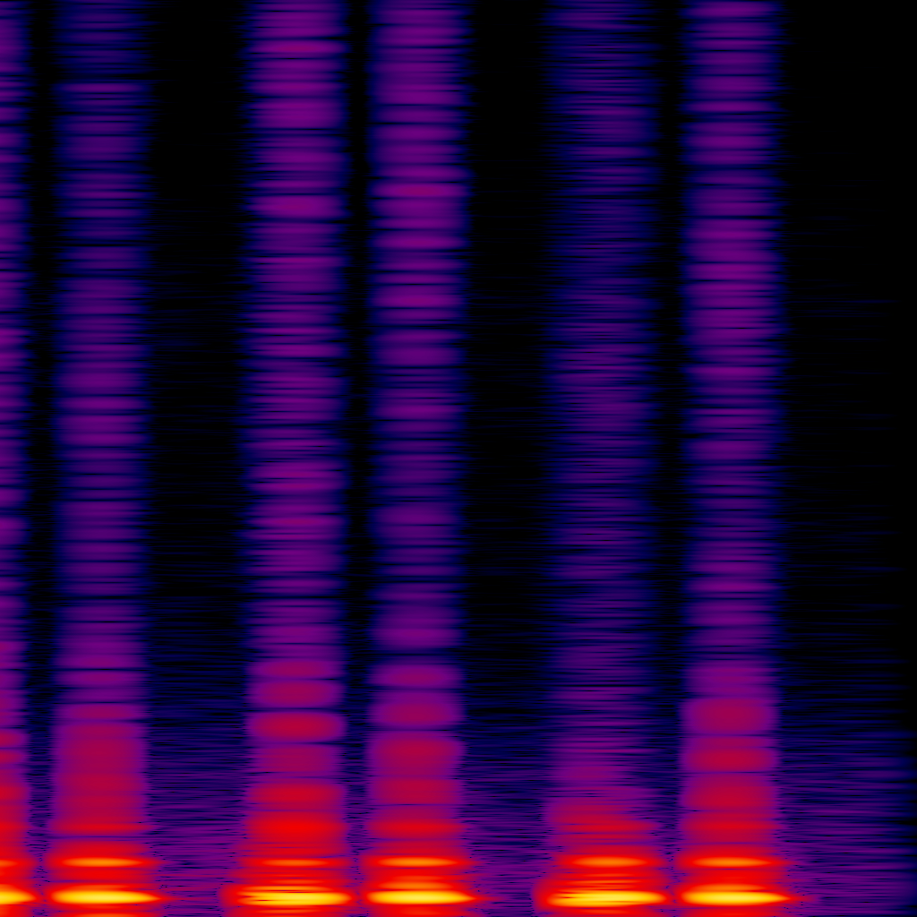
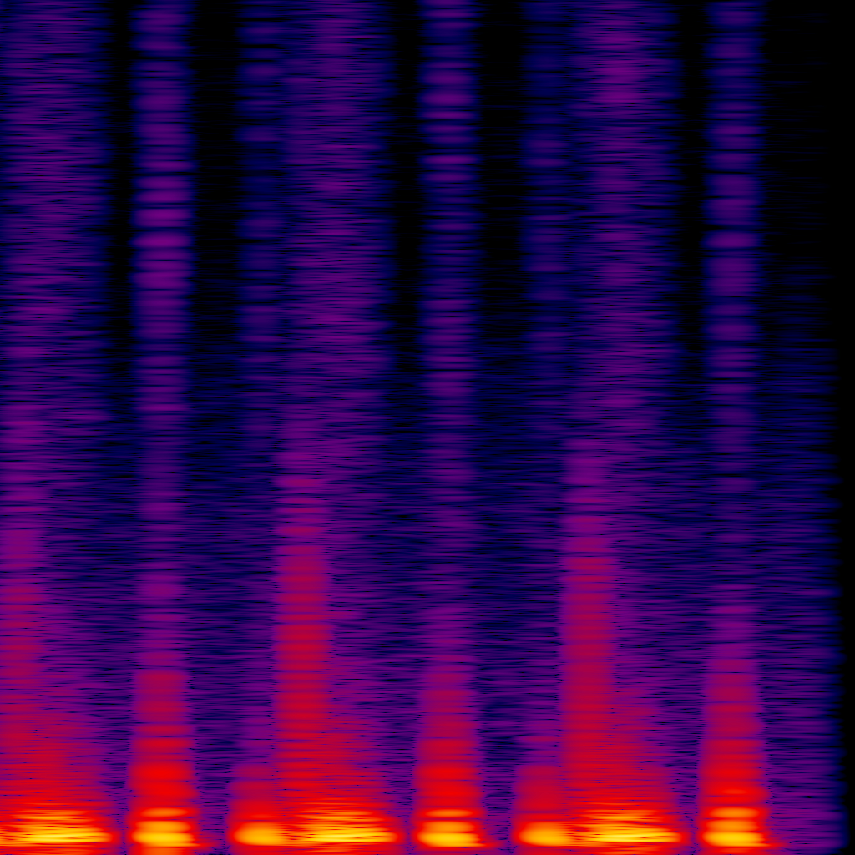
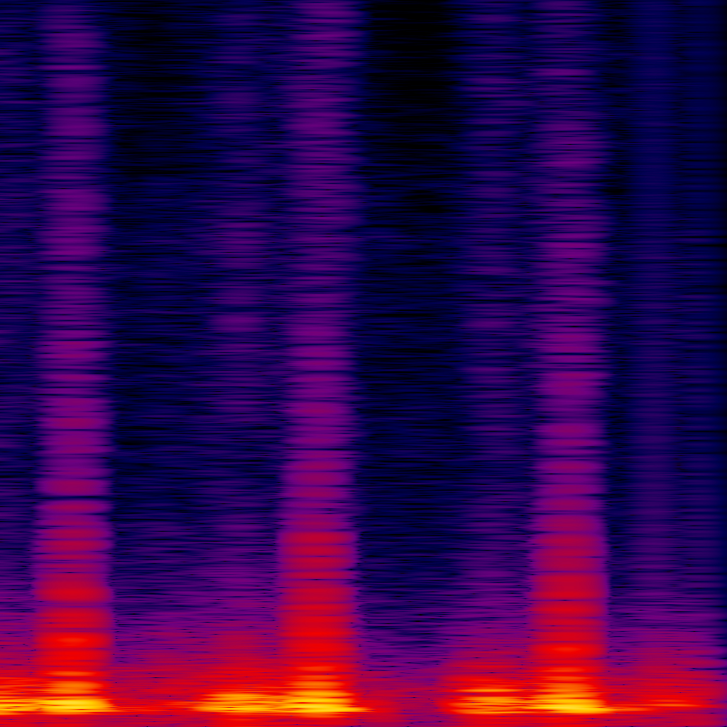
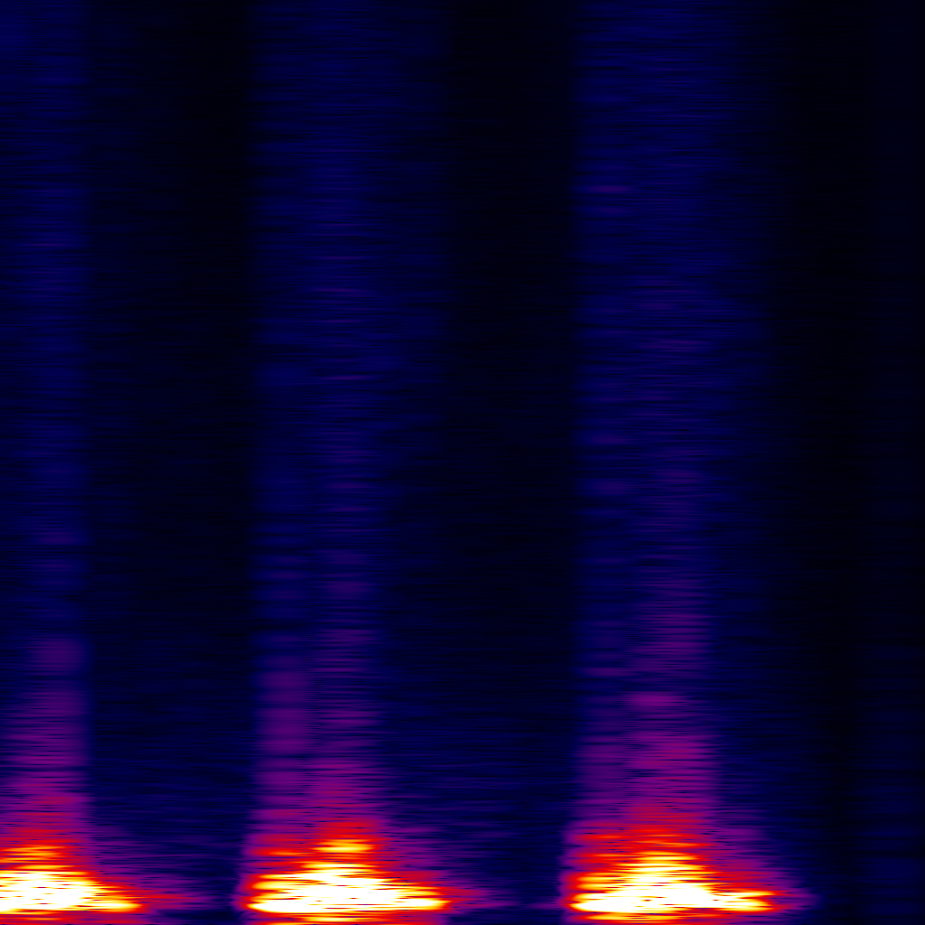
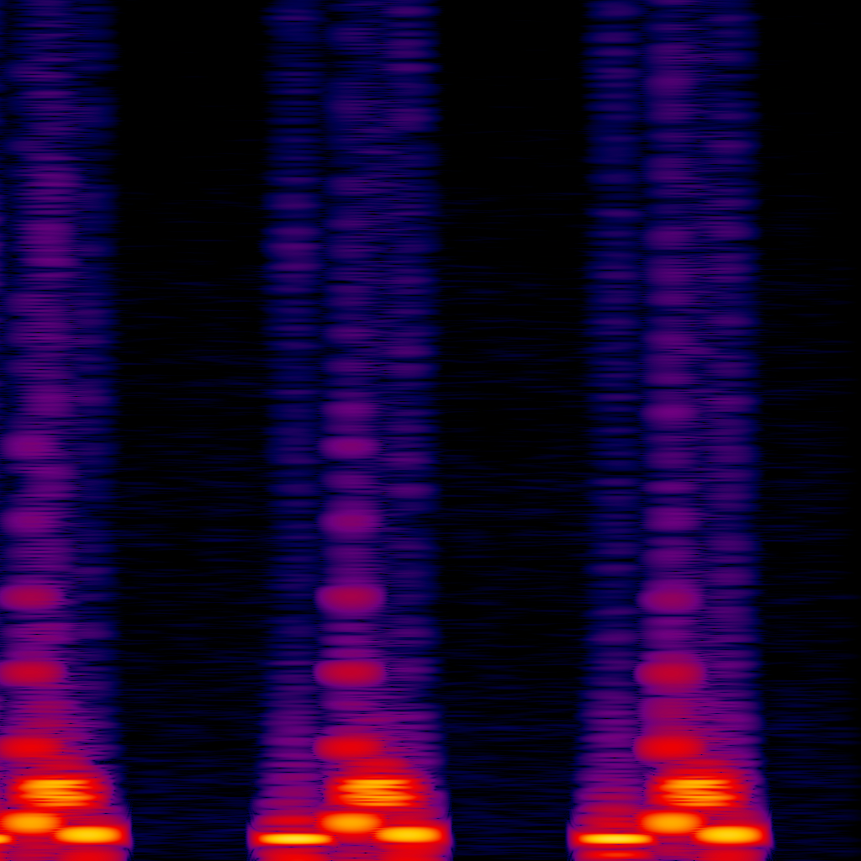
Spectrograms of the
Five classes of heart signals
Normal (N)
Mitral Stenosis (MS)
Mitral Regurgitation (MR)
Aortic Stenosis (AS)
Mitral Valve Prolapse (MVP)

Slide 9
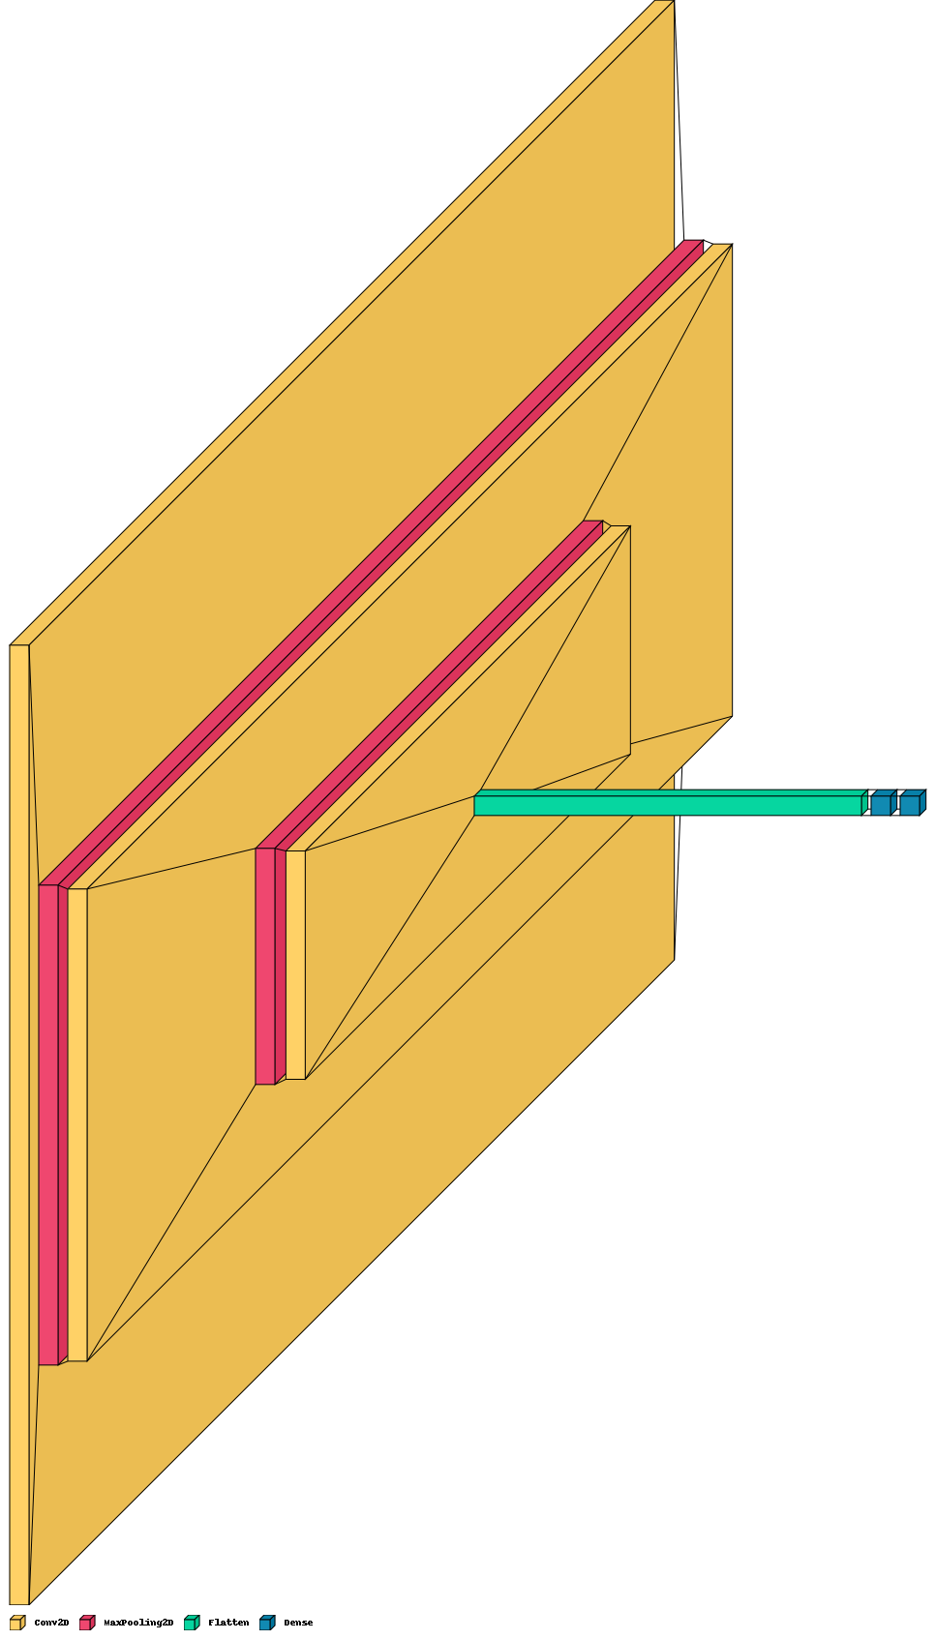
Model 1
Architecture

Slide 10
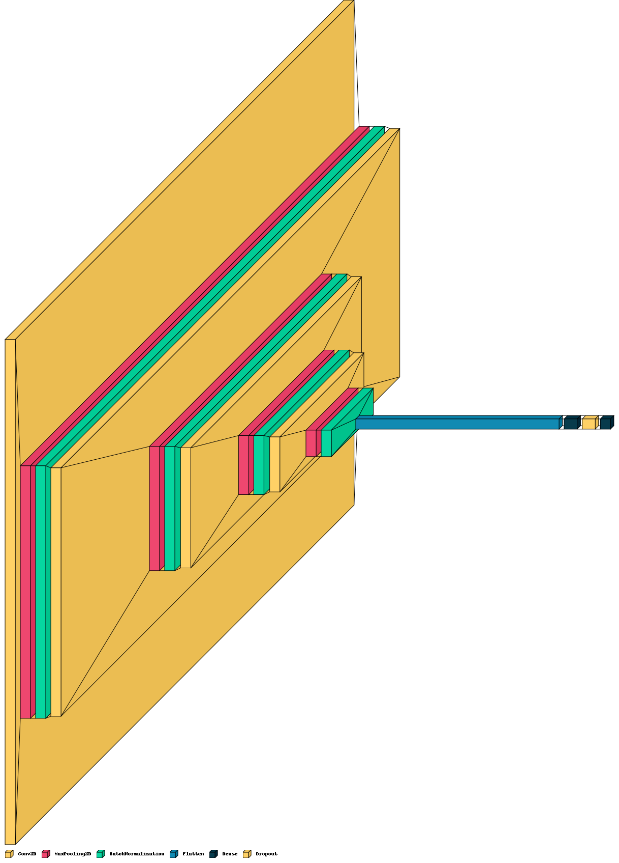
Model 2
Architecture

Slide 11
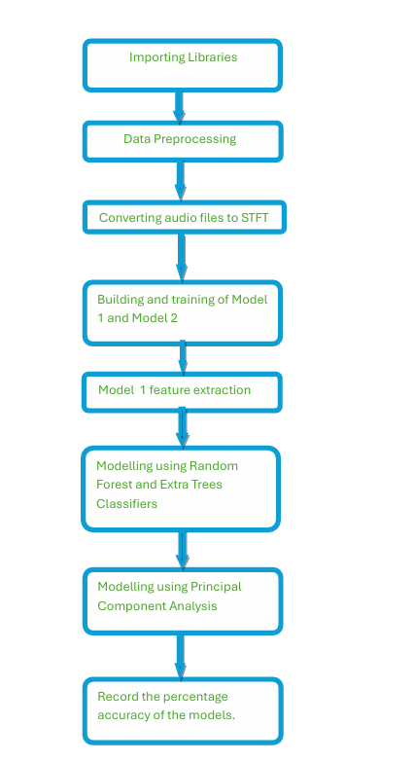
Experimental Steps
Data Preprocessing
Data to STFT
Model 1 and Model 2 Building and Training
Model 1 Feature Extraction
Modelling using Random Forest and Extra Trees Classifiers
Modelling using Principal Component Analysis (PCA)

Slide 12
Observations (using given heart dataset)
Metrics | Model 1 | Model 2 | RFC | ETC | PCA (n=1)
Accuracy | 100% | 70.99% | 100% | 100% | 36.1%
F1 Score | - | - | 100% | 100% | 34.65%
Trainable Params | 60,955,461 | 26,653,509 | - | - | -
Non-trainable Params | 0 | 704 | - | - | -
Total Params | 60,955,461 | 26,654,213 | - | - | -

Slide 13
Observations (using new heart dataset)
Metrics | Model 1 | Model 2 | RFC | ETC | PCA (n=1)
Accuracy | 98.50% | 83.49% | 91.0% | 94.5% | 22.1%
F1 Score | - | - | 94.99% | 97.15% | 21.65%
Trainable Params | 60,955,461 | 26,653,509 | - | - | -
Non-trainable Params | 0 | 704 | - | - | -
Total Params | 60,955,461 | 26,654,213 | - | - | -

Slide 14
Conclusion:
PCG signals carries information about the functioning of heart valves during heartbeat, hence these signals are very important in diagnosing heart problems at early stage.The results that have been obtained shows clear performance superiority and can help physicians in the early detection of heart disease during auscultation examination. This work can be greatly improved if the dataset is prepared on a larger scale and also if the data features are managed in a more innovative way, then the performance can be more fruitful.

Slide 15
Credits
Kanhaiya Agrawal (121CS0134)
Yash Agrawal (121CS0135)
Suzen Akhtar (121CS0136)
Khair Alanam (121CS0137)

