Slide 1
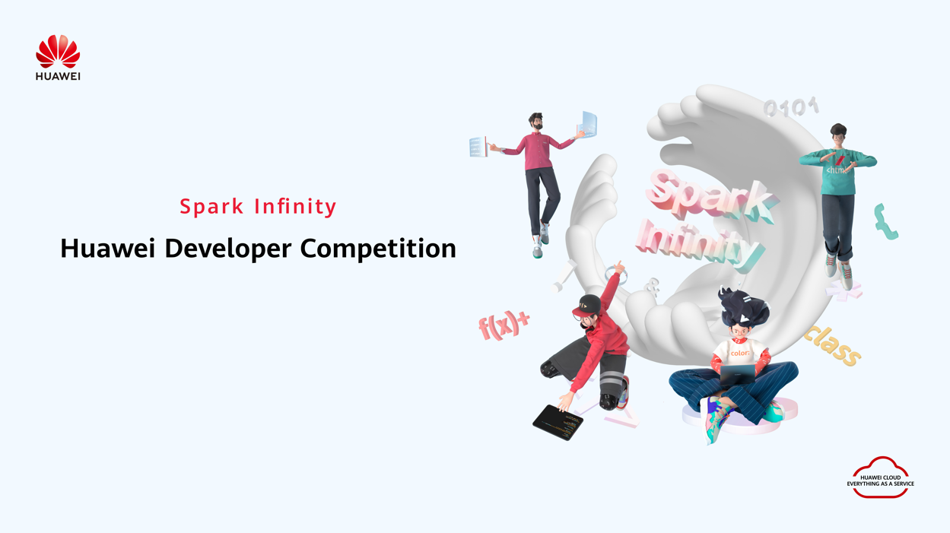
Challenge Name: Huawei Developer Competition 2025 Northern Africa
Project Name: Draftly - Huawei Cloud Native Design Copilot
Team Name: Atlas Shield
Organization: Students
Email/Phone: Khaireddinearbouch8@gmail.com

Slide 2

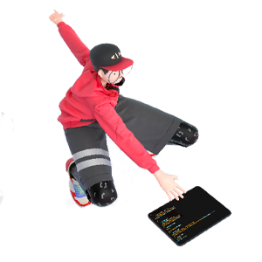
Project Overview
Overview
Project Name | Draftly - Huawei Cloud Native Design Copilot
Team Name | Atlas Shield
Contacts | khaireddinearbouch8@gmail.com
Technical Field | Full Stack Development, AI-powered Design Tools
Technologies | Next.js, Tailwind CSS, Convex (Realtime DB), Inngest (Workflow), Docker, Claude API, Huawei Cloud (planned: OBS, FunctionGraph, ModelArts)
Keywords | Sketch-to-Design, AI Design Copilot, Cloud Native, UI Code Generation, Morocco Tech Ecosystem
Applicable Fields | Creative Industries, SaaS, Design Automation, Cloud Transformation
Description (in 200 words) | Draftly is a SaaS platform that enables designers and developers to transform hand-drawn sketches or wireframes into production-ready UI code instantly. By uploading a sketch or inspiration image, the system applies an AI pipeline — first extracting layout and component structure, then synthesizing React + Tailwind code — saving hours of manual frontend work. Built with open-source backbone (Convex + Inngest), containerised for portability and primed for Huawei Cloud integration, Draftly addresses the productivity bottleneck in emerging African tech markets. Its modular architecture enables future deployment on Huawei Cloud services such as OBS for asset storage, FunctionGraph for event orchestration and ModelArts for multimodal inference. Through Draftly, Moroccan startups, freelancers and education institutions can accelerate UI development, reduce reliance on outsourced design, and foster local innovation.

Slide 3

Note:
  The section titles listed below are for reference and you can re-sequence them as required.
  You can add multiple slides for each section.
  Delete this note when submitting your presentation.
Contents
1
Team Introduction
2
Project Introduction
3
Technical Architecture
4
Functions
5
Innovations
6
Business Value
7
Demo & Follow-up Plan
8
Achievements
Notes:
3

Slide 4


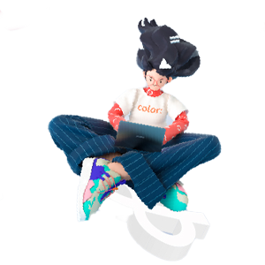
Team Introduction
Khaireddine Arbouch
Anas Labgoul

Slide 5
Project Introduction
Project Background
  Sketch-to-Design gap slows product cycles in emerging tech markets
  Hand-drawn wireframes require manual conversion to production UI code
  North African design/dev ecosystems lack rapid, affordable tooling
  s2c: AI-powered SaaS automating sketch → UI code with cloud-native architecture
Features
  Upload sketches or inspiration images for processing
  Two-stage AI pipeline: layout extraction → code generation
  Live preview of generated UI + exportable code bundle (React + Tailwind)
  Workflow orchestration with Inngest & containerized app for portability
  Cloud-ready architecture (docker-container, ready for Huawei Cloud integration)

Slide 6
Project Introduction
Application Scenarios & Problems Solved
  Startups needing rapid UI prototypes with small teams
  Design agencies converting sketch files into frontend components quickly
  UI/UX education programs bridging design and code for students
  Solves: manual conversion time, skill gaps, resource constraints, slow iteration
  Enables small African teams to scale design production and launch faster
Target Users
  UX/UI Designers seeking automation in frontend component creation
  Frontend Developers who want jump-start generated components
  North African Startups & SMEs building digital products leanly
  Educational Institutions & Bootcamps teaching UI/UX + frontend Dev
  Corporate Digital Transformation teams enabling internal design workflows

Slide 7
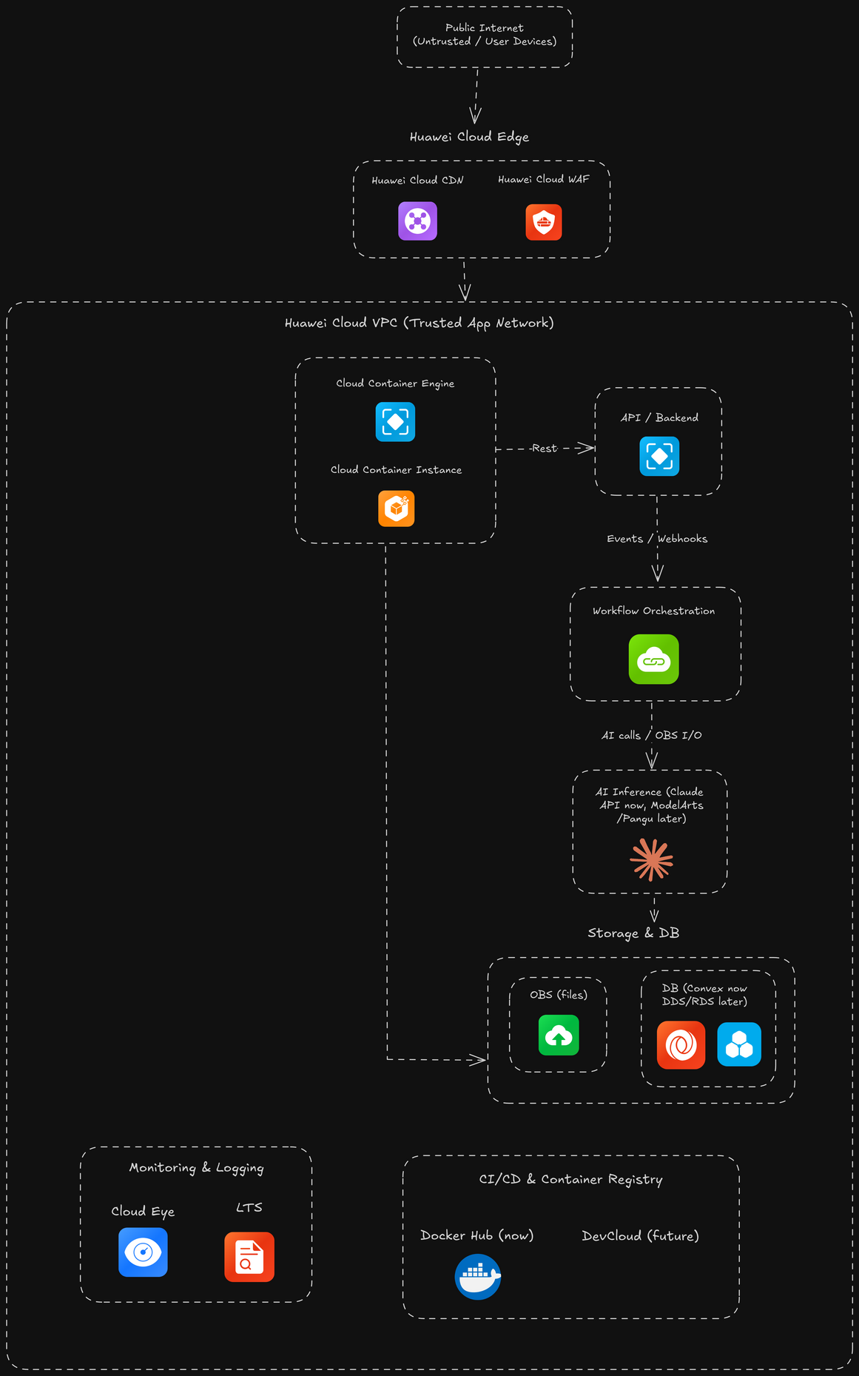
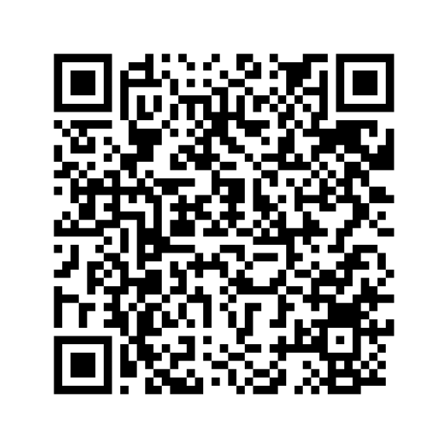
Technical Architecture

Slide 8
Overview & Killer Functions
Overview
  Instant sketch‑to‑code: Turn rough hand‑drawn UI sketches into clean, runnable frontend projects in minutes.
  End‑to‑end pipeline: Upload sketch → AI understands layout → generates components + code → one‑click bundle download.
Killer Functions & Uniqueness
  From doodle to production repo: Not just mockups or snippets – full project structure (pages, components, routing, styles) ready to npm run dev.
  Dual UX: visual + chat: Refine the generated UI with natural language (“more spacing”, “dark theme”, “mobile‑first”) instead of tweaking CSS by hand.
  Component‑aware generation: Produces reusable, clean components (not spaghetti HTML), making dev teams actually want to keep the code.
  Huawei‑ready by design: Architecture fits CCE + OBS + ModelArts, optimized for low latency, scale, and cost in regions like North Africa.

Slide 9
Innovations
  Multimodal sketch‑to‑code engine: Turns messy hand‑drawn sketches into structured UI trees and full, runnable projects (not just pretty mockups or snippets).
  Component‑aware, production‑grade code: Generates clean, reusable components and project structure that real teams can maintain and ship.
  Hybrid AI routing with Huawei readiness: Starts with Claude, but is architected to seamlessly shift inference to Huawei ModelArts/Pangu for sovereign, in‑region AI.
  Cloud‑native orchestration on Huawei stack: Event‑driven pipeline (FunctionGraph + OBS + CCE + Cloud Eye/LTS) that self‑heals, scales, and exposes per‑job cost/latency.
  Business model built for partners: Hybrid subscription + usage model, with a future template/component marketplace and Huawei marketplace listing for co‑selling.

Slide 10
Business Value
  High-impact productivity & inclusion: Dramatically cuts time and cost from idea/sketch to working UI, helping SMEs, public sector, and non‑technical founders ship digital services faster—especially valuable in emerging markets like North Africa.
  Scalable SaaS + usage model: Core revenue from team/enterprise subscriptions plus pay‑per‑generation credits, with clear gross margin levers (model choice, OBS lifecycle, autoscaling) and strong upsell potential (enterprise, private deployments, custom templates).
  End‑to‑end value chain coverage: Captures value from opportunity identification (rapid prototyping with stakeholders) through product design (iterative UI), technology (Huawei Cloud stack), and delivery (ready‑to‑run code), positioning the product as a central platform rather than a single feature.
  Smart go‑to‑market & ecosystem play: Distributed via Huawei Cloud marketplace and partner network (SIs, agencies, educators), combining direct SaaS sales with co‑selling and white‑label options, while differentiating against competitors through Huawei‑native integration and regional focus.
  Compliance‑by‑design: Data residency controls, encrypted OBS storage, IAM least‑privilege, and clear policies for cross‑border AI calls (Claude → ModelArts) ensure alignment with local laws and regulations, enabling adoption in regulated sectors (government, finance, telecom).

Slide 11
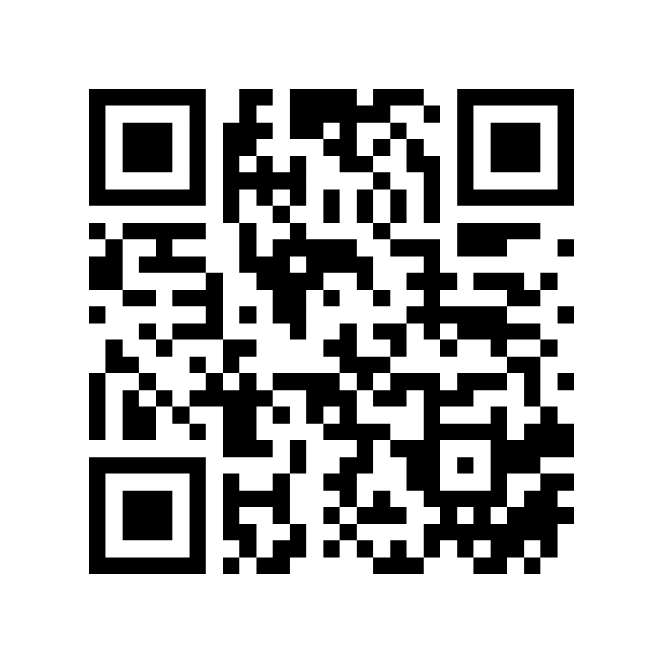
Demo & Follow-up Plan

Slide 12
THANK YOU

