Slide 1


Module-3.1 Basic Statistics and Probability required for Machine Learning

Slide 2
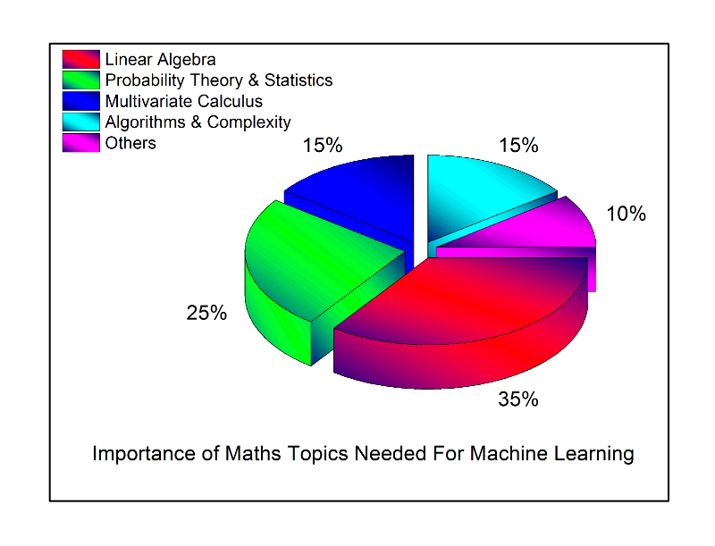
Module-3.1 Basic Statistics and Probability
Do Statistics precede Probability?
I believe that probability requires data on which to operate which descriptive
statistics can supply
https://www.educba.com/machine_learning_n_R/

Slide 3


Module-3.1 Basic Statistics and Probability
What is the difference between variance and covariance?
What is 'Variance'
Variance is a measurement of the spread between numbers in a data set. The variance measures how far each number in the set is from the mean. Variance is calculated by taking the differences between each number in the set and the mean, squaring the differences (to make them positive) and dividing the sum of the squares by the number of values in the set.
Variance and Co-variance are mathematical terms frequently used in statistics, and despite the similar sounding names they actually have quite different meanings.
What is ‘Co-Variance'
A covariance refers to the measure of how two random variables will change together and is used to calculate the correlation between variables. The variance refers to the spread of the data set — how far apart the numbers are in relation to the mean, for instance. Variance is particularly useful when calculating the probability of future events or performance.
https://www.educba.com/machine_learning_n_R/

Slide 4
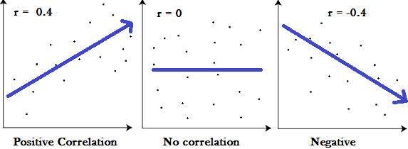
Module-3.1 Basic Statistics and Probability
What is Correlation?
Correlation is used to test relationships between quantitative or categorical variables. In other words, it’s a measure of how things are related. The study of how variables are correlated is called correlation analysis. Some examples of data that have a high correlation:
Your caloric intake and your weight.
Your eye color and your relatives’ eye colors.
The amount of time your study and your GPA.
Some examples of data that have a low
correlation (or none at all):
A dog’s name and the type of dog biscuit they prefer.
The cost of a car wash and how long it takes to buy a soda inside the station.
Graphical explanation of Correlation
Correlations are useful because if you can find out what relationship variables have, you can make predictions about future behavior. Knowing what the future holds is very important in the social sciences like government and healthcare. Businesses also use these statistics for budgets and business plans. Formula for Correlation –
COR(x,y) = COV(x,y) /(σx * σy) (Always between -1 to +1).
https://www.educba.com/machine_learning_n_R/

Slide 5
Module-3.1 Basic Statistics and Probability
1. Correlation Test -
Statistically if y = b +a₁x₁ + a₂x₂ + a₃x₃ … a_{n}x_{n} + e is our regression formula then –
There should be at least some correlation between y and x_{i.}
We can simply test correlation as cor(x,y) or cor.test(x,y).
Also there should not be strong correlation between two independent veriables. If
this exists your model may face multicollinearity problem. i.e cor(x_{i},x_{j}) ~ 1.
Simple solution is to drop one predicator variable in case of multicollinearity.
2. Alternate to correlation test is hypotheses test.
One hypotheses is called null hypotheses, i.e. nothing is happened.
Other hypotheses is called as Alternate hypotheses, i.e. something is happened.
In correlation scenario null hypotheses is two variables are independent.
We compute p value which decides to accept or reject null hypotheses.
If p-value is less than 0.05 we reject null hypotheses. (0.05 is level of significance).
https://www.educba.com/machine_learning_n_R/

Slide 6
Module-3.1 Basic Statistics and Probability
How level of significance is decided?
Conventional limit for many problems is 0.05
If data is too noisy p-value < 0.10 can also reject the null hypothesis
Working with high risk areas p value is < 0.01 or even < 0.001 might be necessary.
https://www.educba.com/machine_learning_n_R/

Slide 7
Module-3.1 Basic Statistics and Probability
Probability is fundamental of statistics. Every distribution that R handles has four functions. There is a root name, for example, the root name for the normal distribution is norm.
This root is prefixed by one of the letters
p for "probability", the cumulative distribution function (c. d. f.)
q for "quantile", the inverse c. d. f.
d for "density", the density function (p. f. or p. d. f.)
r for "random", a random variable having the specified distribution
So different types of normal distribution functions in R are –
dnorm – Normal density function
pnorm – Normal distribution functions
qnorm – Normal quantile function
rnorm – Random normal variates
https://www.educba.com/machine_learning_n_R/

Slide 8
Module-3 A Simple Linear Regression
R has functions to handle many probability distributions. The table below gives the names of the functions for each distribution. And how the functions are used- you can take help of R at any moment of time. But don't read the on-line documentation yet.
First, try the examples in the sections following the table.
Discrete distribution functions
Binomial pbinom qbinom dbinom rbinom
Hypergeometric phyper qhyper dhyper rhyper
Geometric pgeom qgeom dgeom rgeom
Negative Binomial pnbinom qnbinom dnbinom rnbinom
Poisson ppois qpois dpois rpois
https://www.educba.com/machine_learning_n_R/

Slide 9
Module-3 A Simple Linear Regression
Continuous Distrubitions
Beta pbeta qbeta dbeta rbeta
Cauchy pcauchy qcauchy dcauchy rcauchy
Chi-Square pchisq qchisq dchisq rchisq
Exponential pexp qexp dexp rexp
F pf qf df rf
Gamma pgamma qgamma dgamma rgamma
Logistic plogis qlogis dlogis rlogis
Log Normal plnorm qlnorm dlnorm rlnorm
Normal pnorm qnorm dnorm rnorm
Student t pt qt dt rt
Studentized Range ptukey qtukey dtukey rtukey
Uniform punif qunif dunif runif
Weibull pweibull qweibull dweibull rweibull
Wilcoxon Rank Sum Statistic pwilcox qwilcox dwilcox rwilcox
Wilcoxon Signed Rank Statistic psignrank qsignrank dsignrank rsignrank
https://www.educba.com/machine_learning_n_R/

Slide 10
Module-3 A Simple Linear Regression
choose() function computes the combination _{n}C_{r}.
choose(n,r) n: n elements r: r subset elements _{n}C_{r}= n!/(r! * (n-r)!) > choose(5,2)
[1] 10 > choose(2,1)
[1] 2
> combn(1:5,3)
[,1] [,2] [,3] [,4] [,5] [,6] [,7] [,8] [,9] [,10]
[1,] 1 1 1 1 1 1 2 2 2 3
[2,] 2 2 2 3 3 4 3 3 4 4
[3,] 3 4 5 4 5 5 4 5 5 5
https://www.educba.com/machine_learning_n_R/

Slide 11
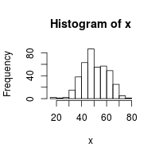
Module-3 A Simple Linear Regression
Problem
You want to generate random numbers.
Solution
For uniformly distributed (flat) random numbers, use runif(). By default, its range is from 0 to 1.
runif(1)
runif(4)
runif(3, min=0, max=100)
floor(runif(3, min=0, max=101))
sample(1:100, 3, replace=TRUE)
sample(1:100, 3, replace=FALSE)
To generate numbers from a normal distribution, use rnorm(). By default the mean is 0 and the standard deviation is 1.
rnorm(4)
rnorm(4, mean=50, sd=10)
x <- rnorm(400, mean=50, sd=10)
hist(x)
https://www.educba.com/machine_learning_n_R/

Slide 12
Module-3 Basic Statistics and Probability
Generating reproducible Random numbers –
Use set.seed command and take sample.
> set.seed(666)
> runif(10)
Randomly permuting a number –
> sample(V,n) /* here V is of vector and n is number elements to choose.
> sample(1:10,5,replace=FALSE)
https://www.educba.com/machine_learning_n_R/

Slide 13
Module-3 Basic Statistics and Probability
Calculating probabilities for discrete distribution –
Question: Suppose widgits produced at Acme Widgit Works have probability 0.005 of being defective. Suppose widgits are shipped in cartons containing 25 widgits. What is the probability that a randomly chosen carton contains exactly one defective widgit?
Question Rephrased: What is P(X = 1) when X has the Bin(25, 0.005) distribution?
> dbinom(1, 25, 0.005)
Question:- If X is Binomoial Distribution with N = 20 (number of trials) and success of probability is 1/6.
X ~ BIN(N=20,p=1/6)
p =3 exact 3 outcomes out of 20 will be success.
we manually solves – p(x=3) = _{n}C_{r} p^{x} q^{(n-x)}
Here p = 1/6 probability of success and q is probability of failure = 5/6
p(x=3) = ₂₀C₃ x (1/6)³ x (5/6)¹⁷
= 20! / 17! x 3! x (1/6)³ x (5/6)¹⁷
= 0.237866
and R code for above example
> dbinom(x=3,size=20,prob=1/6)
[1] 0.237866
https://www.educba.com/machine_learning_n_R/

Slide 14
Module-3 Basic Statistics and Probability
Suppose you want to solve density function for different values 0,1,2,3 etc.
use
> dbinom(x=0:3,size=20,prob=1/6)
[1] 0.02608405 0.10433621 0.19823881 0.23788657
Now if you want cumulative distribution or normal distribution function for x <=3,
either do sum of all above probability density functions or use
> pbinom(q=3,size=20,prob=1/6,lower.tail=TRUE)
[1] 0.5665456
A multiple-choice test has four choices for each answer. Suppose you make a random guess on three of the ten questions. What is the probability that you will answer all three correctly?
> dbinom(x=3,size=3,prob=1/4)
[1] 0.015625
https://www.educba.com/machine_learning_n_R/

Slide 15
Module-3 Basic Statistics and Probability
What is poisson distribution?
If normal distribution has n -> ∞ and p ~ 0,
Means n = large and p = very small, such normal distribution tends toward poisson distribution.
In poisson distribution events occurs independent of time.
The probability that event occurs in a given length of time, does not changes through the time, then X -> no of events occurred in fixed unit of times has a poisson distribution.
here,
p(X=x) = λ^{x} . e^{-λ} / x! where e = 2.71828
for x = 0,1,2,3,4….∞
e.g.
p(X=1) = λ^{x} . e^{-λ} / x! where λ = 2 and e = 2.71828
= 2¹ . 2.71828⁻² / 2!
= 0.2707
R code
> dpois(1,2)
[1] 0.2706706
An astroid with a diameter of at least 1 KM collide with the earth at the rate of 7 per million year. What is probability that there will be exactly 4 collissions in randomly selected million years?
Here λ =7 and x = 4
ans
> dpois(7,4)
[1] 0.09122619
https://www.educba.com/machine_learning_n_R/

Slide 16
Module-3 Basic Statistics and Probability
How to calculate probabilities, percentile and taking random samples from normally distributed variables using R –
note if not specified default values are mean = 0 and SD = 1 --- e.g.
> pnorm(q=70,mean=75,sd=5,lower.tail=T)
[1] 0.1586553
> qnorm(p=.25,mean=75,sd=5,lower.tail=T)
[1] 71.62755
Finding probabilities & percentiles for t-distribution using R. This can be used to find p-value or critical values for constructing confidence interval for statistics that follows t distribution. e.g.
t ~ t df =25, mean = 0, sd = 1
> pt(q=2.3,df=25,lower.tail = F)
> pt(q=2.3,df=25,lower.tail = F) + pt(q=-2.3,df=25,lower.tail = T)
Similarly,
> pf – probability of f distribution
> pexp - probability of exp distribution
https://www.educba.com/machine_learning_n_R/

Slide 17

Module-3 Basic Statistics and Probability
What is t test and f test?
T-test is used to estimate population parameters i.e. population means, and is also used for hypothesis testing for population means. (Though in case you are not aware of SD).
If you know population SD Z test is used.
where x-dash is the sample mean, s is the sample SD of the sample and n is the sample size. The degrees of freedom used in this test are n − 1. Although the parent population does not need to be normally distributed, the distribution of the population of sample means, and μ0 is assumed to be normal.
We compare this t-statistic with critical value of t at degree of freedom. If t-statistic is greater at right side or less than at left side (-ve) then we reject the null hypothesis.
i.e. sample mean is not equal to population mean.
https://www.educba.com/machine_learning_n_R/

Slide 18
Module-3 Basic Statistics and Probability
e.g. 1
I have used airquality dataset from the package databases. We are trying to estimate average temperature in F. If data set average temperature is 80ºF.
e.g.2
Hypotheses test and p-value – A neurologist is testing the effect of a drug on Rats injected with a unit dose of drug, subjecting each in neurologically stimulus and recording with its response time. The neurologist knows that the mean response time for the Rat not injected with drug is 1.2 seconds. The mean response time for 100 injected rat is 1.05 seconds with sample SD = 0.5 seconds.
Do you think that drug has an effect on response time?
https://www.educba.com/machine_learning_n_R/

Slide 19
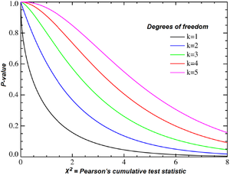
Module-3 Basic Statistics and Probability
A chi-squared test, also written as χ² test, is any statistical hypothesis test wherein the sampling distribution of the test statistic is a chai-squared distribution when the null hypothesis is true.
Chi-squared tests are often constructed from a sum of squared erros, or through the sample variance. Test statistics that follow a chi-squared distribution arise from an assumption of independent normally distributed data, which is valid in many cases due to the central limit theorem. A chi-squared test can be used to attempt rejection of the null hypothesis that the data are independent.
https://www.educba.com/machine_learning_n_R/

Slide 20
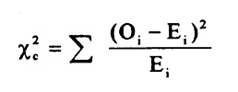
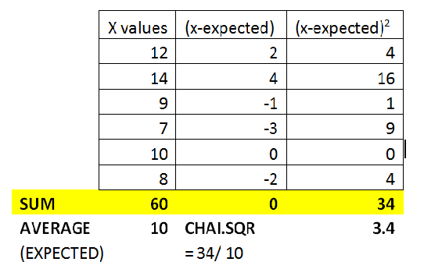
Module-3 Basic Statistics and Probability
Use chi-squared test and tell whether a die is fare or not.
After tossing a die 60 times, the top of die had given following values wrto to number occurred on the top of die i.e. (1,2,3,4,5,6) values – (12,14,9,7,10,8). It the die fare?
NULL Hypothesis H₀ : Die is fare……………………… Formula:
Result
Chai-squared Test statistic = 3.4
Chai-squared critical value at 5 df (degree of freedom) with 95% level of significance means α = 0.05 is 11.070.
As test statistics is less than critical value,
We accept the null hypothesis –
Die is fare ….
https://www.educba.com/machine_learning_n_R/

Slide 21
Module-3 Basic Statistics and Probability
Before I conclude important tips –
What is the 'Central Limit Theorem - CLT'
The central limit theorem (CLT) is a statistical theory that states that given a sufficiently large sample size from a population with a finite level of variance, the mean of all samples from the same population will be approximately equal to the mean of the population. Furthermore, all of the samples will follow an approximate normal distribution pattern, with all variances being approximately equal to the variance of the population divided by each sample's size.
https://www.educba.com/machine_learning_n_R/

Slide 22
Module-3 Basic Statistics and Probability
What is area under normal distribution? ( 6σ Rule)
The 68-95-99.7% or three sigma rule, or empirical rule states that for a normal distribution , nearly all the value lies between 3σ (on both tail) of μ.
Properties of normal distribution –
Continuous probability distribution.
Bell shaped curved also known as Guassian curve.
Mean, Median and mode are at the same place.
Symmetric around mean.
Total area under the curve is ~ 1. Approaches to -∞ to +∞.
Shape can be determined by μ and σ.
Area under the curve can be determined using Z table.
Viz –
μ +/- 1σ => 0.683 ∼ 90% −> 1.65 standard deviation.
μ +/- 2σ => 0.954 ∼ 95% −> 1.96 standard deviation.
μ +/- 3σ => 0.997 ∼ 99% −> 2.57 standard deviation.
https://www.educba.com/machine_learning_n_R/

Slide 23
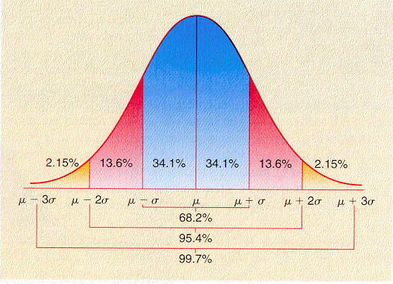
Module-3 Basic Statistics and Probability
The z-table uses the Probability Density Function to find the probability for any given z-value. For one standard deviation, we want the area under the curve from (-1, 1). To do this, we find the z-score for 1 and then subtract the z-score for -1.
z-score for 1 = .8413
z-score for -1 = .1587
So .8413 - .1587 = .6826.
Hence total amount of data that is within one standard deviation of the mean is 68.26%. The same can be done for 2 standard deviations and 3 standard deviations. We probably use 1, 2, and 3 standard deviations because those numbers are whole numbers.
https://www.educba.com/machine_learning_n_R/

Slide 24
Module-3 Basic Statistics and Probability
Thanks….
https://www.educba.com/machine_learning_n_R/

