Slide 1


Machine Learning Module-3 A Simple Linear Regression and More of Statistics required

Slide 2
Module-3 A Simple Linear Regression
Objectives –
3.1 Basic of Linear Regression -
3.2 How to perform Linear Regression Analysis in R -
What is intercept and slope, R², t- Statistics, residual, p-value, F statistics,
degree of Freedom, Standard Error etc.
3.3 Probability –
Generating Random Numbers/Reproducible Random Numbers
Generating Random Samples/ Random Sequence
Calculating Probabilities of Discrete Distribution
Calculating Probabilities of Continuous Distribution
Probability Density Function, Converting Probabilities into quantiles
3.4 General Statistics –
Relative frequencies, Creating Contingency Tables, Converting Data to Z score
Testing of Normality, Runs, Correlation for Significance, graphics functions etc.
https://www.educba.com/machine_learning_n_R/

Slide 3
Module-3 A Simple Linear Regression
3.1 What is Regression Analysis ?
Regression analysis is a form of predictive modelling technique which investigates the relationship between a dependent (target) and independent variable (s) (predictor). This technique is used for forecasting, time series modelling and finding the casual effect relationship between the variables. For example, relationship between rash driving and number of road accidents by a driver is best studied through regression.
Linear regression are of two types.
1. Simple linear Regression - Y = a + bX + e_{i}
2. Multiple Linear Regression – Y = a + b₁X₁ + b₂X_{2…..+} b_{n}X_{n +} e_{i}
Other forms of Regression are –
1. Logistic Regression 2. Polynomial Regression
3. Stepwise Regression 4. Ridge Regression
5. Lasso Regression 6. ElasticNet Regression
https://www.educba.com/machine_learning_n_R/

Slide 4
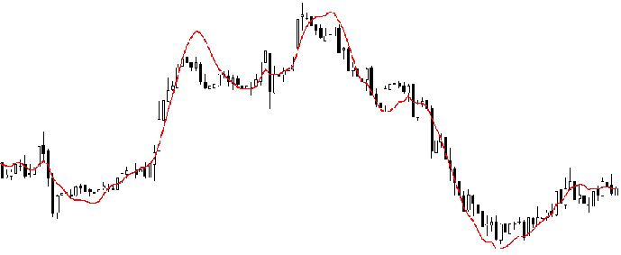
Module-3 A Simple Linear Regression
Regression analysis is an important tool for modelling and analyzing data. Here, we fit a curve / line to the data points, in such a manner that the differences between the distances of data points from the curve or line is minimized.
https://www.educba.com/machine_learning_n_R/

Slide 5
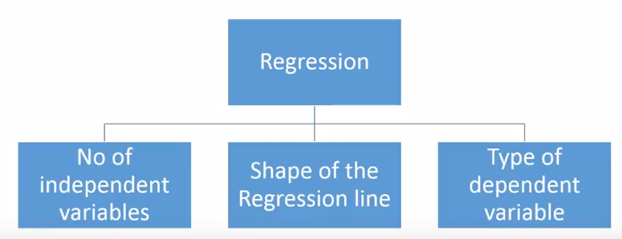
Module-3 A Simple Linear Regression
How to choose regression model?
Multiple benefits of regression analysis:
It indicates the significant relationships between dependent variable and independent variable.
It indicates the strength of impact of multiple independent variables on a dependent variable.
https://www.educba.com/machine_learning_n_R/

Slide 6
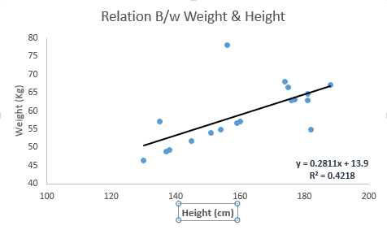
Module-3 A Simple Linear Regression
A Simple Linear Regression –
Linear Regression establishes a relationship between dependent variable (Y) and one or more independent variables (X) using a best fit straight line (also known as regression line). It is represented by an equation Y=a+b*X + e, where a is intercept, b is slope of the line and e is error term. This equation can be used to predict the value of target variable based on given predictor variable(s).
The difference between simple linear regression and multiple linear regression is that, multiple linear regression has (>1) independent variables, whereas simple linear regression has only 1 independent variable. Now, the question is “How do we obtain best fit line?”.
https://www.educba.com/machine_learning_n_R/

Slide 7
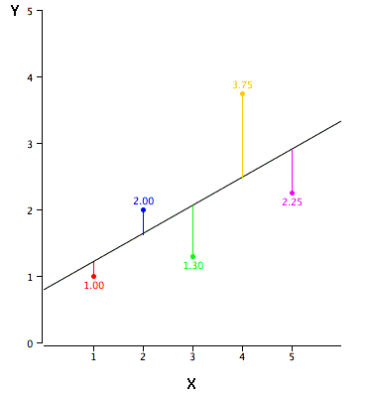

Module-3 A Simple Linear Regression
How to obtain best fit line (Value of a and b)?
This task can be easily accomplished by Ordinary Least Square Method. It is the most common method used for fitting a regression line. It calculates the best-fit line for the observed data by minimizing the sum of the squares of the vertical deviations from each data point to the line. Because the deviations are first squared, when added, there is no cancelling out between positive and negative values.
We can evaluate the model performance using the metric R-square, t- Statistics, p-value, F statistics.
Here Standard Error =
Where y is estimated value and Y is actual value. Standard error majors distance between actual and estimated values.
https://www.educba.com/machine_learning_n_R/

Slide 8
Module-3 A Simple Linear Regression
R-squared measures the proportion of the variation in your dependent variable (Y) explained by your independent variables (X) for a linear regression model. Adjusted R-squared adjusts the statistic based on the number of independent variables in the model.
One major difference between R-squared and the adjusted R-squared is that R-squared supposes that every independent variable in the model explains the variation in the dependent variable. It gives the percentage of explained variation as if all independent variables in the model affect the dependent variable, whereas the adjusted R-squared gives the percentage of variation explained by only those independent variables that in reality affect the dependent variable. R-squared cannot verify whether the coefficient ballpark figure and its predictions are prejudiced. It also does not show if a regression model is satisfactory; it can show an R-squared figure for a good model, or a high R-squared figure for a model that doesn’t fit.
https://www.educba.com/machine_learning_n_R/

Slide 9
Module-3 A Simple Linear Regression
https://www.educba.com/machine_learning_n_R/

Slide 10
Module-3 A Simple Linear Regression
https://www.educba.com/machine_learning_n_R/

Slide 11
Module-3 A Simple Linear Regression
https://www.educba.com/machine_learning_n_R/

Slide 12
Module-3 A Simple Linear Regression
https://www.educba.com/machine_learning_n_R/

Slide 13
Module-3 A Simple Linear Regression
https://www.educba.com/machine_learning_n_R/

Slide 14
Module-3 A Simple Linear Regression
https://www.educba.com/machine_learning_n_R/

Slide 15
Module-3 A Simple Linear Regression
Thanks….
https://www.educba.com/machine_learning_n_R/

