Slide 1


Module-5.1 knn (Know your Nearest Neighbor) A supervised learning classification

Slide 2
Module-5.1 knn
K Nearest Neighbors – Classification:-
K nearest neighbors is a simple algorithm that stores all available cases and classifies new cases based on a similarity measure (e.g., distance functions). KNN has been used in statistical estimation and pattern recognition already in the beginning of 1970’s as a non-parametric technique.
Algorithm
A case is classified by a majority vote of its neighbors, with the case being assigned to the class most common amongst its K nearest neighbors measured by a distance function.
If K = 1, then the case is simply assigned to the class of its nearest neighbor.
Normally k = sqrt(no.of records in training dataset)
e.g. With K=3, there are two Default=Y and one Default=N out of three closest neighbors. The prediction for the unknown case is again Default=Y.
https://www.educba.com/machine_learning_n_R/

Slide 3
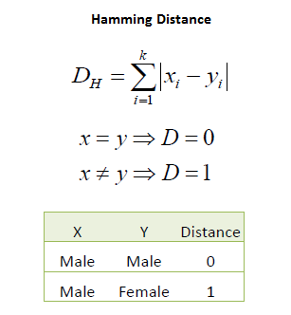
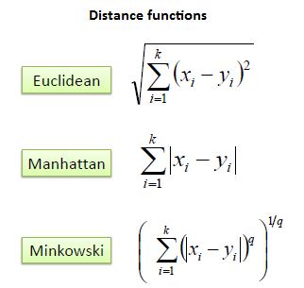
Module-5.1 knn – distance measurement
Various methods of distance measurement:-
https://www.educba.com/machine_learning_n_R/

Slide 4
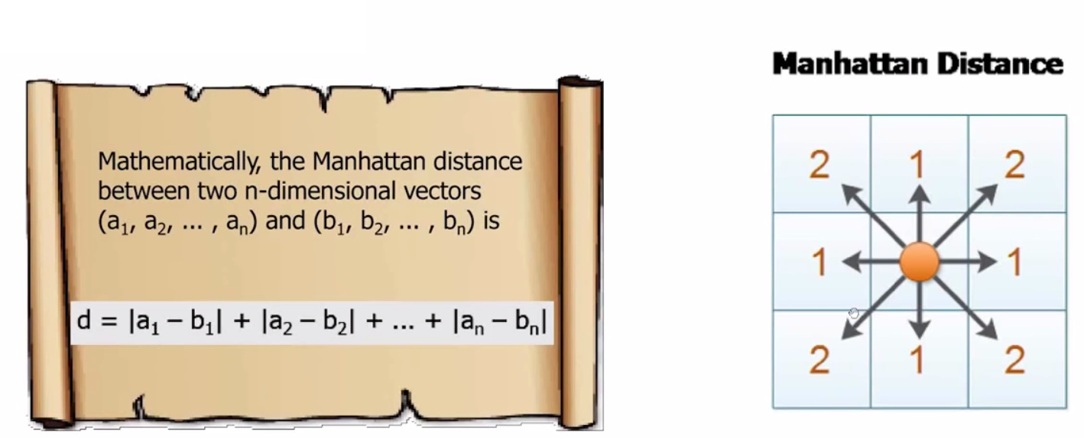
Module-5.1 knn – manhattan distance
https://www.educba.com/machine_learning_n_R/

Slide 5
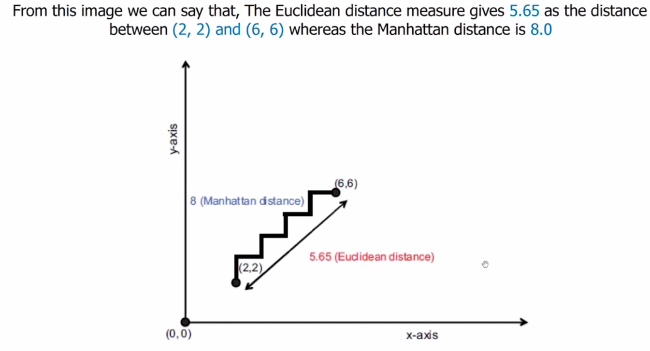
Module-5.1 knn Difference between Euclidean and Manhattan distance.
https://www.educba.com/machine_learning_n_R/

Slide 6
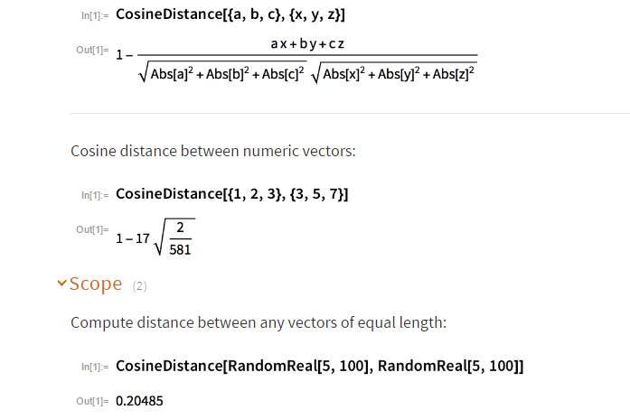
Module-5.1 knn Cosine distance
Cosine Distance [u,v]
gives the angular cosine distance between vectors u and v.
Cosine distance between two vectors →
AND
Cosine similarity[u,v]
= 1 – Cosine distance.
https://www.educba.com/machine_learning_n_R/

Slide 7
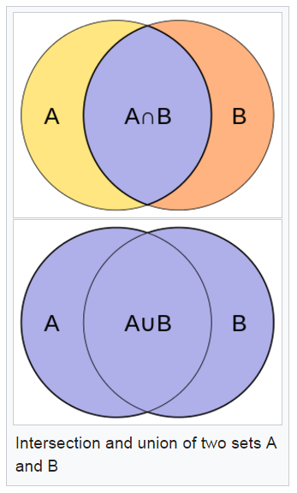
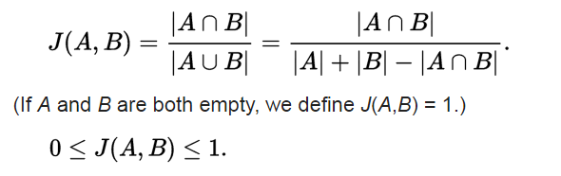
Module-5.1 knn Jaccard Distance
Jaccard Distance or Similarity:-
e.g. Facebook tells how two friends are closed to each other using Jaccard Distance.
This gives distance between set of objects – for exampl, a list of Cathy’s friend A={a,b,f,k,n} and a list of Rachel’s friend B={a,f,p,q,r}and say how similar two sets are-
https://www.educba.com/machine_learning_n_R/

Slide 8
Module-5.1 knn Hamming distance
Hamming Distance:-
In information theory, the Hamming distance between two strings of equal length is the number of positions at which the corresponding symbols are different. In other words, it measures the minimum number of substitutions required to change one string into the other, or the minimum number of errors that could have transformed one string into the other. In a more general context, the Hamming distance is one of several string metrics for measuring the edit distance between two sequences.
Examples-
The Hamming distance between:
"karolin" and "kathrin" is 3.
"karolin" and "kerstin" is 3.
1011101 and 1001001 is 2.
2173896 and 2233796 is 3.
https://www.educba.com/machine_learning_n_R/

Slide 9
Module-5.1 knn – normalization is must!
Modeling Danger Ahead !
Let’s you measure age in years, income in Rs and credit score you have. Then two people would be represented by triplets such as (25,54000,700) and (35,76000,730).
In particular their distance would be completely dominated by the difference in their salaries.
On the other hand, if you instead measures the salary in thousands of Rs, they would have represented by the triplets as (25,54,700) and (35,76,730).
This would give all three variables similar kind of influence.
To overcome these types of issues we normalize the data.
Normalization is simple processing bringing each property in the scale of 0 to 1.
Normalization of X = X – min(x) / ((max(X) – min(X))
for e.g. all values will come in the range of 0 to 1.
https://www.educba.com/machine_learning_n_R/

Slide 10
Module-5.1 knn
Overview of knn process:-
# Step 1: Load data and run numerical and graphical summeries.
# Step 2: Data normalization or standardization as per requirement.
# Step 3: Divide data into test and training data without labels (without providing
y values).
# Step 4: Create vectors for labels (y values) as well for training and test.
# Step 5: Decide your similarity or distance matrix.
# Step 6: Pick an evaluation matrix. (Misclassification rate is a good one. We shall
explain this more in a bit.)
# Step 7: Run knn few times, changing k and checking the evaluation measures.
You can start with k as: k = sqrt(nrow(dataset))
https://www.educba.com/machine_learning_n_R/

Slide 11
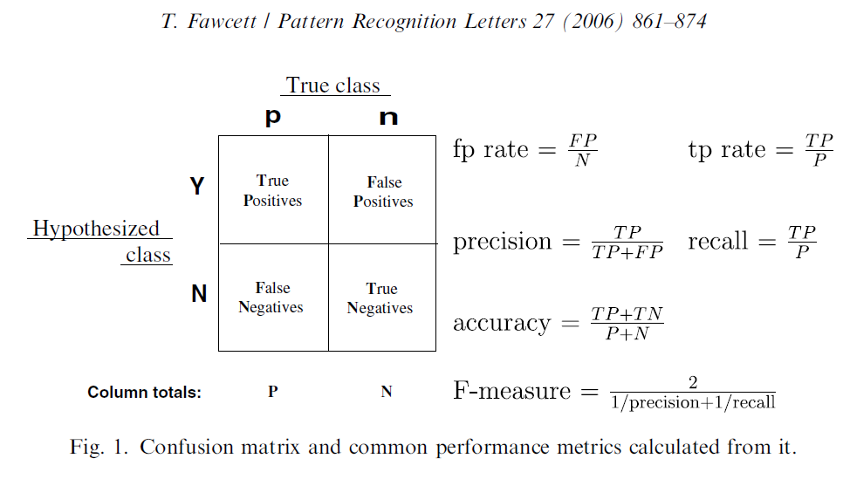
Module-5.1 knn ROC
Abstract
Receiver operating characteristics (ROC) graphs are useful for organizing classifiers and visualizing their performance. ROC graphs are commonly used in medical decision making, and in recent years have been used increasingly in machine learning and data mining research.
https://www.educba.com/machine_learning_n_R/

Slide 12
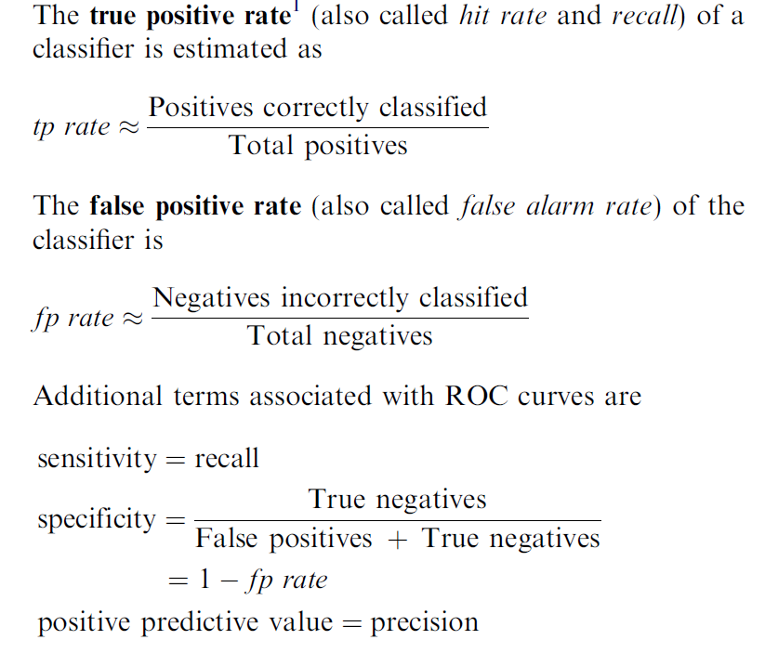
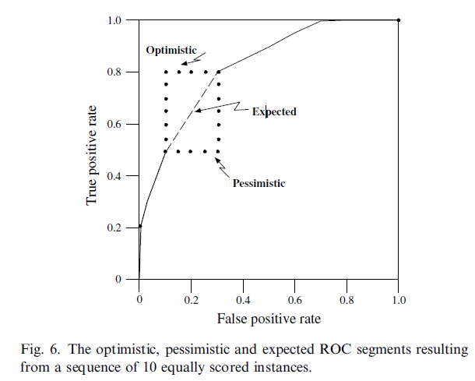
Module-5.1 knn Sensitivity and Specificity
https://www.educba.com/machine_learning_n_R/

Slide 13
Module-5.1 knn ~ Practice more case studies…
Let us take a look at the strengths and weaknesses of this algorithm:
Strengths
• Simple and effective
• Makes no assumptions about the
underlying data distribution
• Fast training phase
Weeknesses
• Does not produce a model, which limits the
ability to find novel insights in relationships
among features
• Slow classification phase
• Requires a large amount of memory
• Nominal features and missing data require
additional processing.
https://www.educba.com/machine_learning_n_R/

Slide 14
Module-5.1 knn ~ Practice more case studies…
Thanks….
https://www.educba.com/machine_learning_n_R/

