Slide 1


Module-6.0 Constructing a Decision Tree and Pruning a decision tree

Slide 2
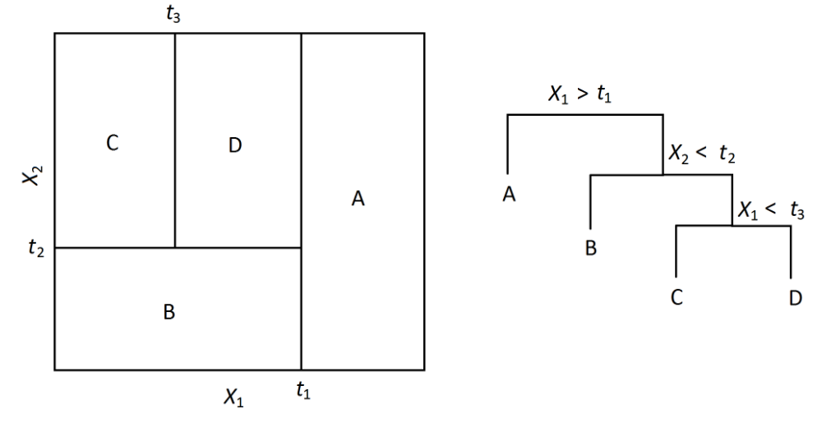
Module-6.0 Decision Tree
How to construct a Decision Tree:-
https://www.educba.com/machine_learning_n_R/

Slide 3
Module-6.0 Decision Tree
Day | Temperature | Outlook | Humidity | Windy | Play Golf?
07-05 | hot | sunny | high | false | no
07-06 | hot | sunny | high | true | no
07-07 | hot | overcast | high | false | yes
07-09 | cool | rain | normal | false | yes
07-10 | cool | overcast | normal | true | yes
07-12 | mild | sunny | high | false | no
07-14 | cool | sunny | normal | false | yes
07-15 | mild | rain | normal | false | yes
07-20 | mild | sunny | normal | true | yes
07-21 | mild | overcast | high | true | yes
07-22 | hot | overcast | normal | false | yes
07-23 | mild | rain | high | true | no
07-26 | cool | rain | normal | true | no
07-30 | mild | rain | high | false | yes
Test →
today |  | cool | sunny |  | normal | false | ?
tomorrow |  | mild | sunny |  | normal | false | ?
https://www.educba.com/machine_learning_n_R/

Slide 4
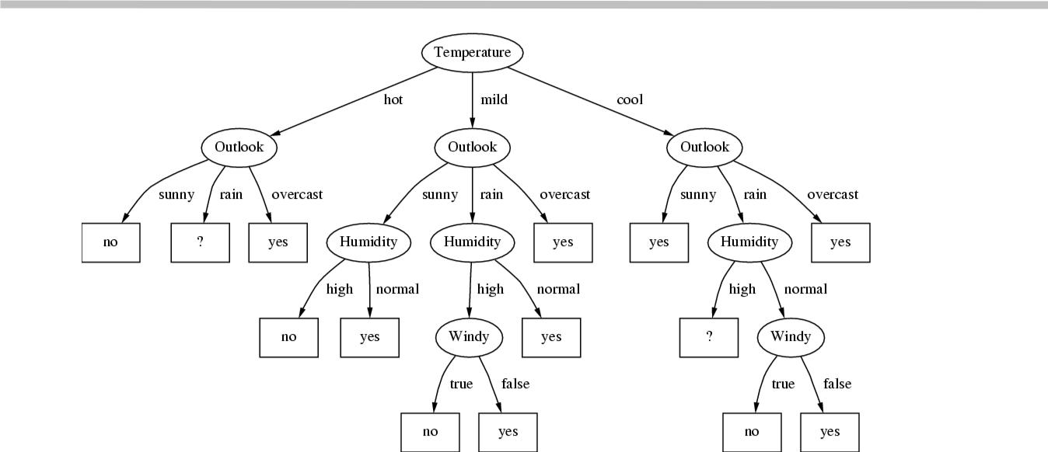
Module-6.0 Decision Tree
https://www.educba.com/machine_learning_n_R/

Slide 5
Module-6.0 Introduction
Which attribute to select as the root?
The decision of making strategic splits heavily affects a tree’s accuracy. The decision criteria is different for classification and regression trees.
Decision trees use multiple algorithms to decide to split a node in two or more sub-nodes. The creation of sub-nodes increases the homogeneity of resultant sub-nodes. In other words, we can say that purity of the node increases with respect to the target variable. Decision tree splits the nodes on all available variables and then selects the split which results in most homogeneous sub-nodes.
The algorithm selection is also based on type of target variables. Following are four commonly used decision tree algorithms:-
Gini Index Chi-Square
Information Gain Reduction in Variance
https://www.educba.com/machine_learning_n_R/

Slide 6
Module-6.0 Decision Tree
An example in Microsoft excel
An example in R
This decision tree learner has a simple post-pruning method. For any interior node, if all its immediate children are identical, the post pruning method replaces that interior node with one of its immediate children. Here, the pruned tree always computes the same function as the original tree.
But with improvement in performance of the Model.
https://www.educba.com/machine_learning_n_R/

Slide 7
Module-6.0 Decision Tree
Advantages:-
Easy to Understand: Its graphical representation is very intuitive and users can easily relate their hypothesis.
Useful in Data exploration: Decision tree is one of the fastest way to identify most significant variables and relation between two or more variables. With the help of decision trees, we can create new variables / features that has better power to predict target variable.
Less data cleaning required: It requires less data cleaning compared to some other modeling techniques. It is not influenced by outliers and missing values to a fair degree.
Data type is not a constraint: It can handle both numerical and categorical variables.
Non Parametric Method: Decision tree is considered to be a non-parametric method. This means that decision trees have no assumptions about the space distribution and the classifier structure.
https://www.educba.com/machine_learning_n_R/

Slide 8
Module-6.0 Decision Tree
Disadvantages:-
Over fitting: Over fitting is one of the most practical difficulty for decision tree models. This problem gets solved by setting constraints on model parameters and pruning (discussed in detailed below).
Not fit for continuous variables: While working with continuous numerical variables, decision tree looses information when it categorizes variables in different categories.
https://www.educba.com/machine_learning_n_R/

Slide 9
Module-6.0 Decision Tree
Thanks….
https://www.educba.com/machine_learning_n_R/

