Slide 1


Module-7.0 Random Forest A supervised learning classification & Regression model

Slide 2
Module-7.0 Random Forest
Introduction to Random Forest Method
What is it and
How does it works?
https://www.educba.com/machine_learning_n_R/

Slide 3
Module-7.0 Random Forest
It develops lots of decision tree based on random selection of data and random
selection of variables. e.g. Original Data...
It provides the class of
dependent variable based
on many trees ( for output is
categorical variable).
And for output is continues
variable (regression) it takes
mean(Y) value for all
outcomes
Y | x1 | x2 | x3 | x4 | x5 | x6 | x7 | x8 | x9 | x10 | x11 | x12
https://www.educba.com/machine_learning_n_R/

Slide 4

Module-7.0 Random Forest
It develops lots of decision tree based on random selection of data and random
selection of variables.
As the trees are based on random selection of data as well as variables, these are
random trees. Many such trees lead to random forest.
https://www.educba.com/machine_learning_n_R/

Slide 5
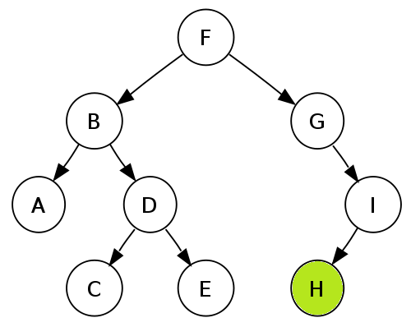
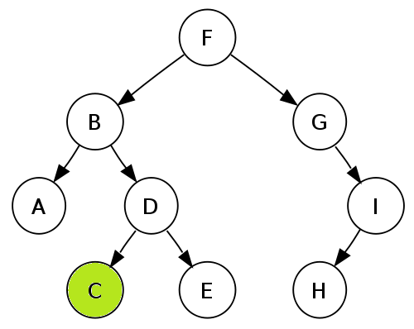
Module-7.0 Random Forest
Two Major belief
Most of the tree can provide correct prediction of class for most part of data.
The tree are making mistakes at different places.
That’s why if we conduct voting for each of the observation and then decide class of the
observation based on poll result, it is expected to be more close to correct classification.
Y = H
https://www.educba.com/machine_learning_n_R/

Slide 6
Module-7.0 Random Forest
Bootstrap aggregating, also called bagging, is a machine learning ensemble meta-algorithm designed to improve the stability and accuracy of machine learning algorithms used in statistical classification and regression. It also reduces variance and helps to avoid overfitting. Although it is usually applied to decision tree methods, it can be used with any type of method. Bagging is a special case of the model averaging approach.
https://www.educba.com/machine_learning_n_R/

Slide 7
Module-7.0 Random Forest
Boosting is a machine learning ensemble meta-algorithm for primarily reducing bias, and also variance in supervised learning, and a family of machine learning algorithms which convert weak learners to strong ones.
Boosting algorithms
While boosting is not algorithmically constrained, most boosting algorithms consist of iteratively learning weak classifiers with respect to a distribution and adding them to a final strong classifier. When they are added, they are typically weighted in some way that is usually related to the weak learners' accuracy. After a weak learner is added, the data are reweighted: examples that are misclassified gain weight and examples that are classified correctly lose weight (some boosting algorithms actually decrease the weight of repeatedly misclassified examples, e.g., boost by majority and BrownBoost). Thus, future weak learners focus more on the examples that previous weak learners misclassified.
https://www.educba.com/machine_learning_n_R/

Slide 8
Module-7.0 Random Forest
Ensemble learning
In statistics and machine learning, ensemble methods use multiple learning algorithms to obtain better predictive performance than could be obtained from any of the constituent learning algorithms alone. Unlike a statistical ensemble in statistical mechanics, which is usually infinite, a machine learning ensemble refers only to a concrete finite set of alternative models, but typically allows for much more flexible structure to exist among those alternatives.
Evaluating the prediction of an ensemble typically requires more computation than evaluating the prediction of a single model, so ensembles may be thought of as a way to compensate for poor learning algorithms by performing a lot of extra computation. Fast algorithms such as decision trees are commonly used in ensemble methods (for example Random Forest), although slower algorithms can benefit from ensemble techniques as well.
https://www.educba.com/machine_learning_n_R/

Slide 9
Module-7.0 Random Forest
https://www.educba.com/machine_learning_n_R/

Slide 10
Module-7.0 Random Forest
Attribute information
LB - FHR baseline (beats per minute)
AC - # of accelerations per second
FM - # of fetal movements per second
UC - # of uterine contractions per second
DL - # of light decelerations per second
DS - # of severe decelerations per second
DP - # of prolongued decelerations per second
ASTV - percentage of time with abnormal short term variability
MSTV - mean value of short term variability
ALTV - percentage of time with abnormal long term variability
MLTV - mean value of long term variability
Width - width of FHR histogram
Min - minimum of FHR histogram
Max - Maximum of FHR histogram
Nmax - # of histogram peaks
Nzeros - # of histogram zeros
Mode - histogram mode
Mean - histogram mean
Median - histogram median
Variance - histogram variance
Tendency - histogram tendency
CLASS - FHR pattern class code (1 to 10)
NSP - fetal state class code (N=normal; S=suspect; P=pathologic)
https://www.educba.com/machine_learning_n_R/

Slide 11
Module-7.0 Random Forest
Data Set Information:
2126 fetal cardiotocograms (CTGs) were automatically processed and the respective diagnostic features measured. The CTGs were also classified by three expert obstetricians and a consensus classification label assigned to each of them. Classification was both with respect to a morphologic pattern (A, B, C. ...) and to a fetal state (N, S, P). Therefore the dataset can be used either for 10-class or 3-class experiments.
FILE – CTG.XLSX
https://www.educba.com/machine_learning_n_R/

Slide 12
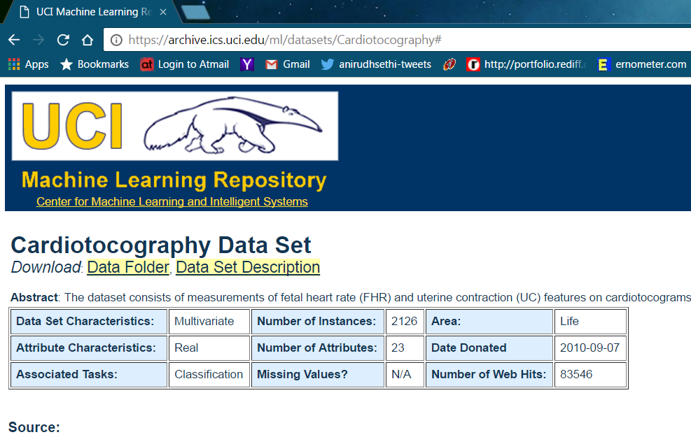
Module-7.0 Random Forest
https://www.educba.com/machine_learning_n_R/

Slide 13
Module-7.0 Random Forest
tuneRF From randomForest v4.6-12 by Andy Liaw
Tune RandomForest For The Optimal Mtry Parameter
Starting with the default value of mtry, search for the optimal value (with respect to Out-of-Bag error estimate) of mtry for randomForest.
Keywords classif, tree
Usage
tuneRF(x, y, mtryStart, ntreeTry=50, stepFactor=2, improve=0.05, trace=TRUE, plot=TRUE, doBest=FALSE, ...)
https://www.educba.com/machine_learning_n_R/

Slide 14
Module-7.0 Random Forest
varImportance From uplift v0.3.5 by Leo Guelman
Extract Variable Importance From UpliftRF Or Ccif Fitted Objects
This is the extractor function for variable importance of predictors.
KeywordsTrees, uplift
Usage
"varImportance"(x, n.trees = x$ntree, plotit = TRUE, normalize = TRUE, ...)
Arguments
xan object of class upliftRF or ccif.n.treesnumber of trees used in the prediction; The default is x$ntree.plotitplot variable importance?normalizeif set to TRUE, the importance is scaled to add up to 100....additional arguments passed to barplot.
https://www.educba.com/machine_learning_n_R/

Slide 15
Module-7.0 Random Forest
Importance From rminer v1.4.1 by Paulo Cortez
Measure Input Importance (Including Sensitivity Analysis) Given A Supervised Data Mining Model.
Measure input importance (including sensitivity analysis) given a supervised data mining model.
Keywords
classif, neural
Usage
Importance(M, data, RealL = 7, method = "1D-SA", measure = "AAD", sampling = "regular", baseline = "mean", responses = TRUE, outindex = NULL, task = "default", PRED = NULL, interactions = NULL, Aggregation = -1, LRandom = -1, MRandom = "discrete", Lfactor = FALSE)
https://www.educba.com/machine_learning_n_R/

Slide 16
Module-7.0 Random Forest
varUsed From snpRF v0.4 by Greg Jenkins
Variables Used In A Random Forest
Find out which predictor variables are actually used in the random forest.
Keywords tree
Usage
varUsed(x, by.tree=FALSE, count=TRUE)
Arguments
xAn object of class snpRF.by.treeShould the list of variables used be broken down by trees in the forest?countShould the frequencies that variables appear in trees be returned.
https://www.educba.com/machine_learning_n_R/

Slide 17
Module-7.0 Random Forest
partialPlot From boostmtree v1.1.0 by Udaya Kogalur
Partial Plot Analysis
Partial dependence plot of x against adjusted predicted y.
Usage
partialPlot(x, pred.data, x.var, which.class,
add = FALSE, n.pt = min(length(unique(pred.data[, xname])), 51),
rug = TRUE, xlab=deparse(substitute(x.var)), ylab="",
main=paste("Partial Dependence on", deparse(substitute(x.var))),
...)
https://www.educba.com/machine_learning_n_R/

Slide 18
Module-7.0 Random Forest
getTree From MST v2.0 by Peter Calhoun
Extract Initial Or Best-Sized Tree
This function extracts the tree based on the split penalty.
Usage
getTree(mstObj, Ga = c("0", "2", "3", "4", "log_n"))
Arguments
mstObjThe output from the MST fitGaThe split penaltyValue
The tree of object class "constparty"
https://www.educba.com/machine_learning_n_R/

Slide 19
Module-7.0 Random Forest
MDSplot From randomForest v4.6-12 by Andy Liaw
Multi-Dimensional Scaling Plot Of Proximity Matrix From RandomForest
Plot the scaling coordinates of the proximity matrix from randomForest.
Usage
MDSplot(rf, fac, k=2, palette=NULL, pch=20, ...)
Arguments
rf - an object of class randomForest that contains the proximity component.faca factor that was used as response to train rf.
k- number of dimensions for the scaling coordinates.
palettecolors - to use to distinguish the classes; length must be the equal to the number of levels.pchplotting symbols to use....other graphical parameters.
https://www.educba.com/machine_learning_n_R/

Slide 20
Module-7.0 Random Forest
Thanks….
https://www.educba.com/machine_learning_n_R/

