Slide 1

Wireless Power Transfer for Electric Vehicle
Senior Design Project, EEE/CSE499
Group-6 Members:
ID: 1721386043 ID: 1530994043 ID: 1621748042
Khairul Alam Md Shahidul Islam Mozumder Md. Mahfuzzaman
Supervisor
Dr. Shahnewaz Siddique – SNS1
Assistant Professor
ELECTRICAL AND COMPUTER ENGINEERING
NORTH SOUTH UNIVERSITY
SUMMER 2021

Slide 2
Introduction
Since global warming is increasing around the globe, all of the industries are trying to lessen the emission of carbon through using electrical machines and devices. Cars are one of the biggest reason for air pollution or carbon emission. Today the automotive industry is trying to go full electric cause it causes almost zero carbon emission and is environment friendly. Almost every country in the world is working on the development of EVs. Since we rely too much on gasoline, it’s a fact of fear that when there will be a shortage of gasoline, the world will face a huge price hike on gasoline and that will eventually affect the economy of the world. EVs are the future of the automobile industry which can actually solve all these problems.

Slide 3
Existing Problems or Challenges
Long charging period.
Insufficient charging stations.
Increased electricity consumption.
Weight causing less efficiency
Not efficient for off-road uses
Single speed transmission

Slide 4
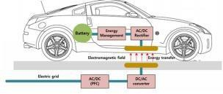
Solution
Inductive wireless power system technology was thereby proffered as a solution in eliminating the charging hazards associated with the plug-in electric vehicle and cable related problems too.
Figure: Wireless Power Transfer System for Electric Vehicle (Choi, 2014)

Slide 5
Technology review
Wireless charging system:
Wireless charging system has become popular in the recent years. It can be a great technology to solve the insufficiency of charging stations. Wireless charging system might cost more but it is more eco friendly than plastic wired fast chargers and it’s also faster than those cable chargers. Since EVs can only be charged at home or a charging station, wireless charging system can be used to charge your vehicle at any parking space where the wireless charging system is installed. The car will be charging till you leave it in a parking lot and do shopping. This might solve the issue of longer charging periods and insufficient charging station problems.

Slide 6
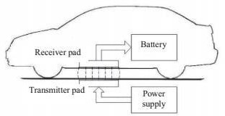
Methodology
Magnetic induction operates on the principle of a transmitting coil that generates a magnetic field and a receiving coil inside the magnetic field, which induces the current in the coils (Hui, 2013).
Figure: Wireless stationary vehicle charging (Hui, 2013)

Slide 7
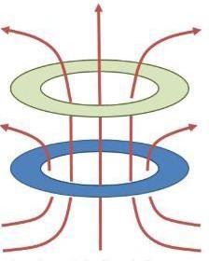
Continue..
Advantages
High frequency
High power
Longer charging distance
Disadvantages
Needs greater windings
Is more costly
Figure: Magnetic Resonance Operation technique

Slide 8
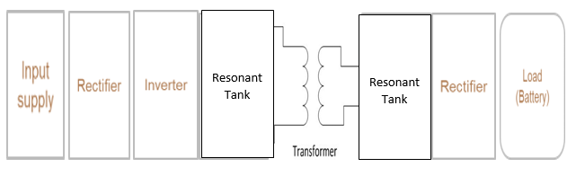
Block Diagram

Slide 9
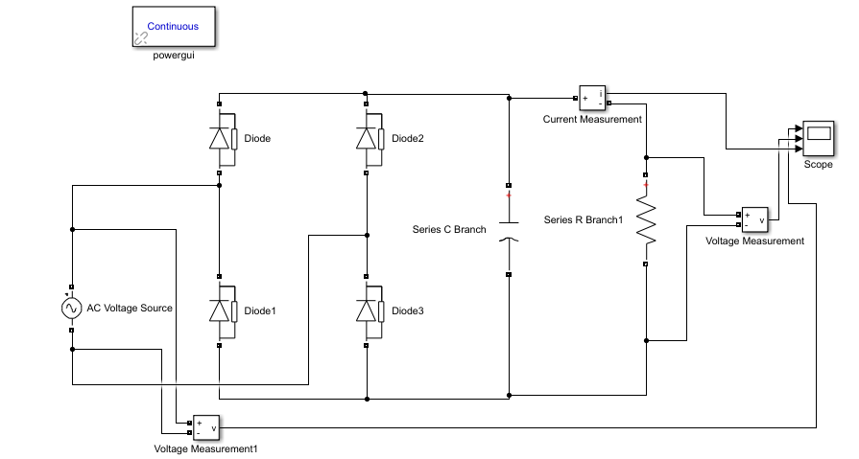
Rectifier
The proposed design uses a full wave rectifier. The rectifier circuit is built using the diode and the filter capacitor
Fig: Simulink rectifier design

Slide 10
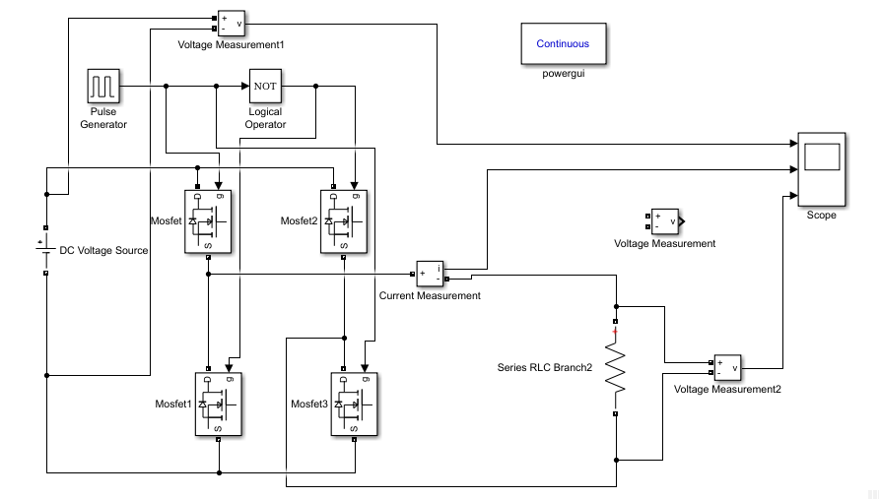
Inverter
The output of the rectifier feeds into the inverter. The element making up the inverter is the MOSFET, and the pulse generation circuit.
Fig: Simulink inverter circuit

Slide 11
Resonant circuit
𝑍 = 𝑅 + 𝑗 𝜔𝐿 +$\frac{1}{jωC}$
The average electromagnetic energy stored in the Inductor (Wm) is equal to the average electric energy stored in Capacitance (We) (Gao, 2016).
𝑊_{m} =$\frac{1}{4}$*|𝐼|²*𝐿
𝑊_{e} =$\frac{1}{4}$*|𝐼|² *1/(𝜔 ²𝐶)
At Resonance, 𝑊_{e} = 𝑊_{m} , and 𝑍_{in}=R
𝜔_{o} =1/√(𝐿𝐶)
Figure: Series RLC circuit connected to a voltage source
(Gao, 2016).

Slide 12
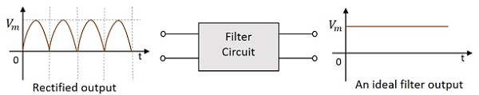
RC Filter Circuit
When we have got our rectified output we need to pass the voltage signal through a RC filter so that the changing DC voltage is converted into a more stable DC voltage. This can also be done by using a DC to DC converter circuit.
Here the R stands for Resistor and C stands for Capacitor.

Slide 13
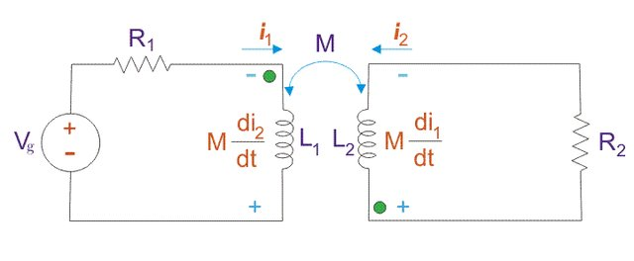
Mutual Inductance
When two devices are structured in such a way that any change in current in one wire induces a voltage around the end of the second wire through electromagnetic induction, they are called mutually inductively coupled or magnetically connected.
This is due to the mutual inductance effect.
Yahaya, C.K.H.C.K. & Adnan, Farid & Kassim, Murizah & Rahman, Ruhani & Rusdi, Mohamad. (2018). Analysis of Wireless Power Transfer on the inductive coupling resonant. Indonesian Journal of Electrical Engineering and Computer Science. 12. 592-599. 10.11591/ijeecs.v12.i2.pp592-599.

Slide 14
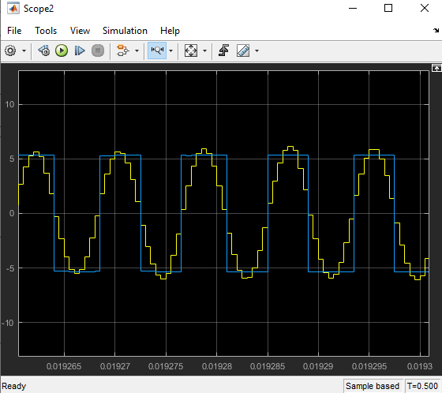
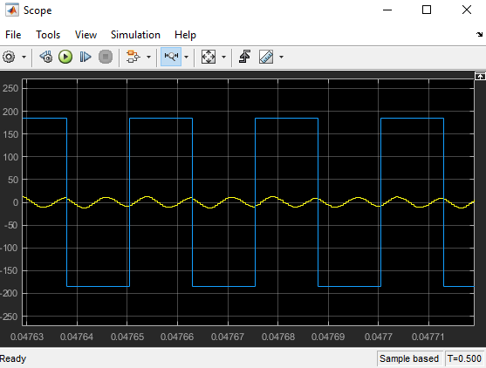
Matlab Graphs
Output current(Y) and voltage(B) in the primary side
Output current(Y) and voltage(B) in the
secondary side

Slide 15

Continued…
`
Quality factor, Q
𝑄 = 𝜔_{o}*$\frac{stored energy in L and C}{average power dissipated}$
= 𝜔_{o}*$\frac{Wm+We}{Ploss}$
Where Power loss is the power the resistor R dissipates
𝑃𝑜𝑤𝑒𝑟 𝑙𝑜𝑠𝑠 = ½*|𝐼|²*𝑅
At Resonance,
𝑄 = 𝜔_{o}*$\frac{2We}{Ploss}$
𝑄 = $\frac{1}{ωoRC}$
Reference: Ayisire, Erhuvwu, (2019)

Slide 16
Limitations of Our solutions
The most prominent drawback of all WPT systems is the fact that low efficiency energy is transferred. Most of the losses takes place during the energy transfer from coil to coil.
Furthermore, installation cost of WPT charging systems will be more than plug-in charging methods

Slide 17
Future Modifications
To implement the simulation we have faced some problem for element calculation. We will try to improve these problem. Since software tests have done on a low-power test bed, future work should focus on implementing the high-power hardware testbed and testing its performance.

Slide 18
Conclusion
This project work proposes a model which can be implemented in the future for dynamic wireless charging. This project work implements the wireless power transfer considering the closed loop system. The transmitter and the receiver coils are both working at a resonant frequency of 50Hz. The voltage induced at the receiver end of a wireless transfer system depends on the mutual coupling between the transmitter and the receiver coil, which in turn depends on the separation between the coils and the coil inductance. As the distance between the two coils is getting larger, the voltage at the receiver end of the transmission reduces.

Slide 19
References
[1] M. Kline I. Izyumin B. a. S. Boser, S., ‘‘Capacitive power transfer for contactlesscharging,” in Applied Power Electronics Conference and Exposition (APEC),Twenty-Sixth Annual IEEE Fort Worth, TX 2011 2011 1398 140
[2] Kafeel Ahmed Kalwar, Muhammad Aamir, Saad Mekhilef,
Inductively coupled power transfer (ICPT) for electric vehicle charging – A review,
Renewable and Sustainable Energy Reviews,
Volume 47, 2015, Pages 462-475, ISSN 1364-0321
[3] Y. Hori, “Future vehicle driven by electricity and control research on four-wheel-motored - uot electric march ii,” IEEE Transactions on Industrial Electronics, vol. 51, no. 5, 2004.
[4] Z. F. Bai, S. X. Li, and B. G. Cao, “h1 control applied to electric torque control for regenerative braking of an electric vehicle,” Asian Network for Scientific Information, vol. 5, 2005.
[5] D. Peng, Y. Zhang, C. Yin, and J. Zhang, “Combined control of a regenerative braking and antilock braking system for hybrid electric vehicles,” International Journal of Automotive Technology, vol. 9, no. 6, 2008.
[6] M.K. Yoong , Y.H Gan, C.K Leong, Z.Y Phuan, B.K Cheah, K.W Chew, “Studies of Regenerative Braking in Electric Vehicle” Proceedings Of the 2010 IEEE Conference on Sustainable Utilization and Development in Engineering and Technology University Tunku Abdul Rehman, November 20-21, 2010.

Slide 20
References
[7] Jingang Guo, Junping Wang, Binggang Cao, “Regeneratie Strategy for Electric Vehicles” IEEE, 2009.
[8] IEA (2020), Global EV Outlook 2020, IEA, Paris https://www.iea.org/reports/global-ev-outlook-2020
[9] Pratik Bhandari, Shubham Dubey, Sachin Kandu, Rupesh Deshbhratar, “Regenerative Braking Systems (RBS)” in International Journal of Scientific & Engineering Research, Volume 8, Issue 2, February-2017 ISSN 2229-5518
[10] L. Ferraro, ‘‘Design And Control Of Inductive Power Transfer System ForElectric Vehicle Charging,” Ph.D, Information Technology And ElectricalEngineering, Università Degli Studi Di Napoli Federico Ii, Università DegliStudi Di Napoli Federico Ii, 2017.
[11]M. Q. Nguyen, P. Woods, Z. Hughes, Y. Seo, S. Rao and J. -. Chiao, "A mutual inductance approach for optimization of wireless energy transmission," Texas Symposium on Wireless and Microwave Circuits and Systems, 2014, pp. 1-4, doi: 10.1109/WMCaS.2014.7015874.
[12] Li, Yong & Hu, Jiefeng & Tianren, Lin & Li, Xiaofei & Chen, Feibin & He, Zhengyou & Mai, R.K.. (2019). A New Coil Structure and Its Optimization Design With Constant Output Voltage and Constant Output Current for Electric Vehicle Dynamic Wireless Charging. IEEE Transactions on Industrial Informatics. PP. 1-1. 10.1109/TII.2019.2896358.

Slide 21
Thank You

