Slide 1
Introduction to Laravel
20 Points in 60 minutes

Slide 2
1. What is Laravel?
PHP Framework
Open source
Fully Object Oriented Programming (OOP)
Created by Taylor Otwell in 2011
Opiniated framework
Selected features / plugin supported out-of-the box

Slide 3
2. Most popular framework
41k+ GitHub stars

Slide 4
3. Extensible
Reusable approach
Easier to develop faster, quality code
Laravel Package
Easy to install and update
Composer 👍
Dependency manager for PHP
http://composer.org

Slide 5
4. Migration File to create Database tables
Create database tables with version control
Easy to synchronize structure
Easy to rollback
Schema::create('users', function (Blueprint $table) {
$table->increments('id');
$table->string('name')->index();
$table->string('email')->unique();
$table->string('password');
$table->rememberToken();
$table->timestamps();
}

Slide 6
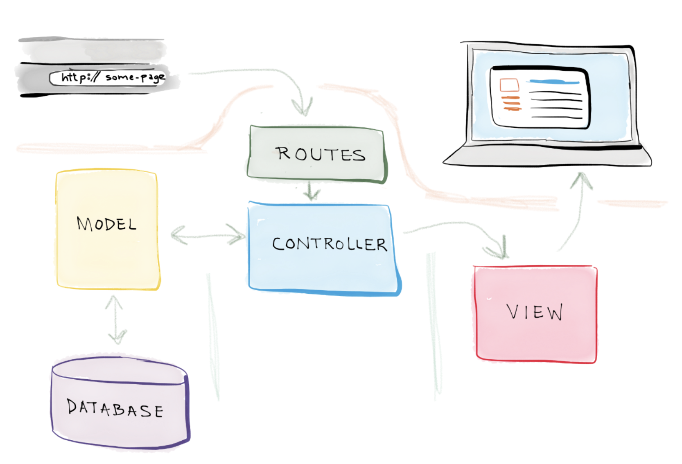
5. MVC: Model, View, Control
Model – Eloquent
View – Blade template
Control – Controller

Slide 7
5.1 Eloquent ORM (Object Relational Mapping)
Model to represent an object (or SQL table)
php artisan make:model User
Example: To query all users:
<?php
//in controller
use App\User;
...
$users= User::all();
foreach ($users as $user) {
echo $user->name;
}

Slide 8
5.1 Eloquent Finding Data
use App\User;
...
//find user where ID is 3
User::find(3);
//find users who are young
User::where(‘age’, ’<‘, 40);
//find users who are young, sort by name ASC
User::where(‘age’, ’<‘, 40)
->orderBy(‘name’, ‘ASC’);

Slide 9
5.1 Updating Data
//update user email
User::find(3)->update(
[‘email’ => ‘ali@gmail.com’]
);
//update the user with siti@gmail.com,
//if not found, create a new user
User::updateOrCreate(
[‘email’ => ‘siti@gmail.com’],
[‘lastlogin’ => \Carbon::now()]
);

Slide 10
5.1 Eloquent Relationship
Define models’ relationship
Able to retrieve data together
Various types
One to one
One to many
Many to many
Has many through

Slide 11
5.1 Eloquent Relationship
e.g: a School belongs to a State
//in Model
class School extends Model{ public function state() {
return $this->belongsTo('\App\Models\State');
}
}
//retrieve Schools with State
$data = School::with('state')->get();

Slide 12
5.2 View (using Laravel Blade template)
Blade is the simple, yet powerful templating engine provided with Laravel
Still can use <?php .. ?> tags
//in index.blade.php
Hello, {{ $name }}.
The current UNIX timestamp
is {{ time() }}.
@if (count($users) >= 1)
At least one user
@else
No users.
@endif

Slide 13
5.2 Blade is extensible
Master layout (layouts/app.blade.php)
<html>
<body>
… <nav> … </nav>
<div class="container"> @yield('content')
</div>
.. <footer> ..</footer>
</body>
</html>
login.blade.php
@extends('layouts.app')
@section('content')
<p>This is login form.</p>
<form ….> </form>
@endsection

Slide 14
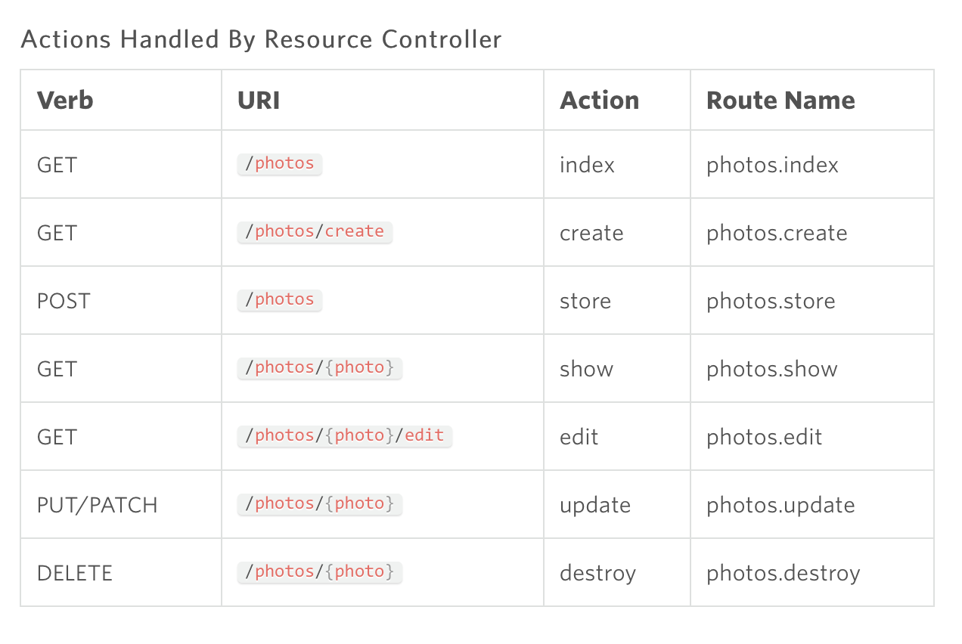
5.3 Controller
Business Logic (PHP methods only)
Similar to other frameworks
Resource Controller (standard methods with URLs)

Slide 15
6. Local Development Environment
Virtualization
Close to production environment
Laravel Homestead (pre-packaged Vagrant)
Vagrant
To setup multiple virtual machines
Laragon 👍
Easy to use Windows (similar to XAMPP)

Slide 16
7. URL Routing
Laravel has a very powerful URL routing
Route::get('foo', function () {
return 'Hello World';
});
Route::get('/users', 'UserController@index');
Route::get('user/{id}’, 'UserController@show')
->where('id', '[0-9]+');;

Slide 17
8. Security
Laravel has many built-in security features
Authentication
Route protection
Route::get('/users', ’..')->middleware(‘auth’);
Guard
Gates and Policies
Validation, Cross Site Scripting, CSRF protection

Slide 18
8.1 CSRF (Cross Site Request Forgery)
<form method="POST" action="/profile">
{{ csrf_field()}}
</form>
<meta name="csrf-token" content="{{ csrf_token() }}">

Slide 19
9. Authentication
Authentication out-of-the-box
php artisan make:auth
In view (Blade) file
@auth
// The user is authenticated... @endauth
@guest
// The user is not authenticated... @endguest

Slide 20
10. Access Control List (ACL)
Laratrust package that provides the following:
Role
Permission
Guard
Gate

Slide 21
11. Front end Scaffolding
Bootstrap CSS Framework
Mobile web / Responsive
CSS
SASS and Less
Laravel Mix (to compile into CSS)
JavaScript
Vue JS (vuejs.org)

Slide 22
12. Command Line Generator
php artisan <command>
To make a controller:
php artisan make:controller PhotoController
To run migration files
php artisan migrate
php artisan migrate:rollback

Slide 23
13. Caching Support
Improved application performance
Easy to use / switch Cache Backend
File system
Redis
Memcached
Database
APC

Slide 24
14. Other Laravel Features
API Programming
Scheduling
Broadcasting
Unit Testing
Localization
Assets Compilation (CSS, JS, minification)
Notification (Email, etc)
Event (Queue, Listener)
Seeding
Pagination

Slide 25
What’s next?
Download this slides from
https://github.com/kometsoft/laravel-introduction
Complete survey form
Receive free gift
Contact us for your Laravel projects
info@kometsoft.com.my

Slide 26
Let’s begin the Laravel journey!
Khairul Amri Yunus
amri@kometsoft.com.my
www.Kometsoft.com.my

