Slide 1

Welcome To Our Presentation

Slide 2
KHIRUL ISLAM
171-15-1375
Farzana Hasnat Mou
171-15-1181

Slide 3

Our Presentation Topic

Slide 4
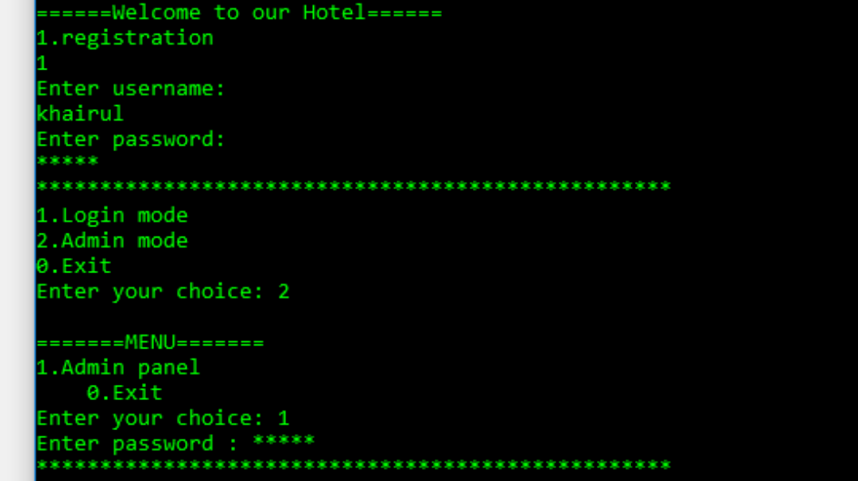

Slide 5
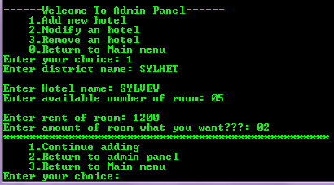

Slide 6
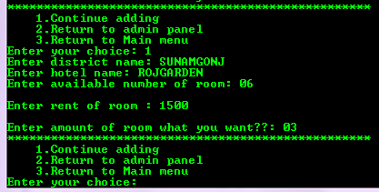

Slide 7
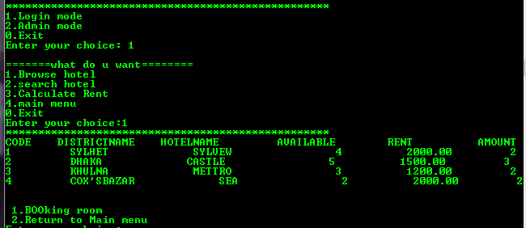

Slide 8


Slide 9
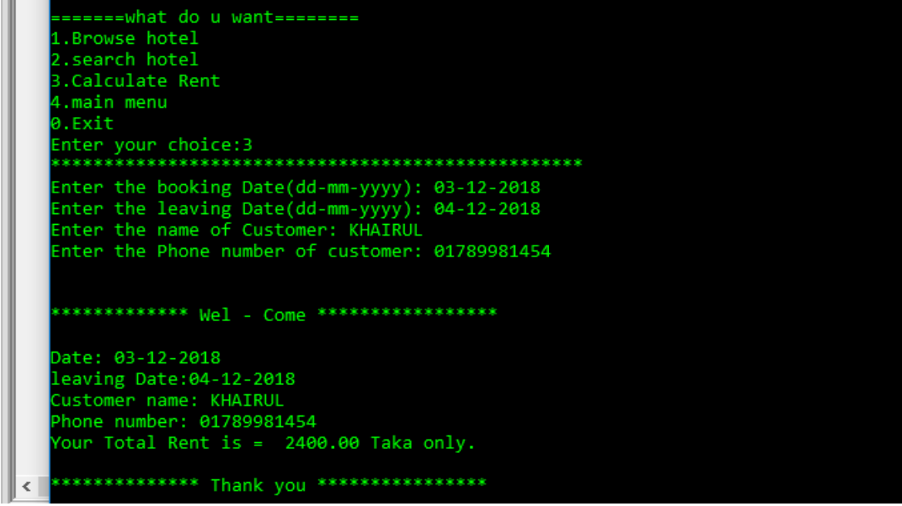

Slide 10
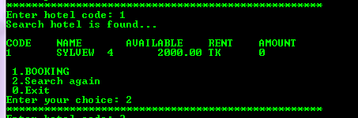

Slide 11
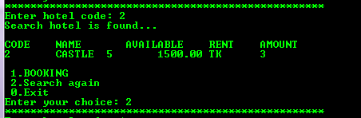

Slide 12
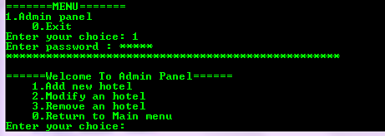

Slide 13
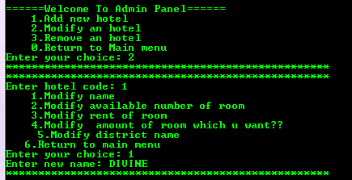

Slide 14



Slide 15
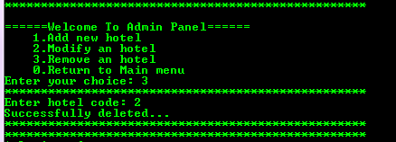

Slide 16


Slide 17
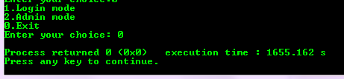

Slide 18

The End

