Slide 1
MARITIME
What does it mean?
“Maritime” refers to anything related to the sea, oceans, and their related activities. This includes shipping, ports, maritime law, and the industries and individuals involved in these areas.

Slide 2
MARITIME INDUSTRY
The Maritime Industry is waterborne commerce – it’s about moving people and goods over the water.
Maritime is most everything connected to the sea or waterways throughout the world, especially in relation to navigation, shipping, and marine engineering. The industry has a direct impact on much of our everyday lives.

Slide 3
Maritime Industry Segments
PORTS
SHIPPING
OFFSHORE WORKS
FISHING
SHIP BREAKING
SHIP BUILDING

Slide 4
WHY IS MARITIME INDUSTRY IMPORTANT
OVER 90% OF WORLD TRADE IS CARRIED BY SEA AND OCEAN
MOST COST EFFECTIVE AND EFFICIENT FOR MOVING LARGE VOLUMES OF GOODS
SUPPORTS MILLIONS OF JOBS
FISHING RESOURCES
TOURISM HOTSPOT

Slide 5
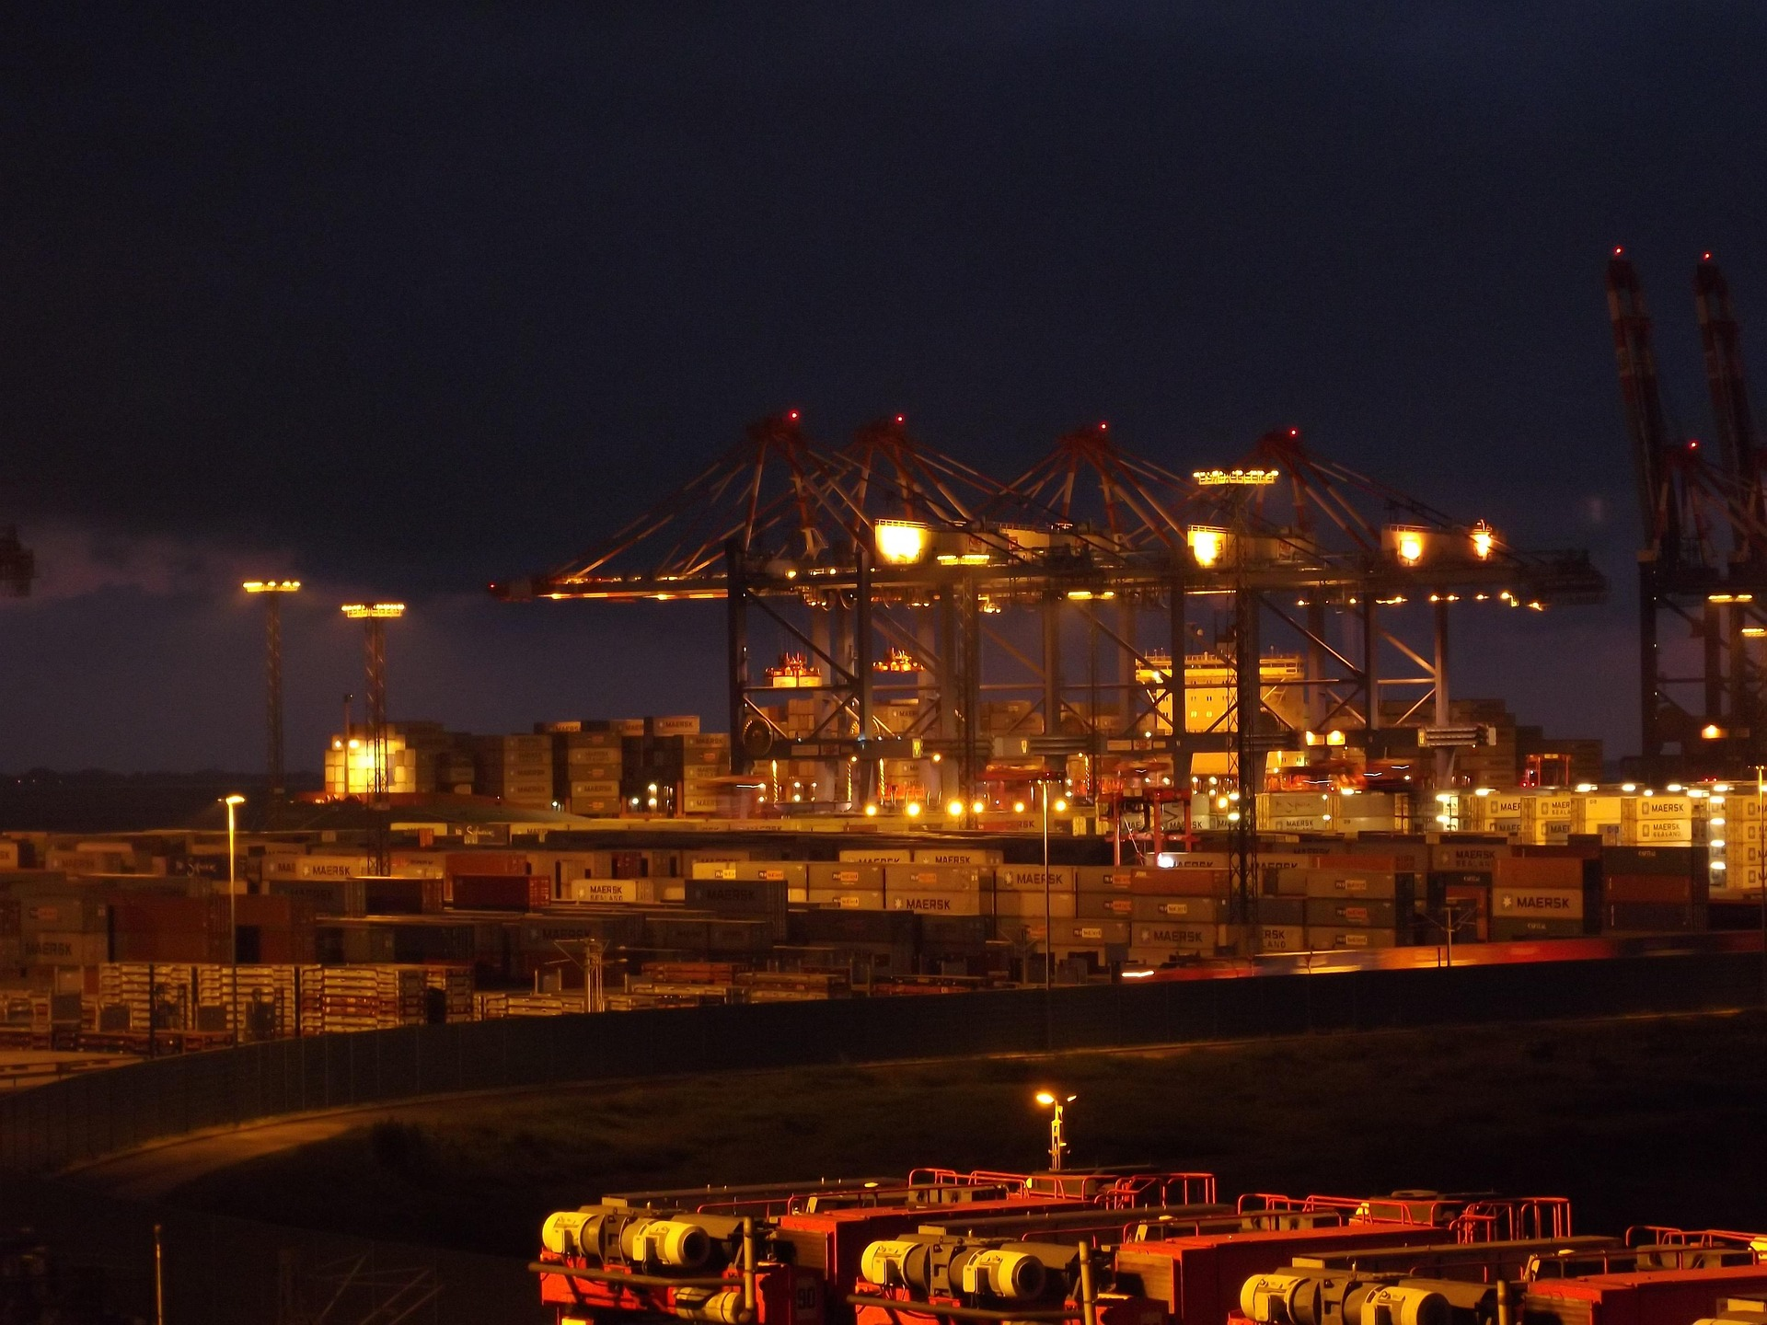
PORT
A Port is a geographical area where ships are brought alongside land to load and unload cargo – usually a sheltered deep water area such as a bay, or river mouth.

Slide 6
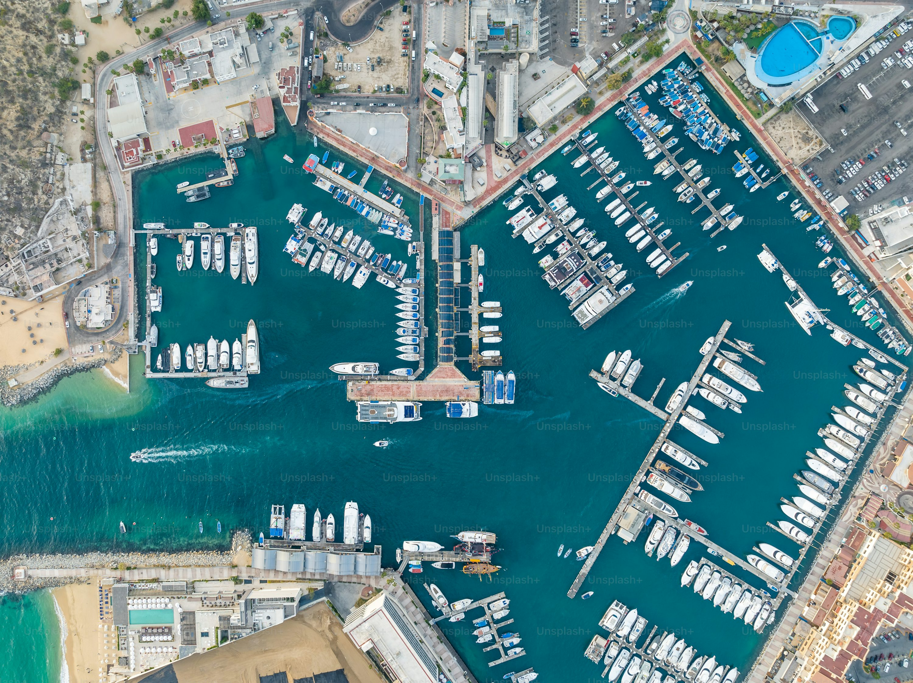
HARBOUR
A harbour can be a man made or a natural feature connecting a piece of land with a large water body that is mainly used to provide shelter to ships and vessels from bad weather. Harbours are used for safe anchorage of ships. Natural harbours are surrounded by land on most sides but have an entrance point to the sea. When harbours are artificially created, they serve as ports.

Slide 7
PORT VS HARBOUR
ASPECT | PORT | HARBOUR
DEFINITION
NATURE | Man-made | Natural or Artificial
PURPOSE | Trade, commerce | Safe anchorage, protection from rough seas
ACTIVITY | Loading/Unloading, Customs clearance, Shipping | Anchoring, Waiting, Protection from weather
COMPONENTS | Docks, Cranes, Warehouse, Terminal | Break waters, Jetties, Piers

Slide 8
IDEAL PORT OR HARBOUR
Deep and Calm Water
Minimum Interference
Strategic Location
Multi-Modal Connectivity
Expandability
Sustainability

Slide 9
CLASSIFICATION
CONDITION
Natural or Man Made
Tidal or Non Tidal
FUNCTION
Commercial Port
Refuge Harbour
FACILITY DEV
Small Local Port
Large Local Port
Sea or River Port
Sandy or Rocky or Muddy Port
Industrial Port
Fishing Port
Recreational Port
Military Port
Large Regional Port
Large Distribution Center

Slide 10
CLASSIFICATION
TRADE PATTERN
Foreign Trade Port
Domestic Trade Port
CALLING PATERN
Hub Port
Free Port
Feeder Port

Slide 11
PORT INFRASTRUCTURES
Entrance Channel
Breakwater
Sea Locks
Turning Basin
Shelter Basin
Peer, Wharf, Jetty, Quay
IWT

Slide 12
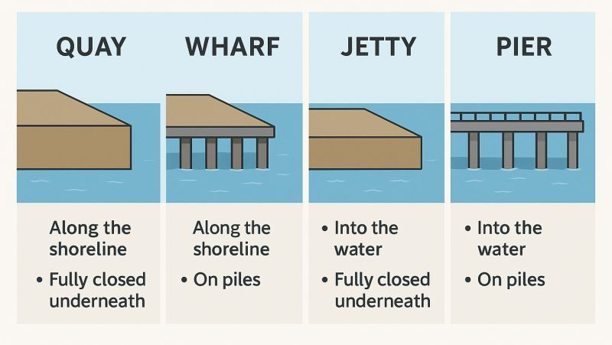
WHARF QUAY PIER JETTY
PILE
FILL
WHARF
QUAY
PARALLEL
PIER
JETTY
EXTEND

Slide 13
Port superstructure
Paving and surfacing;
Terminal lighting;
Parking areas;
Sheds, warehouses, and stacking areas;

Slide 14
Port equipment
Tugs
Line handling vessels
Dredging equipments
Ship and shore handling equipments
Cargo handling equipments

Slide 15
Port function
Functions of a port can be divided into two main parts.
Navigational Service
Handling Service
Service for Ships
Service for Cargo

Slide 16
Services and Facilities for Ships
Berthing
Navigation aids
VTS
Approach channel, breakwater
Pilotage, tugs and mooring gangs
Berths, turning basins, locks(if tidal)
Repairing

Slide 17
Services and Facilities for Cargoes
Ship
Cargo handling
Transfer
transport to/from storage
Storage
storage at shed, silo, open space
Gate
tallying, marking, weighing, surveying
surveillance, protection, sanitary measures
dangerous cargo segregation
customs and documentary control
receiving and delivery

Slide 18
PORT’S ROLE
Landlord for private entities offering a variety of services;
Regulator of economic activity and operations;
Regulator of marine safety, security, and environmental control;
Planning for future operations and capital investments;
Marketer and promoter of port services and economic development;
Provider of ancillary activities (police, immigration, health, supply of fresh water, fuel, food, telephone, medical, waste disposal etc.

Slide 19
PORT’S ROLE
Additional value added services
repackaging, labeling, sorting, assembling
cleaning and preparing cargo
setting up a logistic network
setting up a marketing package

Slide 20
IMPORTANCE OF PORT
Port is a location
Where most maritime accidents happens;
Where cargo is damaged or stolen;
Where repairs are carried out;
Where most cost are incurred;
Where delays are most likely to occur;
Where most shipping services are located, e.g. agents, brokers, etc.
Where industries are situated;
Where cargoes come from;

Slide 21
IMPORTANCE OF PORT
Distribution centre;
Industrial zone and energy supply base;
Mercantile trading centre-attracting banks, brokers and traders;
Urbanization and city redevelopment centre;
Life activity base-this is particularly the case for the smaller rural ports;
Maritime leisure base-yacht marinas, dockside recreation facilities, cruise ship terminal.

Slide 22
PORT DEVELOPMENT
There is no clear pattern of port development as the development have influenced with a combination of:
Trade, economic, spatial, political, social, and even cultural and military influence;
Labor-intensive merchant port to capital and technology –intensive enterprise;
Driving factors of port development are considered:
Industrial revolution;
Containerization.

Slide 23
Global operators
Container
MSC
CMA CGM
Bulk
Teeky
Euronav
Cruise
Carnival Corporation
Norwegian Cruise Line
Offshore
Terminal
DP World
PSA International
APM Terminal
Hutchison Port
Bourbon Offshore
DOF Group
Maersk Supply Service
Royal Caribbean Group
Frontline
Maersk
COSCO

Slide 24
PORT MODEL
1
Service Port
Tool Port
Landlord Port
Private Port
2
3
4

Slide 25
SERVICE PORT
Description: The port authority owns, operates, and manages everything—infrastructure, superstructure, and port services.
Public Role: Full control by the public sector (government or port authority).
Private Role: Minimal to none.
Examples: Some ports in developing countries; traditionally used in centrally planned economies.
Pros: Centralized control, easy coordination
Cons: Inefficiencies, bureaucratic delays, limited innovation

Slide 26
Tool PORT
Description: The port authority owns and maintains the infrastructure and equipment, but private companies operate the services (like cargo handling).
Public Role: Owns port land and equipment.
Private Role: Operates terminals and services using public equipment.
Examples: Some Indian and African ports.
Pros: Shared responsibility, early form of public-private cooperation
Cons: Conflicts over equipment use, inefficiencies in service delivery

Slide 27
landlord PORT
Description: The port authority owns the land and basic infrastructure, but leases terminals to private operators who invest in and operate the superstructure (cranes, warehouses, etc.).
Public Role: Regulator, landlord, strategic planner.
Private Role: Terminal operations, investments, employment.
Examples: Rotterdam, Singapore, Antwerp, Hamburg, Port of Los Angeles.
Pros: Encourages private investment, efficient operations
Cons: Regulatory challenges, risks of monopolistic behavior

Slide 28
PRIVATE PORT
Description: Private companies own and operate most of the port, including land and infrastructure.
Public Role: Limited to regulatory oversight.
Private Role: Full operational and investment control.
Examples: Some UK ports (e.g., Felixstowe), parts of the U.S. under public-private partnerships.
Pros: High efficiency, commercial flexibility
Cons: Risk of under-regulation, focus on profit over public interest

Slide 29
COMPARISON
Type | Infrastructure | Superstructure | Port Labor | Other Functions
Service | Public | Public | Public | Majority Public
Tool | Public | Public | Private | Public/Private
Landlord | Public | Private | Private | Public/Private
Private | Private | Private | Private | Majority Private

Slide 30
CURRENT AND FUTURE TREND
In the present context port management is experiencing change along four dimensions:
Extension of the port role
Strategies of vertical and horizontal integration
Redefinition of port foreland and hinterland
Reassessment of the port customer

Slide 31
CURRENT CHALLENGES
Larger Vessels and Cargo Concentration
ports need larger cranes, traditionally designed crane able to serve 13 containers wide vessels
post panamax vessels are having a 18 containers wide
Latest generation of vessels even needs more greater reach up to 22 to 23 containers
Environmental Concern

Slide 32
Types of Pollution Occurring in PORT
Emission
Cars
Ships
Cargo Operations
Light
Noise
Accident
Oil Spill
Cargo Spill
Trucks
Railway
Cranes
Dust
Vibration
Wash Off
Ballast Water

Slide 34
LOGISTICS
Logistics is the part of supply chain management that deals with the efficient forward and reverse flow of goods, services and related information.
“Logistics” was initially a military-based term used in reference to how military personnel obtained, stored, and moved equipment and supplies. The term is now used widely in the business sector, particularly by companies in the manufacturing sector, to refer to how resources are handled and moved along the supply chain.

Slide 35
INBOUND LOGISTICS
It's all about the movement of raw materials to production.
Inbound logistics includes:
Raw material sourcing
Inventory management
Warehousing
Transportation
Production

Slide 36
OUTBOUND LOGISTICS
It’s all about transporting the finished goods to the customer or end user.
Outbound logistics includes:
Order fulfilment
Packing
Shipping
Delivery
Customer service

Slide 37
REVERSE LOGISTICS
Reverse logistics focuses on finished products going back into the supply chain, from the end use to either the manufacturer or retailer.
Reverse logistics includes:
Customer service
Transportation
Inventory management
Remanufacturing

Slide 38
LOGISTICS SERVICE PROVIDER
Logistics service providers (LSPs) are companies that specialize in planning, implementing, and managing the efficient flow and storage of goods, services, and information between the point of origin and the point of consumption.

Slide 39
What lsp offers
Inventory management
Warehousing solutions
Order fulfillment
International Logistics
Freight shipping
Supply chain management
Transportation services

Slide 40
1st party logistics
1PL or First Party Logistics is when a person or company storing their goods themselves and transporting them to the end user. The 1PL is mostly applied within small production companies with local distribution. These companies are therefore completely self-sufficient in their logistics services.
Control: The company retains full control over its logistics operations.
Investment: Needs significant investment in equipment, personnel, and infrastructure.
Example: A manufacturer that owns and operates its own fleet of trucks to deliver its products to customers.

Slide 41
2nd party logistics
2PL or Second Party Logistics is often the first step in outsourcing logistics tasks including transport. Companies that offer 2PL services can be considered a logistics operator since, in addition to transport, they are also responsible for the storage of goods. Usually, these services take place within the company's own country.
Control: Business retains some control over its logistics operations but outsources the execution of specific tasks, usually transportation.
Investment: Company’s expenses are reduced, as it only needs to manage its own warehouses and inventory.
Example: A retailer that contracts with a trucking company to transport its goods from a supplier to its distribution centres.

Slide 42
3rd party logistics
3PL or Third Party Logistics consists of outsourcing a large part or even the entire logistics process of a company to an external logistics operator. The 3PL acts as an intermediary between the client and its customers, organising transport activities and storage facilities. 3PL also includes preparing orders, cross-docking, inventory management and return logistics. Product orders and invoicing remain with the client.
Control: The company gives some control over its operations to the 3PL but retains responsibility for setting the strategic direction.
Investment: The company’s expenses on fixed assets are further reduced, as it relies on the 3PL’s infrastructure.
Example: An e-commerce company that uses a 3PL to store, pack, and ship its products to customers.

Slide 43
4th party logistics
Fourth-party logistics (4PL) takes things to the next level. They don’t own any physical assets but act as strategic consultants — designing and managing complex supply chains across multiple 3PLs and other partners on your behalf. They use technology and data analytics to optimise your logistics network, increasing efficiency, reducing costs, and enhancing visibility.
Control: The company gives significant control over the supply chain to the 4PL while retaining only the overall responsibility for its supply chain performance.
Investment: The company’s fixed costs are minimal, as the 4PL provider takes on most of the responsibility and costs of managing your supply chain.
Example: An automotive company that uses a 4PL to manage its global supply chain, from sourcing raw materials and manufacturing to delivering finished vehicles to dealers.

Slide 44
5th party logistics
Fifth-party logistics (5PL) is still in its early stages and is building on the 4PL concepts, but it holds great potential for those looking to stay ahead of the curve with innovative logistics solutions for complex projects. 5PL providers act as an extension of the company’s operations, managing the supply chain and other aspects of business processes.

Slide 45
comparison
ASPECT | 1PL | 2PL | 3PL | 4PL
CONTROL | HIGH | MEDIUM | LOW | LOW
SCALABILITY | LIMITED | MODERATE | HIGH | VERY HIGH
PROS | FULL CONTROL, DEEP PRODUCT KNOWLEDGE, COST-EFFECTIVE FOR SMALL BUSINESSES | ACCESS TO SPECIAL EXPERTISE, COST-SAVINGS THROUGH NEGOTIATED RATES | CONVENIENCE, ONE-STOP-SHOP, SCALABILITY, AND BETTER COST OPTIMISATION | ENHANCED VISIBILITY, BETTER CONTROL, OPTIMISED FLOW, AND REDUCED COSTS
CONS | LIMITED RESOURCES, LACK OF EXPERTISE, SCALABILITY ISSUES | LIMITED SCOPE WITH LESS CONTROL, RELIANCE ON PROVIDER | HIGHER COSTS AND LOSS OF SOME CONTROL | COMPLEXITY, EXPENSIVE, REQUIRES SIGNIFICANT RESOURCES

Slide 46
1PL
Manufacturing, Wholesaling, Retailing
Cargo Owner
2PL
Transportation
Carriers
3PL
Logistics
Logistics Service Provider
4PL
Lead LP & Consultant
Supply Chain Management
5PL
Integrate Whole Production & Logistics
Aggregate the Demand of 3PL

