Slide 1
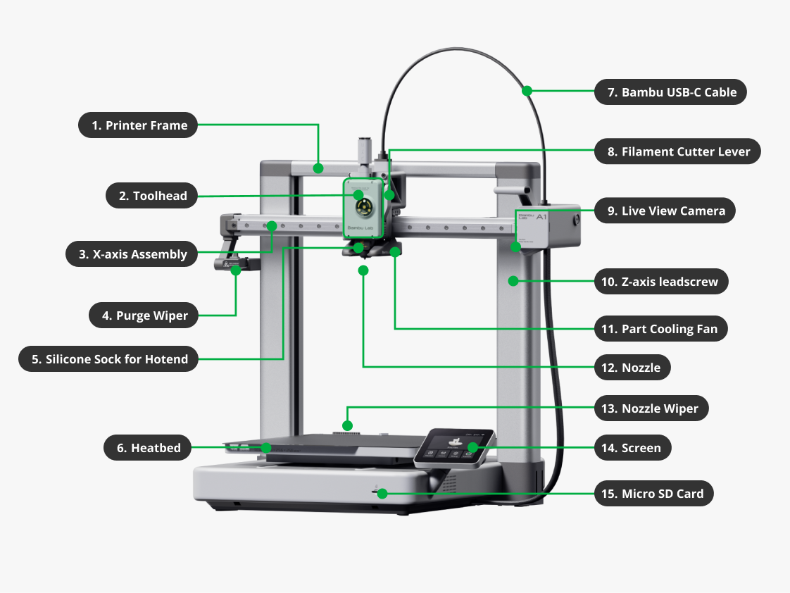
★ HANDS-ON 3D PRINTING WORKSHOP
Mastering 3D Printing
with Bambu Lab A1
Special Edition: Full Guide to Bambu Lab A1 Combo
Hardware Setup, AMS lite Multi-Color Printing, Bambu Studio Slicing & First Print Execution.
Notes:
Welcome participants to the hands-on 3D printing workshop. Ensure everyone is seated at their designated workstation with an A1 Combo unit, PLA filament, and a laptop with Bambu Studio pre-installed.

Slide 2
3D PRINTING WORKSHOP • PROGRAM SCHEDULE
Workshop Agenda & Schedule (10:00 AM - 4:00 PM)
MORNING SESSION (10:00 AM - 1:00 PM)
• 10:00 AM - 10:15 AM
Welcome & Workshop Orientation
• 10:15 AM - 10:45 AM
Session 1: 3D Printing Fundamentals & Materials (PLA, PETG, TPU)
• 10:45 AM - 11:30 AM
Session 2: Hands-on Hardware Setup (Bambu Lab A1 & AMS lite)
• 11:30 AM - 12:15 PM
Session 3: Software Ecosystem (Bambu Handy & Bambu Studio)
• 12:15 PM - 1:00 PM
Session 4: Sourcing 3D Models (MakerWorld & Repositories)
LUNCH & RECHARGE BREAK
1:00 PM - 2:00 PM (1 Hour)
AFTERNOON SESSION (2:00 PM - 4:00 PM)
• 2:00 PM - 3:15 PM
Session 5: Deep Dive into Bambu Studio
(Slicing, Infill, Tree Supports, Multi-Color Painting)
• 3:15 PM - 3:45 PM
Session 6: Hands-on First Print & Machine Operations
• 3:45 PM - 4:00 PM
Session 7: Q&A Session, Troubleshooting & Wrap-Up
Mastering 3D Printing • Bambu Lab A1 Combo Edition
Notes:
Walk through the agenda. Note that the morning is dedicated to foundations and setup, while the afternoon is 100% practical slicing and actual printing.

Slide 3
3D PRINTING WORKSHOP • MODULE 1
SESSION 1 • 10:15 AM - 10:45 AM (30 MINUTES)
3D Printing Fundamentals & Materials
Understanding FDM additive manufacturing, 3-axis motion (X, Y, Z), and selecting the right filament.
Mastering 3D Printing • Bambu Lab A1 Combo Edition
Notes:
Briefly poll participants about their experience levels with 3D printing or CAD design.

Slide 4
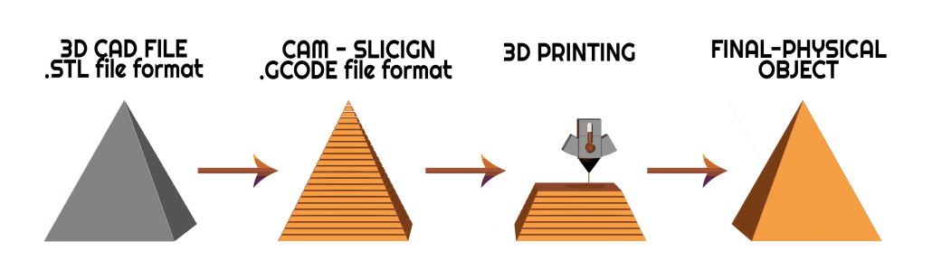
3D PRINTING WORKSHOP • SESSION 1: FUNDAMENTALS
What is 3D Printing (FDM)?
Principles of Additive Manufacturing
✔ Layer-by-Layer Object Construction
Creating physical 3-dimensional objects from digital 3D models by depositing material sequentially in micro-layers.
✔ Fused Deposition Modeling (FDM)
A solid spool of thermoplastic filament is pushed into a heated hotend, melted into viscous fluid, and extruded precisely onto a build plate.
✔ Key Benefits Over Subtractive Manufacturing
Near-zero material waste (only extruded what is needed), no complex CNC tooling required, and complete freedom to fabricate hollow and organic geometries.
Mastering 3D Printing • Bambu Lab A1 Combo Edition
Notes:
Use the hot glue gun analogy: FDM is like a computer-guided, ultra-precise hot glue gun operating on micro-millimeter steps.

Slide 5
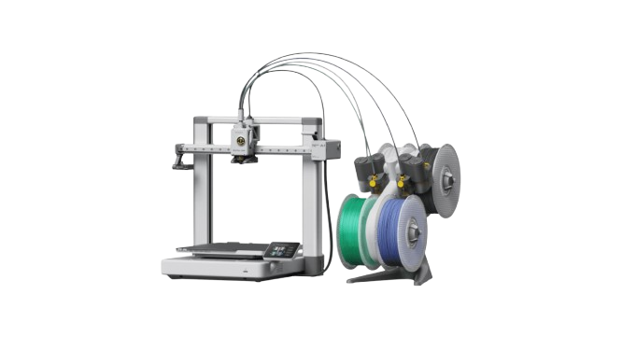
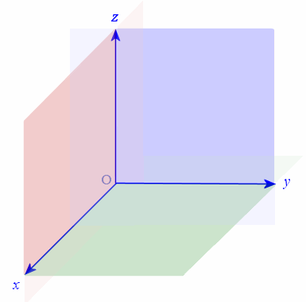
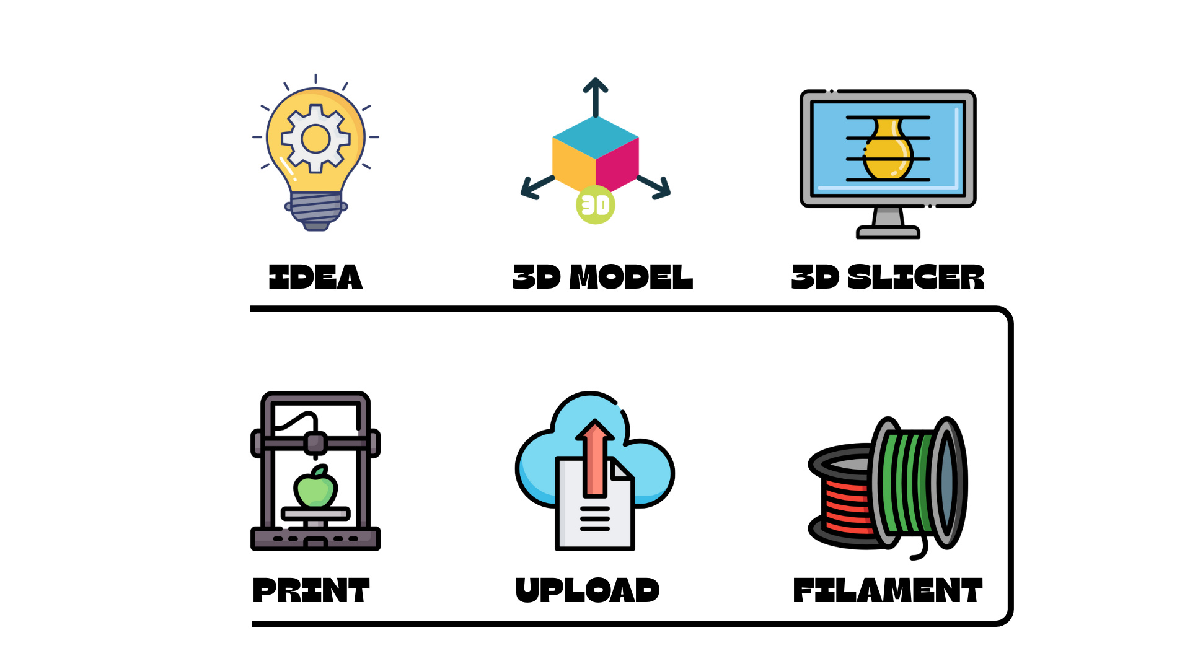
3D PRINTING WORKSHOP • SESSION 1: FUNDAMENTALS
3-Dimensional Motion Anatomy (X, Y, Z Axes)
X-Axis (Horizontal)
Left-to-Right Carriage Motion
The toolhead glides across the top horizontal gantry rail driven by a high-torque stepper belt.
Y-Axis (Longitudinal)
Front-to-Back Bed Motion
The heated print bed moves forward and backward beneath the toolhead (high-speed bedslinger design).
Z-Axis (Vertical)
Up-and-Down Gantry Lift
Dual Z-leadscrews raise the gantry incrementally after each completed layer (0.08 mm to 0.28 mm steps).
Mastering 3D Printing • Bambu Lab A1 Combo Edition
Notes:
Explain how G-code coordinates translate into coordinated motor steps on the physical machine.

Slide 6
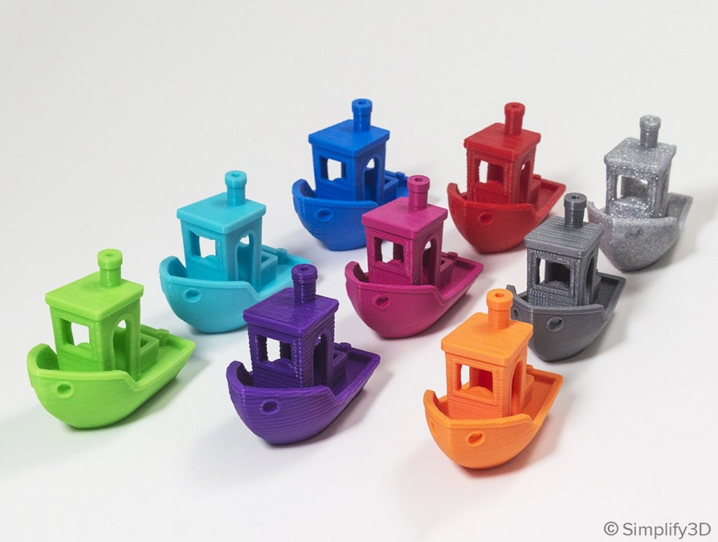
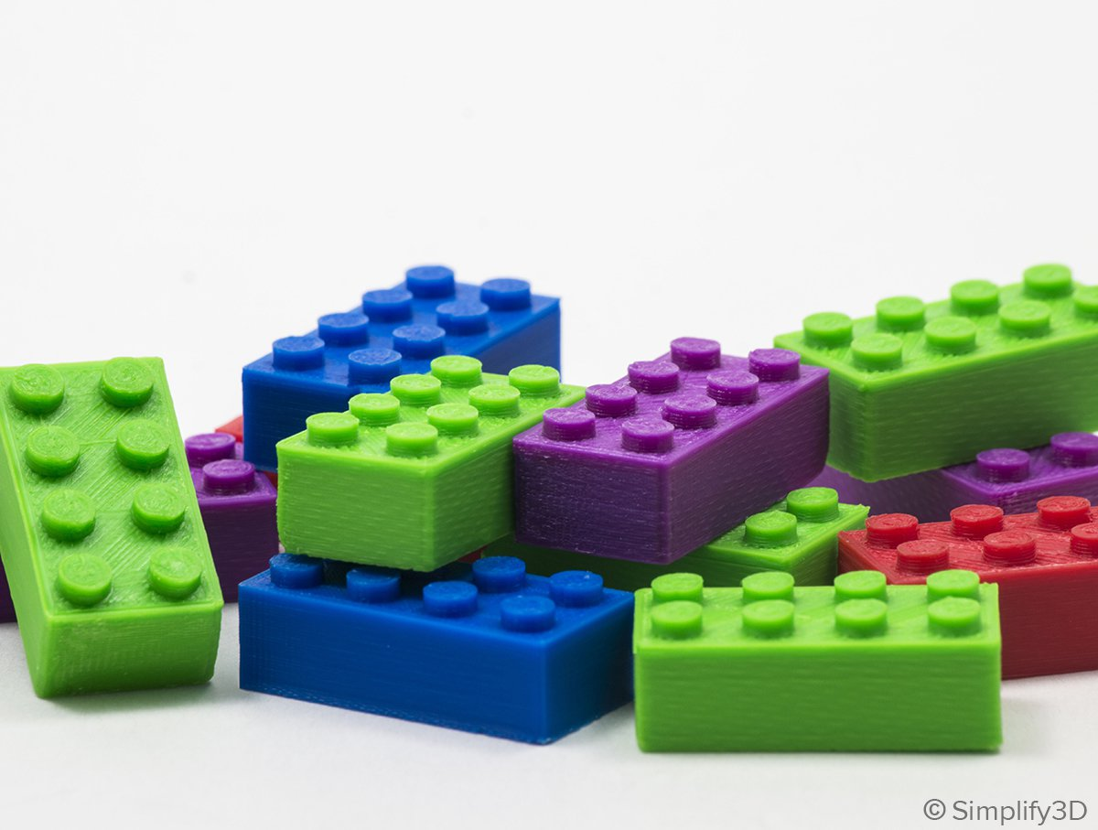
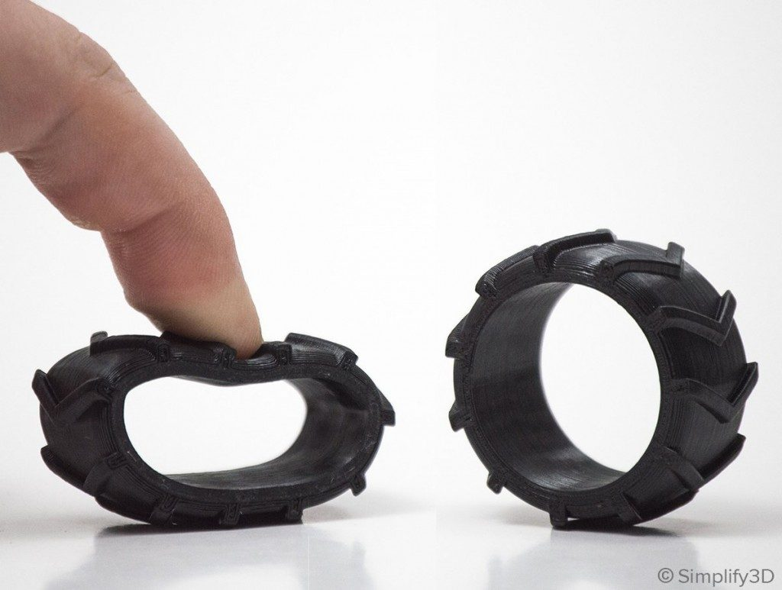
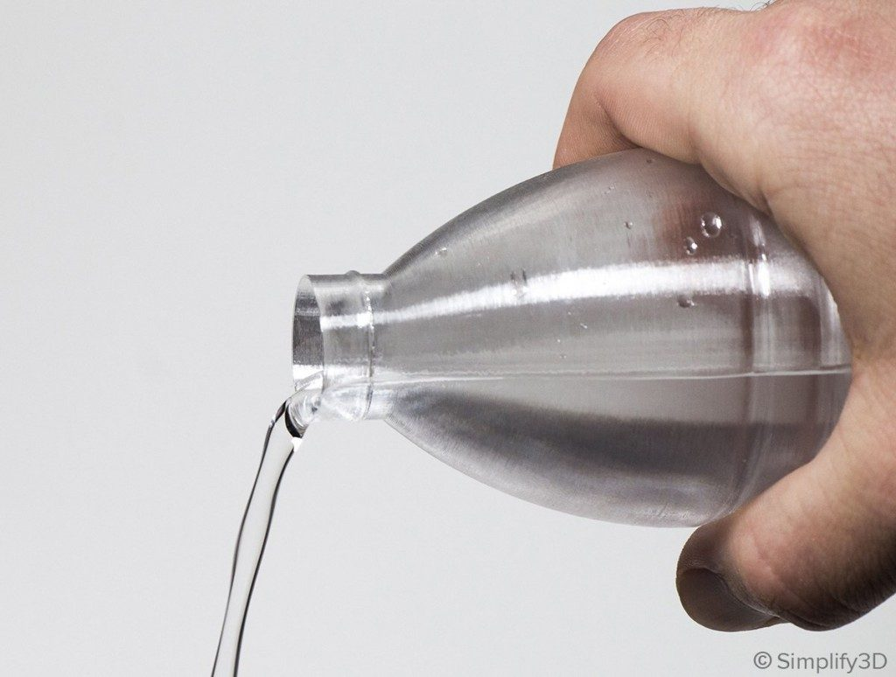
3D PRINTING WORKSHOP • SESSION 1: MATERIALS
Common 3D Printing Filaments & Properties
PLA (Polylactic Acid)
Most Popular & Beginner-Friendly
Cornstarch-based, non-toxic, odorless, zero warping. Perfect for prototypes, desk decor, educational models, and visual mockups.
PETG (Polyethylene Terephthalate)
Tough, Weather & Water Resistant
Combines PLA ease-of-print with enhanced mechanical impact resistance. Heat resistant up to ~75°C, ideal for functional outdoor brackets.
TPU (Thermoplastic Polyurethane)
Flexible & Impact Absorbing
Rubber-like elastic properties. Excellent for phone cases, gaskets, and shock mounts. *Note: Must be printed via external spool holder.
PVA / Support Material
Water-Soluble Dissolvable Support
Specialized support filament that dissolves in plain tap water. Used via AMS lite to achieve flawless overhangs without scarring.
Mastering 3D Printing • Bambu Lab A1 Combo Edition
Notes:
Highlight that today's workshop uses Bambu Lab PLA with automatic RFID spool detection.

Slide 7
3D PRINTING WORKSHOP • SESSION 1: MATERIALS
Filament Parameter Guide for Bambu Lab A1
Filament Type | Nozzle Temp (°C) | Bed Temp (°C) | Heat Resistance | AMS lite Support | Ideal Applications
Bambu PLA Basic / Matte | 190 - 230 °C | 45 - 65 °C | ~55 °C | ✔ Yes (4 Colors) | General prototypes, figurines, decor
Bambu PETG Basic | 220 - 250 °C | 65 - 75 °C | ~75 °C | ✔ Yes | Functional parts, brackets, clips
Bambu TPU 95A | 220 - 240 °C | 35 - 45 °C | ~80 °C | ❌ External Spool Only | Flexible gaskets, tires, shock absorbers
PVA (Water Soluble) | 190 - 210 °C | 45 - 55 °C | ~50 °C | ✔ Yes | Dissolvable supports for complex geometries
Mastering 3D Printing • Bambu Lab A1 Combo Edition
Notes:
Remind participants: Flexible filaments like TPU should never be loaded into AMS lite to prevent feeder jams.

Slide 8
3D PRINTING WORKSHOP • MODULE 2
SESSION 2 • 10:45 AM - 11:30 AM (45 MINUTES)
Bambu Lab A1 Combo Hardware Architecture
Hands-on exploration of the A1 machine, AMS lite 4-color multi-material system, and full-auto calibration.
Mastering 3D Printing • Bambu Lab A1 Combo Edition
Notes:
Direct participants to stand in front of their machine as we begin the hardware walk-through.

Slide 9
3D PRINTING WORKSHOP • SESSION 2: HARDWARE
Meet the Bambu Lab A1 Combo: Speed & Precision
Key Specifications & Advantages
✔ Generous Build Volume (256 × 256 × 256 mm³)
Spacious build area for functional, full-scale mechanical and educational prototypes.
✔ Blazing Print Speeds up to 500 mm/s
With acceleration up to 10,000 mm/s², prints complete 3-4x faster than standard bedslingers.
✔ 3.5-inch Color IPS Touchscreen
Intuitive, smartphone-grade user interface with clear animated status displays.
✔ Dual-Sided Textured PEI Plate
Provides outstanding adhesion without glue stick, with natural print release once cooled down.
✔ Built-in 1080p Camera with Privacy Shutter
Remote live monitoring and automated cinematic timelapse video generation.
Mastering 3D Printing • Bambu Lab A1 Combo Edition
Notes:
Point out the clean construction, all-metal linear rails, and solid cast-metal bed frame.

Slide 10
3D PRINTING WORKSHOP • SESSION 2: HARDWARE
AMS lite: 4-Color Multi-Material System
01
4-Color Multi-Material Printing
Load up to 4 spools simultaneously for seamless, automated multi-color prints without stopping.
02
Automatic RFID Filament Sync
Instantly reads Bambu Lab RFID spools to configure material type, color, and optimal print temperatures.
03
Auto Spool Backup (Runout Protection)
When spool 1 is exhausted, AMS lite automatically switches over to spool 2 of the same color.
04
Active Rewind & Tangle Prevention
Smart active motor drive prevents filament slack, jams, and entanglement during retracts.
💡 AMS lite Mounting Options: Can be positioned beside the printer on its desk stand, or mounted directly on top of the gantry via the top-mount bracket to save workspace footprint!
Mastering 3D Printing • Bambu Lab A1 Combo Edition
Notes:
Show the 4 PTFE tubes routing neatly into the 4-in-1 filament hub at the top of the A1 toolhead.

Slide 11
3D PRINTING WORKSHOP • SESSION 2: HARDWARE
Full-Auto Calibration: Precision Without Guesswork
★ Active Flow Rate Compensation
High-Frequency Eddy Current Sensor
A specialized sensor on the toolhead measures extrusion pressure in real-time, eliminating bulging corners and inconsistent extrusion.
★ Auto Bed Leveling & Auto Z-Offset
Zero Manual Bed Knobs!
The nozzle probes the heatbed across an automated grid. No manual thumbwheels, dial gauges, or feeler gauges required.
★ Vibration Compensation (Resonance)
Input Shaping for X & Y Axes
Accelerometers run high-frequency resonance sweeps before printing to cancel out ghosting and ringing at 500 mm/s.
★ Active Motor Noise Cancellation
Whisper-Quiet Operation (<48 dB)
High-frequency stepper modulation cancels out motor hum. Ideal for quiet classrooms, libraries, and open offices.
Mastering 3D Printing • Bambu Lab A1 Combo Edition
Notes:
Highlight how automated calibration removes 90% of user failure points in conventional 3D printing.

Slide 12
3D PRINTING WORKSHOP • SESSION 2: HARDWARE
Tool-Free Quick-Swap Nozzle Innovation
Fast, Safe & Tool-Free (Under 30 Seconds!)
✔ Magnetic Quick-Release Latch Mechanism
No fragile heater wires to disconnect, no dangerous hot-tightening with wrenches, and no cross-threading risks.
✔ Simple 3-Step Swap Process
1. Pull off the silicone thermal sock.
2. Flip open the spring-loaded metal clip latch.
3. Slide out the hotend, seat the new nozzle, and snap the latch shut!
✔ Nozzle Sizes for Every Use Case
• 0.2 mm: Ultra-fine miniature details, jewelry & micro text.
• 0.4 mm: Standard balanced nozzle (optimal speed & surface quality).
• 0.6 & 0.8 mm: High-volume output for large, thick-walled parts.
IMPORTANT SAFETY REMINDERS
⚠ Always ensure the nozzle has cooled down below 50°C before touching.
⚠ Always update the nozzle diameter in Bambu Studio before slicing your models.
⚠ A1 hotends are available in Stainless Steel (standard) and Hardened Steel (for wear resistance).
Mastering 3D Printing • Bambu Lab A1 Combo Edition
Notes:
Demonstrate the quick-swap latch live in front of the class so everyone sees the mechanism.

Slide 13
3D PRINTING WORKSHOP • SESSION 2: HARDWARE
Hardware Assembly Workflow: Unboxing to Print-Ready
1
Step 1: Unboxing & Gantry Unlocking
Remove protective foam cushions and unscrew the 4 transport transit screws under the chassis.
2
Step 2: Base & Gantry Assembly
Slide gantry column into the base casting and tighten the numbered retention screws securely.
3
Step 3: AMS lite Assembly & PTFE Routing
Assemble the AMS lite stand and route the 4 numbered PTFE tubes into the 4-in-1 toolhead hub.
4
Step 4: Cable & Power Connections
Connect the 4-pin AMS lite data cable to the back of the A1 and plug in the main power cable.
5
Step 5: Loading First Filament Spool
Push filament into the AMS lite feeder funnel until the internal motor automatically engages and grabs.
Mastering 3D Printing • Bambu Lab A1 Combo Edition
Notes:
Assist participants with PTFE routing and verifying cable latch engagement.

Slide 14
3D PRINTING WORKSHOP • MODULE 3
SESSION 3 • 11:30 AM - 12:15 PM (45 MINUTES)
Software Ecosystem: Bambu Handy & Bambu Studio
Connecting mobile controls, cloud synchronization, and desktop slicing workflows.
Mastering 3D Printing • Bambu Lab A1 Combo Edition
Notes:
Instruct everyone to connect to the venue Wi-Fi and launch their apps.

Slide 15
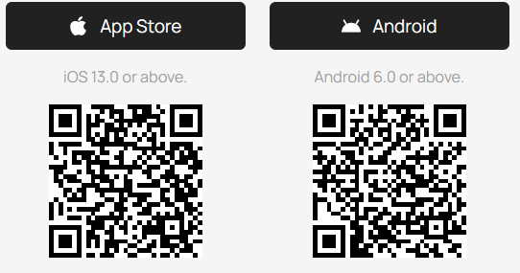
3D PRINTING WORKSHOP • SESSION 3: SOFTWARE
Mobile Operations: Bambu Handy Companion App
Complete Machine Control in Your Pocket
✔ 1. Download the Bambu Handy App
Free download on Google Play Store (Android) and Apple App Store (iOS).
✔ 2. Sign In to Your Bambu Account
Centralizes device synchronization and cloud slicing jobs across all devices.
✔ 3. Pair Printer via On-Screen QR Code
Select 'Add Device' in the app and scan the dynamic QR code displayed on the A1 touchscreen.
✔ 4. Essential Remote Features
• Real-time 1080p camera stream
• Live temperature, fan speed & print progress monitoring
• Instant push notifications on print completion or filament runout
• 1-Click printing directly from MakerWorld
Mastering 3D Printing • Bambu Lab A1 Combo Edition
Notes:
Help participants scan the pairing QR code from the printer touchscreen.

Slide 16
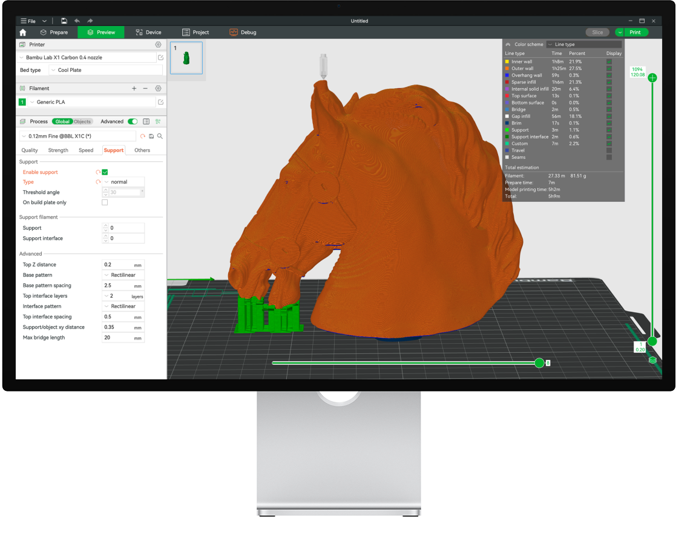
3D PRINTING WORKSHOP • SESSION 3: SOFTWARE
Desktop Slicing Workflow: Bambu Studio
The Command Center for 3D Slicing
• Prepare Tab (Layout & Configuration)
Position, orient, scale, cut, and paint models with multi-color AMS filaments.
• Preview Tab (G-Code Visualizer)
Inspect simulated toolpaths layer-by-layer, check print time estimates, and calculate filament weight in grams.
• Device Tab (Hardware Dashboard)
Monitor current nozzle/bed temps, live camera feed, and real-time AMS lite slot status.
• MakerWorld Tab (Built-in Library)
Browse, customize, and slice thousands of verified 3D models without opening a browser!
Mastering 3D Printing • Bambu Lab A1 Combo Edition
Notes:
Demonstrate the four upper-left navigation tabs in Bambu Studio.

Slide 17
3D PRINTING WORKSHOP • MODULE 4
SESSION 4 • 12:15 PM - 1:00 PM (45 MINUTES)
Sourcing & Preparing Open-Source 3D Models
Exploring MakerWorld, Printables & Thingiverse. Selecting your first model before lunch break.
Mastering 3D Printing • Bambu Lab A1 Combo Edition
Notes:
Guide participants to select a small model (under 30 mins print time) for the afternoon printing session.

Slide 18



3D PRINTING WORKSHOP • SESSION 4: 3D MODELS
3D Model Repositories & Smart File Formats (.3MF vs .STL)
⭐ MAKERWORLD (makerworld.com) — The Ultimate Ecosystem for Bambu Lab
• Verified Print Profiles: Models are pre-calibrated and community-tested specifically for Bambu Lab A1.
• Smart .3MF Format: Packages 3D geometry, AMS color assignments, plate orientation, and infill settings in one file!
• 1-Click Mobile Printing: Send jobs straight to your printer from the Bambu Handy app with zero manual slicing.
Printables.com
High-quality engineering, functional prints, and open-source CAD models by Prusa Research.
Thingiverse.com
The world's largest legacy 3D library with millions of free STL community uploads.
Thangs.com
AI-powered 3D geometric search engine indexing models across all major online repositories.
Mastering 3D Printing • Bambu Lab A1 Combo Edition
Notes:
Have each participant download 1 model file before breaking for lunch at 1:00 PM.

Slide 19
3D PRINTING WORKSHOP • MODULE 5
SESSION 5 • 2:00 PM - 3:15 PM (75 MINUTES)
Deep Dive: Bambu Studio Slicing & Multi-Color
Mastering layer heights, infill density, Tree Supports, and toolhead multi-color painting.
Mastering 3D Printing • Bambu Lab A1 Combo Edition
Notes:
Welcome participants back from lunch. Ensure everyone is ready with their laptops open.

Slide 20
3D PRINTING WORKSHOP • SESSION 5: SLICING
Slicing Anatomy: Layer Height, Walls & Infill
Layer Height
Detail vs Print Speed
• 0.08 - 0.12 mm: Ultra-fine finish (invisible layer lines, longer print time).
• 0.20 mm (Standard): Sweet spot balancing surface quality and printing speed.
• 0.28 mm (Draft): Fast rough prototyping.
Wall Loops (Shell Thickness)
Structural External Strength
• Controls the number of solid perimeter contours.
• 2 Walls: Ideal for light aesthetic decor and figurines.
• 3 - 4 Walls: Recommended for mechanical parts subjected to physical loads.
Infill Density & Patterns
Internal Structural Core
• Density: 15% - 20% is optimal for 95% of prints.
• Gyroid Pattern: Provides uniform multi-directional strength and smooth non-scraping motion.
• Grid / Cubic: Quick options for basic mockups.
Mastering 3D Printing • Bambu Lab A1 Combo Edition
Notes:
Demonstrate adjusting these settings in the Process tab on the left panel in Bambu Studio.

Slide 21
3D PRINTING WORKSHOP • SESSION 5: SLICING
Support Structures: Normal vs Tree Supports
The 45-Degree Overhang Rule
✔ When Are Supports Required?
3D printers cannot extrude into thin air! Any overhang steeper than 45° from vertical requires temporary support.
✔ Normal Supports (Traditional Grid)
Builds straight vertical columns up from the build plate. Harder to break away on curved contours and uses excessive filament.
✔ Tree Supports (Bambu Lab Preferred)
Branches out like tree limbs reaching directly to critical overhang points. Breaks off cleanly with fingers, leaves minimal scarring, and saves up to 40% material!
BAMBU STUDIO PRO SUPPORT TIPS:
★ Select 'Type: Tree (auto)' in the Support settings tab.
★ Choose 'Style: Tree Slim' for small action figures and miniatures.
★ Use the 'Support Painting Tool' to manually brush supports onto specific target areas.
★ Keep 'Top Z distance' at 0.2 mm to ensure supports pop off effortlessly with a gentle finger pull.
Mastering 3D Printing • Bambu Lab A1 Combo Edition
Notes:
Compare the visual difference between Tree Supports and Normal Supports in Preview mode.

Slide 22
3D PRINTING WORKSHOP • SESSION 5: SLICING
Multi-Color Painting Tool & Purge Management
Fill Bucket Tool
Fills entire contiguous surfaces with one click based on detected geometric edge angles.
Brush Tool
Freehand paint directly on the 3D model surface like using a digital drawing paintbrush.
Sphere / Circle Tool
Draws circular color regions (perfect for eyes, buttons, dots, or custom logos).
Height Range Tool
Colors horizontal layer bands across specified Z-axis elevation ranges (great for embossed badges).
⚠️ UNDERSTANDING PRIME TOWER & FLUSH VOLUME (PURGE POOP):
During color changes, the A1 purges old filament into the rear chute and prints a Prime Tower to re-stabilize nozzle pressure. Pro tip: Enable 'Flush Options: Flush into this object's infill' to repurpose purged material as internal infill and cut waste!
Mastering 3D Printing • Bambu Lab A1 Combo Edition
Notes:
Live demo coloring a two-color keychain model in Bambu Studio.

Slide 23
3D PRINTING WORKSHOP • SESSION 6: PRINT EXECUTION
First Print Execution & Machine Maintenance
1
1. Send Print Job (Print Plate)
Select your paired A1 printer, verify AMS lite color-to-filament mappings, and send the job via Wi-Fi Cloud or LAN mode.
2
2. Automated 5-Minute Pre-Print Routine
Let the A1 complete: Nozzle Wiping -> Resonance Vibration Sweep -> Auto Bed Leveling -> Active Flow Calibration.
3
3. First Layer Inspection
Observe the first layer deposition. A smooth, flat, uniform squish across the textured PEI sheet guarantees 99% print success.
4
4. PEI Build Plate Maintenance
Never touch the build area with bare oily fingers! Wash the PEI sheet regularly with warm water and ordinary dish soap to remove oils.
Mastering 3D Printing • Bambu Lab A1 Combo Edition
Notes:
Instruct participants to launch their prints simultaneously and observe the automated leveling process.

Slide 24
3D PRINTING WORKSHOP • WRAP-UP
SESSION 7 • 3:45 PM - 4:00 PM
Q&A SESSION & WORKSHOP WRAP-UP
Congratulations! You are Now Ready to Create with Bambu Lab A1!
Key Official Resources:
• Bambu Lab Official Wiki: wiki.bambulab.com/en/a1
• MakerWorld 3D Community: makerworld.com
• Official Customer Support: bambulab.com/support
Thank you for attending today's workshop! Collect your finished prints and happy making!
Mastering 3D Printing • Bambu Lab A1 Combo Edition
Notes:
Open the floor for questions, hand out completion certificates, and take a group photo with participants' finished prints.

