Slide 1
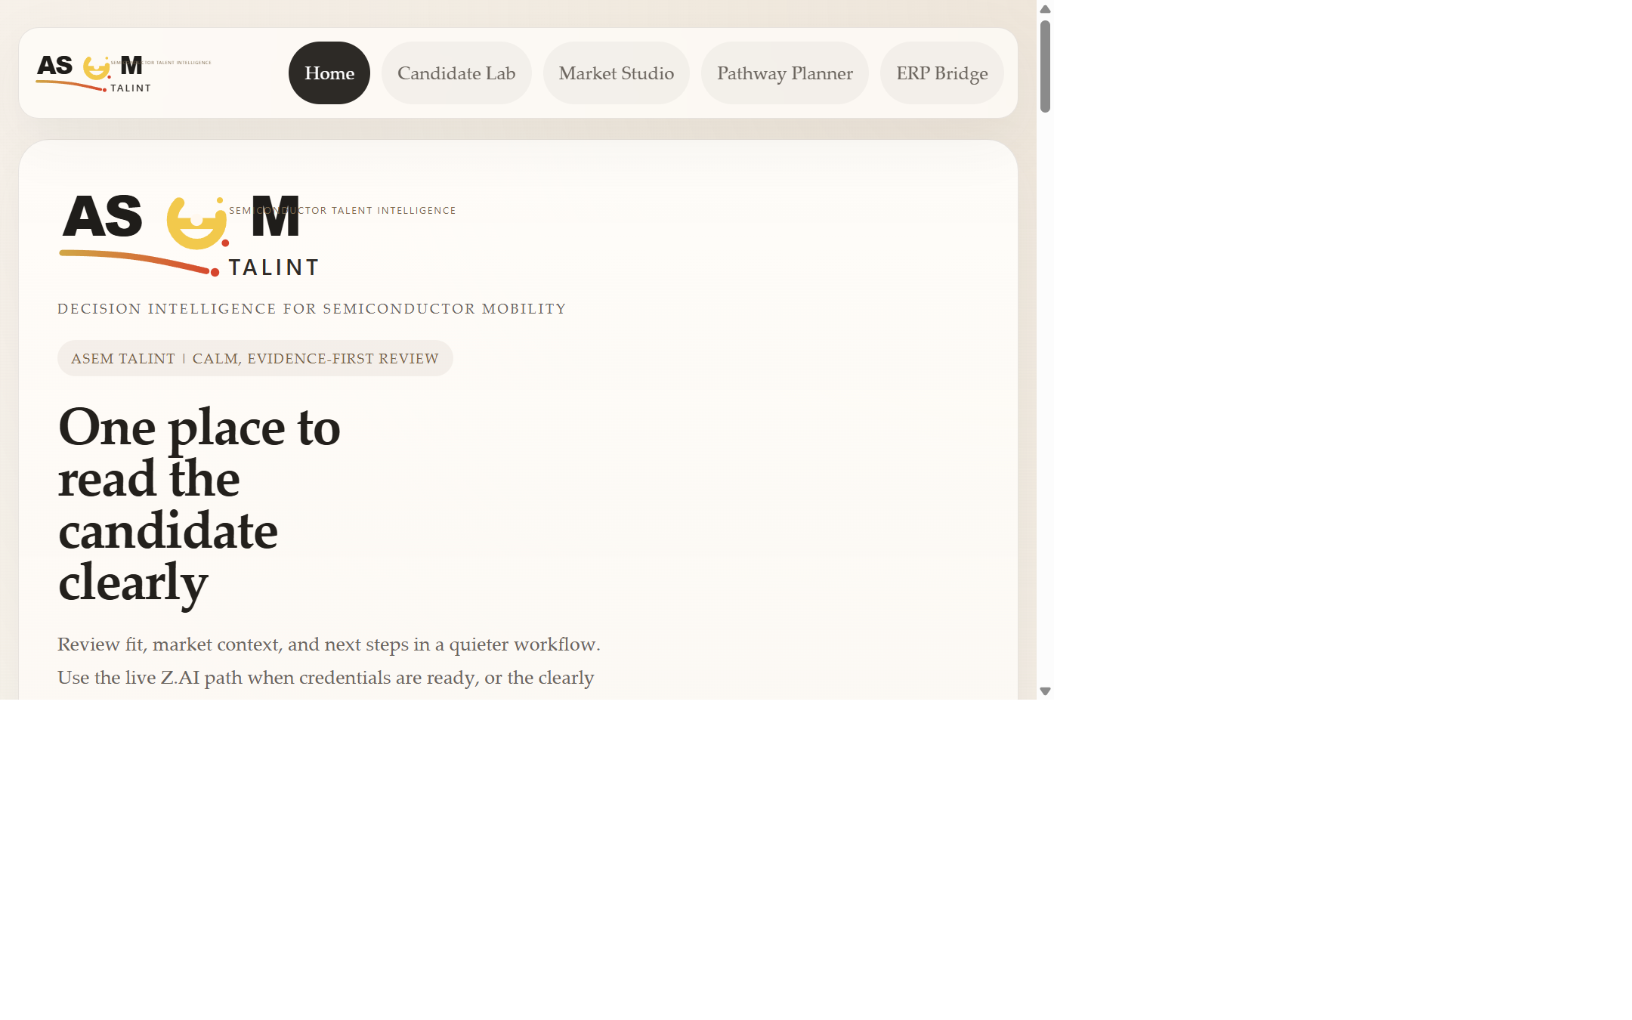
UM Hackathon 2026 | Domain 2
ASEM Talint
Dashboard-first semiconductor talent decision intelligence
Deterministic readiness scoring plus Z.AI GLM structured reasoning
Built for training-path fit, evidence review, and market-context visibility
Team Novum: Ong Khai Sern (team leader), Tan Eng Feng (team member)
One place to read the candidate clearly, with live market context and auditable AI explanation.
ASEM Talint preliminary deck | Team Novum | Local prototype screenshots from current build

Slide 2
Slide 2
Problem: placement decisions are still fragmented
What breaks today
Why it matters
Our response
Show domain fit, not just technical ambition.
Candidate-to-track decisions are still reviewed manually and inconsistently.
Missing inputs, access constraints, and labor-market context are often separated.
Pathway decisions should connect training to real economic outcomes, not only admissions workflow.
Semiconductor pathways require scarce seats, scarce OJT capacity, and better matching discipline.
Reviewers need auditable evidence, not a generic chat response.
Malaysia's industrial push makes local-value pathway allocation more strategic.
Standardize candidate evidence.
Combine deterministic scoring with official data slices.
Use Z.AI GLM for structured explanation on the judged path.
Citations: UMHackathon Domain 2 brief; UMHackathon 2026 Judging Criteria

Slide 3
Slide 3
Economic theory: what friction we reduce
Anchor the product in economic logic, not only features.
Human capital allocation
Signaling and information asymmetry
Training seats and OJT slots are scarce investments.
Resumes and credentials are noisy until structured.
Search and matching frictions
Spatial and wage frictions
Candidate, track, and employer fit must be aligned.
Access and economic payoff change pathway quality.
Feature mapping: Candidate Lab -> signals | Market Studio/OJT -> matching | GIS accessibility -> spatial friction | Wage mobility -> economic payoff | ERP Bridge -> coordination cost
Economic framing source: submission/preliminary/economic-theory-anchor.md

Slide 4
Slide 4
Why this matters in Malaysia now
Tie the product to current industrial capability-building logic.
"Made by Malaysia" raises the bar for local value creation.
Talent pathways need stronger links to vendors, SMEs, and industry demand.
Training decisions should be explainable, evidence-backed, and fast.
A pathway is stronger when access, wage direction, and employer demand all support it.
Malaysia lens
Local capability, not just placement
The national push is toward stronger local vendors, deeper SME participation, and tighter links between investment, training, and research. ASEM Talint keeps that lens visible while pathway decisions are being made.
NST source, 5 Feb 2026
Citation: New Straits Times, 5 Feb 2026, 'Shift to Made by Malaysia strategy'

Slide 5
Slide 5
Users and decision workflow
Make the target users and the review loop concrete.
Primary user
Training reviewer or program lead
Needs fit, gaps, readiness, and next action in one place
1. Ingest candidate and track evidence
2. Parse resume and standardize signals
3. Compute deterministic fit and market context
4. Use Z.AI GLM to generate structured explanation
Supporting user
Employer-partnership or OJT reviewer
Needs match quality, access, and wage context
Workflow source: PRD, pitch deck outline, and current live prototype flow

Slide 6
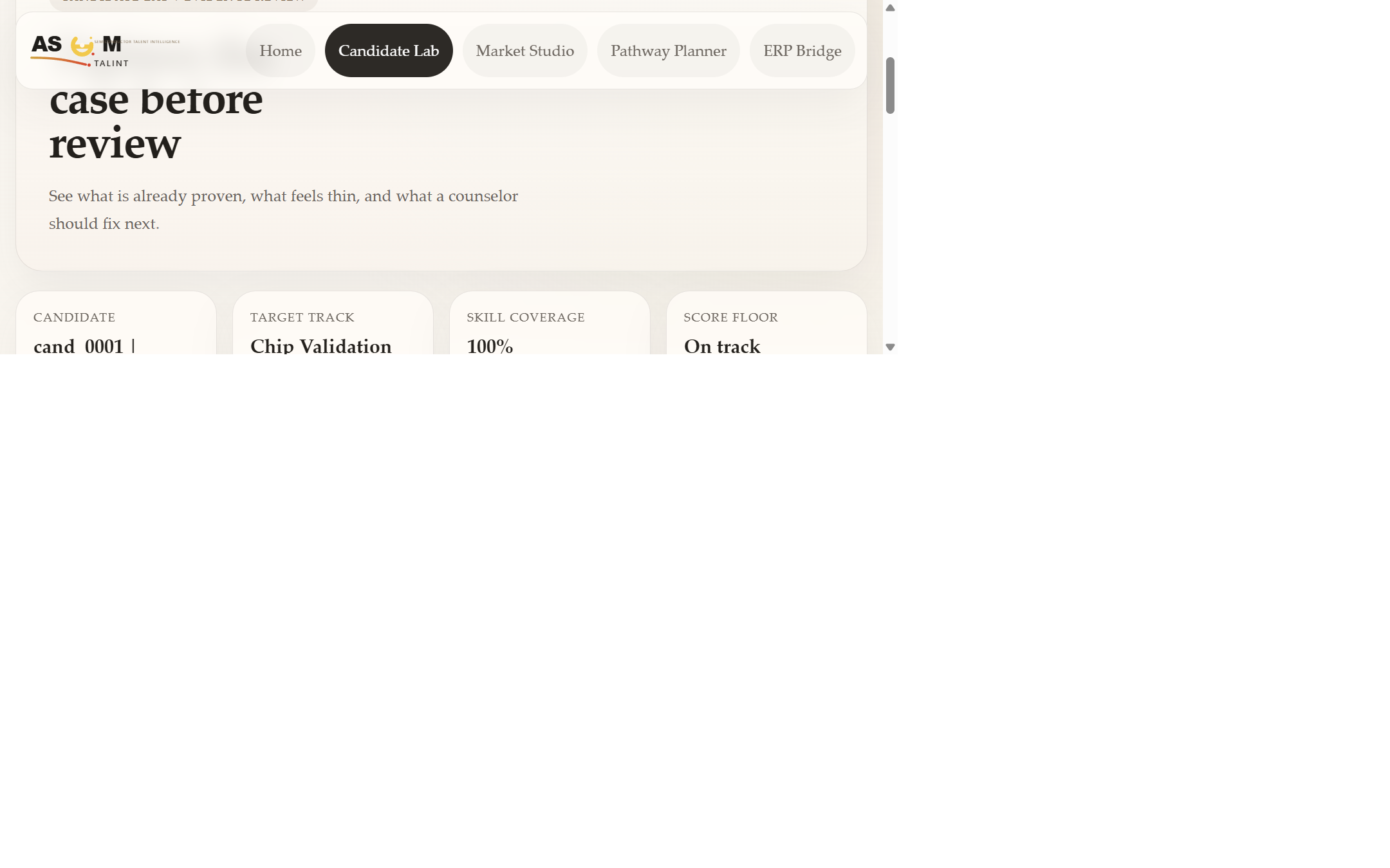
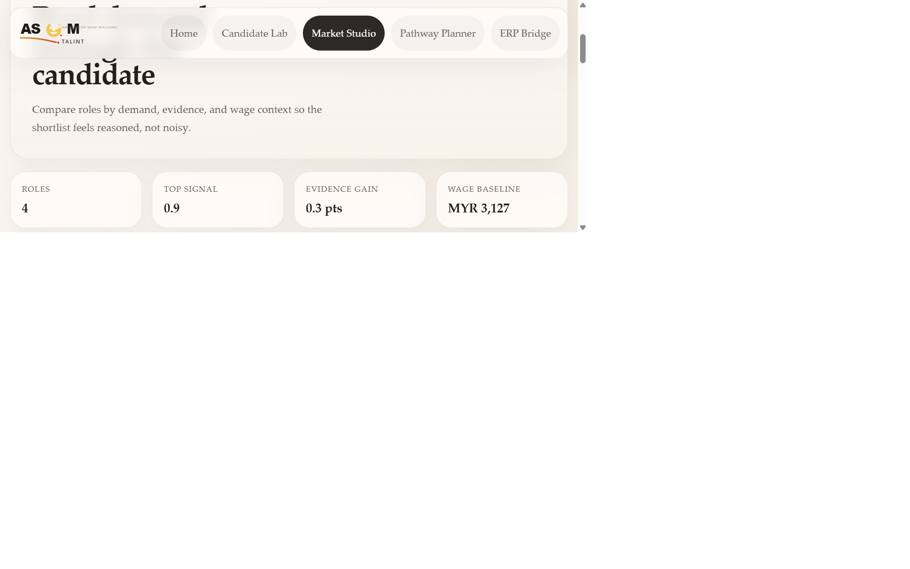
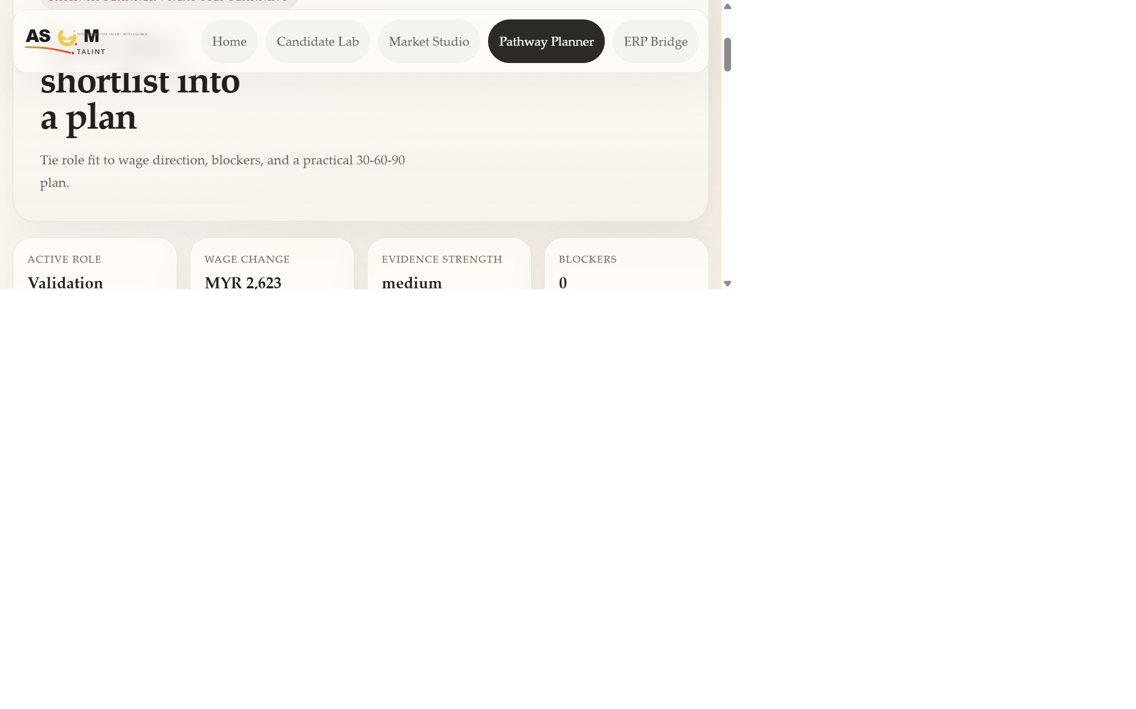
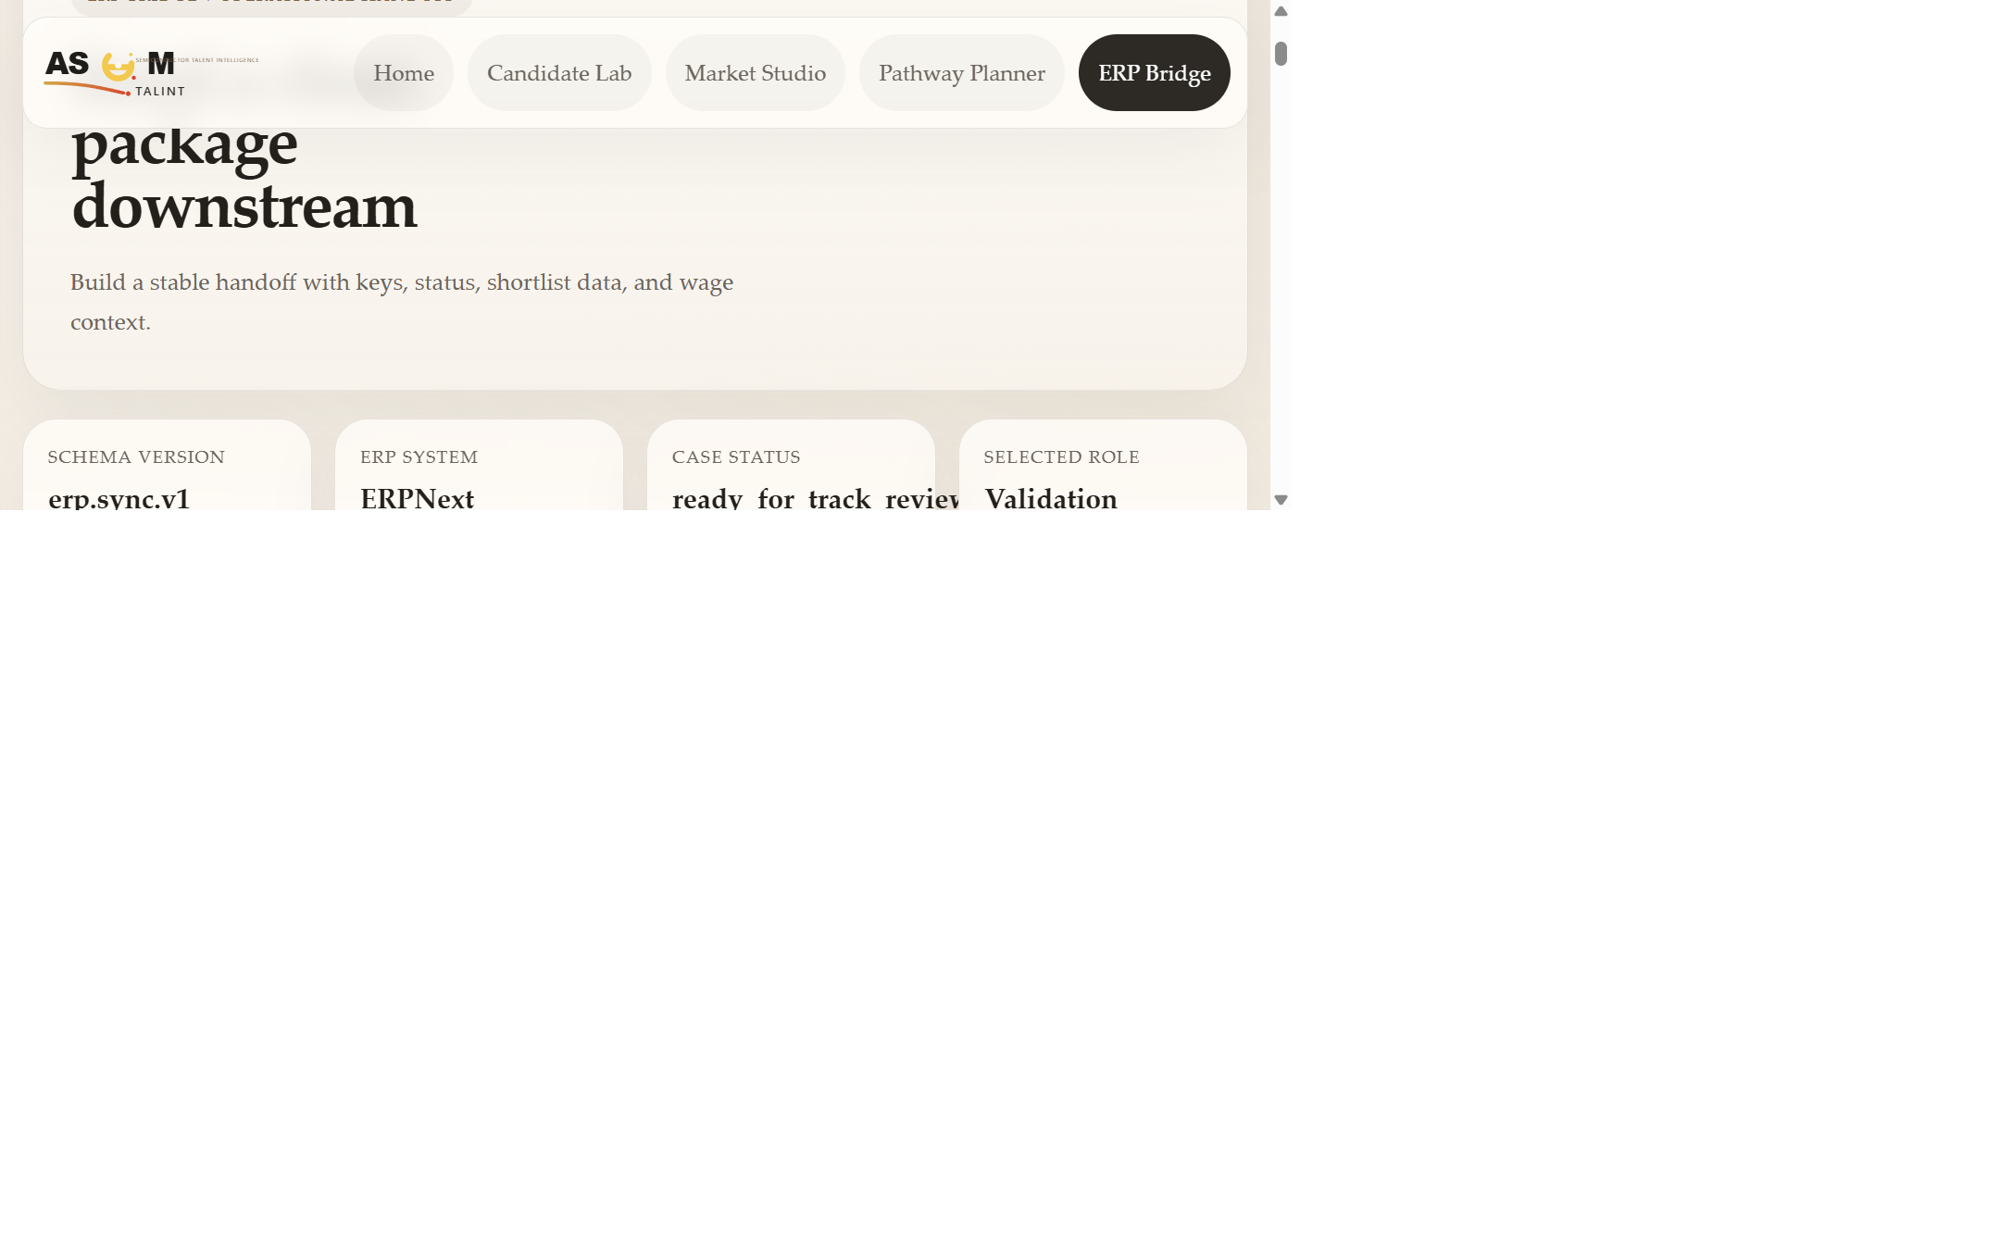
Slide 6
MVP scope and product surfaces
Demonstrate feature prioritization and show real snapshots from the current build.
In scope now
One candidate-to-track fit workflow
Resume parsing for PDF and DOCX with OCR fallback
Wages, employer demand, accessibility, OJT, and wage-mobility panels
Still out of scope
Production authentication and reviewer case management
Full persistence and operational analytics
Public deployment claims beyond local validation
Snapshots: Candidate Lab, Market Studio, Pathway Planner, ERP Bridge from current local app

Slide 7
Slide 7
Why Z.AI GLM is central
Address judging eligibility and technical intent directly.
Deterministic context
Prompt builder
Z.AI GLM provider
Schema validation
Dashboard/API consumer
Scoring, thresholds, missing-input handling, and wage/access logic remain in code.
Bounded JSON evidence is passed forward so the model explains a structured decision problem.
This is the judged reasoning path in the shipped product flow.
Model output must parse into structured response JSON before the app uses it.
Reviewers see recommendation, tradeoffs, missing inputs, and pathway steps.
No silent model replacement: the optional ILMU route is compatibility infrastructure, not the judged runtime path.
Architecture rule: keep Z.AI GLM central in implementation, narrative, and demo

Slide 8
Slide 8
System architecture and feasibility
Explain why the prototype is technically coherent and operationally plausible.
FastAPI interface
Dashboard, decision API, resume API, market routes
Typed request and response models keep the interfaces explicit.
Prompt budgets, token budgets, and upload limits are enforced in code.
Official-data slices are normalized locally for preliminary feasibility.
ERP Bridge packages the same decision output into operational sync-ready JSON.
The architecture reduces screening, matching, spatial, and coordination frictions in one workflow.
Decision engine
Deterministic context + provider boundary
Data and services
Resume parsing, wages, hotspots, OJT, wage mobility
Output contracts
Structured JSON, ERP package, observable errors
Feasibility source: SAD, README, and live prototype implementation

Slide 9
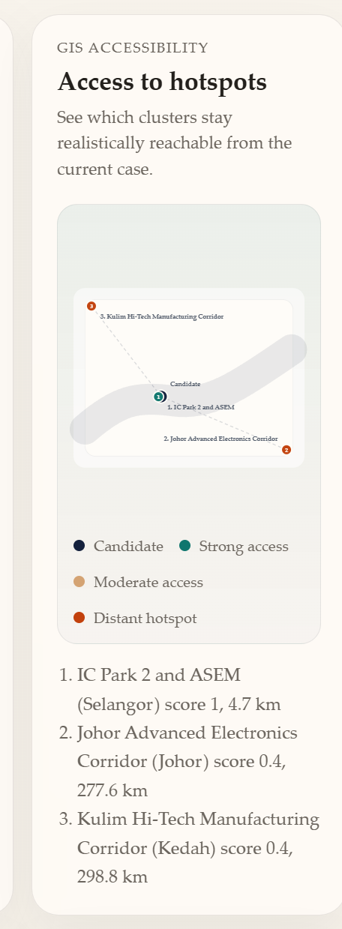
Slide 9
Live demo walkthrough
Show runtime-ready status and the sample candidate payload.
Parse and apply a resume so judges see structured evidence ingestion.
Refresh market panels for wages, employer demand, accessibility, and OJT.
Pause on the cleaned GIS accessibility figure with numbered hotspots and ranked list.
Run the live Z.AI route and inspect recommendation, tradeoffs, and missing inputs.
Open the raw structured response briefly to prove contract discipline.
Show the prototype rather than only talk about it.
Fallback still image in deck: cleaned GIS accessibility panel from current dashboard build

Slide 10
Slide 10
Engineering quality and risk control
Answer code quality and testing feasibility criteria.
Quality controls
Test coverage
Observability
Typed models and explicit provider boundaries
Provider output validated before use
Malformed or empty model output fails visibly
Happy path and invalid payload routes
OCR fallback and parser warnings
Health/readiness behavior and judged-path guardrails
Provider usage metrics surfaced
Warnings kept explicit
No silent degradation of judged model path
Risk excerpt
Live provider readiness
Medium
Validate `/health`, fail visibly, no silent substitution
Data refresh discipline
Medium
Use bounded official-data slices and document refresh path
Submission packaging quality
Low-Med
Keep PRD, SAD, QATD, repo, deck, and video aligned
Validation evidence: pytest route tests, provider parsing, OCR fallback, and documented QATD risk controls

Slide 11
Closing
Feasible prototype, honest scope, submission-ready structure
ASEM Talint fits Domain 2 because it supports economically meaningful pathway decisions.
Z.AI GLM remains central in the product, architecture, and demo narrative.
PRD, SAD, QATD, repository, deck, and video runbook are structured for preliminary submission.
Repository: github.com/khaisernong/ASEM-Talint
ASEM Talint turns candidate placement from a manual review task into an auditable, market-aware, Z.AI-centered decision workflow.
Team Novum | Ong Khai Sern | Tan Eng Feng | Preliminary round presentation deck

