Slide 1

Seasonal Agriculture Performance Analysis
M MOHAMMAD KHAJA HUSSAIN
KONERU LAKSHMAIAH EDUCATION FOUNDATION
AICTE STU ID : STU658b8975b83d61703643509

Slide 2

PROBLEM STATEMENT
Agricultural activities are influenced by seasonal variations in environmental conditions, farming practices, resource availability and market conditions. As a result, agricultural performance may differ from one season to another. However, raw agricultural data does not clearly explain how agricultural performance changes across seasons or what patterns can be observed in different seasonal conditions. The problem is to analyze the given agricultural dataset and investigate seasonal differences in agricultural performance by identifying meaningful patterns, trends, relationships and variations within the available data.

Slide 3
Project Description
I worked with a dataset of 4000 farms spread across 8 states in India, covering the three main growing seasons Kharif, Rabi and Zaid.
First step was cleaning the data some missing rainfall and yield values, checked for duplicates), then I compared things like yield, profit, rainfall, water usage, irrigation type and crop performance between the seasons.
The main thing I found was that Kharif season does the best overall better yield, better profit, and farms use water more efficiently. Zaid was the weakest season, and a lot of farms in Zaid actually ended up losing money.
Based on this, I put together a few suggestions on crop and irrigation choices that could help improve outcomes, especially in Zaid.

Slide 4

WHO ARE THE END USERS?
Farmers deciding what crop to grow in which season
Government agriculture departments planning season-wise policies
Companies selling irrigation equipment or farming inputs
Banks/insurance companies that need to assess risk by season
Other students or researchers who want to study farming trends

Slide 5

Technology Used
Python
Pandas, NumPy – for cleaning and working with the data
Matplotlib, Seaborn – for the charts
Jupyter Notebook – where I did all the analysis
Dataset: CSV file,4000 rows, 8 states, 3 seasons

Slide 6
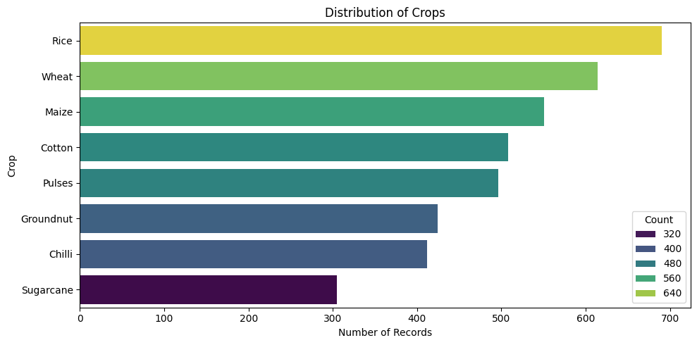
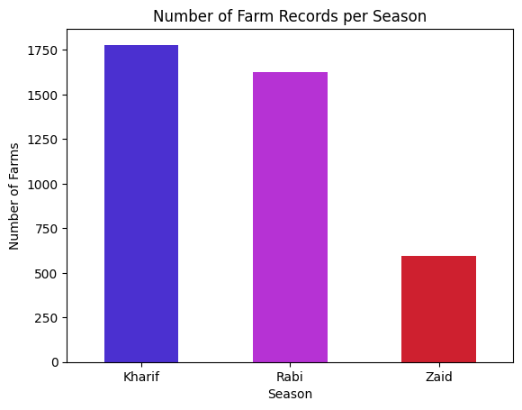
RESULTS
Rice has the most records 690, Sugarcane the fewest 300 dataset skews heavily toward Rice/Wheat/Maize.
Kharif has the highest yield, Zaid the lowest

Slide 7
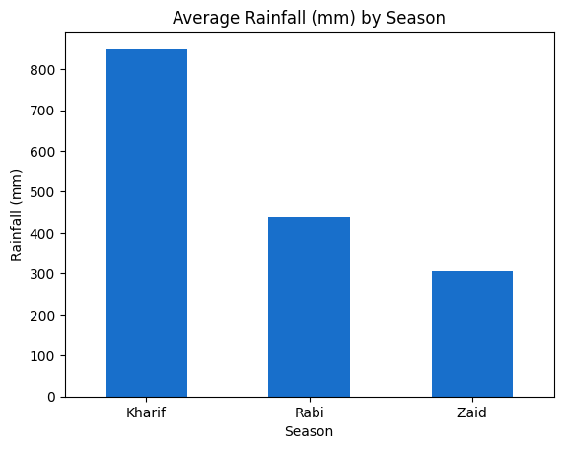
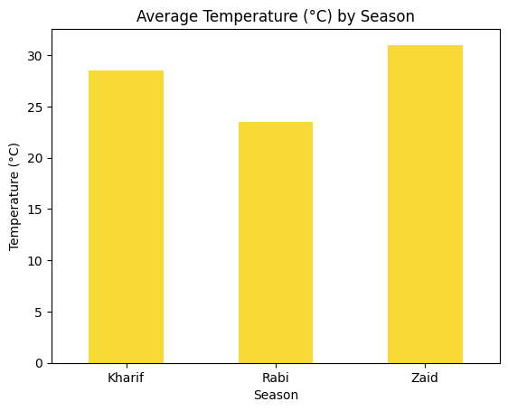
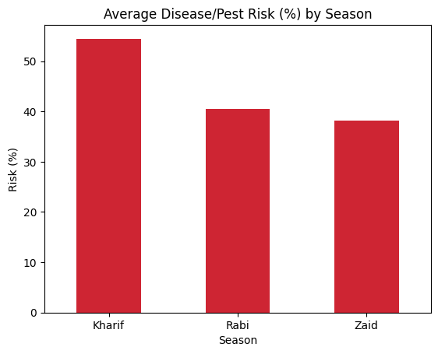
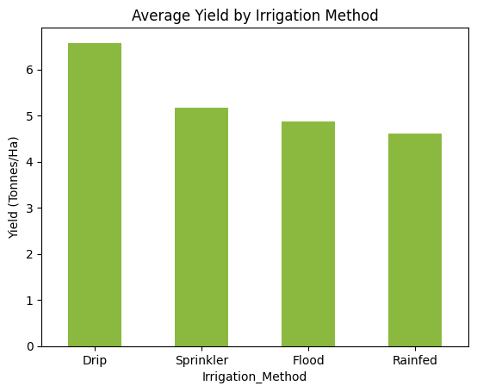
Environmental Conditions across Seasons

Slide 8
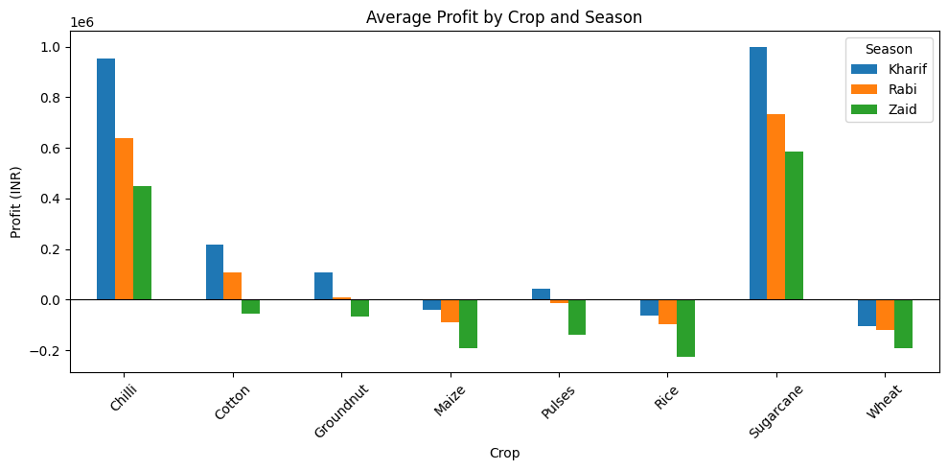
Sugarcane and Chilli are consistently the most profitable crops in every season. Rice, Maize, Wheat and Pulses tend to run at a loss in the Zaid season specifically, showing that season matters as much as crop choice.

Slide 9
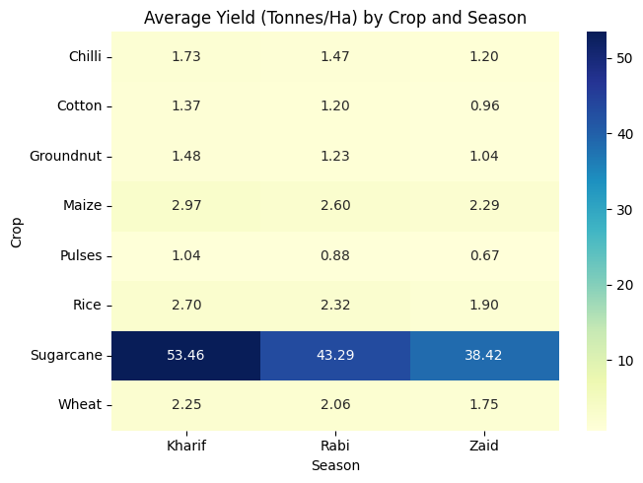
Crop Performance Across Seasons
A heatmap is useful here because it lets us see two things at once crop and season in a single picture. Darker or warmer colors mean higher average yield.

Slide 10
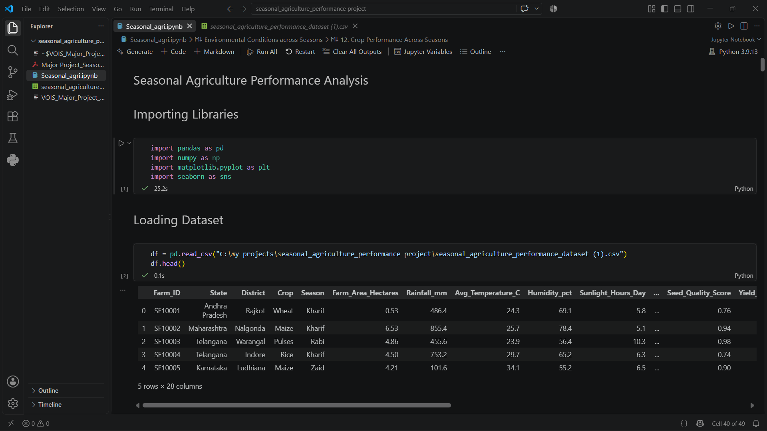
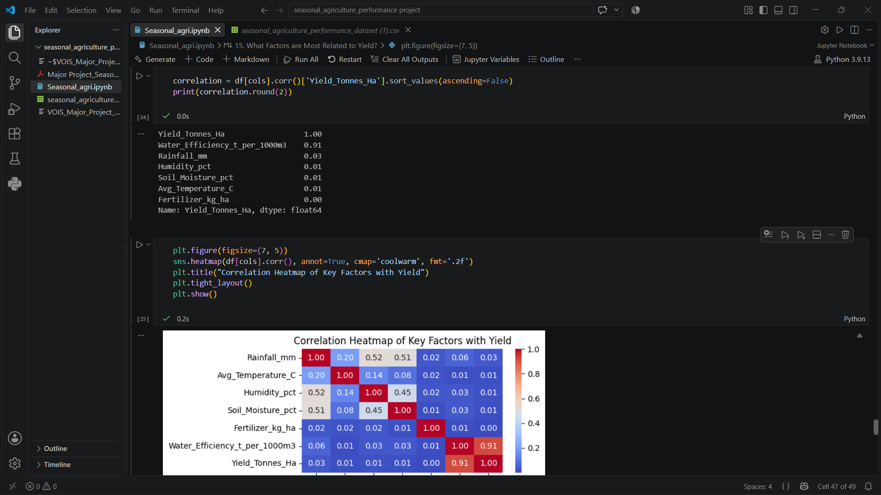
RESULTS

Slide 11
Future scope
Try building a model that predicts yield and profit before the season even starts
Pull in live weather data instead of just historical averages
Add more states, crops, and years of data to make the patterns more reliable
Turn this into a basic dashboard farmers could actually check
Add a feature that suggests the best crop based on soil, irrigation, season

Slide 12
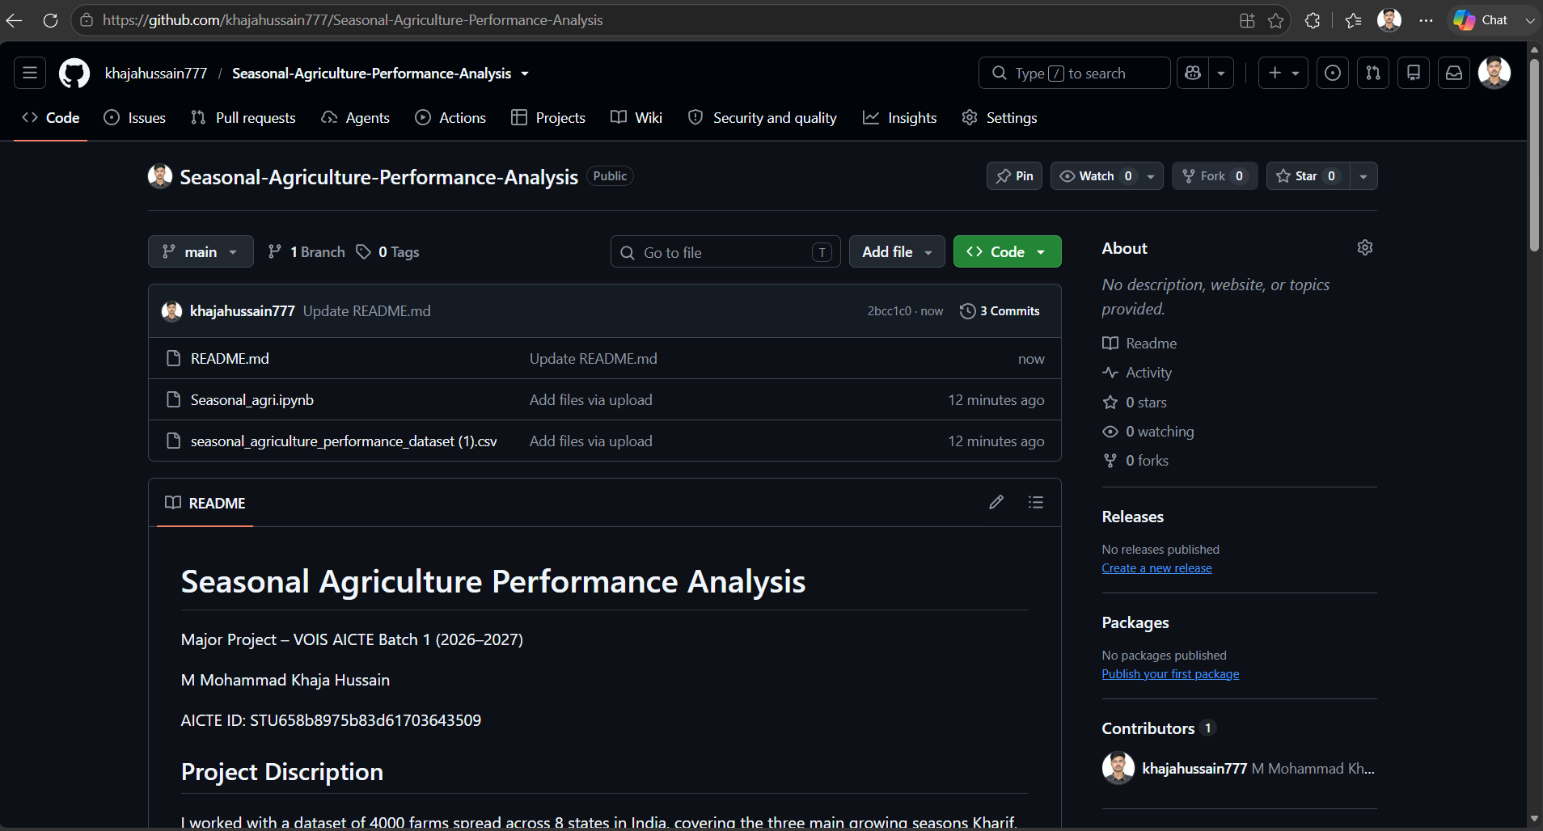
GitHub Link : khajahussain777/Seasonal-Agriculture-Performance-Analysis

Slide 13

VOIS Course completion certificate - Course name- Data Visualization

Slide 14
Thank you
.
.

