Slide 1


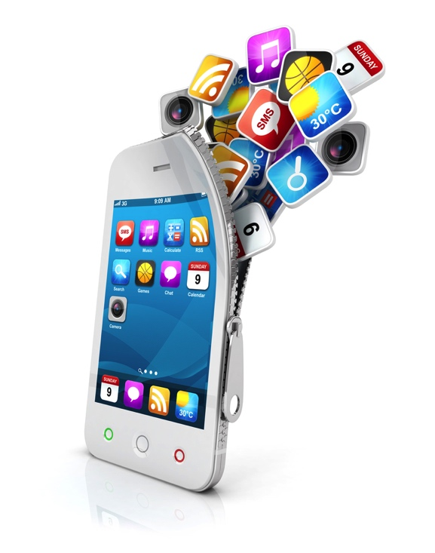
Discovery of User Behaviors from Smartphone Logs
Master Thesis
Khalil Hajji
September 2015
Academic Supervisor: Prof. Patrick Thiran
Sony Supervisor: Dr. Fabien Cardinaux

Slide 2

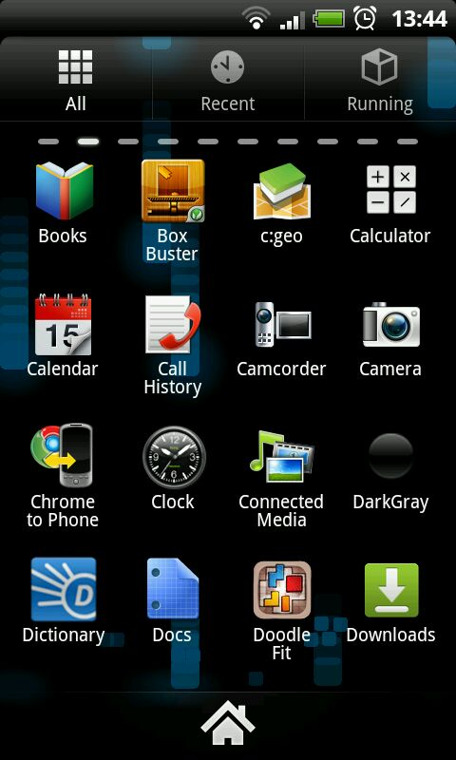






Problem Statement (1)
Smartphone logs is a diverse and rich dataset
Application Launches

Slide 3







Problem Statement (1)
Smartphone logs is a diverse and rich dataset
2
Notifications
1
3
1
4
9
1

Slide 4




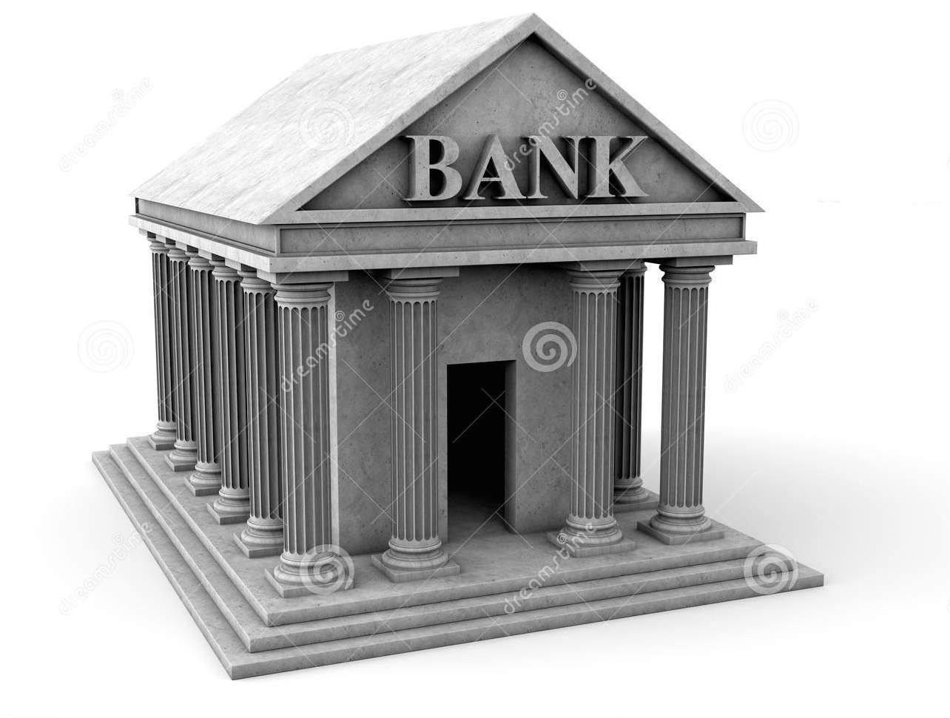


Problem Statement (1)
Smartphone logs is a diverse and rich dataset
2
Locations
1
3
1
4
9
1

Slide 5

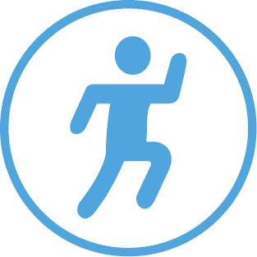



Problem Statement (1)
Smartphone logs is a diverse and rich dataset
2
Activity
1
3
1
4
9
1

Slide 6





Problem Statement (1)
Smartphone logs is a diverse and rich dataset
2
Time
1
3
1
4
9
1

Slide 7








Problem Statement (1)
Smartphone logs is a diverse and rich dataset
2
Day
1
3
1
4
9
1

Slide 8
Problem Statement (1)
Smartphone logs is a diverse and rich dataset
2
1
3
1
4
9
1

Slide 9

Problem Statement (1)
Use smartphone logs to discover user behaviors and habits
Bob habits
2
Plays sport on Week-end
1
3
1
4
9
1
Does reading at night
Listens to music while driving

Slide 10



Problem Statement (1)
Use smartphone logs to discover user behaviors and habits
Plays sport on Week-end
2
Does reading at night
3
1
1
9
4
Model
1
Listens to music while driving

Slide 11
Problem Statement (2)
Goal: Use smartphone logs to discover user behaviors and habits in an unsupervised manner
Is it possible?
How precise can it be?
The smartphone logs of a unique user are considered at one time
No prior knowledge used
Ex: A user is likely to sleep at night (What if Bob is a watchman)
Ex: A user is likely to work during the week days (What if Bob is a farmer)
Terms:
behavior = habit
Smartphone logs = user logs = dataset

Slide 12
Headlines
Latent Multimodal Representation (LMR)
Dirichlet Latent Multimodal Representation (DLMR)
Evaluation Metrics
Other Baseline models
Results
Conclusion

Slide 13
What is a good representation of a Behavior with smartphone logs?
Bob habits
Often does sport on the week-end: running outside or go to the gym
Sometimes, goes to a park on the week-end
Usually works on the week days
May travel on the week days

Slide 14
What is a good representation of a Behavior with smartphone logs?
Often does sport on the week-end: running outside or go to the gym
A Behavior is represented by a set of distributions
Each distribution represents one different feature
The probabilities of the distribution of feature f indicates the likelihood of each of the realizations of f to appear in the concerned behavior
Gps_gym 0.6
Gps_other_places 0.4
Activity_running 0.8
Activity_still 0.2
App_nikeplus 0.7
App_noapp 0.3
Notif_nikeplus 0.8
Notif_others 0.2
Day_saturday 0.4
Day_sunday 0.6
Models the multimodality of the smartphone data

Slide 15
What is a good representation of a Behavior with smartphone logs?
Sometimes, goes to a park on the week-end
A Behavior is represented by a set of distributions
Each distribution represents one different feature
The probabilities of the distribution of feature f indicates the likelihood of each of the realizations of f to appear in the concerned behavior
Gps_park 0.9
Gps_other_places 0.1
Activity_running 0.1
Activity_still 0.9
App_news 0.1
App_noapp 0.9
Notif_email 0.2
Notif_others 0.8
Day_saturday 0.6
Day_sunday 0.4
Models the multimodality of the smartphone data

Slide 16
Representing smartphone logs as a corpus
One Record Of Bob
Represent smartphone logs as a list of records
Each record represents the events that happened during 1 hour of the period of observation of the user
A record contains the number of times each realization were observed during the concerned period of observation
Gps_gym 2
Gps_park 1
Activity_still 1
App_nikeplus 2
App_news 1
Notif_nikeplus 5
Notif_others 2
Day_saturday 1
Time_morining 1

Slide 17
Latent Multimodal Representation (LMR)
One Record Of Bob
Gps_gym 2
Gps_park 1
Activity_still 1
App_nikeplus 3
App_news 1
Notif_nikeplus 5
Notif_others 2
Day_saturday 1
Time_morining 1
Notes:
1- In the Latent Multimodal Representation model, we assume that the records generated by Bob’s smartphone follow a process similar to they way we assumed that Bob behaves. Let’s see what does this mean

Slide 18
Latent Multimodal Representation (LMR)
Gps_gym 0.6
Gps_other_places 0.4
.
..
One Record Of Bob
Day_sunday 0.6
Gps_gym 2
Gps_park 1
Gps_park 0.9
Gps_other_places 0.1
Activity_still 1
.
..
Day_sunday 0.4
App_nikeplus 3
App_news 1
Gps_work 0.8
Gps_other_places 0.2
Notif_nikeplus 5
Notif_others 2
.
..
Day_saturday 1
Day_monday 0.2
Gps_work 0.1
Gps_abroad 0.9
Time_morining 1
.
..
Day_tuesday 0.2
Notes:
2- First, we know that Bob Often does sport on the week end, often goes to a park in the week end, usually works during the week days and sometimes travels in the week days. Those are the behaviors of Bob.
3- Second, we recall that in our representation of a human behavior, a context results in a set of behaviors that Bob might do with more or less likelihood. When considering the smartphone logs, each record represents a subsample of Bob’s life in a certain time frame and thus a record is actually a context that represents Bob’s behavior during the concerned time frame. Thus, it is natural to assume that each record has a distribution over the behaviors representing the likelihood of the Behavior that might be chosen to generate the record. We assume that for each record, we know this distribution over the behaviors.
4- We assume that the record we are observing was generating by the following way

Slide 19
Latent Multimodal Representation (LMR)
Gps_gym 0.6
Gps_other_places 0.4
.
..
One Record Of Bob
Day_sunday 0.6
Gps_gym
, Gps_gym
Gps_park 0.9
Gps_other_places 0.1
Gps_park
Activity_still
.
..
Day_sunday 0.4
App_nikeplus
, App_nikeplus
App_news
Gps_work 0.8
Gps_other_places 0.2
Notif_nikeplus
,…
Notif_others
.
..
Day_Saturday
Day_monday 0.2
Gps_work 0.1
Gps_abroad 0.9
Time_morining
.
..
Day_tuesday 0.2

Slide 20
Latent Multimodal Representation (LMR)
Gps_gym ?
Gps_other_places ?
.
..
One Record Of Bob
Day_sunday ?
Gps_gym , Gps_gym
Gps_park
Gps_park ?
Gps_other_places ?
Activity_still
.
..
Day_sunday ?
App_nikeplus, App_nikeplus
App_news
Gps_work ?
Gps_other_places ?
Notif_nikeplus,…
Notif_others
.
..
Day_Saturday
Day_monday ?
Gps_work ?
Gps_abroad ?
Time_morining
.
..
The distributions of features for each behavior are unknown
Day_Tuesday ?

Slide 21
Latent Multimodal Representation (LMR)
Gps_gym ?
Gps_other_places ?
.
..
One Record Of Bob
The distribution of behaviors for each record is unknown
Day_sunday ?
Gps_gym , Gps_gym
Gps_park
Gps_park ?
Gps_other_places ?
We choose the parameters (i.e probabilities) that maximize the probability of the observed data
Activity_still
.
..
?
Day_sunday ?
App_nikeplus, App_nikeplus
App_news
Gps_work ?
Gps_other_places ?
Notif_nikeplus,…
Notif_others
.
..
Day_Saturday
Day_monday ?
Gps_work ?
Gps_abroad ?
Time_morining
.
..
The distributions of features for each behavior are unknown
Day_Tuesday ?

Slide 22
LMR: some properties
Gps_gym ?
Gps_other_places ?
.
..
For each Behavior, learns one distribution for each feature
K= the number of behaviors, V = number of possible realizations (over all the features), #parms_to_learn = K.V
Day_sunday ?
Gps_park ?
Gps_other_places ?
.
..
Day_sunday ?
Gps_work ?
Gps_other_places ?
.
..
Day_monday ?
Gps_work ?
Gps_abroad ?
.
..
Day_Tuesday ?

Slide 23
LMR: some properties
For each Behavior, learns one distribution for each feature (K.V params)
For each record, learns one distribution over the possible behaviors
M=number of records in the corpus, #parms_to_learn = K.M
?
?
?
?

Slide 24
LMR: some properties
For each Behavior, learns one distribution for each feature (K.V params)
For each record, learns one distribution over the possible behaviors (K.M)
Number of total parameters to learn (K.V+K.M) grows linearly with K and with V
Risk of overfitting when K or V increases

Slide 25
Dirichlet Latent Multimodal Representation (DLMR)
For each record, Use a Dirichlet distribution of parameter to generate behavior distribution
One Record Of Bob

Slide 26
Dirichlet Latent Multimodal Representation (DLMR)
To generate a behavior do the following : For each feature f, Use a Dirichlet distribution of parameter to generate the distribution of realizations of feature f
Gps_gym 0.6
Gps_other_places 0.4
Activity_running 0.8
Activity_still 0.2
App_nikeplus 0.7
App_noapp 0.3
Notif_nikeplus 0.8
Notif_others 0.2
Day_saturday 0.4
Day_sunday 0.6

Slide 27
Dirichlet Latent Multimodal Representation (DLMR)
To generate a behavior do the following : For each feature f, Use a Dirichlet distribution of parameter to generate the distribution of realizations of feature f
Gps_park 0.9
Gps_other_places 0.1
Activity_running 0.1
Activity_still 0.9
App_news 0.1
App_noapp 0.9
Notif_email 0.2
Notif_others 0.8
Day_saturday 0.6
Day_sunday 0.4

Slide 28
Dirichlet Latent Multimodal Representation (DLMR)
To generate a behavior do the following : For each feature f, Use a Dirichlet distribution of parameter to generate the distribution of realizations of feature f

Slide 29
Dirichlet Latent Multimodal Representation (DLMR)
To generate a behavior do the following : For each feature f, Use a Dirichlet distribution of parameter to generate the distribution of realizations of feature f

Slide 30
DLMR: record generation
When behaviors generated and behaviors distribution for records generated, DLMR behaves as LMR
Behaviors generated
One Record Of Bob
Behaviors Distribution for record generated

Slide 31
DLMR: some properties
Learns how to generate behaviors of Bob by estimating V parameters for
Learns how to generate behaviors of Bob by estimating V parameters for

Slide 32
DLMR: some properties
Learns how to generate behaviors of Bob by estimating V parameters for
Learns how to generate behavior distribution for records by estimating K parameters for

Slide 33
DLMR: some properties
Learns how to generate behaviors of Bob by estimating V parameters for
Learns how to generate behavior distribution for records by estimating K parameters for
Needs to estimate K+V parameters

Slide 34
DLMR vs LMR
LMR | DLMR
K.V+K.M parameters to estimate | K+M parameters to estimate
Fits one behavior distribution to each record | Learns how to generate behavior distributions according to Bob
Learns K behaviors of Bob | Learns how to generate behaviors of Bob
Tries to find behaviors that describe the observed part of Bob life
Tries to understand how Bob behaves from the observed part of his life

Slide 35
Latent Dirichlet Allocation (LDA)
LDA is a widely used model based on topic modeling
Corpus of Text representation
Recommender Systems
Image processing
DLMR model is very similar to LDA
Gps_park 0.2
Gps_other_places 0.05
Activity_running 0
Activity_still 0.2
App_news 0.05
App_noapp 0.2
Notif_email 0.05
Notif_others 0.2
Day_saturday 0.05
Day_sunday 0.05
However, LDA represents behavior as a unique distribution over all the possible realizations

Slide 36
DLMR vs LDA
LDA | DLMR
Model the behavior by combining the elements of different types in a same distribution | Model the behavior by representing the different types in separate distributions, then combine distributions to describe the behavior using the different types
Behaviors not intuitive to interpret | Behaviors very intuitive to interpret
Is not a good representation of multimodal data
Is a realistic representation of multimodal data

Slide 37
Evaluation Metrics(1): Idea
Goal: Verify that behaviors extracted represent real user habits
Find a objective metric to evaluate the quality of the results
Find a objective metric to compare the performance of models
Idea: If extracted behaviors able to describe future data behaviors representative of user habits
Train the model on train data
Hide some information from the test records
See How well the model is able to guess correctly the missing information from the truncated context described by the test record

Slide 38
Evaluation Metrics(2): Location Prediction
Classify location into classes: “1st_frequent_loc”, “2nd_frequent_loc”, “others”
Hide location from test records
Use the model to guess a location
See if the location guessed belongs to the right class
Metrics:

Slide 39

Evaluation Metrics(3): Dataset
Logs of 5 users observed during several months
 | User 1 | User 2 | User 3 | User 4 | User 5
Days of observation | 300 | 231 | 229 | 249 | 224
Features

Slide 40
Discovery of User behaviors models
Already presented LDA, LMR, DLMR (all probabilistic models)
Use of some matrix factorization models
Singular Value Decompostion (SVD)
Linearly Constrained Bayesian Matrix Factorization (LCBMF)
State of the art matrix factorization model
Used for blind source separation

Slide 41
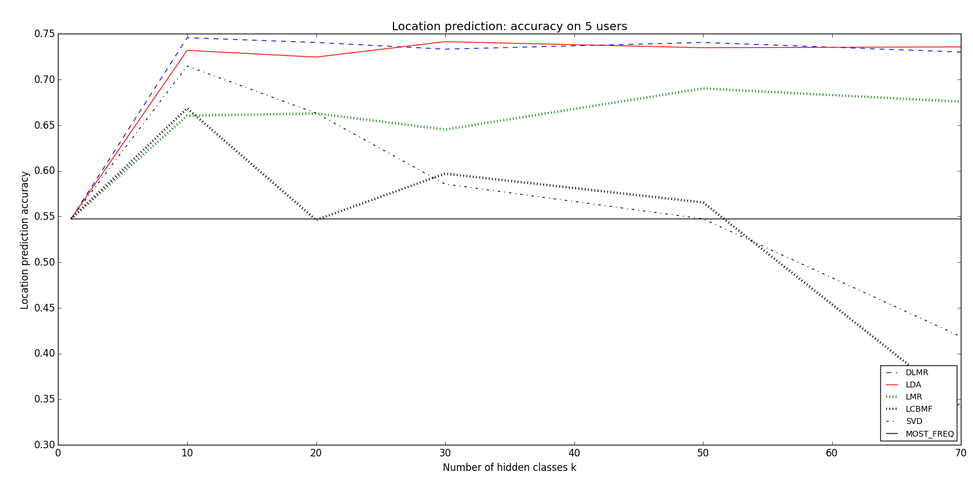
Results(1): Location prediction accuracy
DLMR (and LDA) stable for big K
DLMR and LDA largely outperforms all the other models
DLMR (and LDA) makes a good prediction accuracy around 73%

Slide 42
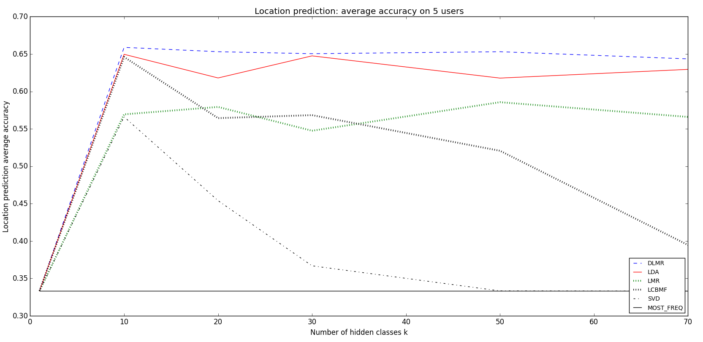
Results(2): Location prediction average accuracy
DLMR (and LDA) stable for big K
DLMR better than LDA in average accuracy, i.e 2% better
DLMR outperforms all the models in average accuracy

Slide 43
Results(3): Prediction results conclusions
,
DLMR is able to better catch the rare contexts than LDA
Sign for better generalization performances on unseen data
Why? : By representing the multimodality of logs, DLMR assumes more realistic model of user habits than LDA
DLMR largely outperforms LMR
Why? : DLMR learns who Bob behaves, LMR finds behaviors that describe the observed sample of data
DLMR has good prediction performances in Both considered scores
Extracted behaviors describe well user’s life (able to predict future events)

Slide 44
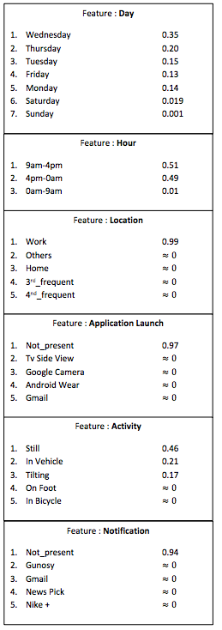
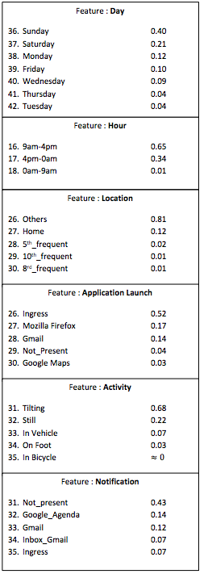
Results(4): Examples of extracted behaviors
User2: works during the weed days
User2: plays an augmented reality game on the week end

Slide 45
Conclusion
DLMR able to catch both general (i.e recurrent) behaviors and specific ones
The Behaviors extracted are very intuitive to understand and interpret
As LDA for unimodal data, DLMR can be applied to any multimodal data to accomplish many different tasks:
Profile Facebook users by integrating their messages, their likes, their friends, their interests, their events,…
Analyze a sensor equipped car dataset by integrating its different sensors at the same time
Compress a big multimodal dataset

Slide 46

Many Thanks!

Slide 47

Questions

