Slide 1






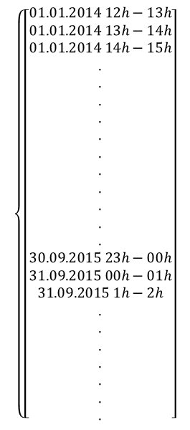

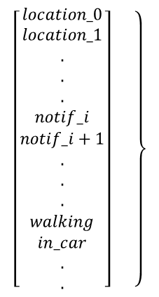



$$\left\{\left[\begin{aligned}01.01.2014 12h−13h \\ 01.01.2014 13h−14h \\ 01.01.2014 14h−15h \\ . \\ . \\ . \\ . \\ . \\ . \\ . \\ . \\ . \\ . \\ . \\ 30.09.2015 23h−00h \\ 31.09.2015 00h−01h \\ 31.09.2015 1h−2h \\ . \\ . \\ . \\ . \\ . \\ . \\ .\end{aligned}\right]\right.$$
$$time t, size n$$
$$\left.\left[\begin{aligned}location_0 \\ location_1 \\ . \\ . \\ . \\ notif_i \\ notif_i+1 \\ . \\ . \\ . \\ walking \\ in_car \\ . \\ .\end{aligned}\right] \right\}$$
$$\left[\begin{matrix} & ⋯ & \\ ⋮ & ⋱ & ⋮ \\ & ⋯ & \end{matrix}\right]$$
$$0$$
$$0$$
$$1$$
$$features f, size m$$
$$1$$
$$0$$
$$0$$
$$feature i occured$$
$$at time j$$

