Slide 1
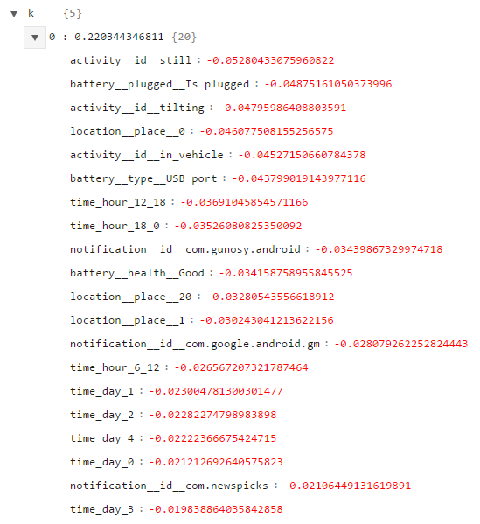
Most visited place: corresponds to Work
Other Places
2nd most visted place:
corresponds to Home
Thuesday
Wednesday
Friday
Monday
Thursday

Slide 2
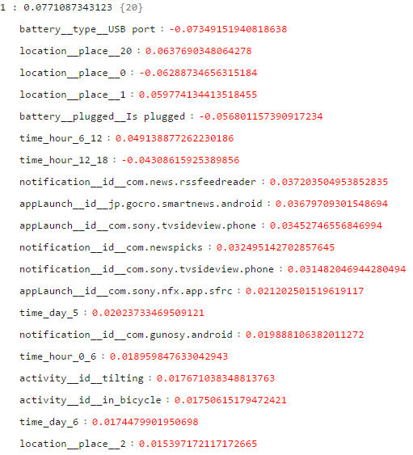
Saturday
Sunday
3rd most visited place

Slide 3
