Slide 1
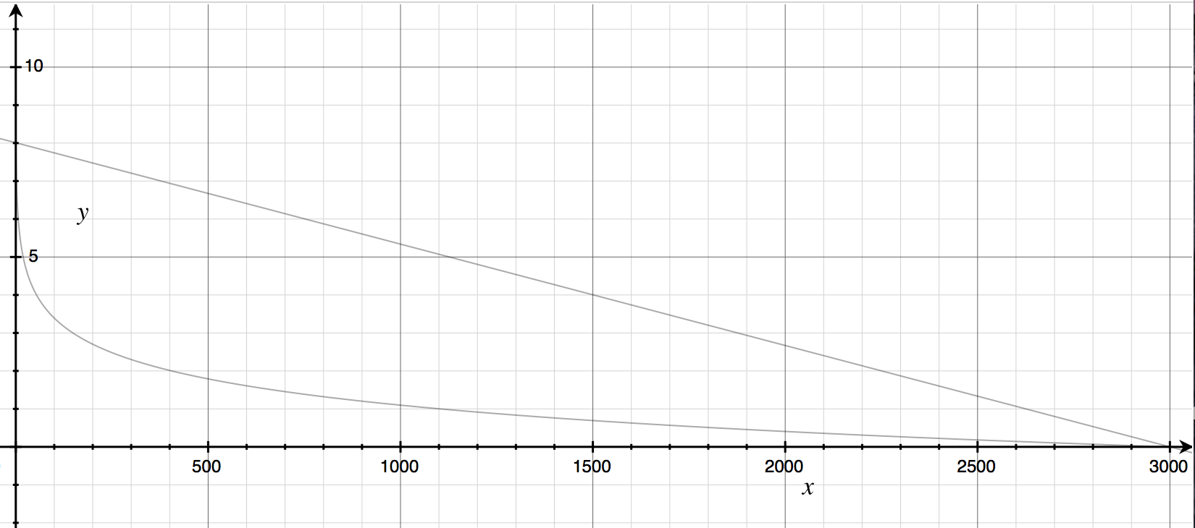
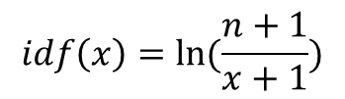

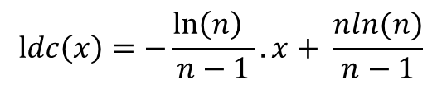
$$ldc\left(x\right)=−\frac{\ln\left(n\right) }{n−1}. x+ \frac{nln(n)}{n−1}$$
$$n=3000$$
$$idf\left(x\right)=ln⁡(\frac{n+1}{x+1})$$

