Slide 1
Module: CPU Activity Briefing
2110221 Computer Engineering Essential

Slide 2
Brookshere’s Simple Machine
https://www.amazon.com/Computer-Science-Overview-Glenn-Brookshear/dp/0133760065
ALU
Register Unit
Main Memory
$0
A3
BUS
@00
11
@01
0A
$1
0A
@02
22
@03
01
Control Unit
@04
51
@05
12
$2
00
PC
02
IR
110A
$F
…
@FE
27
@FF
BA
16 general-purpose registers ($0 - $F)
Program Counter ($PC)
Instruction Register ($IR)
256 bytes main memory (@00 - @FF)

Slide 3
Machine Cycle: Fetch-Decode-Execute
1. Retrieve the next instruction from memory (as indicated by the program counter) to the instruction register and then increment the program counter
Fetch
Decode
Execute
2. Decode the bit pattern in the instruction register
3. Perform the action required by the instruction in the instruction register

Slide 4
Parts of Instruction
Op-code (Operation code) – 4 bits
Specify the operation to execute
Operand – 12 bits
Additional details about operation
Address, register, constant
r1 <- r1 + r2
Op-code
Operand
0101
0001
0001
0010
5
1
1
2
ADD
[RST] -- R = S + T

Slide 5
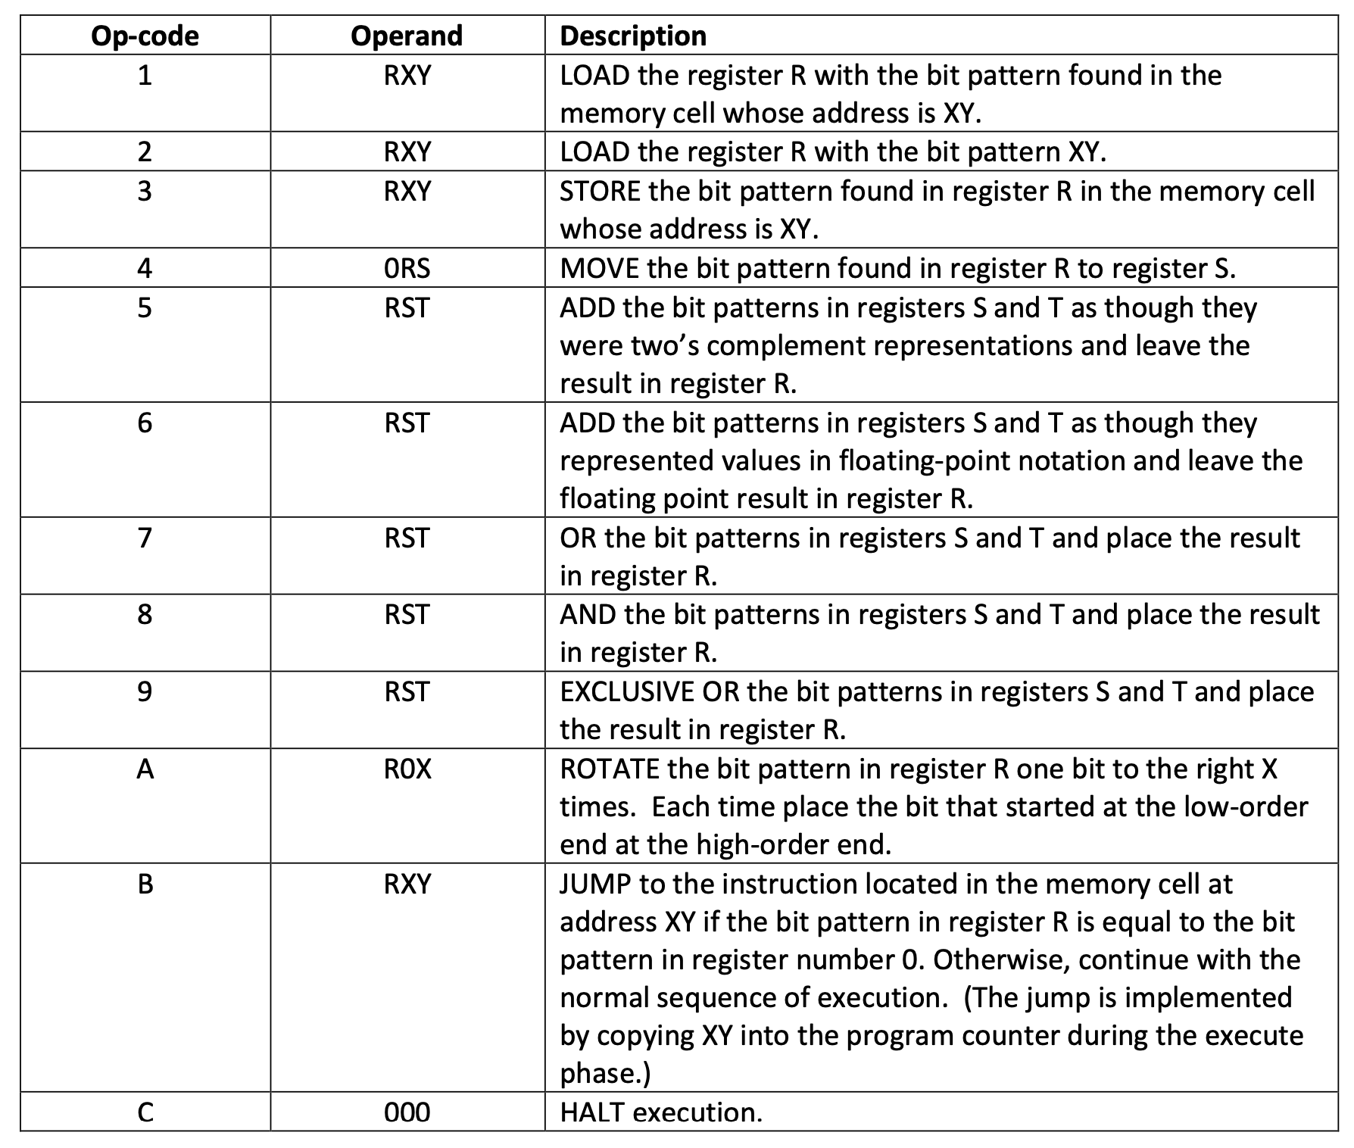

Slide 6
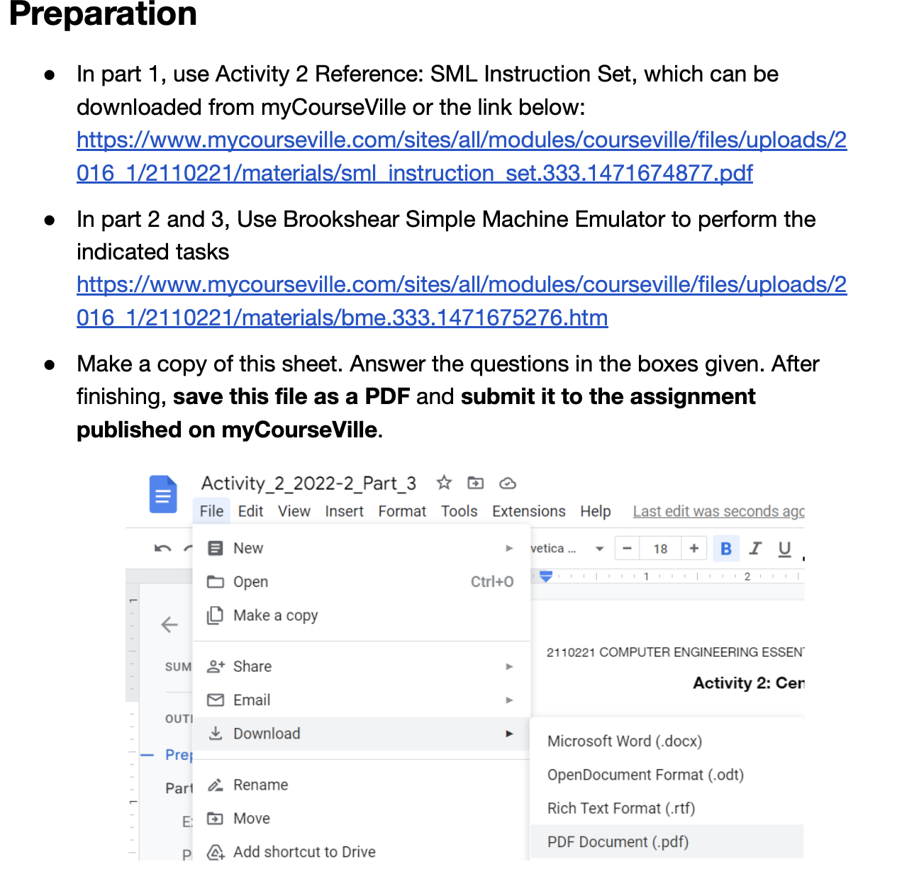

Slide 7
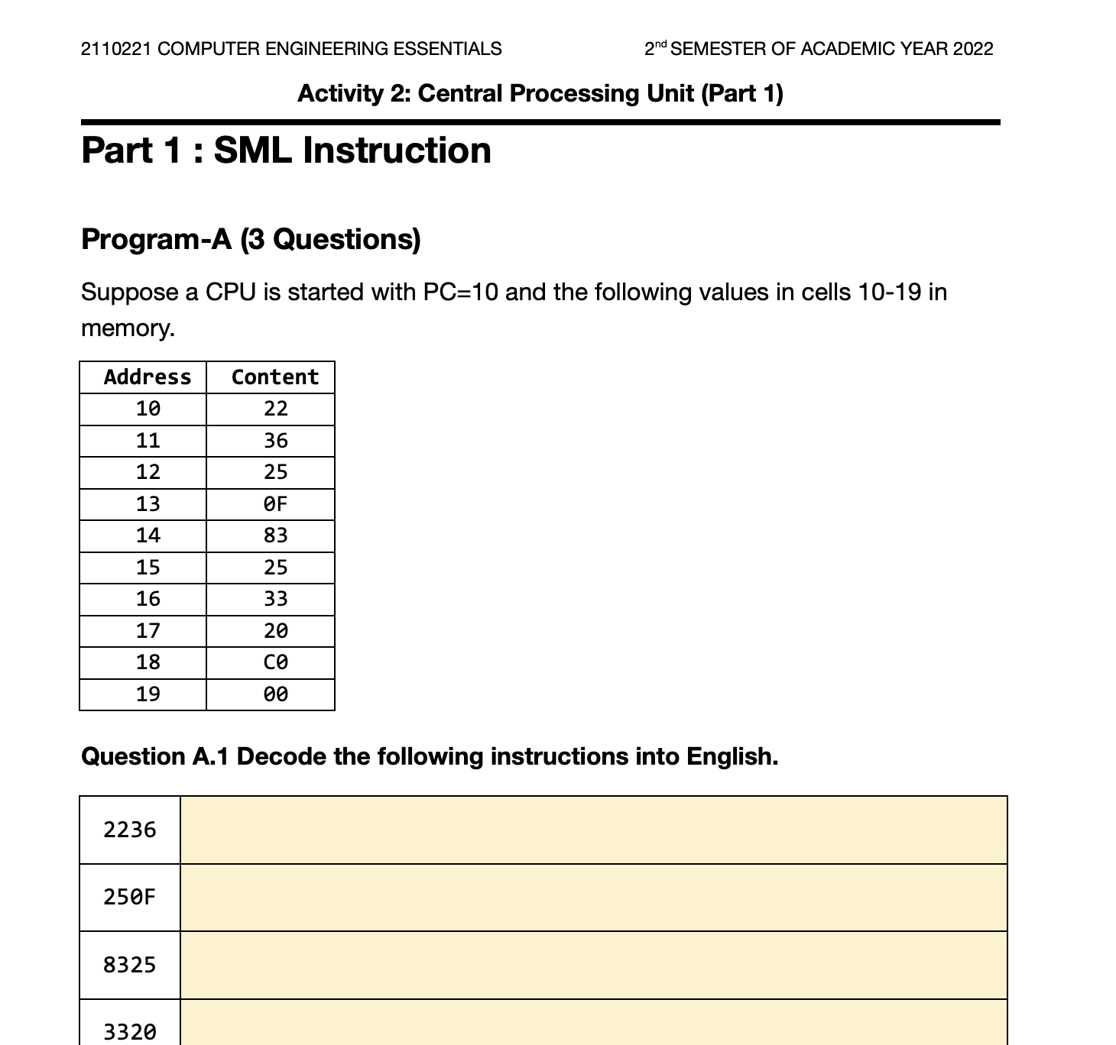
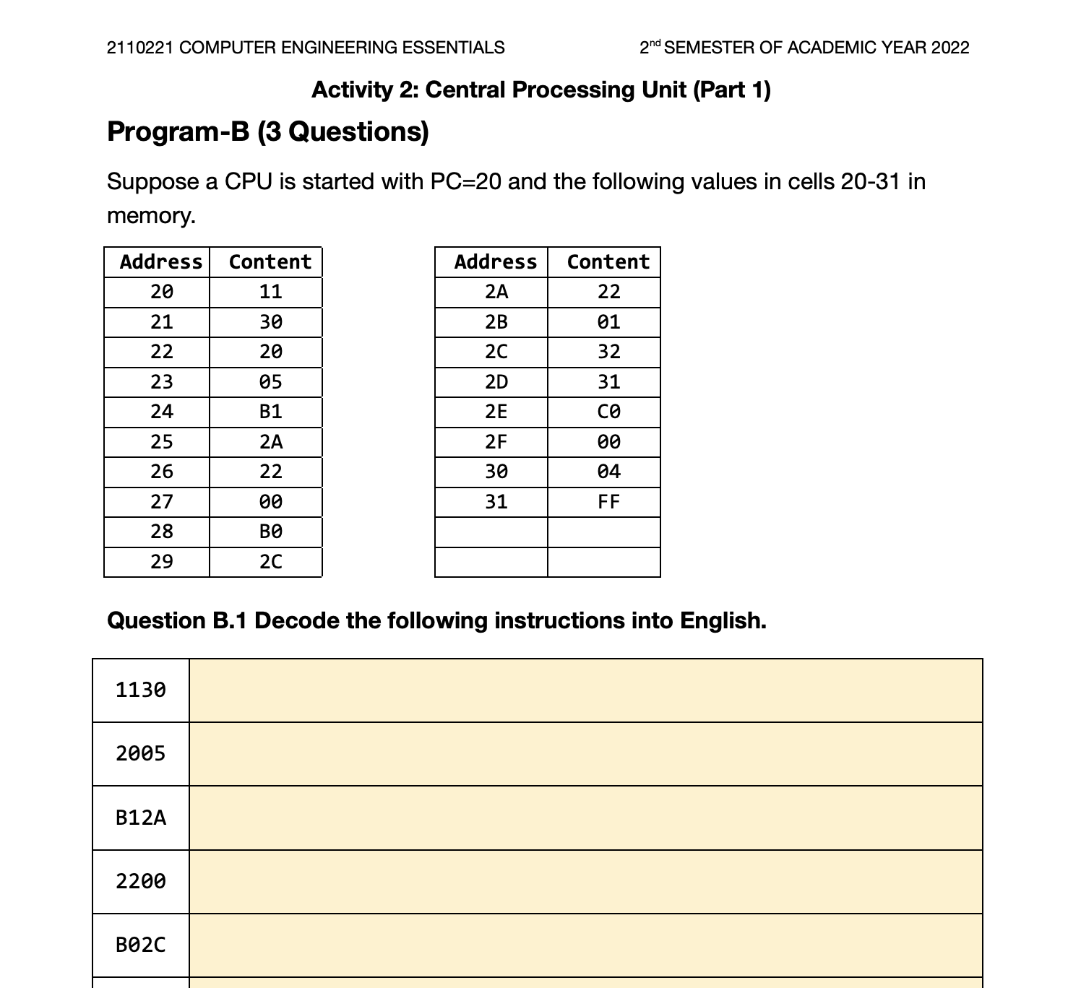
Part-1 Decoding Instructions

Slide 8
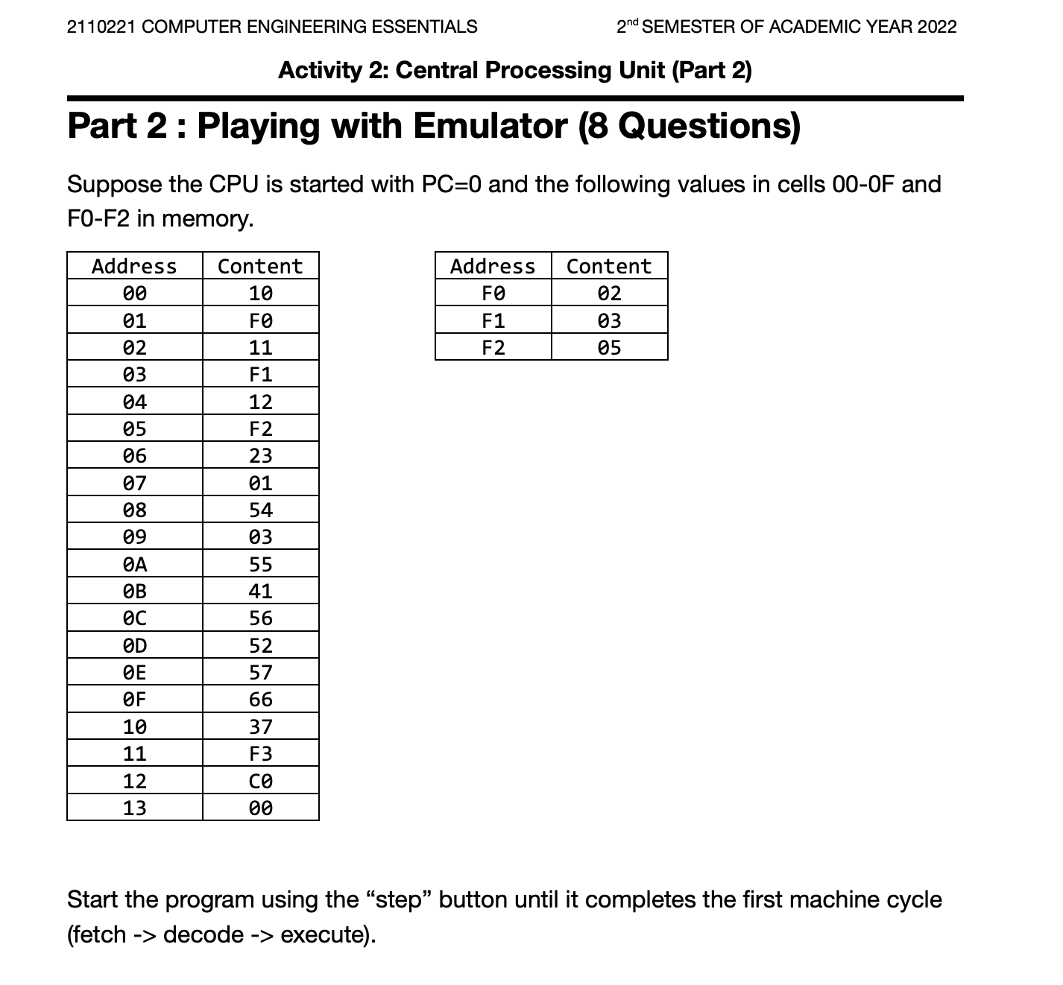
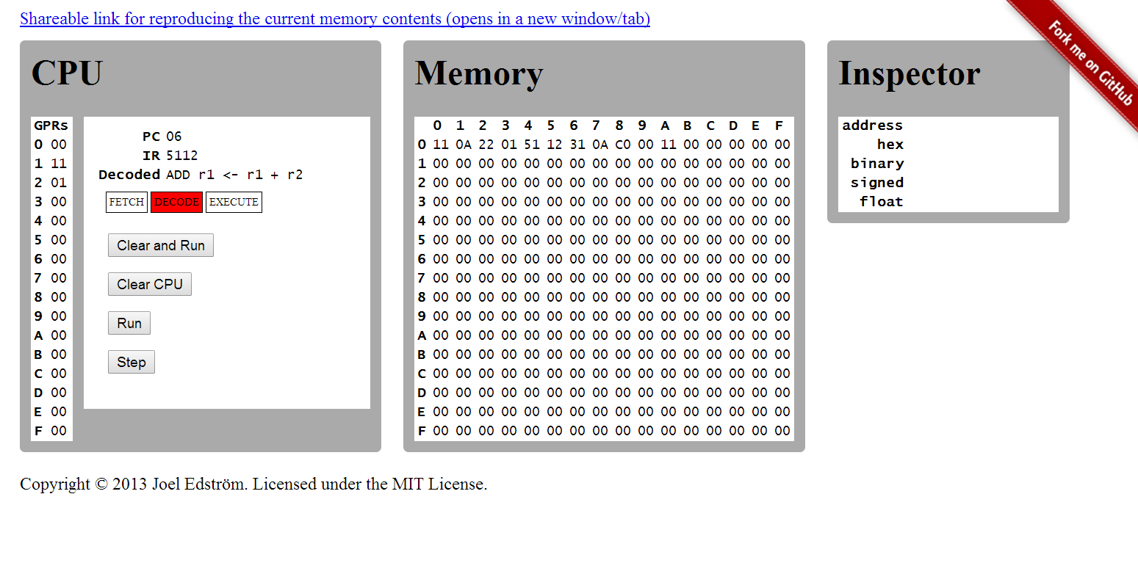
Part-2 Playing with Emulator

Slide 9
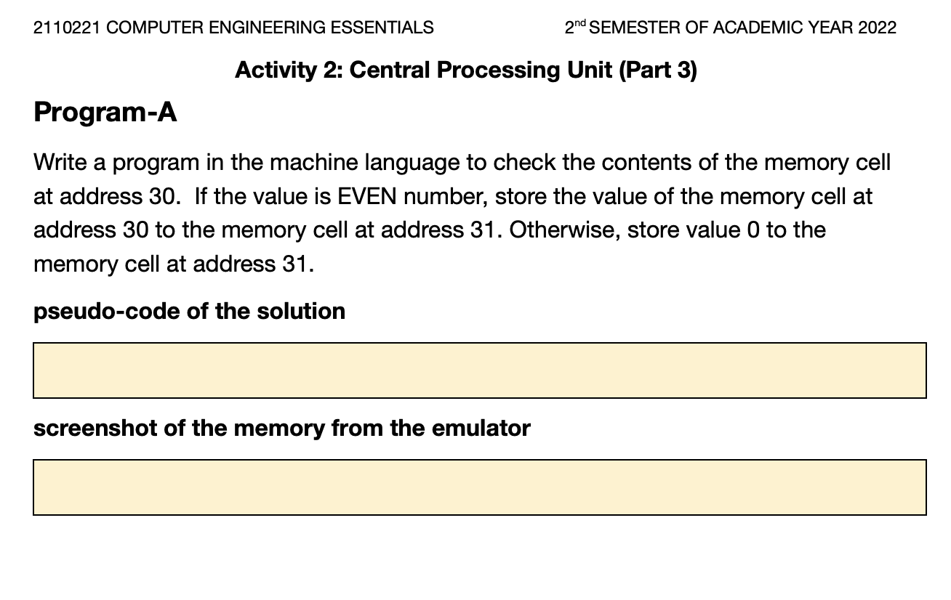
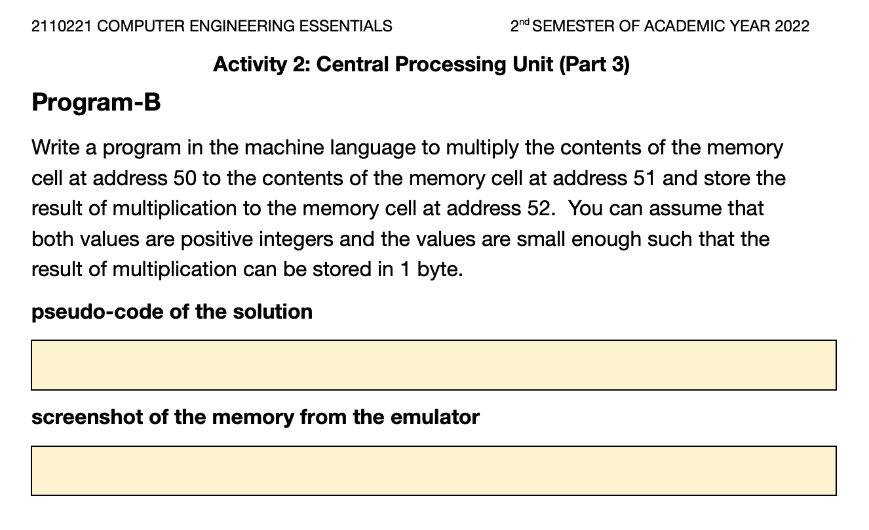
Part-3 Writing Programs

Slide 10
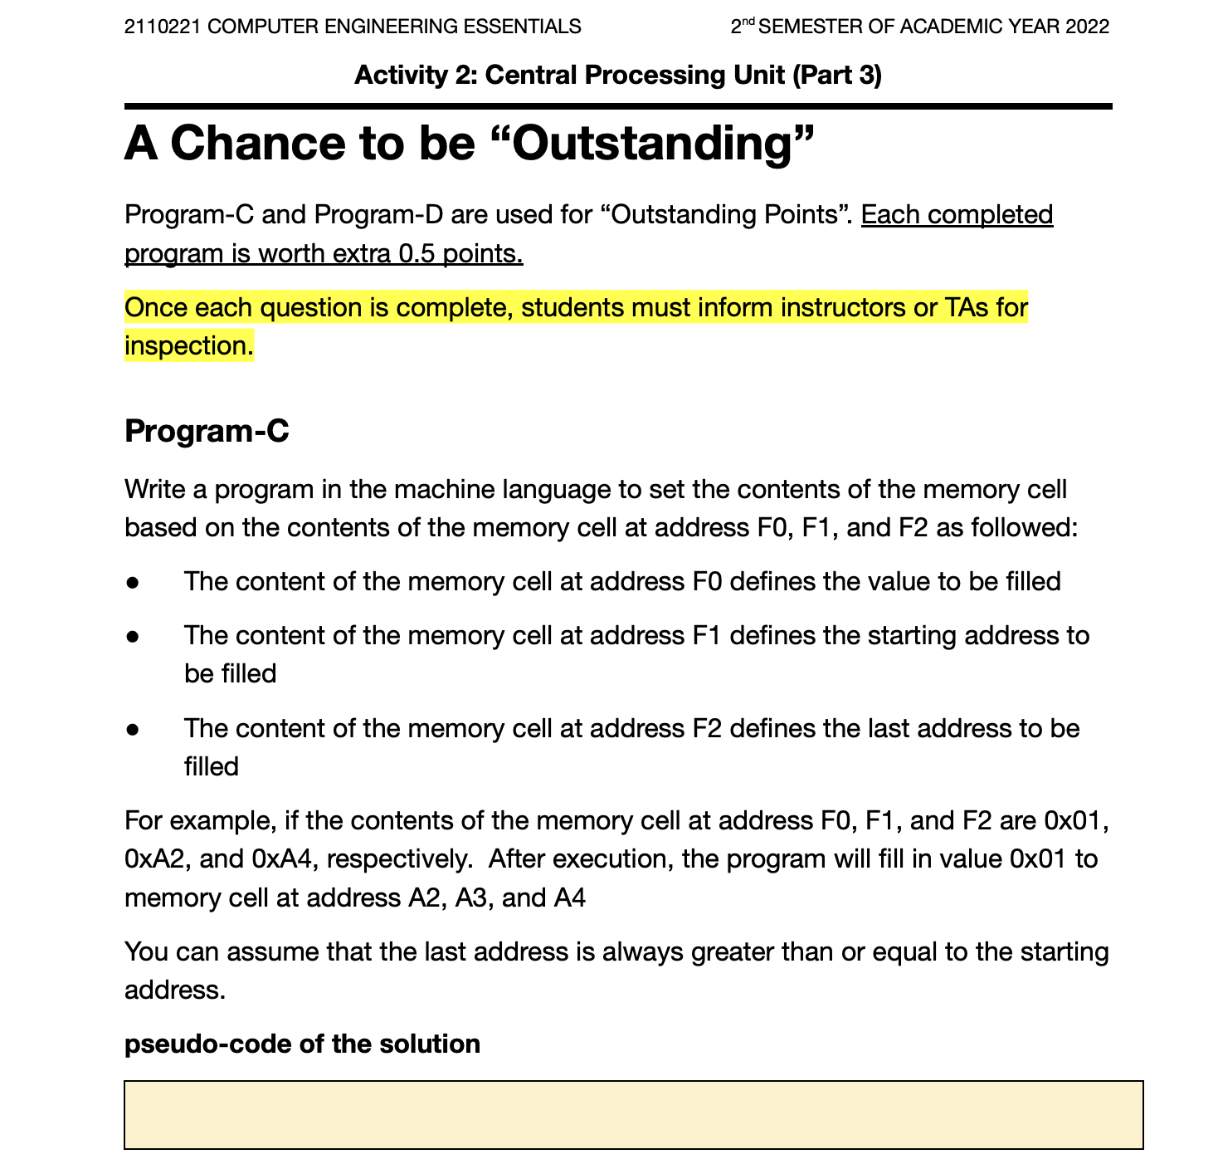
Part-3 Outstanding

