Slide 1

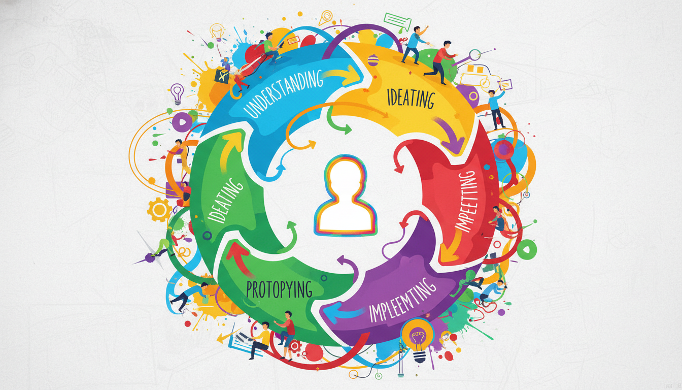
Learning Theories: The Toolkit Analogy
Theories are not mutually exclusive paradigms.
Act as complementary lenses for instructional design.
Each theory serves specific educational goals.
A toolkit containing varied tools illustrates how different learning theories serve unique, complementary instructional purposes.
Notes:
Welcome to the foundational map of instructional design. A common misconception is that one learning theory is universally superior to the others and replaces them. Instead, we should view Behaviorism, Cognitivism, and Constructivism as an instructional toolkit. Just as you wouldn't use a hammer to turn a screw, you must select a learning theory based on the specific instructional problem you need to solve.

Slide 2


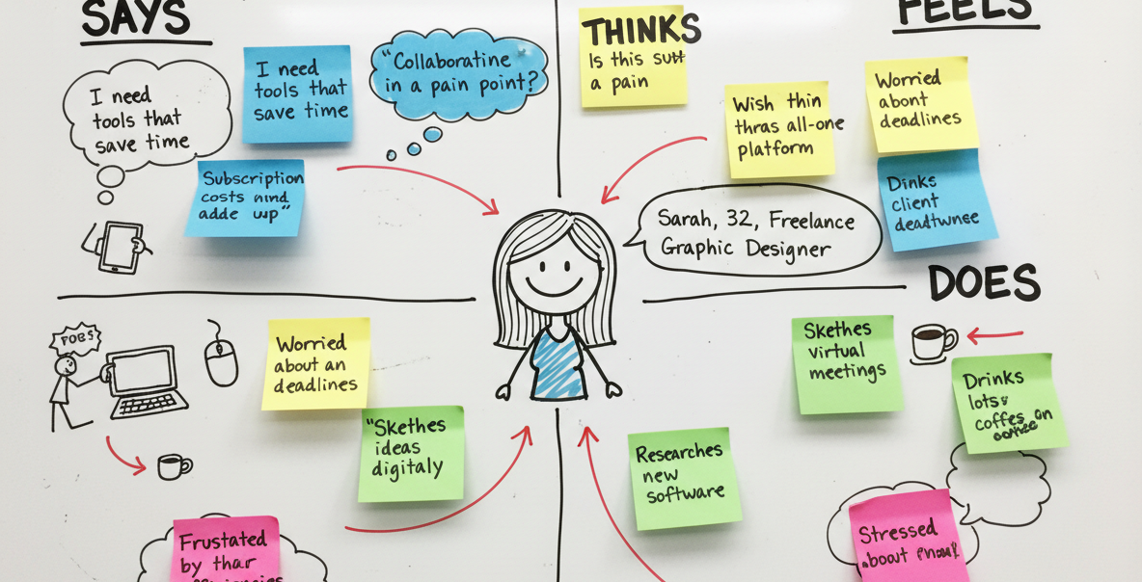

Paradigm vs. Toolkit
Non-Example: Theories as competing dogmas.
Concept: Theories as strategic design tools.
Focus shifts from 'which is right?' to 'which is useful?'
Competing paradigms create unnecessary friction and limit design potential.
Selecting the right theoretical tool for the task ensures targeted and effective instructional design.
Notes:
Let's clarify what learning theories are not. They are not competing dogmas where one must 'win' and the others must be discarded as false. If you view them as mutually exclusive paradigms, you severely limit your design capabilities. The reality is that they are complementary frameworks. The best instructional designers shift their mindset from asking 'which theory is correct' to asking 'which theory is most useful for this specific learning objective'.

Slide 3
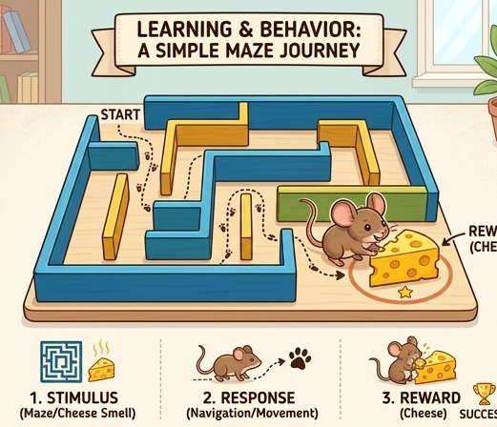


The Foundations of Instructional Design
Behaviorism: Shapes observable responses.
Cognitivism: Processes internal information.
Constructivism: Actively constructs meaning.
Behaviorism focuses on shaping observable behaviors through external stimuli and reinforcement.
Cognitivism treats the mind as an active computer, focusing on how internal information is processed and stored.
Constructivism emphasizes learners actively building their own knowledge through context and experiences.
Notes:
Here are the three main tools in our instructional design toolkit. First, Behaviorism treats learning as a change in observable behavior, which is perfect for foundational drill-and-practice tasks. Second, Cognitivism opens the 'black box' of the mind, focusing deeply on how we mentally process, sequence, and store information. Third, Constructivism views the learner as an active creator of knowledge, making it ideal for complex, collaborative problem-solving. Each angle gives us distinct strategies for different cognitive challenges.

Slide 4
Selecting the Right Lens
Analyze the specific instructional goal first.
Match the learning theory to the task complexity.
Blend approaches for holistic AI-driven design.
Evaluate effectiveness through learner outcomes.
Notes:
How do we apply this toolkit in practice? You must always begin by analyzing your specific instructional goal before blindly selecting a theory. For instance, if you are building an AI app for rote vocabulary memorization, Behaviorist principles like immediate corrective feedback work best. However, if you are designing a complex, open-ended business simulation, Constructivist principles will guide your design far better. The ultimate key is to blend these approaches logically to create a holistic, highly effective learning environment.

Slide 5

Selecting the Right Lens
Theories act as complementary tools, not competitors.
The instructional goal dictates the theoretical lens.
Avoid forcing a single framework onto every learning problem.
Different learning theories act as interchangeable lenses, each clarifying a specific type of instructional goal.
Notes:
Welcome to the practical application of learning theories. A common mistake instructional designers make is treating these theories as competing religions. Instead, think of them as complementary lenses in a camera bag. You wouldn't use a macro lens to shoot a landscape; similarly, you shouldn't use Constructivism to teach basic multiplication tables. The instructional goal always dictates which theoretical lens we apply.

Slide 6


Behaviorism: The Lens for Rapid Recall
Optimal for foundational, automated recall.
Requires immediate feedback and repetition.
Ineffective for critical thinking or abstract creation.
Effective Example: Drilling basic vocabulary for automated recall.
Non-Example: Using simple rewards for complex, creative tasks.
Notes:
When your goal is rapid rote memorization or habit-building, Behaviorism is your best tool. Think about learning a new language: you need automated recall of vocabulary before you can write poetry. Drill-and-practice with immediate feedback works perfectly here. However, Behaviorism is a strict non-example for teaching deep, critical thinking; rewarding a student simply for writing an essay doesn't help them structure complex arguments.

Slide 7
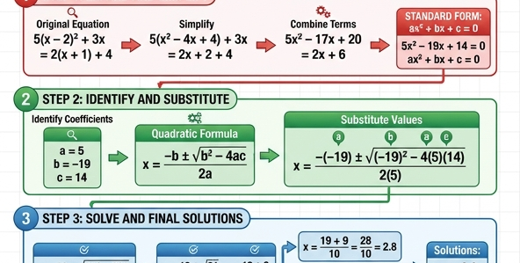

Cognitivism: The Lens for Mental Models
Optimal for teaching complex concepts and rules.
Focuses on scaffolding and working memory limits.
Ineffective if learners lack foundational guidance.
Effective Example: Scaffolding complex information processing step-by-step.
Non-Example: Expecting learners to process complex systems through trial and error.
Notes:
If the learning goal requires processing complex new concepts, we switch to the Cognitivist lens. This is where we manage working memory and help learners build internal mental models. A great example is providing a step-by-step worked solution for an advanced algebra problem. A clear non-example would be throwing learners into a complex simulation without any guidance, expecting them to figure out the underlying rules just by clicking around.

Slide 8


Constructivism: The Lens for Collaboration
Optimal for novel, open-ended problem solving.
Requires active meaning-making and social negotiation.
Ineffective via passive, one-way information delivery.
Effective Example: Actively constructing knowledge through shared problem-solving.
Non-Example: Passive reception of information for complex application tasks.
Notes:
Finally, when the instructional goal is to have learners synthesize knowledge to solve novel, open-ended problems, we use Constructivism. This theory shines when students collaborate to build a unique project or debate ethical dilemmas. It requires active meaning-making. Conversely, a non-example of Constructivism is having students passively watch a two-hour lecture to learn how to design a building; true constructivist learning requires active, hands-on creation.

Slide 9
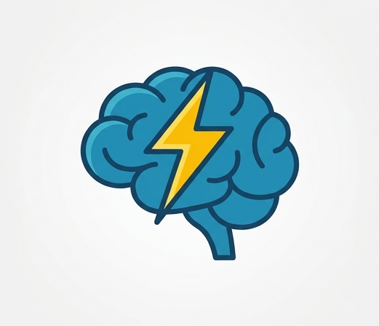
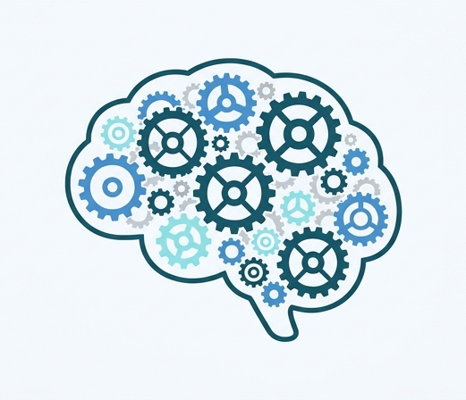

Aligning Goals Across the Spectrum
Behaviorism: Best for automated recall.
Cognitivism: Best for processing complex rules.
Constructivism: Best for collaborative creation.
Behaviorism: Rapid Recall
Cognitivism: Complex Processing
Constructivism: Collaborative Creation
Notes:
To summarize, effective instructional design requires explicitly aligning your pedagogical lens to the specific task. Use Behaviorism for foundational memorization. Upgrade to Cognitivism when managing working memory for complex problem-solving. Deploy Constructivism when learners must collaborate to create something entirely new. By mastering all three, you can intentionally design learning experiences that perfectly match human cognitive architecture.

Slide 10

The Obsolescence Myth
Theories are not a timeline of obsolescence.
New paradigms do not replace older ones.
All learning theories remain relevant today.
Learning theories are overlapping puzzle pieces, not a discarded timeline.
Notes:
Welcome to our first major concept. A very common misconception in instructional design is treating learning theories as a historical timeline where newer theories render older ones obsolete. You might hear people say Behaviorism is dead because Constructivism is newer, but this is fundamentally false. These paradigms do not compete; rather, they coexist and apply to different types of learning challenges.

Slide 11


The Toolkit Analogy
One theory cannot solve every problem.
Avoid the "only a hammer" approach.
Use multiple theories as complementary tools.
Using only one theory is like trying to build a house with just a hammer.
Good instructional design uses a complete toolkit of complementary theories.
Notes:
Let's use an analogy to understand this better. Relying exclusively on one theory for all your training needs is exactly like trying to build an entire house using nothing but a hammer. It might work for pounding nails, but it will fail miserably when you need to cut wood or turn a screw. Instead, view these learning theories as a diverse toolkit. Your job as an instructional designer is to know exactly which tool to pull out based on the specific cognitive task your learners face.

Slide 12
Applying Complementary Lenses
Non-Example: Abandoning Behaviorism completely.
Example: Blending drill-practice with problem-solving.
Goal: Match the theory to the learning objective.
Notes:
To solidify this, let's look at a concrete non-example of good instructional design. A poor practice would be entirely abandoning Behaviorism just because Constructivism aligns better with your personal philosophy. If you need learners to memorize emergency safety codes, a behaviorist drill-and-practice approach is highly effective. You would then switch to a Constructivist approach when asking those same learners to collaboratively solve a complex safety crisis. The key is matching the theoretical lens to your immediate instructional goal.

Slide 13

Designing the AI Tutor
Effective design integrates multiple learning theories.
Theories act as complementary lenses, not competing dogmas.
Each lens serves a specific instructional goal.
AI systems combine these to optimize learning.
An AI tutor interface representing a unified toolkit of different educational theories.
Notes:
Welcome to the practical application of our learning theories. Imagine you are tasked with designing an AI tutor. To create a truly effective system, you must remember that Behaviorism, Cognitivism, and Constructivism are complementary lenses. You don't pick just one; you use them together like tools in a toolkit to solve different instructional challenges.

Slide 14

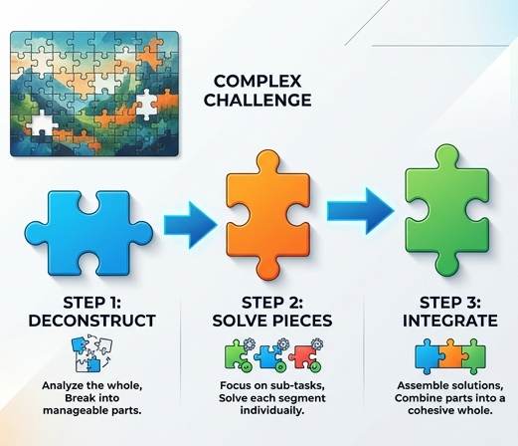

Applying the Three Lenses
Behaviorist: Immediate reward points and streaks.
Cognitivist: Chunking and sequencing content.
Constructivist: Socratic, open-ended questioning.
Select the right lens for the cognitive task.
Behaviorism: Gamification points reinforce observable habits.
Cognitivism: Step-by-step chunking prevents cognitive overload.
Constructivism: Socratic prompts guide active meaning-making.
Notes:
Let's break down how these lenses apply to specific AI features. First, a Behaviorist lens is used when the AI gives immediate reward points for a correct answer, shaping rapid, observable habits. Next, a Cognitivist lens informs how the AI chunks and sequences that information, managing working memory to prevent overload. Finally, a Constructivist lens is applied when the AI stops giving direct answers and instead asks Socratic, open-ended questions to help the learner build their own understanding.

Slide 15


Integration vs. Isolation
Effective: Seamlessly blending theories to support the user.
Ineffective (Non-Example): Dogmatically forcing one theory.
Example: Points alone ignore deep comprehension.
Example: Pure exploration overwhelms novices.
Effective: Integrating multiple theories creates a robust learning experience.
Non-Example: Forcing a single theory onto every learning task causes friction.
Notes:
A strong mental model requires knowing what effective design is NOT. A common trap is dogmatic design, where an instructional designer forces one theory onto every task. For example, relying strictly on behaviorist points will fail to build deep comprehension, while forcing pure constructivist exploration on novices will overwhelm their working memory. Effective design seamlessly weaves these lenses together based on the learner's immediate cognitive needs.

Slide 16
The Seamless AI Experience
Start with behaviorist mechanisms to build initial engagement.
Apply cognitivist principles to deliver core content efficiently.
Transition to constructivist tasks for mastery and application.
Ultimate goal: An adaptive system responding to learner state.
Notes:
Ultimately, the best AI learning experiences sequence these theories naturally. You might hook the learner initially with behaviorist gamification to build momentum. As they dive into the material, you rely on cognitivist structures to efficiently deliver the core concepts without overwhelming them. Finally, once foundational schemas are built, the AI shifts to a constructivist mode, challenging the user with open-ended scenarios. This adaptability is the hallmark of expert instructional design.

