Slide 1
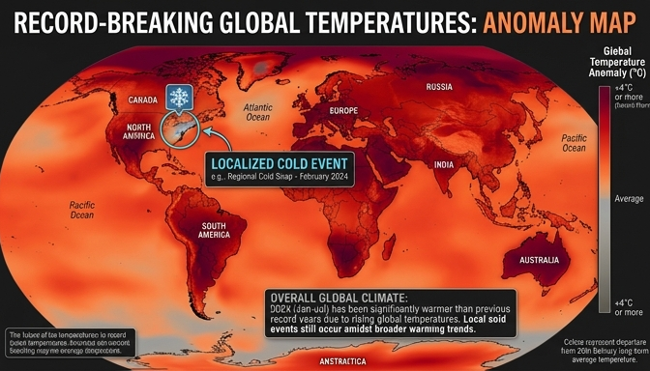

Is Global Warming Fake if it Snows?
Local snow doesn't negate global warming.
A single event isn't a long-term trend.
Proxy data shows 2023 was the hottest year.
The baseline spans over 125,000 years.
Global temperature anomalies show a long-term warming trend despite isolated cold weather events.
Notes:
If you walk outside and it's snowing, you might hear someone joke, 'So much for global warming!' But this represents a fundamental misunderstanding of how the Earth works. A single snowstorm in one city doesn't invalidate a global trend. To put things in perspective, despite any local cold snaps, proxy data shows that 2023 was the hottest year on Earth in over one hundred and twenty-five thousand years.

Slide 2
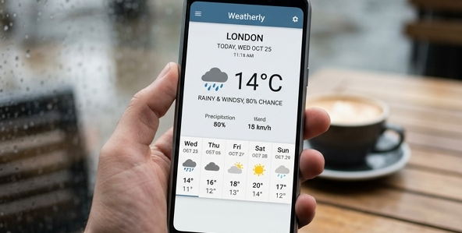
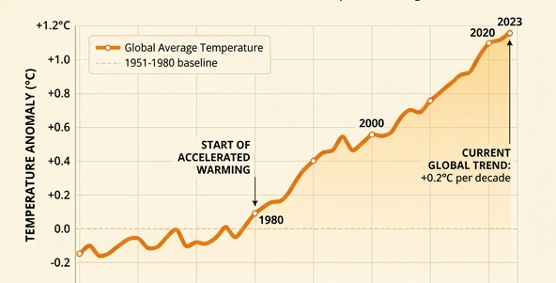


Defining Weather and Climate
Weather = short-term, local conditions.
Examples: Today's rain, tomorrow's wind.
Climate = long-term statistical averages.
Climate requires decades of data collection.
Weather describes the short-term, day-to-day atmospheric conditions in a specific location.
Climate represents the statistical average of weather data collected over thirty years or more.
Notes:
Let's formally separate these two ideas. Weather describes the short-term, local atmospheric conditions—what you see when you look out the window right now, like rain or sunshine. Climate, on the other hand, is the long-term statistical average of those conditions over a specific region. While weather changes minute by minute, climate is typically measured in trends spanning thirty years or more.

Slide 3


Analogy: Mood vs. Personality
Weather is your current mood.
Moods change rapidly from day to day.
Climate is your overall personality.
Personality remains stable and predictable.
Your mood changes rapidly based on daily events, just like the weather.
Your personality is your stable, long-term baseline, just like the climate.
Notes:
To lock this in your memory, let's use a relatable analogy. Think of weather as your current mood. You might wake up grumpy one day and be ecstatic the next; it changes rapidly. Climate is your overall personality. Even if a generally optimistic person has one bad day, their baseline personality remains positive. Similarly, a cold day doesn't mean the climate isn't warming.

Slide 4
Evaluating Long-Term Trends
Do not conflate single data points with trends.
Climate relies on mathematical means: $\mu = \frac{1}{n}\sum_{i=1}^{n} x_i$
Cold outliers don't erase a warming baseline.
Always focus on decadal shifts, not daily events.
Notes:
A common trap—and our non-example for today—is using a single cold temperature reading to claim the climate is cooling. In science, climate relies on statistical averages, represented mathematically as the mean of many years of data. When the baseline average shifts upwards, you can still have individual days that are below average. The existence of an outlier does not erase the mathematical reality of a shifting, warming baseline.

Slide 5

Identifying the Difference
Distinguish between short-term events and long-term trends
Avoid confusing localized conditions with global averages
Use clear analogies to build a strong mental model
Weather represents the daily pages, while climate is the hourglass measuring decades.
Notes:
To truly understand global warming, we have to recognize the fundamental difference between weather and climate. People often confuse the two, mistakenly assuming that a remarkably cold day means the Earth isn't warming. In this section, we will look at clear, real-world examples to help you instantly identify whether you are looking at a short-term weather event or a long-term climate pattern.

Slide 6
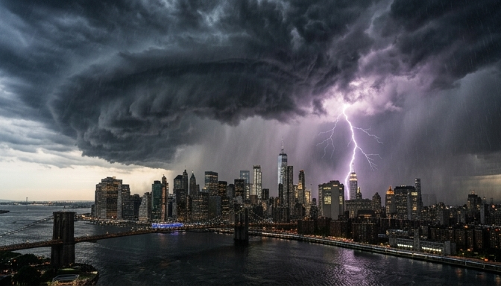
Weather: Short-Term Events
Sudden, highly localized atmospheric conditions
Changes rapidly over minutes, days, or weeks
Example: A sudden thunderstorm or a freezing weekend
A sudden thunderstorm is a classic example of weather: short-term and localized.
Notes:
Let's start by looking at weather. A sudden thunderstorm rolling in on a Tuesday afternoon, or a freezing weekend in Texas, are perfect examples of weather. These are short-term, highly localized conditions that can change rapidly from one day to the next. They tell us exactly what is happening outside right now, but they do not define the baseline normal of a region.

Slide 7

Climate: Long-Term Patterns
Statistical average of weather over decades
Establishes the baseline expectations of a region
Example: The Sahara Desert averaging $< 3$ inches of rain annually
The Sahara's century-long dry streak is an example of climate, not just daily weather.
Notes:
In contrast, climate is the statistical average of weather over a long period, usually at least $30$ years. For instance, the Sahara Desert receives less than $3$ inches of rain per year on average over the last century. That consistency over decades is what defines a climate. Even if it happens to rain one afternoon in the Sahara—which is weather—its overall climate remains profoundly dry.

Slide 8
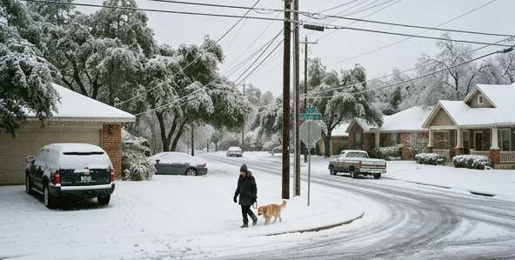
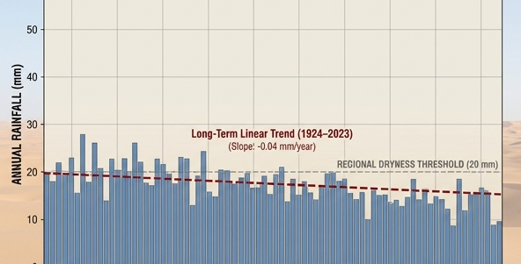
Weather vs. Climate in Action
Weather = A freezing weekend anomaly in Texas
Climate = A century of drought in the Sahara
Non-example: A single hot day does NOT prove climate change
Weather: A localized, short-term temperature anomaly.
Climate: A century-long historical average establishing a trend.
Notes:
Let's compare these side-by-side to solidify this mental model. A freezing weekend in Texas is a localized weather anomaly; it is an isolated event, not a trend. A century of drought in the Sahara is a climate reality based on statistical data. A crucial non-example to remember is that a single unusually hot summer day does not, by itself, prove global warming. We must always look at decades of data to make accurate claims about the climate.

Slide 9

The Cold Day Fallacy
Does snow today mean global warming is fake?
A very common climate misconception
Confuses a local event with a global trend
A local snowstorm is a short-term weather event, not an indicator of overall global climate trends.
Notes:
If it snowed today, does that mean global warming is a hoax? This is what we call the Cold Day Fallacy. It happens when people confuse what is happening right now outside their window with long-term global trends. A local cold snap tells us nothing about the Earth's overall rising temperature.

Slide 10
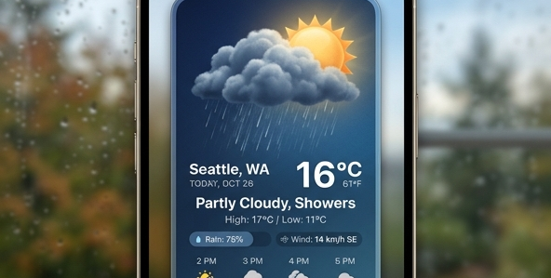
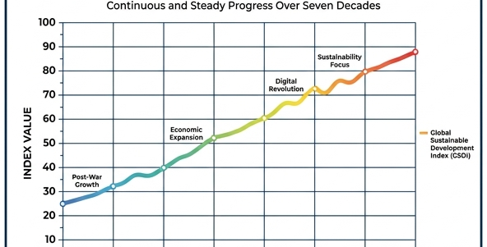
Weather vs. Climate
Weather: Short-term, local conditions
Climate: Long-term statistical averages
Analogy: Mood vs. Personality
Weather changes daily; climate shifts over decades
Weather represents your temporary daily 'mood' and changes rapidly.
Climate represents your long-term 'personality' or historical baseline average.
Notes:
To break this down, we must clearly define weather versus climate. Weather is short-term and local, like the rain or snow you see on a given Tuesday. Climate, however, is the long-term statistical average of these conditions over decades. Think of it this way: weather is your current mood, while climate is your overall personality. You might have a sad day, but generally still be a happy person.

Slide 11
The Snowstorm (A Non-Example)
A single snowstorm is a strict non-example of climate
It represents an isolated, local anomaly
Cannot invalidate decades-long global warming trends
Statistical averages outweigh single data points
Notes:
Let's look at a strict non-example of climate: a severe winter snowstorm. A snowstorm is simply weather. You cannot use one isolated cold day to invalidate a decades-long global warming trend. In science, a single local data point never overrides the statistical average of thousands of data points collected worldwide.

Slide 12
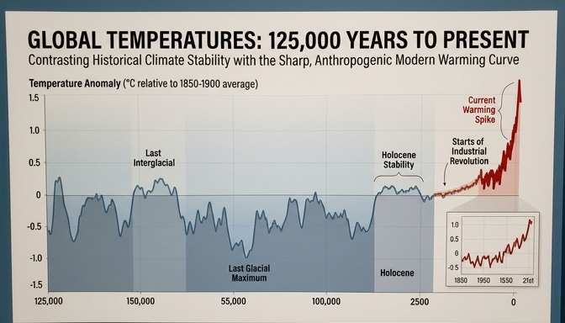
The Baseline Reality
Proxy data reveals long-term historical context
Short-term weather obscures global reality
2023: The hottest year in over 125,000 years
Global warming is a measured statistical trend
Historical proxy data demonstrates that 2023 broke global temperature records spanning millennia.
Notes:
When we zoom out and look at the actual climate, the baseline reality becomes undeniable. Despite occasional cold snaps or snowstorms, the overarching global trend is rapidly warming. In fact, historical proxy data reveals that 2023 was the hottest year in over 125,000 years. We must always rely on these long-term statistical trends, rather than our daily weather, to truly understand global climate change.

Slide 13
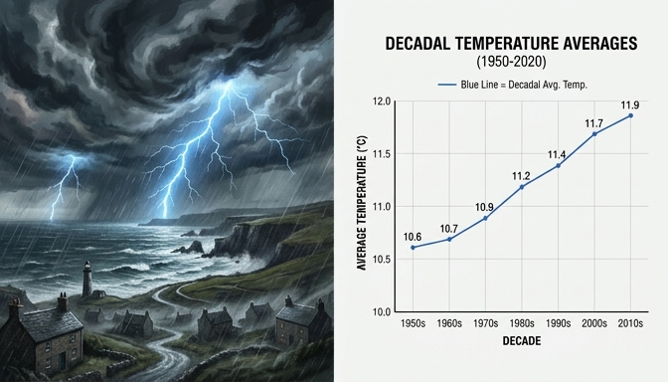
Classifying Meteorological Events
Analyze real-world observations.
Identify the underlying timeframe.
Distinguish between isolated events and trends.
Weather represents immediate, chaotic conditions, while climate represents smooth, long-term statistical trends.
Notes:
When we look at the world around us, we constantly experience meteorological events, from sudden rainstorms to long-term droughts. The challenge is correctly classifying these observations so we can make sense of what is actually happening to our planet. To do this accurately, we must focus on the time scale of the event rather than just its intensity. Let's learn how to apply the 'timeline test' to categorize these events.

Slide 14
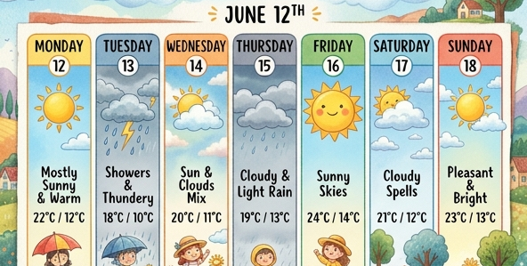

The Timeline Test
Weather = Short-term conditions.
Climate = Long-term statistical averages.
Standard climate baseline is 30 years.
Weather tracks daily or weekly fluctuations in the atmosphere.
Climate tracks statistical averages over minimum 30-year periods.
Notes:
The fundamental rule for categorizing meteorological data is the timeline test. If an observation spans a period of hours, days, or even a few weeks, you are looking at weather. However, in atmospheric science, the standard period to determine a climate baseline is 30 years of data. If your observation involves analyzing a statistical trend over decades, you are evaluating climate.

Slide 15
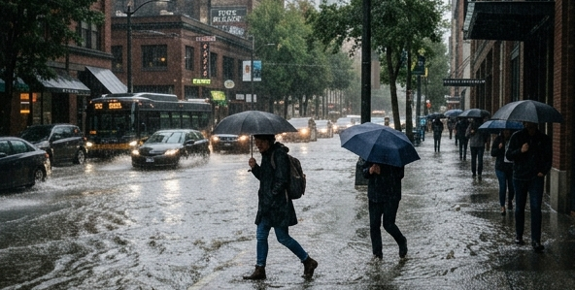
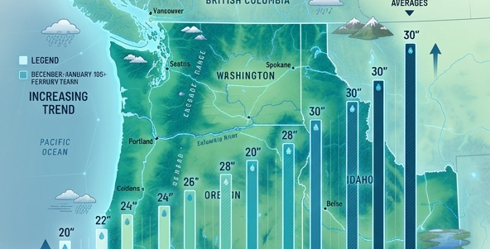
Application: Analyzing a Trend
Observation: Progressively wetter winters.
Identify the timeframe: 30 years.
Conclusion: This is a climate observation.
A single severe winter storm is classified as a weather event.
A 30-year trend of increasing precipitation is classified as a climate shift.
Notes:
Let's apply this concept to a specific real-world example. Consider the statement: 'The Pacific Northwest has experienced progressively wetter winters over the past 30 years.' Ask yourself what the timeline is here. Because this statement tracks a statistical trend over a long, multi-decade period, it is firmly an observation of climate. We are not looking at a single stormy winter, but a sustained shift in the region's long-term baseline.

Slide 16
Non-Example: Misinterpreting Extremes
Extreme events do not instantly redefine climate.
A 100-year blizzard is still just weather.
Isolated cold snaps do not disprove global warming.
Always look for long-term statistical significance.
Notes:
It is crucial to build a strong mental model of what climate is NOT. For instance, experiencing a massive, record-breaking blizzard today does not mean global warming has stopped. That blizzard is a single weather event, highly localized in time. While climate change might make extreme weather events more frequent or severe, the isolated event itself is just weather. Always zoom out and look for the statistical trend to accurately assess the climate.

