Slide 1


What is Intellectual Property?
Protects creations of the human mind
Goal: Encourage societal innovation
Focuses on intangible assets
Intellectual Property protects the intangible creations of the mind, just like physical property protects tangible objects.
Notes:
Welcome to our first lesson on Intellectual Property law. When we talk about IP, we are talking about protecting the creations of the human mind, like inventions, art, and brand names. The overarching goal of these laws isn't just to reward creators, but to encourage innovation across society by ensuring people can benefit from their hard work. Think of it as the legal foundation that makes a modern knowledge economy possible.

Slide 2


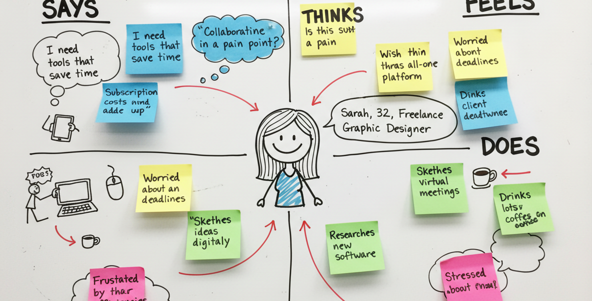

The 'Bundle of Rights' Model
IP is not a single, indivisible block
Think of it as a 'bundle of sticks'
Rights can be separated and managed
Flawed Mental Model: Treating IP as a single, all-or-nothing unbreakable right.
Accurate Mental Model: IP is a 'bundle of sticks' where individual rights can be separated and handed out.
Notes:
Now, how should we conceptualize owning an idea? Most people incorrectly think of IP ownership as a single, solid block—you either own it all or you don't. Instead, legal experts use the 'bundle of sticks' mental model. Every piece of intellectual property is actually a collection of distinct, separable legal rights grouped together. This means you don't have to give up the entire bundle if you want to share your work.

Slide 3

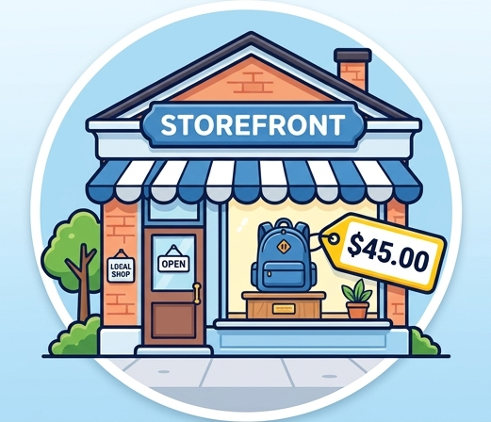
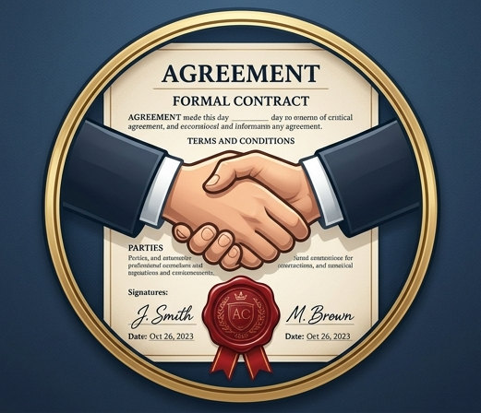
Breaking Down the Bundle
Right to Reproduce (Copy)
Right to Commercialize (Sell)
Right to Authorize (License)
The right to copy or reproduce the original work.
The right to sell or commercially distribute the work.
The right to license or permit others to use the work under specific terms.
Notes:
Let's look closely at some of the individual sticks within this bundle. One stick might represent the right to make copies of your work, while another represents the right to sell it. A completely different stick gives you the power to license your work, meaning you give someone else permission to use it under specific conditions. Because these rights are separable, you can rent out one stick while keeping all the others firmly in your hands.

Slide 4
Licensing vs. Selling
Licensing is NOT transferring ownership
You keep the bundle, others borrow a stick
Allows creators to maximize asset value
Notes:
A common pitfall for new creators is believing that allowing a company to use their IP means they have sold it entirely. This is a non-example of ownership transfer. When you sign a licensing agreement, you are simply letting someone borrow one stick from your bundle for a limited time or specific purpose. You still own the bundle itself. Understanding this separable nature is critical to protecting your assets while generating revenue.

Slide 5

The IP Bundle in Action
IP is not a single, indivisible legal right.
It functions as a 'bundle of sticks'.
Each 'stick' represents a distinct, controllable right.
Creators start with ownership of the entire bundle.
A tied bundle of sticks represents the total original intellectual property rights of a creator.
Notes:
Imagine you just finished writing your first novel. At that moment, you hold an entire 'bundle' of legal rights to that work. Intellectual Property is rarely a single, indivisible thing that you simply keep or give away entirely. Instead, think of it as a bundle of individual sticks tied together. As the creator, you own every single stick in that bundle until you decide to do something with them.

Slide 6


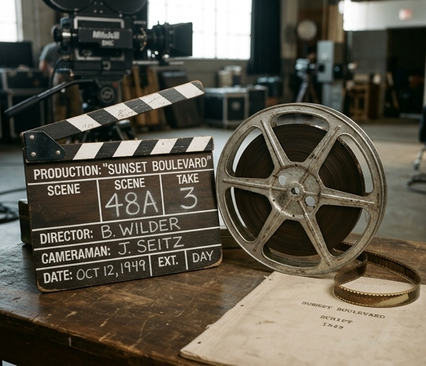
Separating Rights: The Novel Example
Keep: The right to publish physical books.
Lease: The audio rights to a narrator.
Sell: The adaptation rights to a film studio.
Rights can act completely independently.
Keeping the 'stick' for publishing physical copies.
Leasing the 'stick' for audiobook narration.
Selling the 'stick' for cinematic film adaptation.
Notes:
Let's look at how you can separate this bundle practically using a novel as an example. You might choose to keep the publishing rights so you can print and sell physical books yourself. At the same time, you can lease or license the audio rights to a voice actor to create an audiobook for a set period. Finally, you might completely sell the film adaptation rights to a Hollywood studio. Each of these actions involves distributing a separate 'stick' from your bundle while maximizing your reach.

Slide 7


What Separating the Bundle is NOT
Selling one right does not transfer all rights.
You retain full ownership of the remaining sticks.
A movie deal does not equal losing book ownership.
Correct: Transferring only a specific right while keeping the rest.
Incorrect: Believing you must surrender the entire IP to make a deal.
Notes:
A common misconception among early creators is that selling the movie rights means you have sold your book entirely. This is a crucial non-example of how IP works. Giving away one stick does not mean you drop the whole bundle. When you transfer the film rights to a studio, you still retain total ownership over the remaining sticks, meaning you alone control the sequels, merchandise, or translated versions.

Slide 8
Strategic IP Application
Identify every distinct right your asset holds.
Strategically decide which to hold, lease, or sell.
Maximize revenue by treating rights individually.
Protect the core bundle while expanding access.
Notes:
Understanding this concept allows you to be highly strategic as an entrepreneur or creator. Instead of selling your entire intellectual property for a lump sum, you can piecemeal the rights to maximize revenue streams over time. Identify every potential market for your work, from physical goods to digital media or international distribution. By managing each right individually, you protect your core asset while still participating safely in various global industries.

Slide 9

What the Bundle of Rights is NOT
IP ownership is NOT tied to physical objects.
Physical assets and IP are entirely separate concepts.
Possession does not equal IP ownership.
The intellectual rights to an artwork hover separately from the physical canvas itself.
Notes:
Let's address a massive misconception right away. When you hold a physical creation in your hands, it feels like you own everything about it. However, the intellectual property 'bundle of rights' is not an all-or-nothing package tied to that physical object. Simply possessing an item does not mean you own the underlying ideas, expressions, or rights to reproduce it. We must strictly separate the tangible asset from the intangible rights.

Slide 10


Owning the Physical Asset
Physical purchase transfers tangible property.
You own the canvas, wood, and paint.
You can hang it, sell it, or destroy it.
You do NOT own the creative expression.
Purchasing the physical object transfers ownership of the materials.
You own the canvas, wood, and paint, but nothing more.
Notes:
To make this concrete, imagine you buy an original painting from a local gallery. What did you actually buy? Legally speaking, you purchased the physical materials: the canvas, the wooden stretcher, and the dried paint. Because you own this physical asset, you can hang it in your living room, sell it to a friend, or even throw it in the trash. However, this transaction strictly ends at the physical boundary of the object.

Slide 11

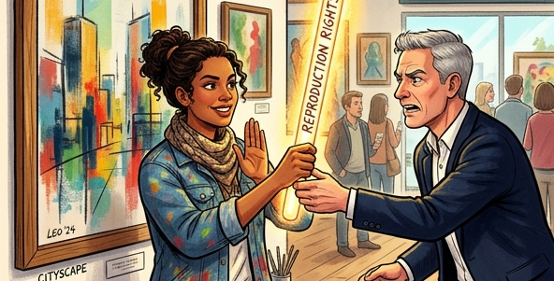
The Intangible Rights (A Non-Example)
Reproduction rights remain with the creator.
Buying the painting gives no right to copy.
Printing the art on merchandise is infringement.
The 'reproduction stick' was never sold.
Owning the painting does not grant the right to manufacture merchandise.
The artist retains the 'stick' representing the right to reproduce the work.
Notes:
This brings us to a critical non-example. Let's say you take that painting you bought, scan it, and print it onto a hundred T-shirts to sell online. This is illegal. Why? Because when you bought the painting, the artist did not hand over the specific 'stick' in their bundle of rights that allows for reproduction. The right to copy and distribute the image remains entirely with the creator, proving that physical ownership and IP ownership are completely separate.

Slide 12
Rule of Thumb: Tangible vs. Intangible
Tangible property = The physical medium.
Intangible IP = The bundle of rights.
Transferring one does NOT transfer the other.
Always verify if IP rights are explicitly licensed.
Notes:
To summarize this foundational rule: always divide your thinking into the tangible medium and the intangible intellectual property. Transferring a physical object never automatically transfers the intellectual property attached to it. Unless a creator explicitly signs a contract transferring or licensing their specific bundle of rights to you, you only own the physical atoms you purchased. This separation is the bedrock of avoiding accidental IP infringement.

Slide 13

Knowledge Check: The Software Scenario
You develop custom software for a startup.
You grant permission for internal company use.
You strictly prohibit them from reselling the code.
Question: Have you lost your IP rights?
Granting conditional access to a creation does not equal surrendering total ownership.
Notes:
Let's test our understanding of the 'bundle of rights' with a real-world scenario. Imagine you create a piece of custom software for a new startup. You give them a license to use this software internally for their daily operations. However, your agreement explicitly states they cannot resell your code to anyone else. The big question here is: by letting them use it, have you lost your intellectual property rights?

Slide 14

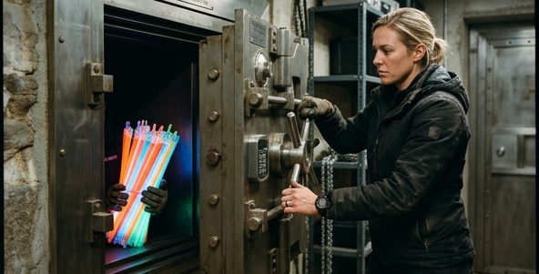
Licensing a Single 'Stick'
IP is a bundle of separable "sticks" (rights).
Given Away: The right to internal use.
Retained: The right to resell, modify, or copy.
Result: You remain the IP owner.
Licensing: Handing over just one specific right from your bundle.
Ownership: Securely retaining the remaining rights for yourself.
Notes:
The answer is no, you have not lost your IP rights. Remember that intellectual property is a bundle of distinct rights, or 'sticks'. In this scenario, you simply licensed one specific stick—the right to use the software internally. You securely retained the rest of the bundle, including the valuable rights to sell, distribute, or modify the core code.

Slide 15


What Licensing is NOT
Example: Renting an apartment (Licensing).
Non-Example: Selling the house (Assignment).
Licensing is temporary and conditional.
Assignment permanently transfers all ownership.
Licensing grants limited permission without transferring ultimate ownership.
Assignment is the absolute, permanent transfer of the entire bundle of rights.
Notes:
To build a strong mental model, let's look at a clear non-example. What you did NOT do in the software scenario was 'assign' your IP. Assignment is the complete transfer of ownership—like selling a house outright and giving away the deed. Licensing, which you did, is more like renting out an apartment. You allow someone to use the space under strict conditions, but you ultimately still own the building.

Slide 16
Maximizing Value Through Separation
Distributing rights separately maximizes revenue.
The same code can be licensed to multiple clients.
Explicit contracts prevent accidental assignment.
Retaining core IP secures long-term business leverage.
Notes:
Understanding this separation of rights is crucial in business strategy. Because you only licensed the internal use right, you can legally take that exact same software and license it to ten other startups, multiplying your revenue. This is why explicit contracts are essential; they ensure you don't accidentally assign your entire bundle of rights when you only meant to lease out a single stick.

