Slide 1
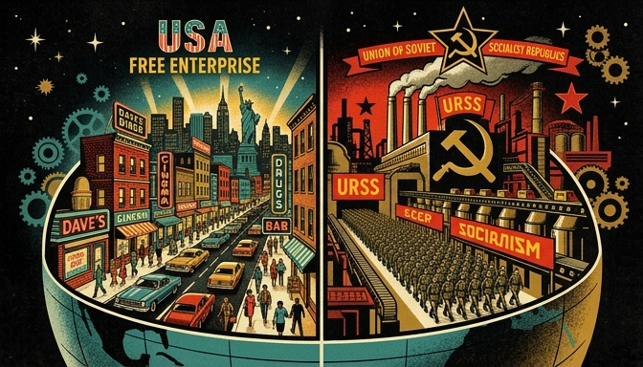

The Core Divide: Capitalism vs. Communism
Two opposing blueprints for society emerged post-WWII.
United States championed Democratic Capitalism.
Soviet Union enforced Authoritarian Communism.
Ideological clash replaced a fragile wartime alliance.
The post-WWII world fractured into two distinct ideological blueprints: individual enterprise versus state-directed collective action.
Notes:
Welcome to the origins of the Cold War. Following World War II, the fragile alliance between the United States and the Soviet Union quickly dissolved, replaced by a deep ideological divide. We will explore how these two superpowers offered completely opposite blueprints for how society, economics, and government should function. This wasn't merely a political disagreement; it was a fundamental clash over human freedom and collective responsibility.

Slide 2
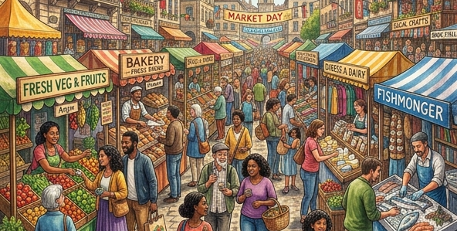



Defining the Systems: Individual vs. State
Capitalism: Free markets and individual property rights.
Communism: State control and collective ownership.
Democracy emphasizes personal liberty and voting.
Authoritarianism mandates strict obedience to the state.
Capitalism relies on private ownership, competition, and individual choice.
Communism relies on total state control to enforce collective equality and resource distribution.
Notes:
To truly understand the Cold War, we must define the two competing systems at its core. Democratic capitalism, championed by the US, emphasizes free markets, private property, and individual rights. In stark contrast, authoritarian communism, pushed by the USSR, relies on complete state control of the economy to enforce collective equality. One system prioritizes individual liberty and opportunity, while the other prioritizes collective outcome under strict government direction.

Slide 3


Mental Model: The Group Project Analogy
System A (Capitalism): Choose roles, earn individual grades.
System B (Communism): Assigned roles, earn shared grades.
Non-example: Neither system is a chaotic free-for-all.
Both aim for societal success using opposite motivations.
System A: Individual effort leads to distinct, individualized rewards.
System B: Assigned roles result in an equal, collective reward regardless of individual effort.
Notes:
Let's use a mental model to simplify this: imagine a massive classroom group project. In System A, representing capitalism, you choose your own role, work independently, and get a grade based entirely on your personal effort. In System B, representing communism, the teacher assigns your role based on the group's needs, and everyone receives the exact same shared grade. Note what these are NOT: neither system is absolute anarchy; they just use fundamentally opposite incentive structures to motivate people.

Slide 4
The Inevitable Clash Post-WWII
WWII alliance was purely strategic against a common enemy.
Post-war rebuilding goals were inherently incompatible.
US sought open global markets for economic growth.
USSR sought secure buffer zones and ideological conformity.
Notes:
With these deeply opposed ideological blueprints, you can begin to see why their post-WWII cooperation was doomed to fail. Their alliance during the war was purely a marriage of convenience to defeat Nazi Germany. Once that common enemy was eliminated, their respective visions for rebuilding the world could not coexist. The United States needed open global markets to fuel its capitalist economy, while the Soviet Union demanded secure borders and ideological conformity to protect its vulnerable state.

Slide 5

The Post-WWII Ideological Divide
WWII alliance between US and USSR ends
Two rival global superpowers emerge
Fundamentally incompatible societal models
The post-WWII world was immediately split into two fundamentally opposing ideological spheres.
Notes:
Welcome to our exploration of the Cold War's foundational conflict. Following the end of World War II, the temporary alliance of convenience between the United States and the Soviet Union quickly dissolved. In its place emerged a fierce global rivalry driven by two entirely incompatible visions for how society should function. This stark ideological divide would dictate global politics, economics, and warfare for nearly half a century.

Slide 6
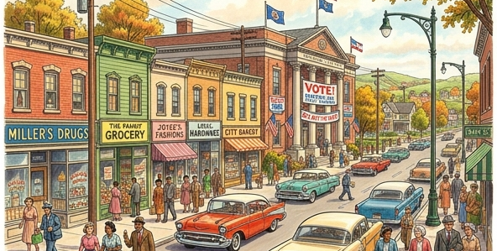
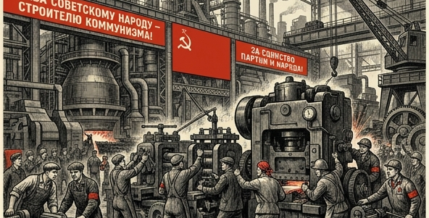
Contrasting Systems: US vs. USSR
US: Free markets and private ownership
US: Multi-party elections and individual rights
USSR: State-owned economy and agriculture
USSR: Single-party rule for collective equality
Democratic Capitalism: Emphasizing private ownership, free markets, and individual rights.
Authoritarian Communism: Emphasizing state control, collective labor, and strict political uniformity.
Notes:
Let's break down these two opposing structural models. On one side, the United States championed democratic capitalism, where private citizens owned businesses and individuals voted in multi-party elections. On the other side, the Soviet Union operated under authoritarian communism, where the government owned all factories and farms to enforce collective equality. This meant a multi-party democracy was pitted directly against single-party rule, and a free market against a state-commanded economy.

Slide 7
Why Cooperation Failed
Capitalism does NOT guarantee equal wealth
Communism does NOT value individual consumer choice
Core values were exact opposites
Post-war diplomatic partnership became impossible
Notes:
To truly understand these systems, it helps to identify what they are not. Democratic capitalism does not guarantee equal wealth for everyone; it focuses heavily on providing the opportunity to compete. Conversely, authoritarian communism is not concerned with individual consumer choices or personal liberty; it strictly prioritizes the survival and economic equality of the collective state. Because their foundational definitions of freedom and justice were exact opposites, maintaining any kind of post-war partnership became virtually impossible.

Slide 8
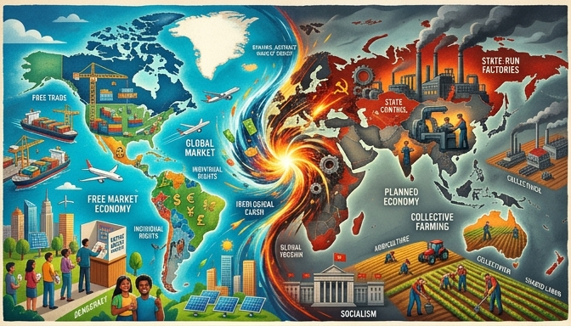
Not Just a War for Territory
Traditional wars fight for land or resources
The Cold War was a clash of absolute worldviews
A fundamental struggle between two incompatible systems
The Cold War was an ideological struggle for the future of global society, not just a fight over physical borders.
Notes:
When we think of war, we usually picture armies fighting over land, resources, or borders. The Cold War was fundamentally different. It was a total clash of worldviews between democratic capitalism and authoritarian communism. Understanding this ideological divide is crucial to seeing why the conflict lasted for decades without direct military confrontation between the superpowers.

Slide 9
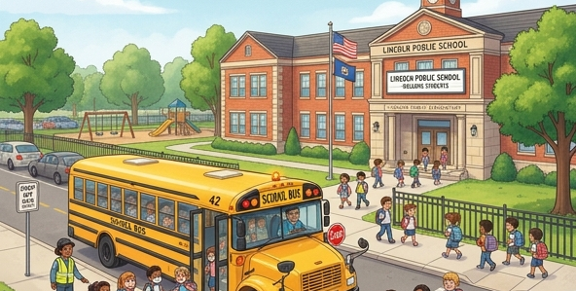

Clearing Misconceptions: What Communism is NOT
Basic public services $\neq$ Communism
Roads, schools, and fire departments exist in capitalism
Public goods are funded by taxes, not total state control
Public services like schools are standard functions of government, not 'communism'.
Soviet communism requires state ownership of all production, not just basic public goods.
Notes:
A common misconception is that any government program, like building roads or funding public schools, is a form of communism. This is entirely false. Democracies and capitalist economies rely heavily on public services funded by taxes. We must separate standard government functions from the total ideological control demanded by the Soviet system.

Slide 10

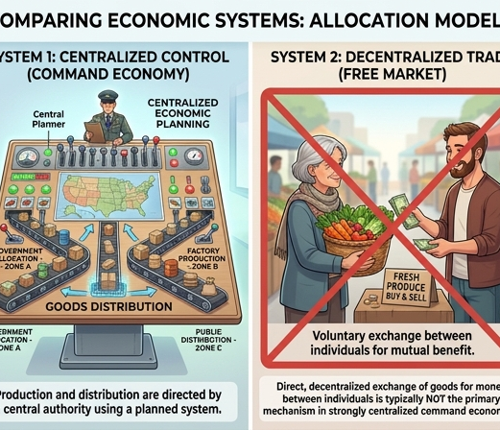

The Core Traits of Soviet Communism
Elimination of private property
Abolition of free market economics
Eradication of opposing political parties
Private ownership was abolished and replaced by collective state ownership.
Prices and production were dictated by the government, not supply and demand.
Political opposition was banned, ensuring a single-party authoritarian rule.
Notes:
To truly define Soviet communism, we have to look at its absolute requirements. It demanded the complete elimination of private property, meaning individuals could not own businesses or land. It eradicated free markets, replacing them with a centrally planned economy where the state dictated all production. Finally, it required strict authoritarianism by outlawing any opposing political parties.

Slide 11
An Absolute Divide
Worldviews were structurally incompatible
Ideology drove global geopolitical strategy
A zero-sum game: one side's gain is the other's loss
Notes:
Because the core tenets of the US and USSR were exact opposites, there was no middle ground. The survival of one system was perceived as an existential threat to the other. This absolute divide is what turned regional disputes into global crises, as every geopolitical move was filtered through this zero-sum ideological lens.

Slide 12
The WWII Alliance: A Temporary Truce
Allied from 1941 to 1945 against Nazi Germany
United strictly by a shared enemy, not shared values
Functioned as a strategic 'marriage of convenience'
The Empathize phase involves conducting research to understand users' experiences, needs, and pain points.
Notes:
Between 1941 and 1945, the United States and the Soviet Union formed a crucial alliance to defeat Nazi Germany. However, this was purely a marriage of convenience, not a partnership built on shared values. They were united by a shared, existential threat, proving that sometimes 'the enemy of my enemy is my friend.'

Slide 13

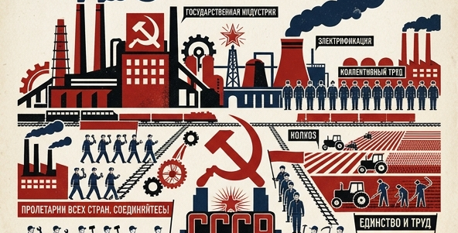
The Sudden Pivot (1945)
Defeat of Germany removed the shared threat
Alliance instantly collapsed without a common enemy
Clashing visions for post-war reconstruction emerged
The US vision prioritized free markets and individual rights for rebuilding Europe.
The Soviet vision prioritized state control and collective equality.
Notes:
Once World War II ended in 1945, the glue holding the US-Soviet alliance together dissolved. Without a common enemy to unite them, the strategic partnership instantly collapsed. They were left facing each other in a power vacuum, with radically different plans for how to rebuild a devastated Europe.

Slide 14
Why Cooperation Failed
Non-example: The WWII alliance was never a true friendship
Fundamentally incompatible visions for society and economy
Democratic capitalism vs. authoritarian communism
Ideological differences made the Cold War inevitable
Notes:
It is important to remember what this alliance was not: it was never a sign of long-term friendship or mutual trust. The foundational ideologies of democratic capitalism and authoritarian communism were completely incompatible in their goals for human society. Without a shared enemy to force them to the same table, these deep ideological differences made peaceful cooperation impossible and the Cold War inevitable.

Slide 15
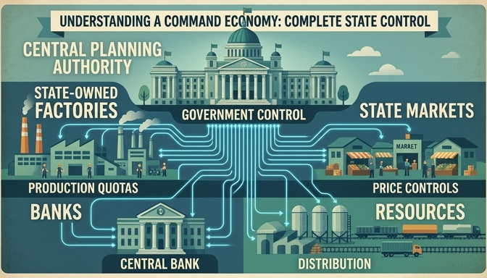
Knowledge Check: Identifying the Ideology
A post-WWII nation seeks to prevent poverty.
Government takes ownership of all private banks.
The state dictates the prices of all goods.
Citizens are directly assigned jobs by the government.
Visualizing a state-controlled economy where the central government manages all resources and infrastructure.
Notes:
Let's test our understanding of the two major ideologies we just discussed. Imagine a newly formed nation right after World War II. To eliminate poverty, this nation's leaders decide the government must own all banks, set all prices, and assign jobs to every citizen. Read through these actions carefully and think about the core principles driving them.

Slide 16

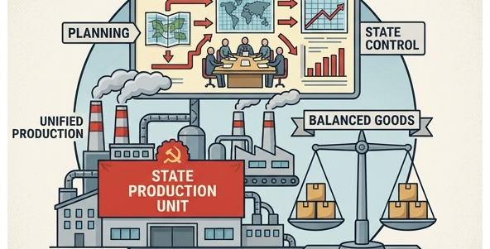
Which Ideology Is It?
Option A: Democratic Capitalism (United States)
Option B: Authoritarian Communism (Soviet Union)
Consider who controls the means of production and distribution.
Capitalism emphasizes free markets, supply and demand, and private ownership.
Communism relies on strict state control and the collective distribution of goods.
Notes:
Now, ask yourself: does this scenario align more closely with the ideology of the United States or the Soviet Union? Remember, the United States championed democratic capitalism, focusing on free markets, private property, and individual liberty. In contrast, the Soviet Union operated under authoritarian communism, where the state controlled all resources to enforce collective equality. Which of these systems matches a government completely taking over banks and dictating prices?

Slide 17
The Answer: Authoritarian Communism
Correct Answer: The Soviet Union.
Defining Trait: Absolute state control over the economy.
Non-Example: Free-market capitalism (prices fluctuate based on supply and demand).
Conclusion: This fundamental incompatibility made post-WWII cooperation impossible.
Notes:
The correct answer is the Soviet Union, representing authoritarian communism. When a government completely takes over private banks, sets prices, and assigns jobs, it is exercising absolute state control over the economy. A strict non-example of this would be free-market capitalism, where prices naturally fluctuate based on supply and demand without heavy government interference. This fundamental ideological difference in economic control is exactly what made post-WWII cooperation between the US and USSR virtually impossible.

